Slide 1
vedi lezione Magliotti modello a shell
vedi testo Martin

Slide 2
PART 3 – NUCLEAR PHYSICS
3 NUCLEAR MODELS
3.1 Liquid Drop Model
3.2 Fermi gas Model
3.2 Nuclear Interactions – the deuteron
3.3 Nuclear Shell Model
3.4 Collective Models
...
Istituzioni di fisica nucleare e subnucleare – Corso A – Silvia Leoni

Slide 3
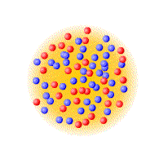
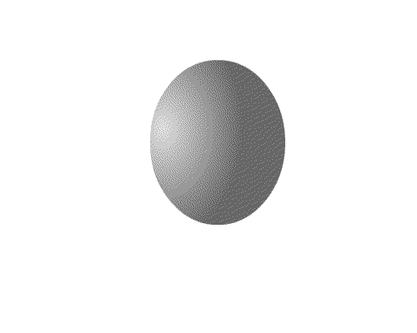
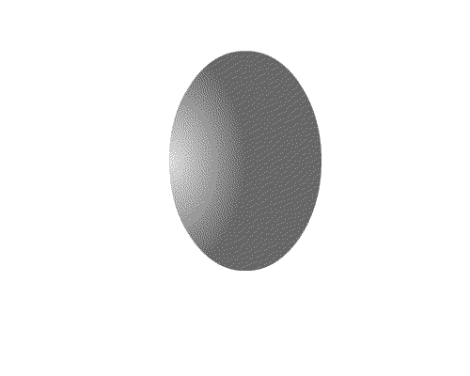
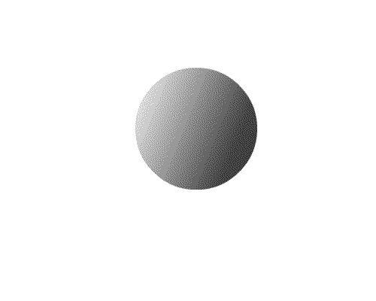
Themes and challenges in modern science
Complexity out of simplicity – Microscopic
  How the world, with all its apparent complexity and diversity can be constructed out of a few elementary building blocks and their interactions
Simplicity out of complexity – Macroscopic
  How the world of complex systems can display such remarkable regularity and simplicity
individual excitations
of nucleons
vibration rotation fission

Slide 4
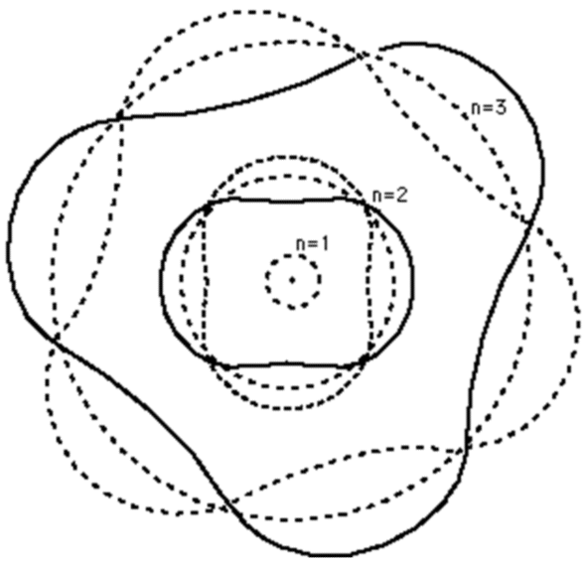
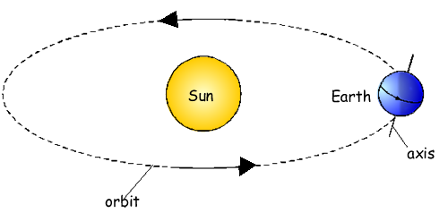
The atomic structure – electrons in atoms
quantum numbers:
n (principal) 1,2,3,…
ℓ (orbital angular momentum) 0, ..., n-1
m (magnetic, projection of ℓ on z) - ℓ ≤ m ≤ + ℓ
s (spin) ↑↓ or +½ħ -½ħ
n=3
n=2
n=1
classical analogy
spin s
electron orbitals
(in first approximation
orbital dimension
and energy depend on n;
n=1 spherical orbit
n=2 dipole orbit
n=3 ...)
orbital angular momentum ℓ
sun ≡ nucleus
earth ≡ electron
electron is structureless and hence can not rotate
spin s is a quantum mechanical concept (from Dirac)

Slide 5
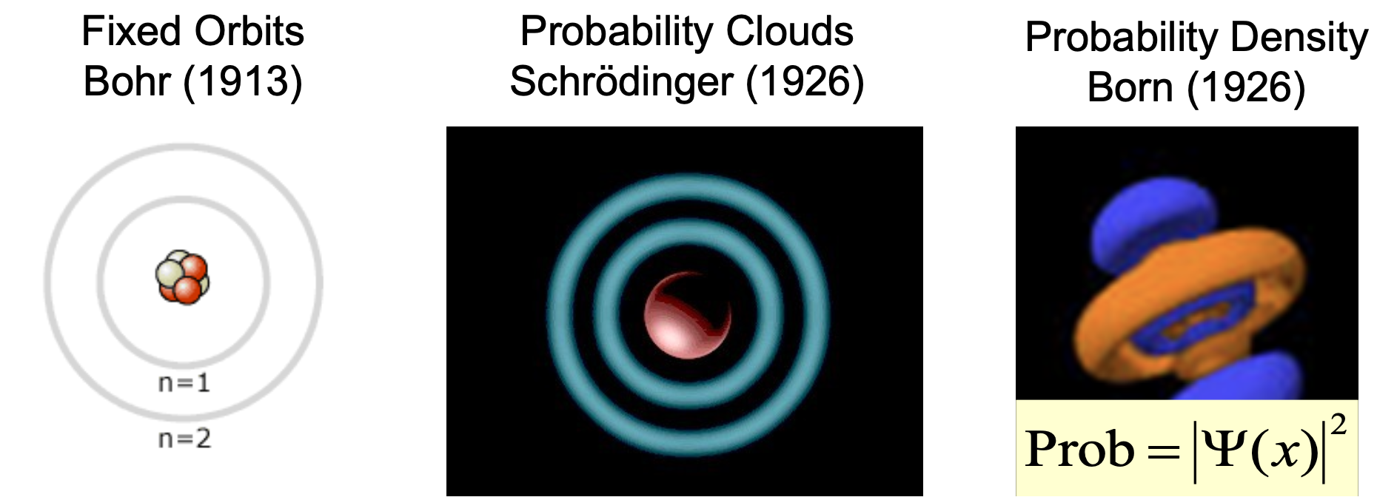
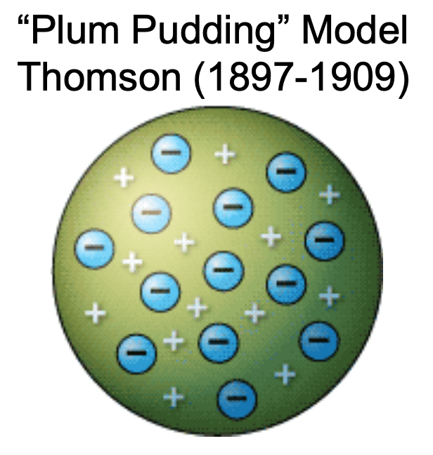
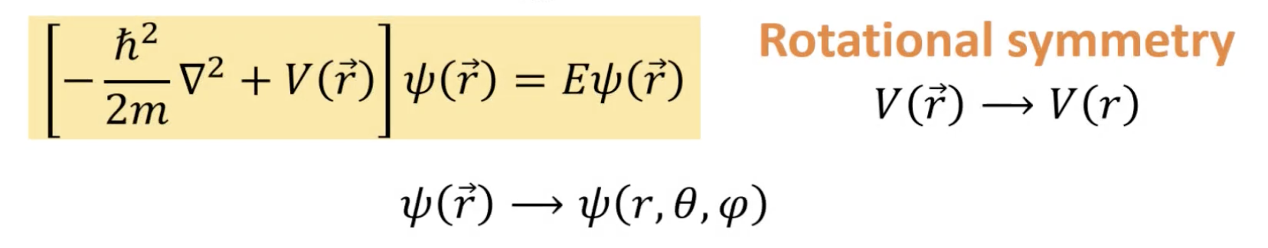
Evolution of the picture of the atomic structure
wave–particle duality
Schrodinger equation solutions to the hydrogen atom
Central Potential

Slide 6
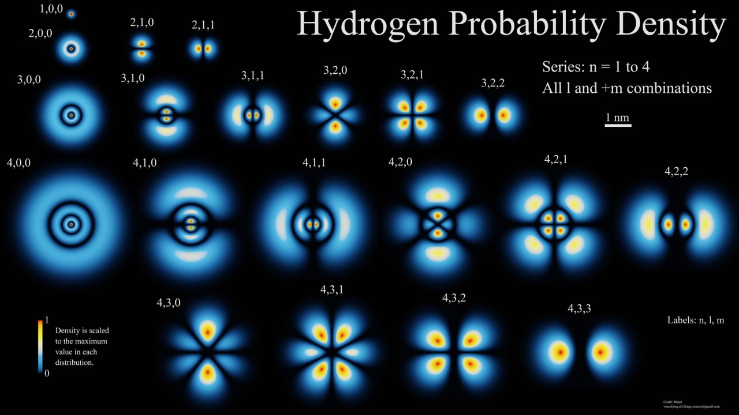
Electrons in an atom
With the development of quantum mechanics,
electrons orbiting a nucleus are explained by wave–particle duality
The electrons are never in a single point location
The probability of interacting with the electron at a single point can be found from the electron's wave function.

Slide 7
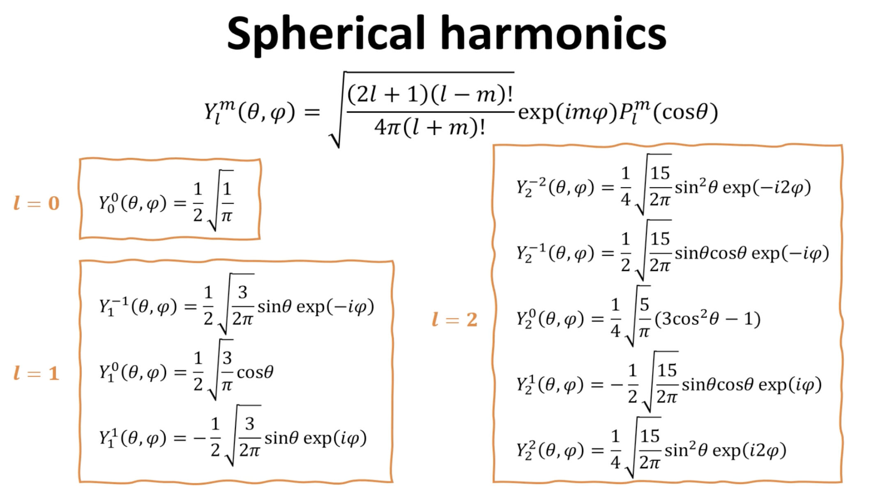
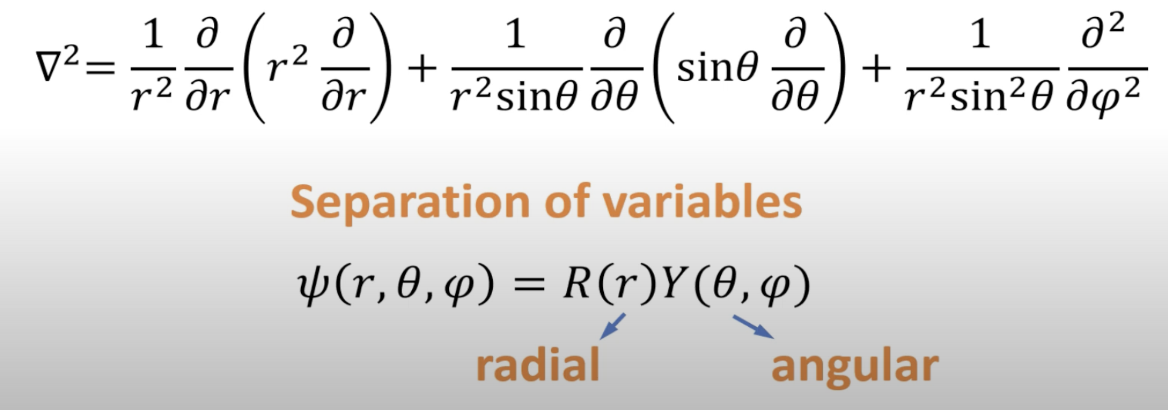
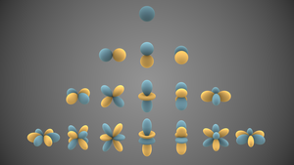
Schrodinger equation solutions to the hydrogen atom
Central Potential
Visual representations of the first few real
spherical harmonics
Blue portions represent regions where the function is positive,
and yellow portions represent where it is negative.
The distance of the surface from the origin indicates
the absolute value of Y_{ℓ}^{m}(θ,φ)

Slide 8
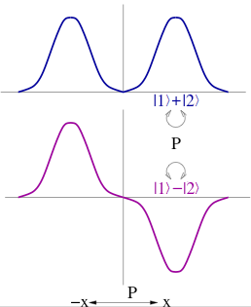
Parity of Nuclear States (wave-particle duality)
The parity operation causes a reflection of all of the coordinates through the origin: r → - r
In Cartesian coordinates: x → -x, y → -y, z →- z ;
in Spherical coordinates: r → r, θ → π − θ, φ → φ + π
parity operator applied on spherical harmonics
(used in wave function description in spherical coordinates)
wave function
Ψ(x)
Ψ(x) = Ψ(-x) → parity = even (+)
Nuclear
State
Spin^{Parity}=I^{π}
x
ℓ = 0, 2, 4, … even
Ψ(x)
Ψ(x) = -Ψ(-x) → parity = odd (-)
x
ℓ = 1, 3, 5, … odd
The wave function for a system of many particles is formed from the product of the wave functions for the individual particles → nuclear states can be assigned a definite parity, odd or even
π = + for even or odd positive-parity particles
= + for even number of negative-parity particles
= - for odd number of negative-parity particles
Mixed-parity wave functions are NOT permitted

Slide 9
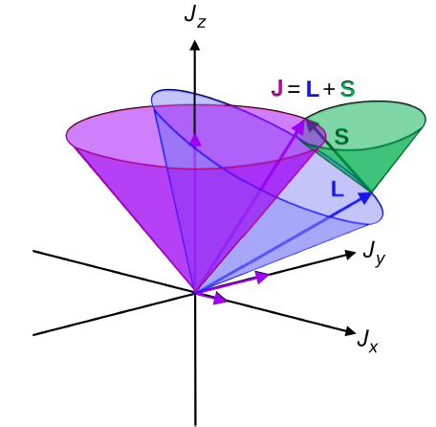
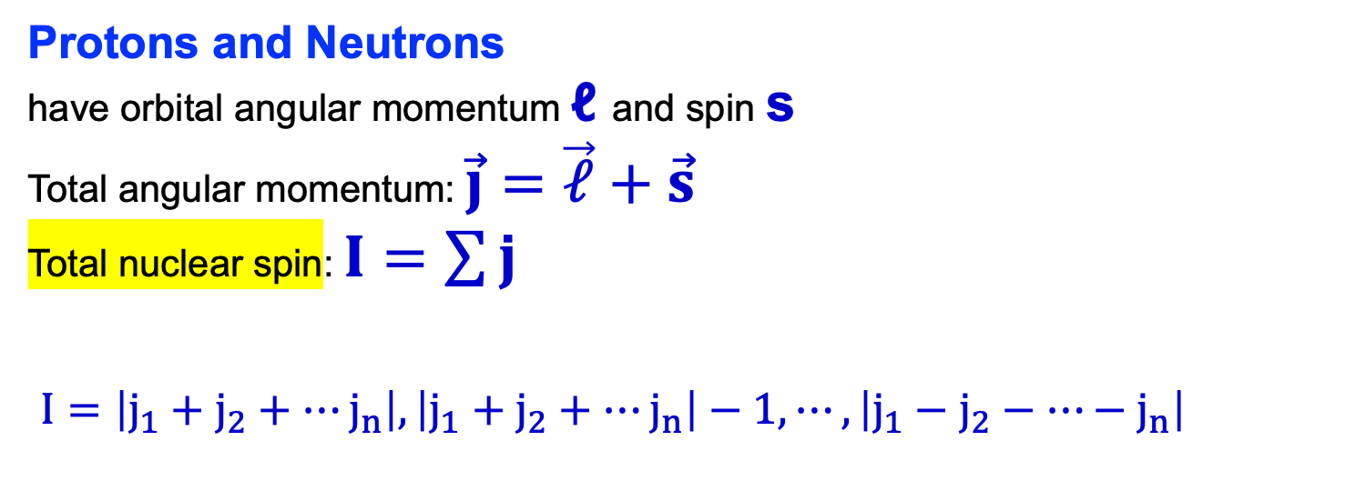
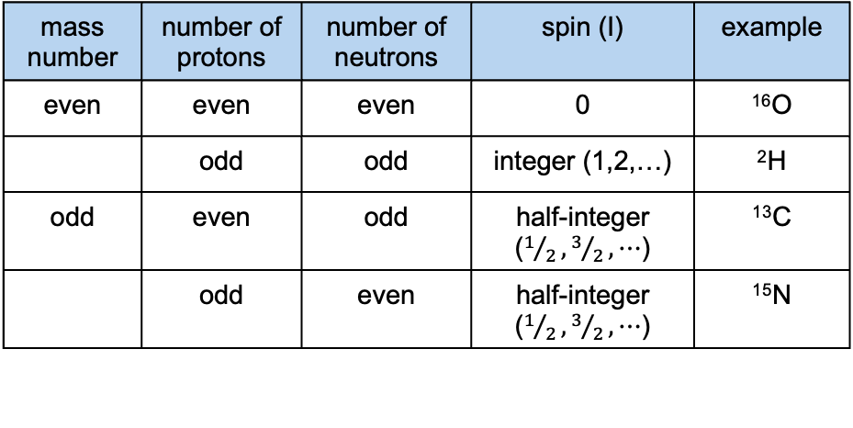
Nuclear Angular Momentum or Spin
Protons and Neutrons
have orbital angular momentum ℓ and spin s
Total angular momentum: $\vec{j}=\vec{ℓ}+\vec{s}$
Total nuclear spin: $I=\sum{j}$
$I=\left|j_{1}+j_{2}+⋯j_{n}\right|,\left|j_{1}+j_{2}+⋯j_{n}\right|−1,⋯,\left|j_{1}−j_{2}−⋯−j_{n}\right|$
angular momenta
(vectors) coupling
Possible values of Spin from quantum mechanics
General Guidelines
¹H = 1 proton, so I = ½
²H = 1 proton and 1 neutron, so I = 1 or 0
For heavier nuclei, it is not immediately evident
what the spin should be as there are a
multitude of possible values.
mass number | number of protons | number of neutrons | spin (I) | example
even | even | even | 0 | ¹⁶O
 | odd | odd | integer (1,2,…) | ²H
odd | even | odd | half-integer ($1/2,3/2,⋯$) | ¹³C
 | odd | even | half-integer ($1/2,3/2,⋯$) | ¹⁵N

Slide 10
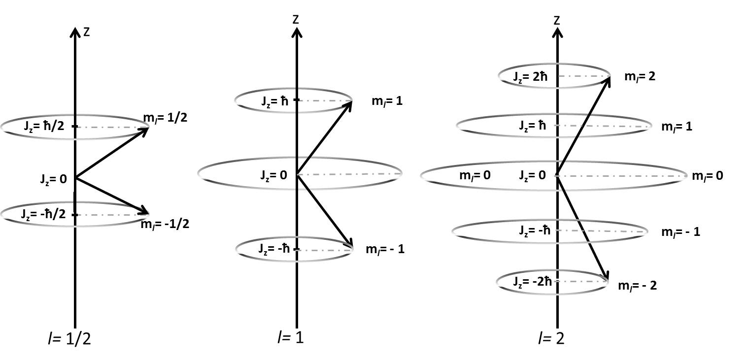
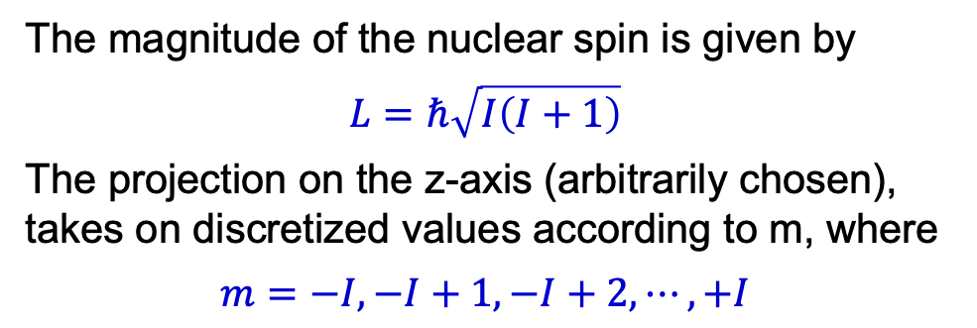
Nuclear Spin: magnitude and projections
(measurable quantities)
The magnitude of the nuclear spin is given by
$$L=ℏ\sqrt{I\left(I+1\right)}$$
The projection on the z-axis (arbitrarily chosen), takes on discretized values according to m, where
$$m=−I, −I+1, −I+2, ⋯, +I$$

Slide 11
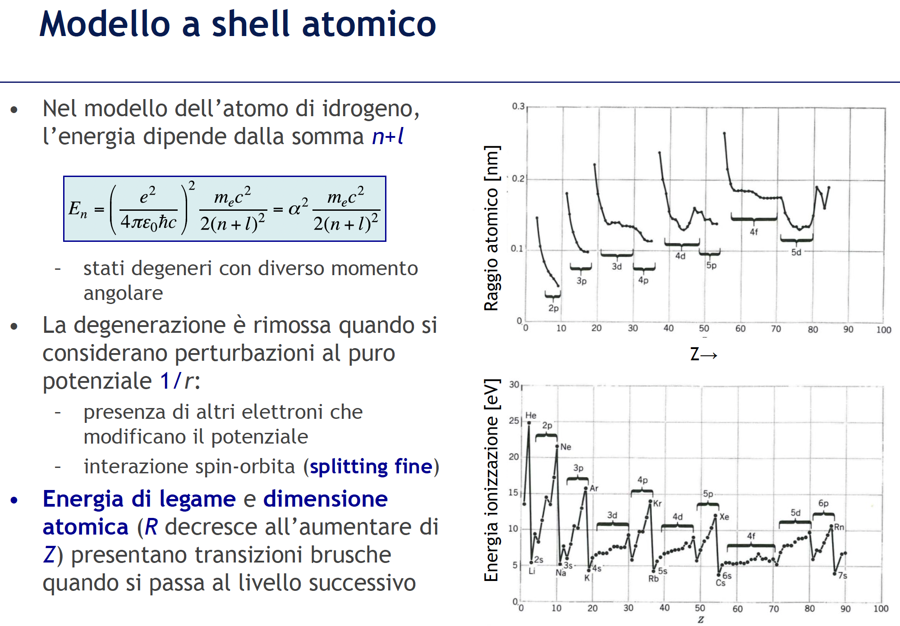
SHELL MODEL in Atomic Physics
Quantum Numbers:
n (principal) 1,2,3,…
ℓ (orbital angular momentum) 0, ..., n-1
m (magnetic, projection of ℓ on z) - ℓ ≤ m ≤ + ℓ
s (spin) ↑↓ or +½ħ -½ħ
Dimensione atomica (R decresce all’aumentare di Z, a causa di maggiore attrazione di e da parte di carica nucleare) ed Energia di legame
presentano transizioni brusche quando si passa al livello successivo

Slide 12
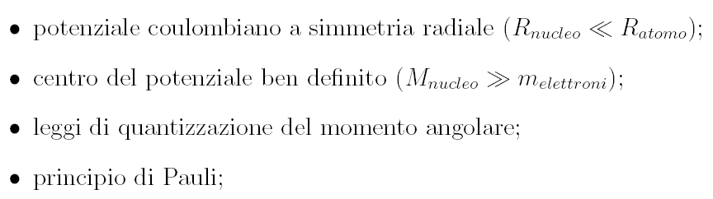
SHELL MODEL in Atomic Physics
(due fermioni identici non possono avere gli stessi numeri quantici)
(l in lettere= s, p, d, f, g, h, …)
Prof. Angela Bracco

Slide 13
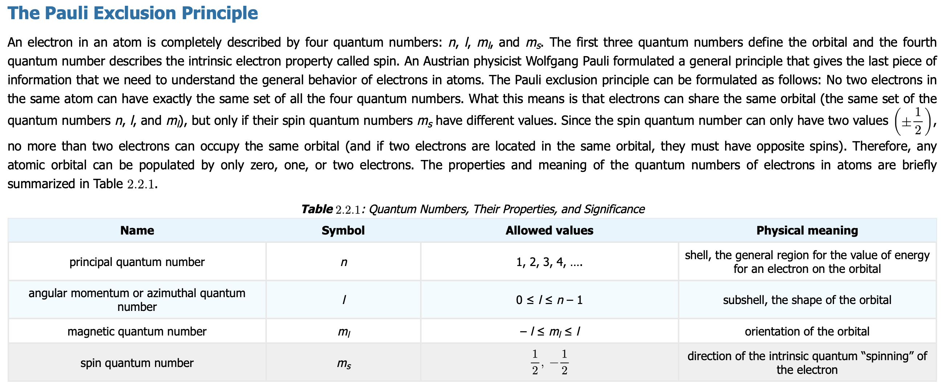

Slide 14
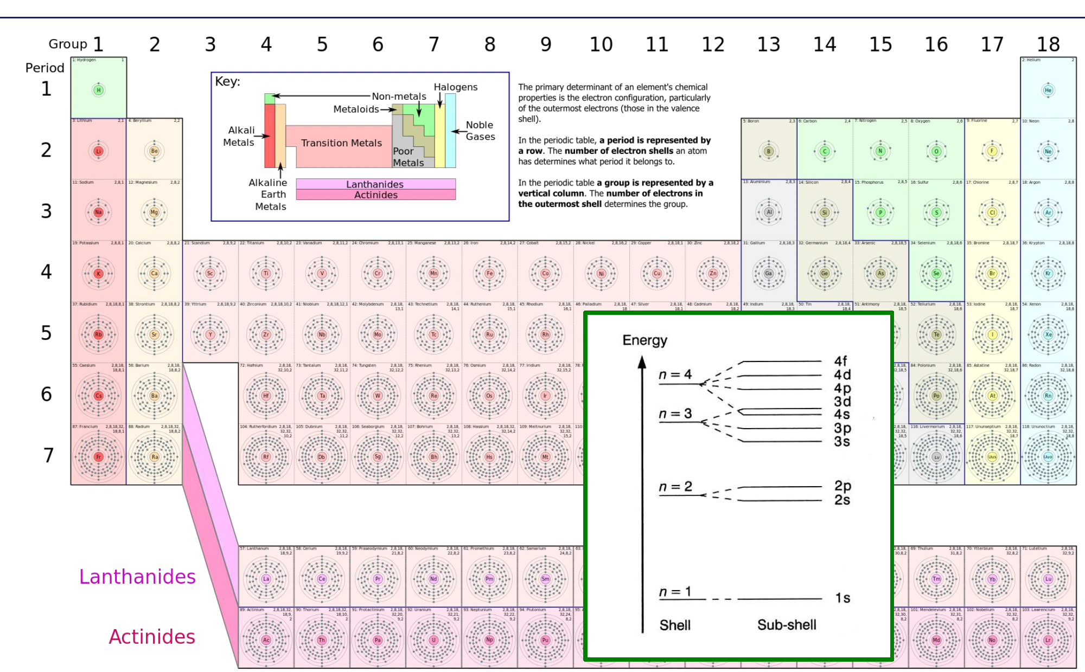
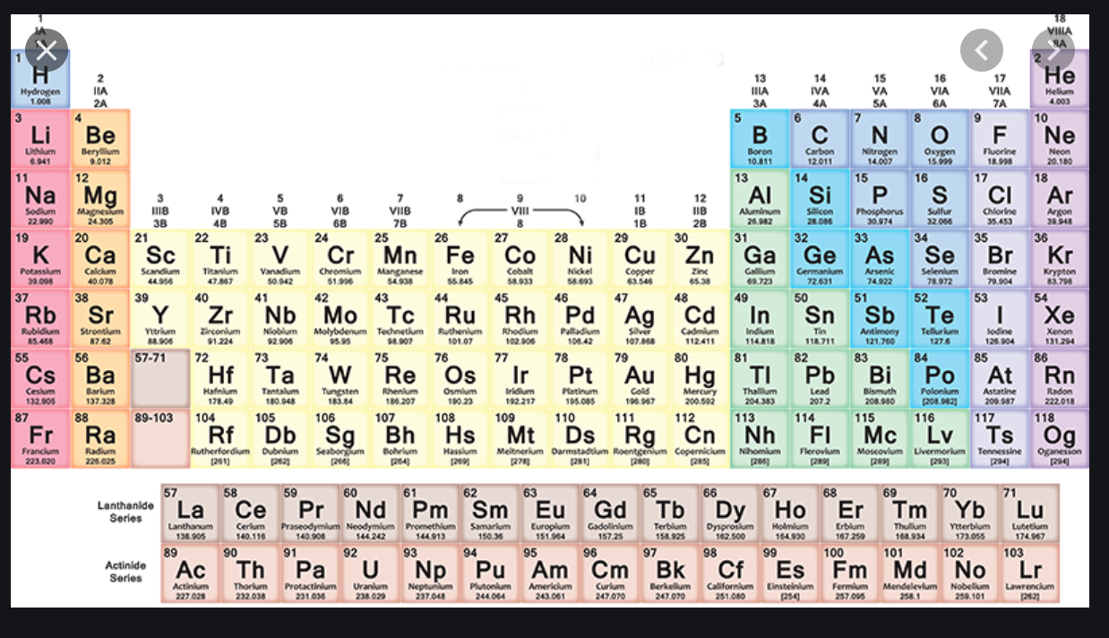
SHELL MODEL in Atomic Physics
Gas
Nobili
Gruppo
Periodo ↓
è il
numero
n della
shell

Slide 15
SHELL MODEL in Atomic Physics
Gas
Nobili
Gruppo →
Periodo ↓
è il
numero
n della
shell

Slide 16
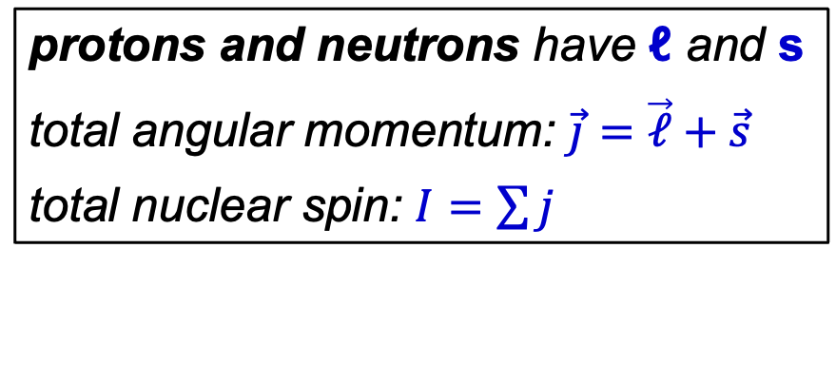
Evolution of the picture of the atomic structure
wave–particle duality
protons and neutrons have ℓ and s
total angular momentum: $\vec{j}=\vec{ℓ}+\vec{s}$
total nuclear spin: $I=\sum{j}$
A similar picture holds for
the atomic nucleus
made of protons and neutrons
located in different «orbitals»

Slide 17
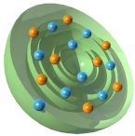
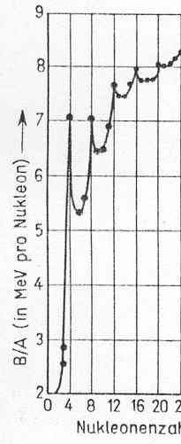
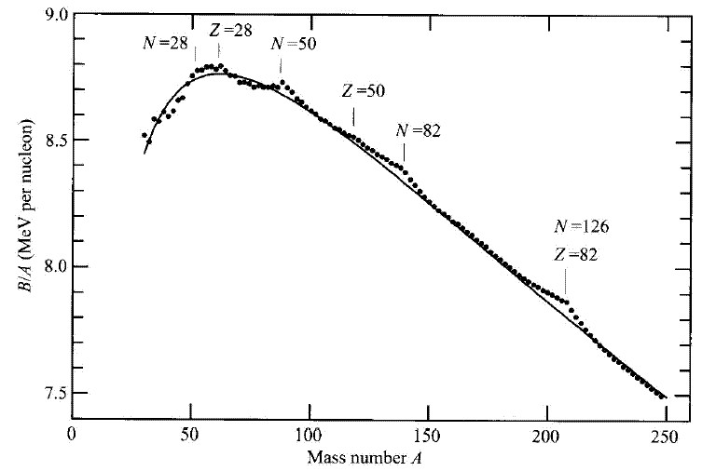
Evidence for Shell structure in nuclei
Deviations are observed from the Weizsäcker liquid drop mass formula
(which does NOT apply for A<20)
Neutron
(10,10)
Proton
(N,Z)
(6,6)
(2,2)
28
(8,8)
28
50
especially stable:
50
B/A (MeV per nucleon)
82
2*(2,2)
= Be(4,4)
E_{α−α}=94keV
126
82
A
mass number A

Slide 18
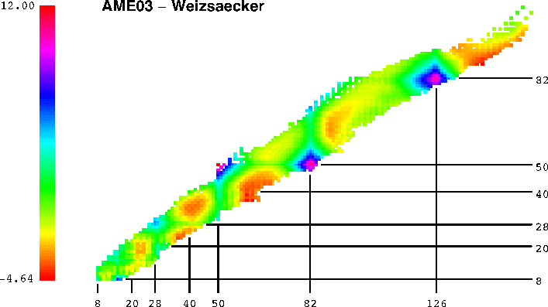
Evidence for Shell structure in nuclei
Deviations from the Weizsäcker liquid-drop mass formula:
large binding energies for certain Z and/or N
²⁰⁸Pb
¹³²Sn

Slide 19

Evidence for Shell structure in nuclei
Large jumps in 2-neutron binding energies = 2-neutron ´separation´ energies
$$S_{2n}=BE\left(N,Z\right)−BE\left(N−2,Z\right)$$
N = 82
25
23
21
N = 126
1) A key quantity in nuclear physics for assessing
the stability of a nucleus, particularly for neutron-rich isotopes
2) Reveals shell structure
3) Shows pairing effects
4) Helps locate the drip line
19
17
S(2n) MeV
15
13
²⁰⁸Pb
¹³²Sn
11
Sm
Hf
9
N = 84
Ba
Pb
7
Sn
5
52
56
60
64
68
72
76
80
84
88
92
96
100
104
108
112
116
120
124
128
132
Neutron Number

Slide 20
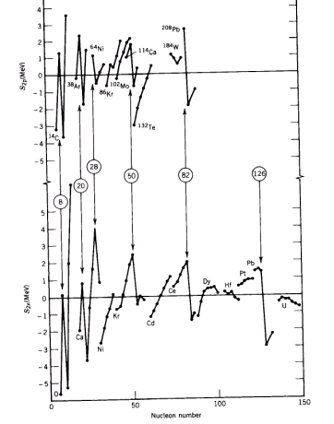
Evidence for Shell structure in nuclei
Energia di separazione
di 2 protons
Energia di separazione
di 2 nucleons

Slide 21
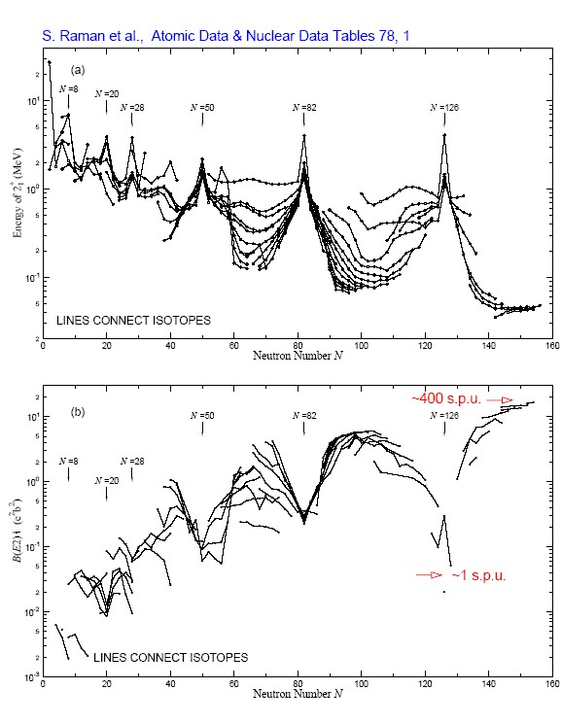
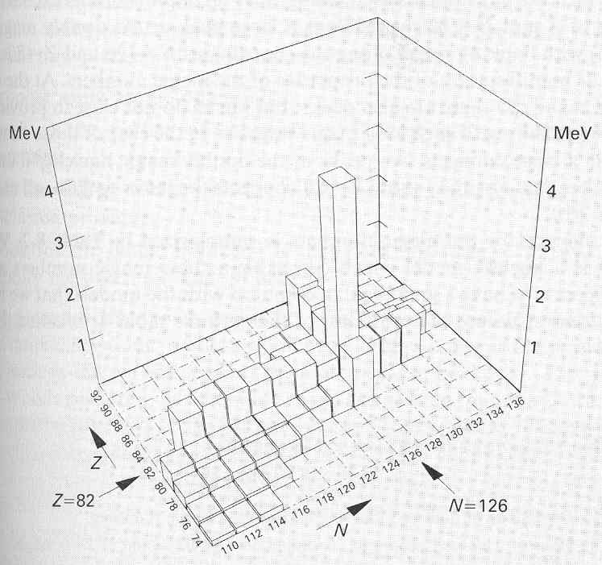


Evidence for Shell structure in nuclei
high energies
of the first excited 2⁺ state
small nuclear deformations
as deduced from gamma-decay transition probabilities
measured in single particle units (spu)
$$E_{2_{1}^{+}}$$
Nuclei with "magic” numbers of neutrons/protons
are characterized by
²⁰⁸Pb
$$B\left(E2;2_{1}^{+}→0^{+}\right)$$

Slide 22
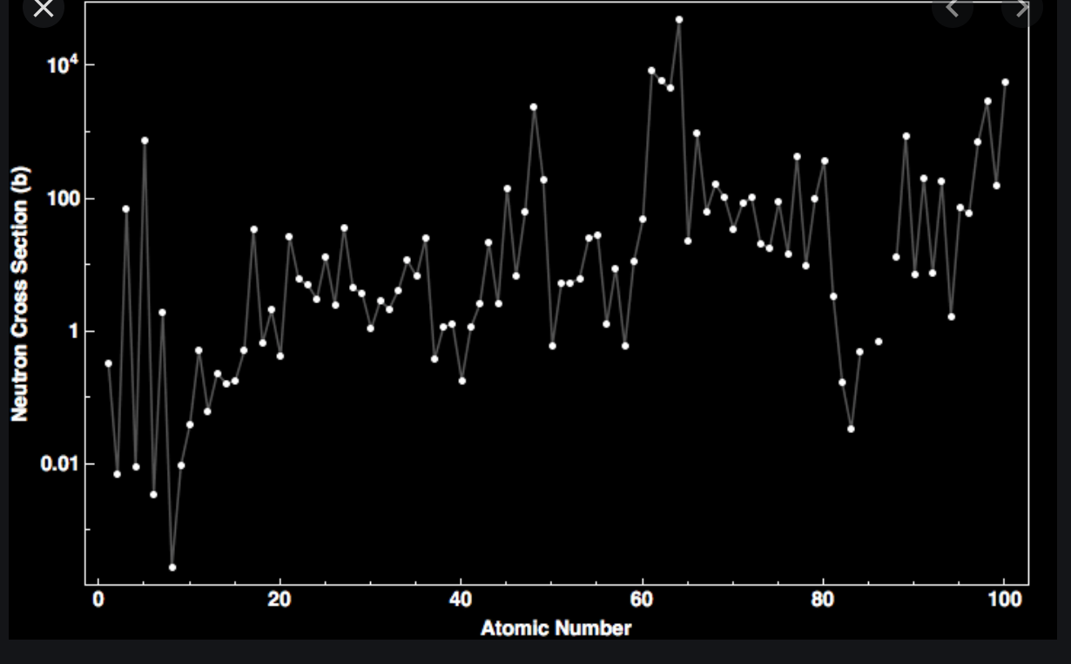
Evidence for Shell structure in nuclei
other anomalies
Nuclei with N=magic have abnormally small n-capture cross sections
(they don’t like adding neutrons)
sudden jumps in cross sections (σ ∼πR²)
is related to sudden reduction of nuclear radius
Z=20
Close to magic numbers nuclei can have
“long lived” excited states (τ > 10⁻⁶ s)
called “isomers”. One speaks of “islands of isomerism”.
Z=50
Z=82
Z=8
spin & parity of nuclei do not fit into a drop model
magnetic moments of nuclei are incompatible with drops
value of nuclear density is unpredicted
values of the liquid-drop model coefficients are completely empirical

Slide 23
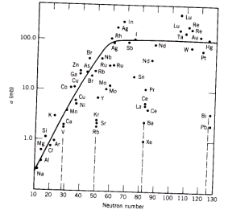
Evidence for Shell structure in nuclei
Sezione d’urto di cattura neutronica
Le sezioni d’urto sono
due ordini di grandezza piu’ piccole
in corrispondenza a certi numeri di Z e N

Slide 24
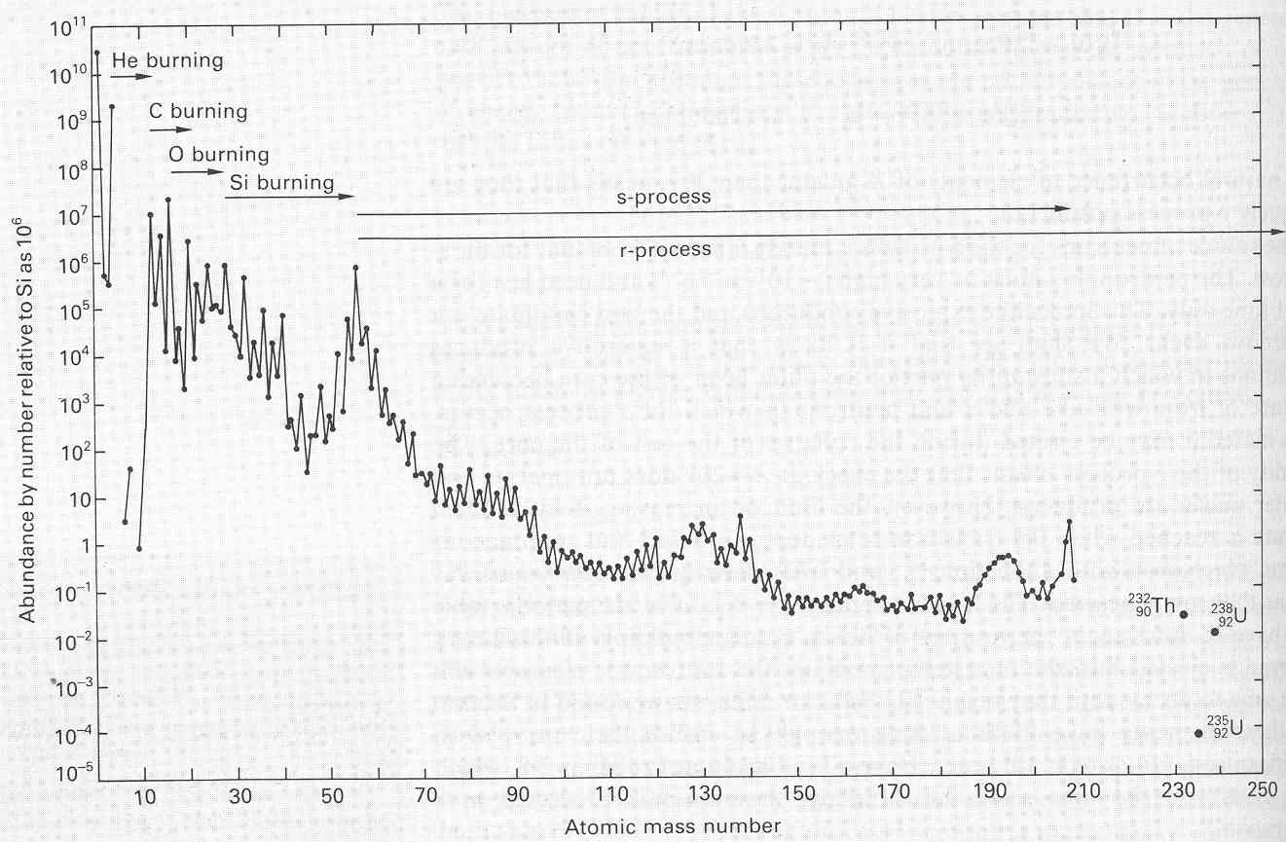
Evidence for Shell structure in nuclei
Abundances of stable isotopes in the solar system
show “peaks” in correspondence of “magic N and Z numbers
Complex plot due to dynamics of creation, see lecture on nucleosynthesis
N=82
Z=82
N=126
N=50
Z=50
iron mountain
no A=5 or 8

Slide 25
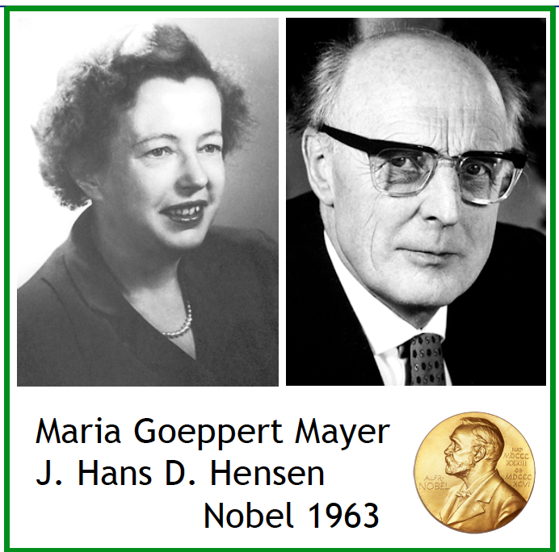
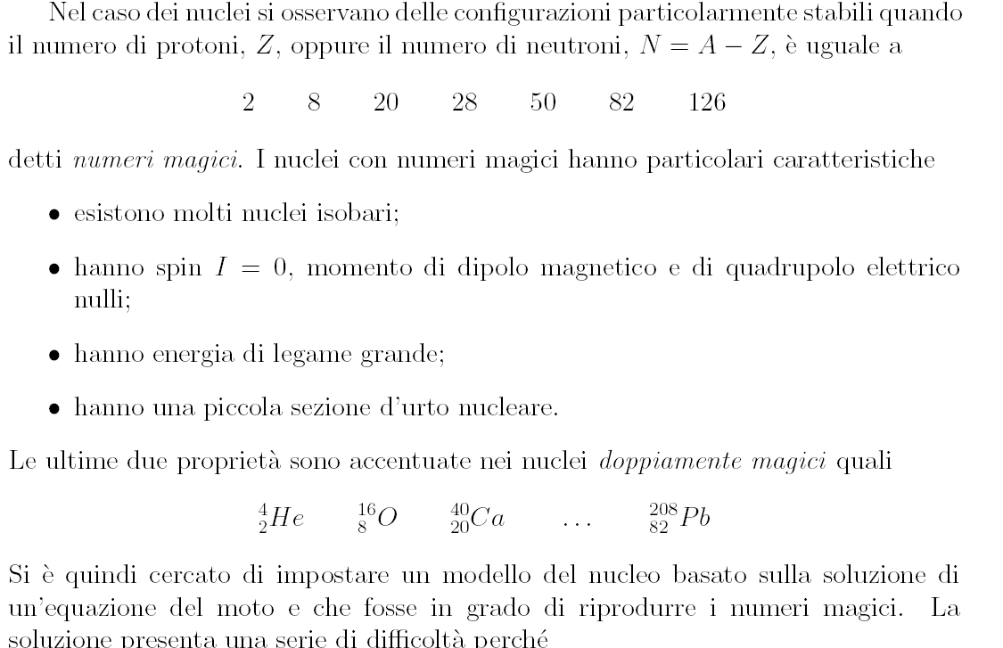
SHELL MODEL for nuclei
1949: Modello a particelle indipendenti costruito in analogia con il modello atomico che riproduca i numeri magici e le proprietà dei nuclei magici
Numeri magici

Slide 26
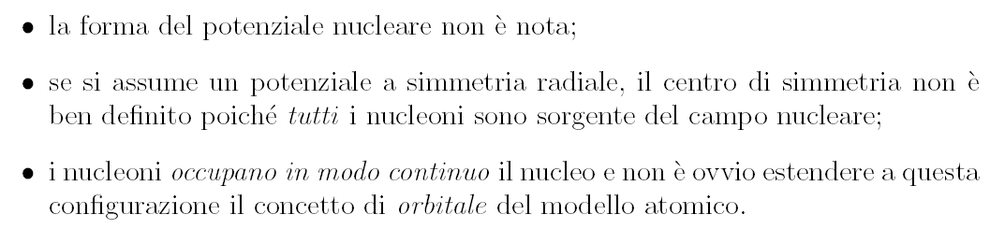
SHELL MODEL for nuclei
difficulties
(non è nota la forza, a differenza del caso atomico con forza Coulombiana)

Slide 27
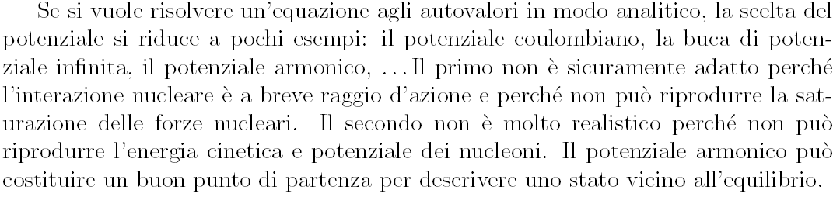

SHELL MODEL for nuclei
difficulties
Nucleone
nel campo medio
generato
da N-1 nucleoni
Prof. Angela Bracco

Slide 28
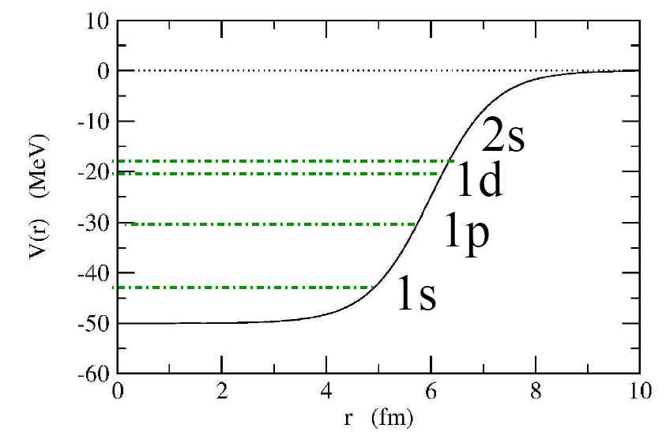
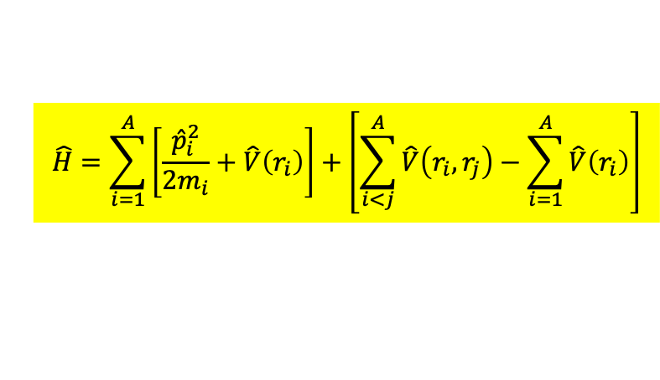
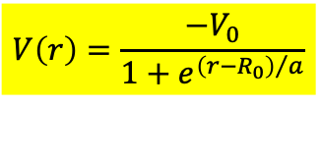
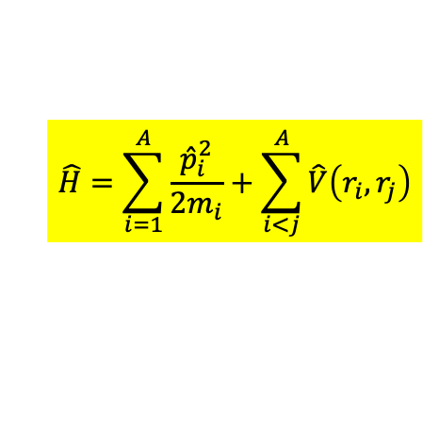

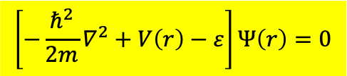
Choice of the Nuclear Potential
$$\hat{H}=\sum_{i=1}^{A}{\frac{{\hat{p}}_{i}^{2}}{2m_{i}}+\sum_{i<j}^{A}{\hat{V}\left(r_{i},r_{j}\right)}}$$
Hamiltonian =
Kinetic energy individual nucleons + Interaction with other nucleons
$$\hat{H}=\sum_{i=1}^{A}{\left[\frac{{\hat{p}}_{i}^{2}}{2m_{i}}+\hat{V}\left(r_{i}\right)\right]}+\left[\sum_{i<j}^{A}{\hat{V}\left(r_{i},r_{j}\right)}−\sum_{i=1}^{A}{\hat{V}\left(r_{i}\right)}\right]$$
introduction of a central potential (in analogy with atom) =
it allows to eliminate the residual interaction
All single particle energies can be calculated starting from this average potential V(r )
$$\left[−\frac{ℏ^{2}}{2m}∇^{2}+V\left(r\right)−ε\right]Ψ\left(r\right)=0$$
$$V\left(r\right)=\frac{−V_{0}}{1+e^{{\left(r−R_{0}\right)}/a}}$$
$$Ψ\left(r\right)=\frac{u_{ℓ}\left(r\right)}{r}∙Y_{ℓm}\left(θ,φ\right)∙Χ_{m_{s}}$$
In the average nuclear potential V(r):
harmonic oscillator
square well potential
Woods-Saxon potential
the nucleons move freely

Slide 29

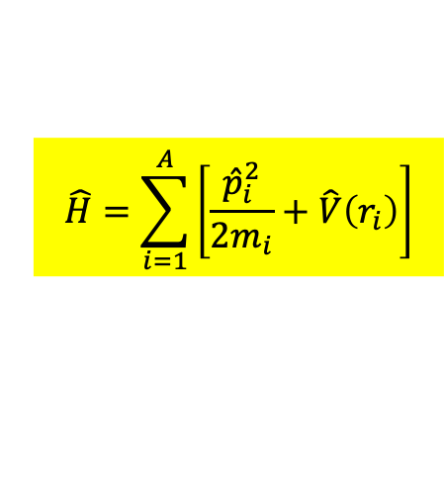






Choice of the Nuclear Potential
$$\hat{H}=\sum_{i=1}^{A}{\left[\frac{{\hat{p}}_{i}^{2}}{2m_{i}}+\hat{V}\left(r_{i}\right)\right]}$$
harmonic
oscillator
square-well
potential
realistic potential
+ spin-orbit coupling
168
V
$$6ℏω$$
168
4s
4s1/2
112
3d
3d3/2
2g
2g7/2
$$5ℏω$$
3d5/2
3p
126
1i11/2
70
1i
2g9/2
2f
2f5/2
0
3p1/2
1i13/2
r
$$4ℏω$$
2p3/2
1h/3s
82
2f7/2
40
1h9/2
2d
3s1/2
1h11/2
1g
2d1/2
$$3ℏω$$
50
2d5/2
1g7/2
20
2p
1g9/2
1d
2p1/2
28
3p3/2
$$2ℏω$$
1f5/2
2s
20
1f7/2
8
1d
2g1/2
1d3/2
V₀
$$1ℏω$$
8
1d5/2
1p
1p1/2
2
1p3/2
1s
2
$$0ℏω$$
1s1/2

Slide 30
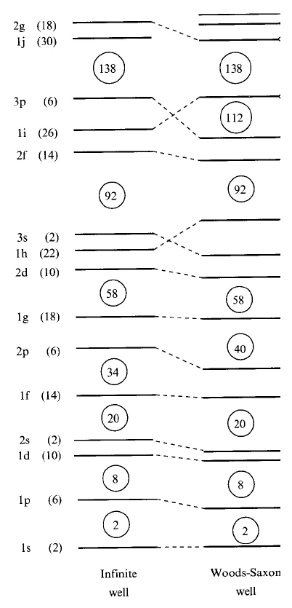
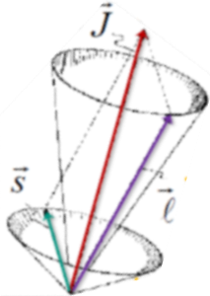

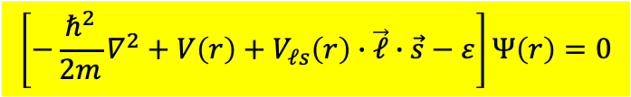


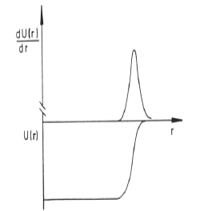

Woods-Saxon potential
Woods-Saxon does not reproduce the correct magic numbers
(2, 8, 20, 40, 70, 112, 168)_{WS} (2, 8, 20, 28, 50, 82, 126)_{exp}
Mayer und Jensen (1949): strong spin-orbit interaction
$$\left[−\frac{ℏ^{2}}{2m}∇^{2}+V\left(r\right)+V_{ℓs}\left(r\right)∙\vec{ℓ}∙\vec{s}−ε\right]Ψ\left(r\right)=0$$
$$V_{ℓs}\left(r\right)\sim −λ∙\frac{1}{r}∙\frac{dV}{dr} with λ>0$$
$$\vec{J}$$
$$\vec{s}$$
$$\vec{ℓ}$$
The spin-orbit term has its origin in the relativistic description of the single particle motion inside the nucleus

Slide 31
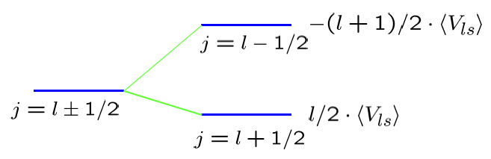










Woods-Saxon potential
$$\vec{j}=\vec{ℓ}+\vec{s}$$
$$⇒ \left\langle ℓ∙s\right\rangle =\frac{1}{2}∙\left[\left\langle j^{2}\right\rangle −\left\langle ℓ^{2}\right\rangle −\left\langle s^{2}\right\rangle \right]∙ℏ^{2}$$
$$=\frac{1}{2}\left[j\left(j+1\right)−ℓ\left(ℓ+1\right)−s\left(s+1\right)\right]∙ℏ^{2}$$
The nuclear potential with spin-orbit term:
spin-orbit interaction leads to a large splitting for large ℓ
$$V\left(r\right)+\frac{ℓ}{2}∙V_{ℓs} for j=ℓ+1/2$$
$$V\left(r\right)−\frac{ℓ+1}{2}V_{ℓs} for j=ℓ−1/2$$
$$−\left(ℓ+1\right)/2∙\left\langle V_{ℓs}\right\rangle$$
$$j=ℓ−1/2$$
$$j=ℓ±1/2$$
$$ℓ/2∙\left\langle V_{ℓs}\right\rangle$$
$$j=ℓ+1/2$$

Slide 32





Woods-Saxon potential
The spin-orbit term
lowers the j = ℓ+1/2 orbital from the
higher oscillator shell (intruder states)
reproduces the magic numbers
large energy gaps → very stable nuclei
$$ℓ−1/2$$
$$∆E_{ℓs}=\frac{2ℓ+1}{2}∙ℏ^{2}∙\left\langle V_{ℓs}\right\rangle$$
Important consequences:
lowering orbitals from higher lying N+1 shell
having different parity than orbitals from the N shell
strong interaction preserves the parity.
The lowered orbitals with different parity are rather pure states
and do not mix within the shell
$$ℓ+1/2$$
energy levels
for N=82
nucleus

Slide 33


Slide 34

Nuclear Shell Model

Slide 35

SHELL MODEL: predictions
Parità
Momento di dipolo magnetico
Momento di quadrupolo elettrico
Data la semplicita’ del modello le previsioni non sono molto accurate ma sono una buona base per esaminare la fenomenologia dei nuclei e impostare estensioni del modello per tener conto dele differenze osservate.
Il nucleo è rappresentato dagli stati occupati
momento angolare TOTALE (orbitale l + spin s)

Slide 36

SHELL MODEL: predictions
SPIN
PARITA’

Slide 37





SHELL MODEL mass dependence of single-particle energies
Mass dependence of the neutron
energies:
number of neutrons in each level:
$$E\sim R^{−2}$$
$$2∙\left(2ℓ+1\right)$$

Slide 38




SHELL MODEL
Ground state of Odd Nuclei
$$occupation number$$
$$\left(2j+1\right)$$
6
2
4
2
$${}_{8}^{15}{O_{7}}$$
$${}_{8}^{17}{O_{9}}$$

Slide 39


SHELL MODEL
Single-particle energies of ODD nuclei: excited states
Exercise
$${}_{8}^{17}{O_{9}}$$
Single-particle states observed in odd-A nuclei (in particular, one nucleon + doubly magic nuclei
like ⁴He, ¹⁶O, ⁴⁰Ca) characterize single-particle energies of the shell-model picture.

Slide 40

from Martin

Slide 41

16.451 Lecture 23: Applications of the Shell Model 27/11/2003
1
Generic pattern of single particle states
solved in a Woods-Saxon (rounded square
well) potential model with appropriate
spin-orbit interaction to reproduce the
observed “magic number” pattern:
State labels:
where n labels the order of occurrence of
a given l value, and the state labels for
orbital angular momentum are:
Each state can hold (2j +1) neutrons
and (2j+1) protons, corresponding to
2(2j+1) distinct configurations of
identical nucleons (m_{t}, m_{j}) to satisfy
the Pauli exclusion principle

Slide 42
Quantum numbers for a nucleus:
2
First of all, consider a “closed shell”, which corresponds to a completely filled
single-particle state, e.g. 1s_{1/2}, 1p_{3/2}, etc... containing (2j+1) protons or neutrons:
The total angular momentum is:
all have the same
j in a given shell
each m value is different,
ranging from –j to +j
There is effectively only one configuration here, with total z-projection M = 0.
Therefore, the total angular momentum of a closed shell must be J = 0!
The total parity is:
Since (2j+1) is always even, the parity of a closed shell is always positive.

Slide 43
Valence Nucleons:
3
For a closed shell + n nucleons, the angular momentum and parity is determined by
the n “valence” nucleons, since the closed shell contributes J^{π} = 0⁺ :
The parity is uniquely determined, but there may be several different values of J
that are consistent with angular momentum coupling rules. Residual interactions
between the valence nucleons in principle determine which of the allowed J has the
lowest energy – we can’t predict this a priori but can learn from experiment.
“Holes” -- for a state that is almost full, it is simpler to consider angular momentum
coupling for the missing nucleons than for the ones that are present:
result for
a closed shell
magnitudes of the two partial sums have
to be the same, and M values opposite.
Total angular momentum for a collection of missing particles, i.e. holes, is the same
as for that same collection of particles in a given shell model state.

Slide 44
Magnetic Moments:
4
As in lecture 19, we can write:
Predictions are only simple in the limit of one valence nucleon, and then we have:
valence proton:
valence neutron:
Simplifying the results (assignment 4), we find:
with

Slide 45

Application with one valence nucleon: ¹⁷O
5
There are 8 protons and 9 neutrons, so we only
need the low lying states in the shell model spectrum
to understand the energy levels:
E (MeV)
valence n
Ground state:
full to here plus
one neutron
Ground state quantum numbers should be those
of the valence neutron in the 1d_{5/2} state:
J^{π} = 5/2⁺ ☺
Magnetic moment prediction: j = l + ½, odd neutron
→ μ = μ_{neutron} = -1.91 μ_{N}
measured value: -1.89 μ_{N} excellent agreement!

Slide 46
Excited states of ¹⁷O can be understood by promoting the valence neutron:
6
First excited state: J^{π} = ½ ⁺
E (MeV)
½ + state
ground state full to here

Slide 47
Excited states of ¹⁷O:
7
Next excited state: J^{π} = ½ ⁻
→ explained by promoting a neutron from
the filled 1 p_{1/2} level to the 1d_{5/2} level
E (MeV)
0⁺ pair
½ ⁻ neutron hole

Slide 48
Excited states of ¹⁷O
8
The 5/2⁻ state is not so easy: to have negative parity,
there must be an odd nucleon in a p state (or f state,
but that is higher)
E (MeV)
J = ?
But two neutrons are required to have different
values of m_{j} by the Pauli principle. Writing out
the allowed configurations → only J = 0, 2, 4
are allowed! (J = 2 will work here)

Slide 49
Two valence nucleons: (enough already!)
9
This problem is much more complicated! The inner “core” nucleons couple to J^{π} = 0⁺
but in general there is more than one possibility for the angular momentum coupling
of the valence particles.
a) (pp) or (nn) case: Z and N are both even in these cases, so we know that
the ground state configuration will be 0⁺ no matter what
shell model state they are in. Excited states will have higher
angular momentum, with possibilities restricted by the
Pauli principle.
b) (np) case: Z and N are both odd in this case. Only 6 examples in the whole
nuclear chart!!! In isolation, (np) prefers to form a bound
state – the deuteron – with J^{π} = 1^{+.}
Example: ¹⁸F, Z = 9, N = 9
np pair: no restrictions on total J.
possibilities are 0, 1, 2, 3, 4, 5
Ground state of ¹⁸F is 1+ i.e. deuteron
quantum numbers!
N.B. valence nucleons interact with each other, or
all J values would be degenerate!

Slide 50

SHELL MODEL
Success of the extreme single-particle shell model
Ground state spin and parity:
Every orbital has 2j+1 magnetic sub-states,
completely filled orbitals have spin J=0,
they do not contribute to the nuclear spin.
For a nucleus with one nucleon outside a
completely occupied orbital the nuclear spin
is given by the single nucleon.
n ℓ j → J
(-)^{ℓ} = π

Slide 51

SHELL MODEL
Success of the extreme single-particle shell model
$${}_{4}^{7}{Be}$$ | 1p3/2 | 3/2-
$${}_{9}^{17}F$$ | 1d5/2 | 5/2+
$${}_{28}^{63}{Ni}$$ | 1f5/2 | 5/2-
$${}_{29}^{61}{Cu}$$ | 2p3/2 | 3/2-
$${}_{40}^{91}{Zr}$$ | 2d5/2 | 5/2+
$${}_{51}^{123}{Sb}$$ | 1g7/2 | 7/2+
$${}_{65}^{159}{Tb}$$ | 1h11/2 | 11/2-
$${}_{73}^{183}{Ta}$$ | 1h11/2 | 11/2-
$${}_{81}^{199}{Tl}$$ | 3s1/2 | 1/2+
$${}_{82}^{209}{Pb}$$ | 2g9/2 | 9/2+
gradual filling of the orbitals
and correct prediction of spin and parity of ground states

Slide 52

SHELL MODEL
Success of the extreme single-particle shell model
$${}_{4}^{7}{Be}$$ | 1p3/2 | 3/2-
$${}_{9}^{17}F$$ | 1d5/2 | 5/2+
$${}_{28}^{63}{Ni}$$ | 1f5/2 | 5/2-
$${}_{29}^{61}{Cu}$$ | 2p3/2 | 3/2-
$${}_{40}^{91}{Zr}$$ | 2d5/2 | 5/2+
$${}_{51}^{123}{Sb}$$ | 1g7/2 | 7/2+
$${}_{65}^{159}{Tb}$$ | 1h11/2 | 11/2-
$${}_{73}^{183}{Ta}$$ | 1h11/2 | 11/2-
$${}_{81}^{199}{Tl}$$ | 3s1/2 | 1/2+
$${}_{82}^{209}{Pb}$$ | 2g9/2 | 9/2+
gradual filling of the orbitals
and correct prediction of spin and parity of ground states

Slide 53


Esercizio
Quali sono spin e parità secondo il modello a shell degli stati fondamentali di ${}_{5}^{13}B$, ${}_{6}^{13}C$ e ${}_{5}^{13}N$? Perché il ${}_{6}^{13}C$ ed il ${}_{5}^{13}N$ hanno $J^{π}$ uguali tra loro?
I dati per i nuclei considerati sono i seguenti:
$${}_{5}^{13}B: N=8, Z=5$$
$${}_{6}^{13}C: N=7, Z=6$$
$${}_{7}^{13}N: N=6, Z=7$$
Il ${}_{5}^{13}B$ riempie tutti i livelli di neutroni fino a $1p_{1/2}$, mentre i protoni lasciano una buca (hole) nel livello $1p_{3/2}$. Quindi $J_{GS}^{13B}=\frac{3}{2}$. Siccome il livello è di tipo $p (l=1)$ allora la parità dello stato sarà ${(−1)}^{1}=−1$. Dunque per il
$${}_{5}^{13}B→J^{π}={\frac{3}{2}}^{−}$$
Il ${}_{6}^{13}C$ riempie, con sei protoni, le shell $1s_{1/2}$ e $1p_{3/2}$. Il neutrone in eccesso si colloca nella shell $1p_{1/2}$, quindi
$${}_{6}^{13}C→J^{π}={\frac{1}{2}}^{−}$$
L’azoto-13 (${}_{7}^{13}N$) ha lo stesso comportamento del ${}_{6}^{13}C$, ma stavolta è il protone in eccesso che occupa il livello $1p_{1/2}$. Dunque
$${}_{7}^{13}N→J^{π}={\frac{1}{2}}^{−}$$
Questo comportamento avviene sempre nei nuclei speculari, quali sono il ${}_{6}^{13}C$ ed il ${}_{7}^{13}N$.

Slide 54


Esercizio
Modello a SHELL/Emissione gamma
Si determinino i valori di $J^{π}$ per lo stato fondamentale e il primo stato eccitato del ${}_{8}^{17}O$ secondo il modello a shell. Riguardo al primo stato eccitato, si supponga che esso sia dovuto al neutrone in eccesso. Si determini quindi il tipo della transizione $γ$ che porta il primo stato eccitato a diseccitarsi verso lo stato fondamentale.
In base alla successione degli stati di modello a shell a particelle indipendenti mostrato in alto a destra, il neutrone disaccoppiato si troverà nello stato fondamentale del ${}_{8}^{17}O$, nella shell $1d_{5/2}$, mantre al primo stato eccitato esso può essere promosso alla $2s_{1/2}$. Avremo quindi $J_{GS}^{π}={\frac{5}{2}}^{+}$e $J_{1°EX}^{π}={\frac{1}{2}}^{+}$.
Il momento angolare orbitale che può trasportare con sé il fotone nella transizione $γ$ si ricava dalla regola della composizione dei momenti angolari:
$\left|J_{1°EX}^{π}−J_{GS}^{π}\right|≤l≤J_{1°EX}^{π}+J_{GS}^{π}$e quindi:
$$\left|\frac{1}{2}−\frac{5}{2}\right|≤l≤\frac{1}{2}+\frac{5}{2} → 2≤l≤3 → l=2,3$$
Inoltre la parità nella transizione resta invariata, considerando che le transizioni $γ$ obbediscono alle regole di selezione:
$$π_{i}=π_{f}→El con l pari oppure Ml con l dispari$$
$π_{i}≠π_{f}→El con l dispari oppure Ml con l pari$
In questo caso avremo che la transizione $γ$ può essere di tipo E2 o M3.

Slide 55



Slide 56







SHELL MODEL
Success of the extreme single-particle shell model
Predictions of magnetic moments of ODD nuclei
Magnetic moments:
The g-factor g_{j} is given by:
with
Simple relation for the g-factor
of single-particle states
$$\vec{μ_{j}}=g_{ℓ}∙\vec{ℓ}+g_{s}∙\vec{s}=g_{j}∙\vec{j}$$
$$⇒ \vec{μ_{j}}=\left[\left(g_{ℓ}∙\vec{ℓ}+g_{s}∙\vec{s}\right)∙\frac{\vec{j}}{\left|j\right|}\right]∙\frac{\vec{j}}{\left|j\right|}$$
$${\vec{ℓ}}^{2}={\left(\vec{j}−\vec{s}\right)}^{2}={\vec{j}}^{2}−2∙\vec{j}∙\vec{s}+{\vec{s}}^{2}$$
$${\vec{s}}^{2}={\left(\vec{j}−\vec{ℓ}\right)}^{2}={\vec{j}}^{2}−2∙\vec{j}∙\vec{ℓ}+{\vec{ℓ}}^{2}$$
$${\vec{μ}}_{j}=\frac{g_{ℓ}∙\left\{j\left(j+1\right)+ℓ\left(ℓ+1\right)−3/4\right\}+g_{s}∙\left\{j\left(j+1\right)−ℓ\left(ℓ+1\right)+3/4\right\}}{2∙j\left(j+1\right)}∙\vec{j}$$
$$g_{j}=\frac{1}{2}∙\left(g_{ℓ}+g_{s}\right)+\frac{1}{2}∙\frac{ℓ\left(ℓ+1\right)−s\left(s+1\right)}{2j\left(j+1\right)}∙\left(g_{ℓ}−g_{s}\right)$$
μ/μ_{N}
nucleus state J^{π} model experiment
$$\frac{μ}{μ_{N}}=g_{nucleus}=g_{ℓ}±\frac{\left(g_{s}−g_{ℓ}\right)}{2ℓ+1} for j=ℓ±1$$

Slide 57



SHELL MODEL
Success of the extreme single-particle shell model
Predictions of magnetic moments of ODD nuclei
$$\left\langle μ_{z}\right\rangle =\left\{\begin{matrix} \left[g_{ℓ}∙\left(j−\frac{1}{2}\right)+\frac{1}{2}∙g_{s}\right]∙μ_{N} for j=ℓ+1/2 \\ \frac{j}{j+1}∙\left[g_{ℓ}∙\left(j+\frac{3}{2}\right)−\frac{1}{2}∙g_{s}\right]∙μ_{N} for j=ℓ−1/2\end{matrix}\right\}$$
magnetic moments:
g-factor of nucleons:
proton: g_{ℓ} = 1; g_{s} = +5.585
neutron: g_{ℓ} = 0; g_{s} = -3.82
proton:
neutron:
$$\left\langle μ_{z}\right\rangle =\left\{\begin{matrix} \left(j+2.293\right)∙μ_{N} for j=ℓ+1/2 \\ \left(j−2.293\right)∙\frac{j}{j+1}∙μ_{N} for j=ℓ−1/2\end{matrix}\right\}$$
$$\left\langle μ_{z}\right\rangle =\left\{\begin{matrix} −1.91∙μ_{N} for j=ℓ+1/2 \\ +1.91∙\frac{j}{j+1}∙μ_{N} for j=ℓ−1/2\end{matrix}\right\}$$

Slide 58





SUCCESS of the extreme single-particle SHELL MODEL
Predictions of magnetic moments of ODD nuclei – SCHMIDT LINES
Only general trend is well predicted! Why?
intrinsic nucleon magnetic
moment influenced by
environment
(interactions with other nucleons)
Configuration mixing:
The pairing of spins is not exact.
Many configurations possible
with slightly “unpaired” nucleons
to give one effective unpaired nucleon
Nucleon-Nucleon interaction
has “charged component”
(π± exchange) giving extra currents!
Nuclei are not really spherical
as assumed (see collective model)
magnetic moments: proton
Odd Proton
magnetic moments: neutron
$0.6 (gs$)_{Free}
Odd Neutron
$0.6 (gs$)_{Free}
μ(μ_{N})
$0.6 (gs$)_{Free}
μ(μ_{N})
$0.6 (gs$)_{Free}
j
j
Notes:
Predictions are “pretty bad”! Why?
intrinsic nucleon magnetic moment influenced by environment (compound nucleons)
Configuration mixing: The pairing of spins is not exact. Many configurations possible with slightly “unpaired” nucleons to give one effective unpaired nucleon
Nucleon-Nucleon interaction has “charged component” (π± exchange) giving extra currents!
nuclei are not really spherical as assumed (see collective model)

Slide 59

Magnetic moments revisited: (see Krane, Fig. 5.9)
10
Single particle predictions:
μ
Data for odd-proton
nuclei:
(lines are calculated
from the formulae)
Agreement is not
terrific, but the
values lie within the
two “Schmidt lines”
j

Slide 60
Odd neutron nuclei:
11
¹⁷O example: “perfect”
What is wrong?
the single particle model is too simple – nucleons interact with each other
configurations may be mixed, i.e. linear combinations of different shell model states
magnetic moments of bound nucleons may not be the same as those of free nucleons...

Slide 61


Title page of a research monograph, Oxford, 1990:
12
From the preface:

Slide 62


SUCCESS of the extreme single-particle SHELL MODEL
Predictions of magnetic moments of ODD nuclei

Slide 63










REMINDER
Magnetic moment (classical description)
$$\vec{L}$$
e⁻-movement ⇒ magnetic moment $\vec{μ_{e}}$
$$\vec{n}$$
$$\vec{μ_{e}}=\frac{I}{c}∙A∙\vec{n}$$
A
I
$$I=−e∙ν=−e∙\frac{v}{2πr}$$
$$⇒ \vec{μ_{e}}=−\frac{1}{2}∙\frac{e∙v∙r∙\vec{n}}{c}$$
$$\vec{r}$$
$$A=π∙r^{2}$$
e⁻
angular momentum:
$$\vec{L}=\vec{r}×\vec{p}=r∙m_{e}∙v∙\vec{n} ⇒ \vec{μ_{e}}=−\frac{e}{2∙m_{e}∙c}\vec{L}$$
Quantum mechanical description: angular momentum will be quantized, in units of ħ.
$$μ_{B}=\frac{e∙ℏ}{2∙m_{e}∙c}=5.788∙{10}^{−11} \frac{MeV}{Tesla}$$
$$μ_{K}=\frac{e∙ℏ}{2∙m_{P}∙c}=3.152∙{10}^{−14} \frac{MeV}{Tesla}$$

Slide 64











Magnetic dipole moments (spin)
REMINDER
$$μ_{ℓ}={gl μ}_{B}∙ℓ$$
orbital magnetic moment
$$μ_{s}={gs μ}_{B}∙s$$
spin magnetic moment
g_{s} = g-factor for spin momentum
$$μ_{s}={−2.0023∙μ}_{B}∙s$$
electron spin magnetic moment
g = $2$
for s = 1/2 structure-less particle from Dirac equation
$$μ_{s}={+5.585691∙μ}_{N}∙s$$
proton spin magnetic moment
$$μ_{s}={−3.826084∙μ}_{N}∙s$$
neutron spin magnetic moment
Why has a neutron a magnetic moment when it is uncharged?
u-quark: $+2/3e$
d-quark: $−1/3e$
strong evidence that neutrons and protons are NOT elementary particles
(BIG deviation from g=2) - they have internal structure, they have charges.
proton
+1e
neutron
0e
Assuming Quark structure
good agreement with measured deuteron magnetic dipole moment (see next slides)
$$μ_{s}\left({}_{1}^{2}H\right)=\left(5.59−3.83\right){∙μ}_{N}∙\frac{1}{2}=0.87980{ μ}_{N}$$
$=0.8574∙μ_{N}$ (experiment)

Slide 65












Magnetic dipole moments in nuclei
REMINDER
Spin values in nuclei
mass number | number of protons | number of neutrons | spin (I) | example
even | even | even | 0 | ¹⁶O
 | odd | odd | integer (1,2,…) | ²H
odd | even | odd | half-integer ($1/2,3/2,⋯$) | ¹³C
 | odd | even | half-integer ($1/2,3/2,⋯$) | ¹⁵N
In even-even nucleus:
spin (I) is 0 → magnetic moment is 0
in odd-A nuclei (from Shell Model):
all nucleons coupled to 0 except one
→ magnetic moment is given by the unpaired one
$\vec{I}$ = $\vec{j}=\vec{ℓ}+\vec{s}$
Magnetic moments
important information on single particle structure
? ?
=1
$$\vec{μ_{j}}=g_{ℓ}∙\vec{ℓ}+g_{s}∙\vec{s}=g_{j}∙\vec{j}$$
$$⇒ \vec{μ_{j}}=\left[\left(g_{ℓ}∙\vec{ℓ}+g_{s}∙\vec{s}\right)∙\frac{\vec{j}}{\left|j\right|}\right]∙\frac{\vec{j}}{\left|j\right|}$$
in units of
nuclear magneton $μ_{N}$
The g-factor g_{j} is given by:
with
$${\vec{ℓ}}^{2}={\left(\vec{j}−\vec{s}\right)}^{2}={\vec{j}}^{2}−2∙\vec{j}∙\vec{s}+{\vec{s}}^{2}$$
$${\vec{s}}^{2}={\left(\vec{j}−\vec{ℓ}\right)}^{2}={\vec{j}}^{2}−2∙\vec{j}∙\vec{ℓ}+{\vec{ℓ}}^{2}$$
$\vec{ℓ}∙\vec{s}=\frac{1}{2}({\vec{j}}^{2}−{\vec{ℓ}}^{2}$ $−{\vec{s}}^{2}$)
$${\vec{μ}}_{j}=\frac{g_{ℓ}∙\left\{j\left(j+1\right)+ℓ\left(ℓ+1\right)−s(s+1)\right\}+g_{s}∙\left\{j\left(j+1\right)−ℓ\left(ℓ+1\right)+s(s+1)\right\}}{2∙j\left(j+1\right)}∙\vec{j}$$
$$g_{j}=\frac{1}{2}∙\left(g_{ℓ}+g_{s}\right)+\frac{ℓ\left(ℓ+1\right)−s\left(s+1\right)}{2j\left(j+1\right)}∙\left(g_{ℓ}−g_{s}\right)$$
nuclear g factor

Slide 66





Magnetic dipole moments of proton and neutron from quarks
(simple quark bag model – quarks confinement)
 | Charge | Mass m_{q} | Spin | mag. Moment
u-quark | + 2/3 | ~ 1/3 M_{p} | 1/2
d-quark | - 1/3 | ~ 1/3 M_{p} | 1/2
$$2∙\left(\frac{2}{3}\right)∙\frac{e∙ℏ}{2{∙m}_{q}∙c}∙s=4∙μ_{K}∙s$$
$$μ_{s}={gs μ}_{K}∙s$$
$gs$= 2
$$2∙\left(−\frac{1}{3}\right)∙\frac{e∙ℏ}{2∙m_{q}∙c}∙s=−2∙μ_{K}∙s$$
point-like particle
$$μ_{K}=\frac{e∙ℏ}{2∙m_{P}∙c}$$
general coupling rule:
Proton (uud) :
proton
+1e
Neutron (ddu) :
neutron
0e
g_{Dirac} = 2 prediction of the Dirac-theory for the gyromagnetic factor for spin ½-particles
g_{s}^{proton} = +5.58 ⇒ big deviation from g = 2 ⇔ no fundamental particle
g_{s}^{neutron} = -3.82

Slide 67
Approfondimento
Spins and Magnetic Moments:
experimental techniques

Slide 68


Spins and Magnetic Moments: experimental techniques
The spin of a nuclear state is in many cases inferred indirectly
from a variety of experiments:
selection rules in β-decay;
nucleon-transfer reaction measurements;
observed nuclear g-factor or magnetic dipole moment;
etc.
There is only one way to directly measure a nuclear spin
(model independent way) - by measuring the
hyperfine structure (small shift and splitting) of atomic levels
which reflects the hyperfine interaction with the atomic electron spin
Most accurate methods:
study of hyperfine structure in
external magnetic field
for states with lifetime > few ps
(interaction energy U= -μ • B)
2) laser spectroscopy methods
for states with lifetimes > few ms
now available lasers both pulsed and
continuous wave with
λ∼ 200 nm up to 1000 nm
techniques employed with both
stable and exotic nuclei
(ISOLDE facility at CERN,
ALTO at Orsay,
TRIUMF (Canada), ...)
level multiplicity is smaller number
between 2I+1 and 2J+1
nuclear
spin
atomic
spin
shift of atomic level energies
in external magnetic field
interaction nuclear moment
with atomic field
interaction nuclear moment
with external field
interaction atomic moment
with external field
Notes:
hyperfine structure refers to small shifts and splittings in the atomic, ionic, or molecular energy levels, which result from the interactions of the nucleus with internally generated electric and magnetic fields

Slide 69

Recap:
General Concept

Slide 70


Study of hyperfine structure in external magnetic field
ΔE∼g_{I}
2I+1
level
ΔE∼g_{F}
2F+1
level
ΔE∼g_{J}
(direct
nuclear spin
measure)
angular momenta
(vectors) coupling
nuclear
spin
atomic
spin
Weak magnetic Field
B_{ext} < 0.02 T
Total magnetic moment F
interact with B_{ext}
Zeeman effect
Large magnetic Field
B_{ext} >> 0.02 T
magnetic moments I and J interact separately with B_{ext}
Paschen-Back effect
see Stern-Gerlach (Rabi) experiments
with atomic and molecular beams
(from Krane)

Slide 71




Study of hyperfine structure in external magnetic field
Technique used to determine proton dipole moment
ΔE∼g_{I}
2I+1
level
interaction nuclear moment I
with external field
ΔE∼g_{J}
(direct
nuclear spin
measure)
resonance
absorption
frequency curve
interaction atomic moment J
with external field
Large magnetic Field
B_{ext} >> 0.02 T
magnetic moments I and J interact separately with B_{ext}
Paschen-Back effect
(similar technique used for n from reactor)
Winkler et al., PRA5, 83(1972)

Slide 72



High-precision lasers: selection of exotic species and study of hyperfine structure
protons
from LHC
Selection of exotic species
Hyperfine structure studies
LASER
laser
ionization
ISOLDE-CERN:
https://home.cern/news/series/meet-isolde
https://home.cern/news/series/meet-isolde/meet-isolde-where-did-it-all-begin
hyperfine studies
on exotic nuclei
(at ISOLDE-CERN, ...)
Ruben P. de Groote and Gerda Neyens, HANDBOOK (2023)
P. Campbell et al. / Progress in Particle and Nuclear Physics 86 (2016) 127

Slide 73



Study of hyperfine structure with high-precision lasers
pronounced structural
change observed at ⁷³Ga

Slide 74








Application
of nuclear spin
to medicine
random spin orientation
with B=0
proton in magnetic field
energy difference
between states
$$∆E=h∙ν$$
$$ΔE=−{ μ}_{I}∙B_{0}$$
frequency causing
proton spin flip
(∼42.57 MHz/T)
low energy
high energy
nuclear spin
realignment
and
wave emission
low energy
high energy
Tissue Imaging
with high resolution
relaxation (tissue dependent)

Slide 75



Magnetic Resonance Imaging/Nuclear Magnetic Resonance (MRI, NMR or MR)
chemist & physicist
knee
Notes:
chemist

Slide 76

Magnetic Resonance Imaging/Nuclear Magnetic Resonance (MRI, NMR or MR)
spatial resolution: 0.45-2 mm
La Risonanza Magnetica fornisce immagini dettagliate del corpo umano. Con questa tecnica molte malattie e alterazioni degli organi interni possono essere visualizzate e quindi facilmente diagnosticate.
Tramite la RM sono ben visibili i tessuti molli ed è possibile la discriminazione tra tipologie di tessuti, talora non apprezzabile con altre tecniche radiologiche. È un esame innocuo che non utilizza nè raggi X nè sorgenti radioattive.
From https://www.paginemediche.it/medicina-e-prevenzione/esami/risonanza-magnetica-nucleare-rmn

Slide 77
CURRENT Challenges of SHELL MODEL

Slide 78




Theory Challenges in MODERN NUCLEAR PHYSICS
Microscopic descritption of ALL Nuclei
Shell Structure
for p and n
Density
Functional Theory
More extended approach
Configuration Space
6 ħw
126
5 ħw
Number of ways to distribute
A nucleons over K orbitals
82
4 ħw
N=Z
Number of
configurations
ab-initio
NN, NNN
(EFT, QCD)
50
SHELL Model
Large Scale Calculations
With Frozen CORE
- A up to ≈ 100
- Around Closed shell
44 ⁸⁸Ru ≈ 10²⁸
3 ħw
28
28 ⁵⁶Ni ≈ 10¹⁰
20
24 ⁴⁸Cr ≈ 10⁷
2 ħw
22 ⁴⁴Ti ≈ 10⁴
8
1 ħw
2
0 ħw
MICROSCOPIC Structure of Nuclei:
a computational challenge due to the size of the configuration space

Slide 79


Modern SHELL-MODEL CALCULATIONS
Shell Structure
MAIN IDEA
Use SHELL GAPS as a TRUNCATION of the model space
Nucleus (N,Z) =
Frozen CORE + valence nucleons (N-N*, Z-Z*)
6 ħw
126
Doubly magic
nucleus (N*, Z*)
⁴He, ¹⁶O, ⁴⁰Ca, ¹³²Sn, ²⁰⁸Pb
Excitations restricted
to ONE-TWO oscillator SHELLS
5 ħw
82
4 ħw
50
3 ħw
^{LIMITATIONS}
    interactions
    among valence nucleons only
    CORE excitations are not fully included (few nucleons only)
28
20
$$\hat{V}\left(r_{i},r_{j}\right)$$
2 ħw
1 ħw
8
0 ħw
2
CORE Excitations may be very complex and not doable with SHELL MODEL
(see lectures of collective modes of excitations – vibrations in particular)

Slide 80

Large Computers with parallel processors allow to perform SHELL MODEL calculations in larger and larger model space
(using also ad-hoc computational scheme)
from
HANDBOOK of Nuclear Physics
SPRINGER 2023
Configuration interaction approach in atomic nuclei.
The Shell Model
by Yusuke Tsunoda
and Takahary Otsuka

Slide 81
vedi lezione Magliotti modello a shell

