Slide 1
I Raggi Cosmici di Ultra Alta Energia
Corso di Astroparticelle a.a. 2015-16

Slide 2
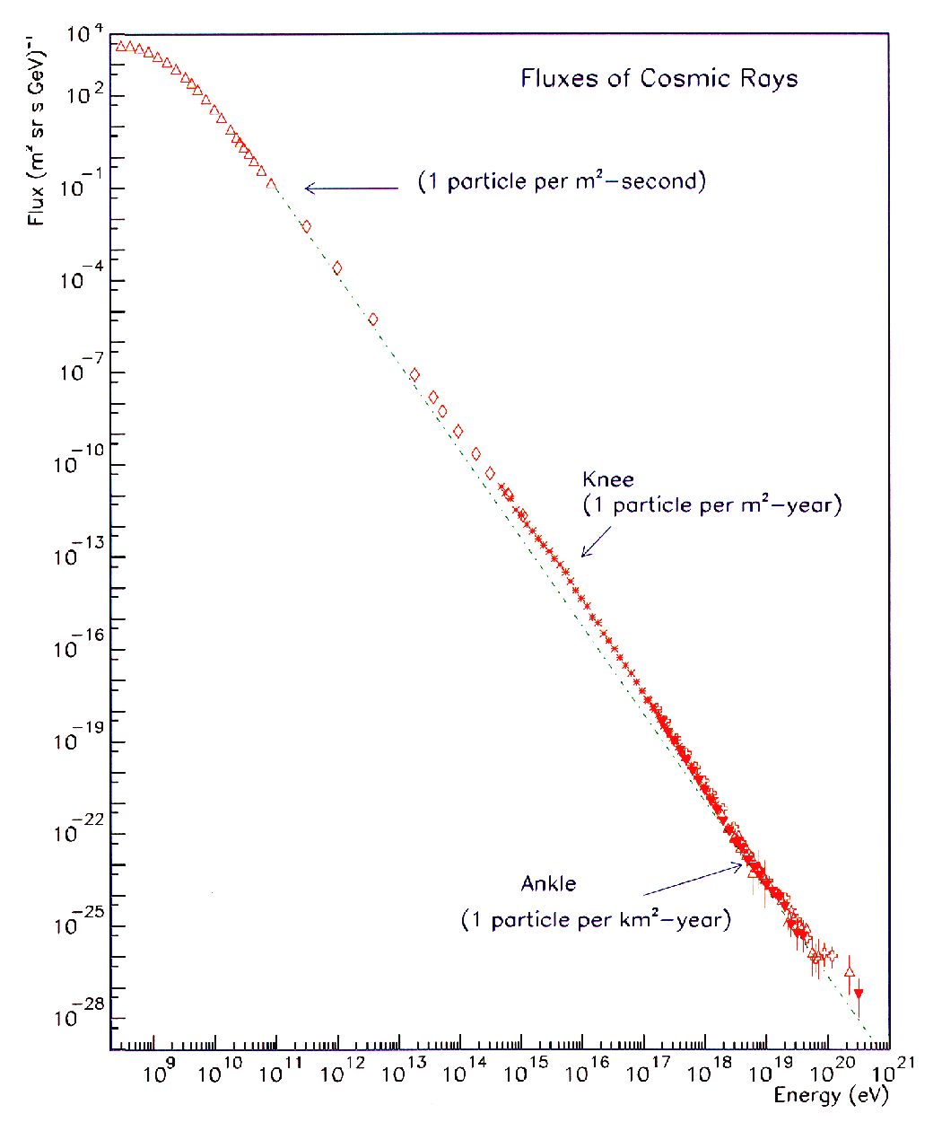
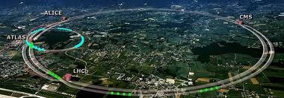
UHECRs: CRs with E> 10¹⁸ eV
OPEN QUESTIONS:
Where and how these cosmic rays are accelerated to these energies
Which are the sources that generated these cosmic rays
The chemical composition is unknown
From a Particle Physics point of view:
UHE Cosmic Rays probe physics at energies out of reach of any man made accelerator
Nearly uniform power-law spectrum E^{-γ}:
10 orders of magnitude in Energy
32 orders of magnitude in flux

Slide 3
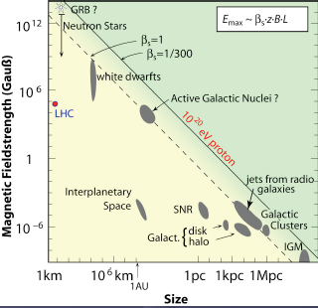
Possible UHECR Sources: 2 scenarios
Bottom-Up Acceleration
(Astrophysical Acceleration Mechanisms)
UHECR’s are accelerated in extended objects or catastrophic events (supernova remnants, rotating neutron stars, AGNs, radio galaxies)
Experimental evidence:
anisotropy in arrival directions
Photons < ≈1%
Top–Down Decay
(Physics Beyond the Standard Model)
Decay of topological defects
Monopoles Relics
Supersymmetric particles
Strongly interacting neutrinos
Decay of massive new long lived particles
Etc.
Now disfavored
from the measurement of the photon flux with the PAO
Experimental evidence:
isotropy in arrival directions
Photons > ≈10%

Slide 4
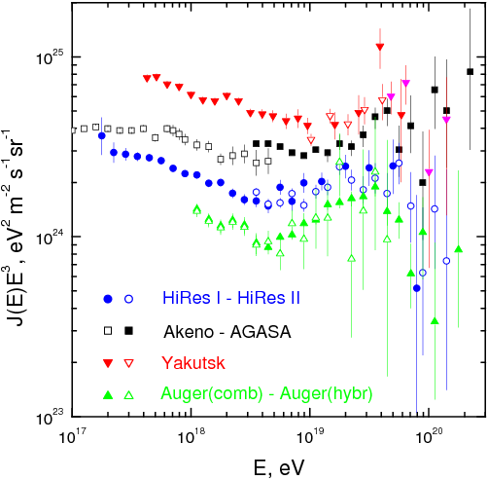
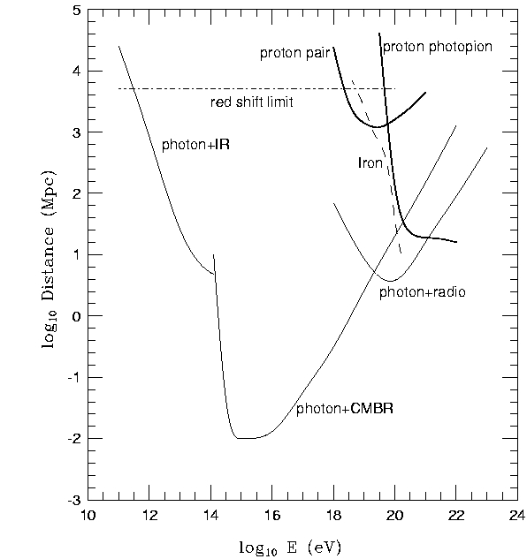
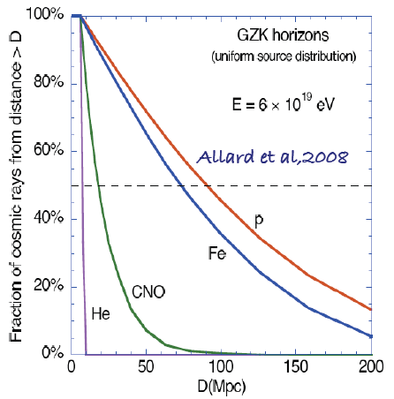
End to the cosmic ray spectrum?
Before AUGER it wasn’t know if there were an end to the CR spectrum or not.
Now, we know (see later) that there is a suppression but we do not know its nature.
The suppression may be due to:
GZK or E_{max}?
Size of the observable Universe ≈ 4.000 MPc
propagation scenario
the interaction with Cosmic Microwave Background (CBM)
as forseen by Greisen, Zatsepin, Kuzmin in 1966 (the GZK cutoff)
The Universe is opaque for protons with energy > 6 10¹⁹ eV
“horizon” (p and nuclei) ≈100 Mpc (≈10²⁰ eV )
source scenario
to the reach of the maximum energy in the celestial accelerators:
“source exhaustion” (i.e. maximum injection energy)
Intermediate nuclei disappear at UHE: mostly p and Fe

Slide 5
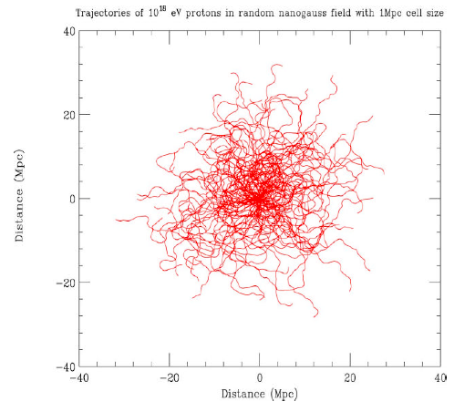
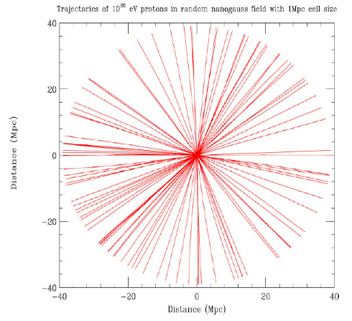
Influence of the Magnetic Field on propagation
Above 10²⁰ eV Δφ < 2° that is larger than the experimental resolution!
A window to Cosmic Rays Astronomy?

Slide 6
How to detect Cosmic Rays ?

Slide 7
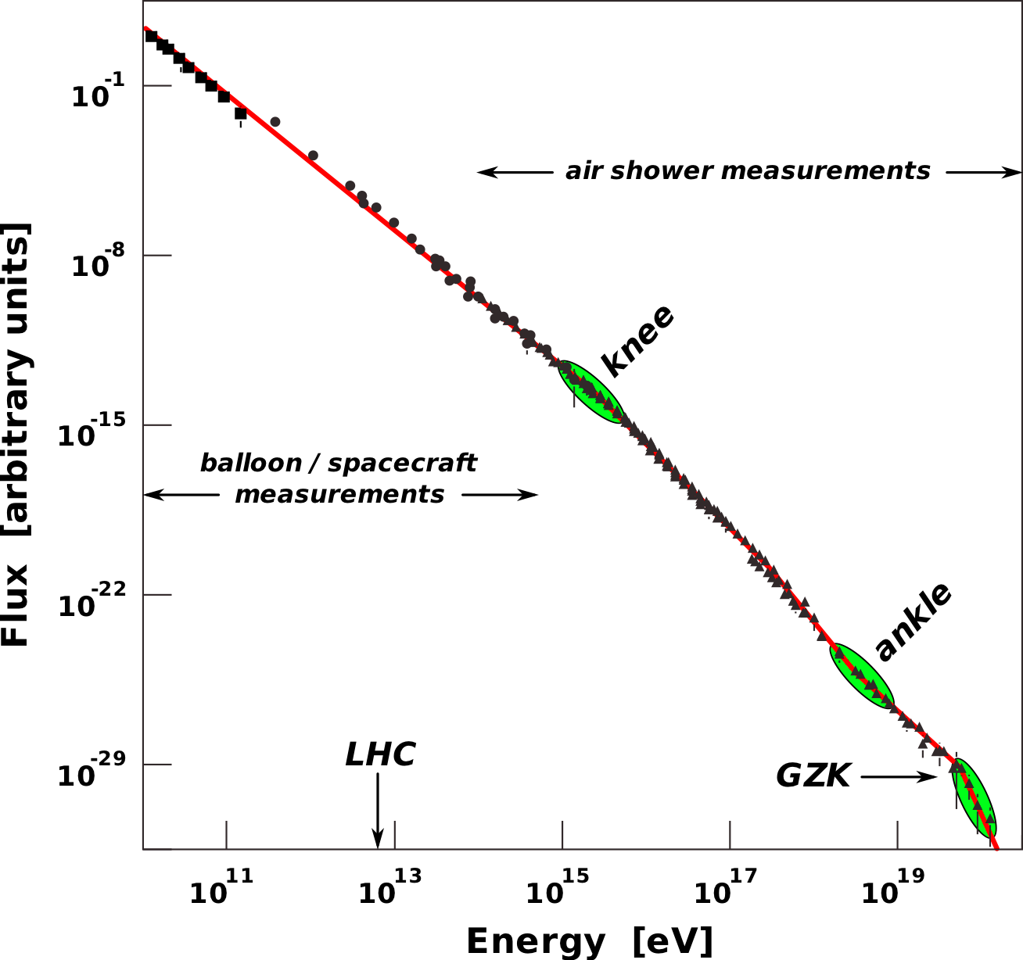
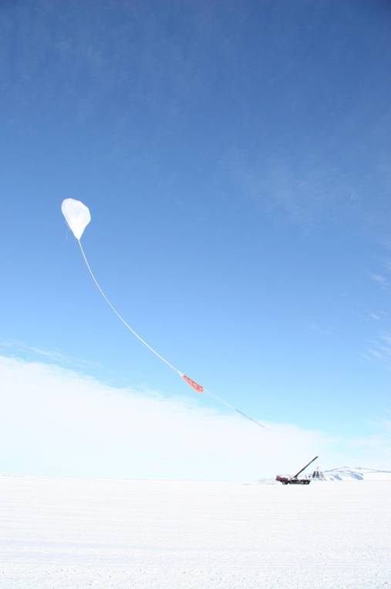
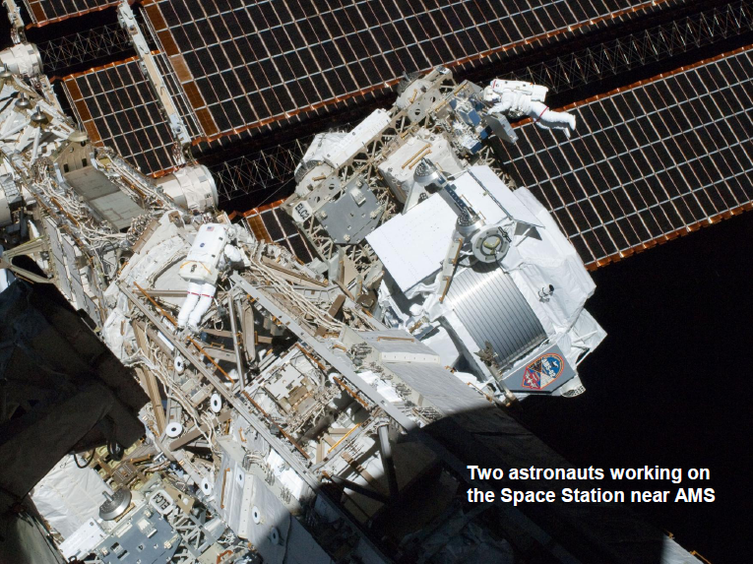
How to detect “low”CRs?
Up to 10¹⁴ eV it is possible to detect CR directly putting detectors on balloons or satellites
The chemical composition of CRs can be accurately measured through experiments carried at a negligible residual atmospheric depth or outside the atmosphere.
presence of primary antiparticles
Simultaneous measurements of
energy, charge, and mass (E, Z, A)
Energy measurement:
From ∼1 GeV to ∼1 TeV magnetic spectrometers or Cherenkov detectors. (Individual elements are identified, characterized by their charge Z through the dE/dx method)
At high energy Transition Radiation Detectors (TRDs)
The weight of a detector with a thickness of one hadronic interaction length and area of 1 m² amounts to ∼1 ton.

Slide 8
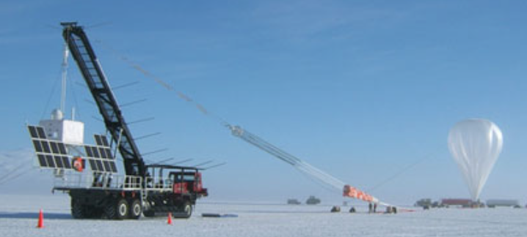
Balloon Experiments
Scientific balloons are made of 20 μm thick polyethylene film with a diameter of about 140 m filled with helium gas and fly at altitudes up to 42 km.
Payloads up to 3,600 kg attached to a parachute. The flights are terminated by remotely firing an explosive squib that separates the payload from the balloon.
In the early 1990s, successful long flights (1–2 weeks) around Antarctica.
From 2005 to 2010, the cosmic ray energetics and mass (CREAM) payload flew six times, for a cumulative exposure of 162 days.
Major improvement was the use of superconducting magnet spectrometers.
Balloon Experiment with a superconducting Solenoid Spec- trometer (BESS),
Cosmic AntiParticle Ring-Imaging Cherenkov Experiment (CAPRICE),
High-Energy Antimatter Telescope (HEAT).
The Transition Radiation Array for Cosmic Energetic Radiation (TRACER) experiment extended the flux measurements of heavy nuclei to higher energies
(two layers of plastic scintillators (2 × 2m²) which measured the electric charge, and a TRD).
Pioneering calorimeters using emulsions for measurements of CRs above 2 TeV (limited charge resolution and measured groups of nuclei with close electric charge) were:
Japanese-American Collaborative Emulsion Experiment (JACEE),
RUssian-Nippon JOint Balloon Experiment (RUNJOB).

Slide 9
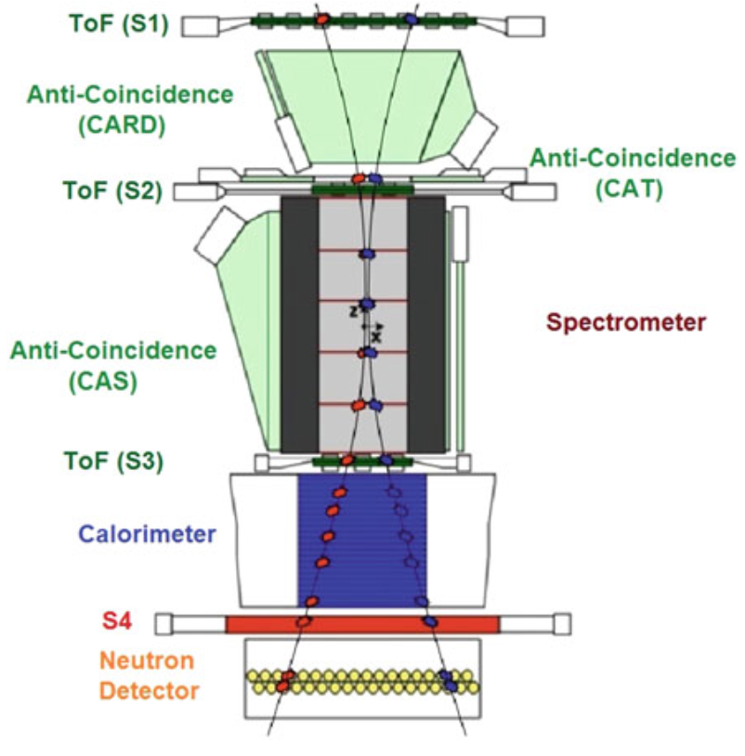
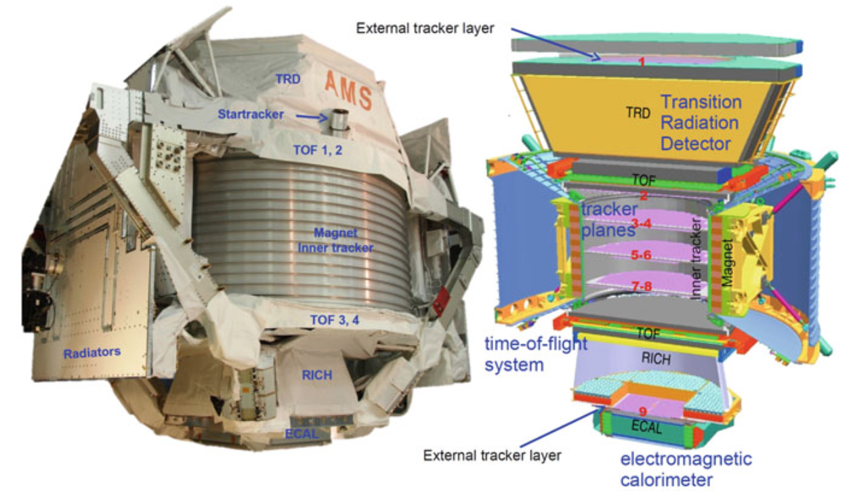
Satellite Experiments
The Payload for Antimatter Matter Exploration and Light-nuclei Astrophysics (PAMELA) mainly devoted to antimatter studies.
launched in June 2006 from the Baikonur cosmodrome in Kazakhstan.
The Alpha Magnetic Spectrometer (AMS) is the largest particle physics detector ever carried outside the atmosphere. It was designed to operate as an external module on the International Space Station (ISS).

Slide 10
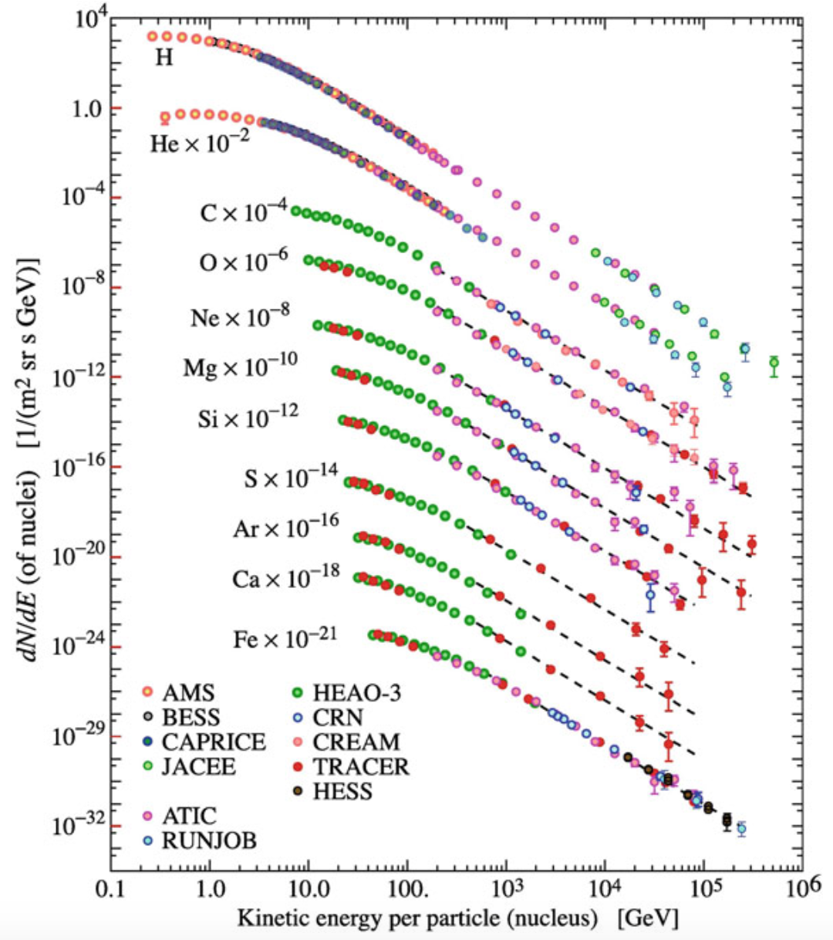

Slide 11
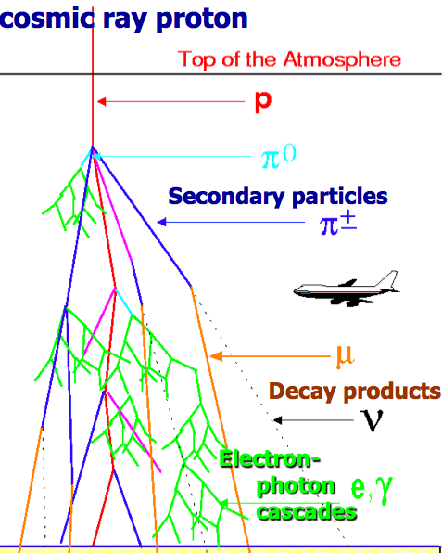
How to detect UHECRs?
For higher energy the flux is too poor and we have to study the showers (EAS) generated by primary CRs
The UHECR flux is less than 1 particle per km² per century
There are two main techniques to detect EAS from UHECRs:
A) To sample the EAS at ground with an Array of surface detectors (Lateral profile)
B) To detect the fluorescence light with Fluorescence telescopes (Longitudinal profile)

Slide 12
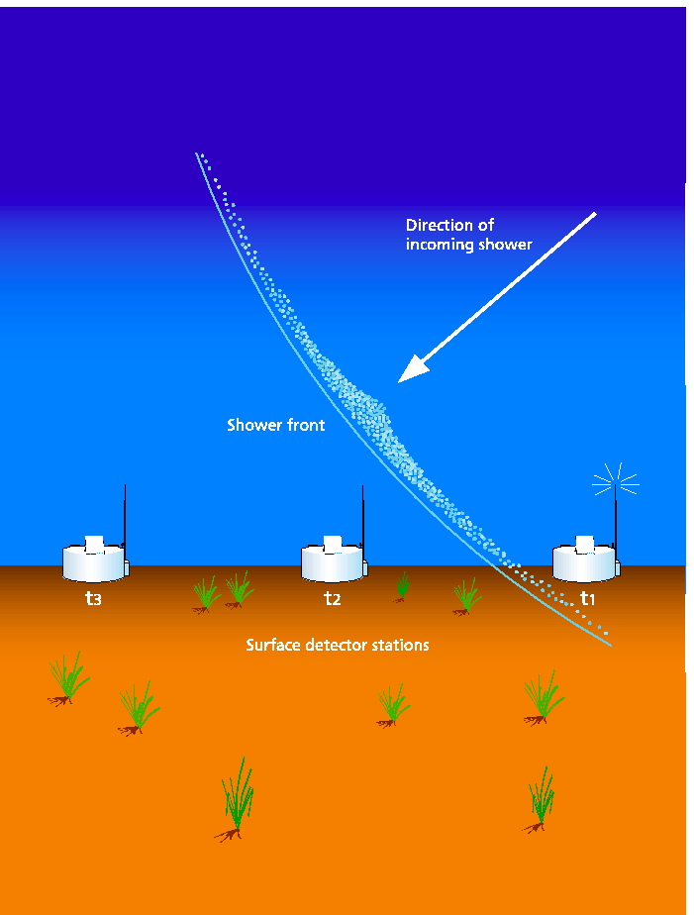
Array of surface detectors (Lateral profile)
The Surface Detector arrays samples the EAS at ground
- Time of arrival at each station
Thanks to the time of arrival it is possible to deduce the arrival direction of primary cosmic ray.
- Number of particles
From the number of secondary particles it is possible to infer the energy of primary cosmic ray.
- Muon number and Pulse rise time
Thanks to the number of muons and the study of the pulse rise time it is possible to measure the mass of primary cosmic ray.
Scintillators or
Cerenkov water tanks

Slide 13
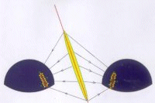
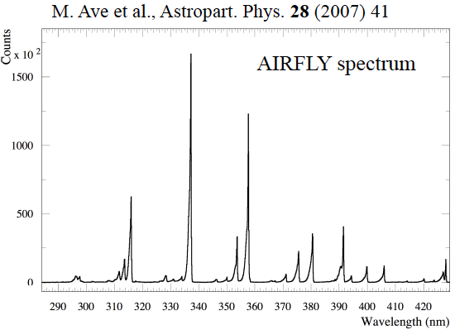
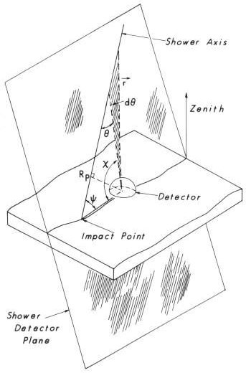
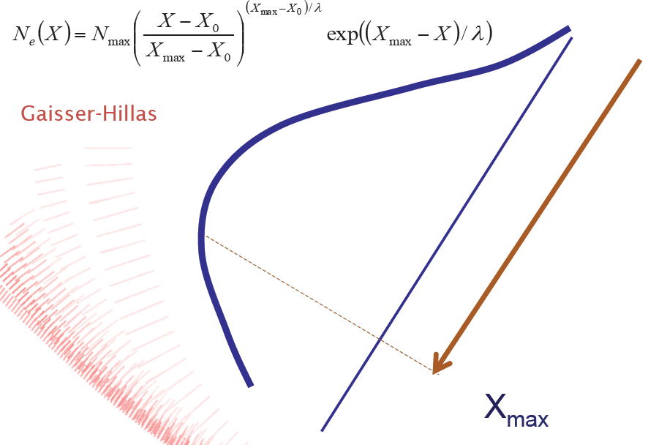
Fluorescence telescopes (Longitudinal profile)
Secondary charged particles excite nitrogen molecules. The de-excitation process occurs in the UV (fluorescence)
The fluorescence technique allows to measure the ionization density of the EAS at different altitudes. This enables to detect the longitudinal development of the shower.

Slide 14
Pros and Cons of two techniques
Array of surface detectors
Pros Duty cycle almost 100%
Cons Very strong dependence of nuclear interaction models (MonteCarlo simulations). Thus a big incertitude on the determination of the primary cosmic ray energy.
Fluorescence telescopes
Pros Less model dependent
Cons Duty cycle of about 10-15 % (clear moonless nights)
The Pierre Auger Observatory
is an Hybrid detector that combines the two techniques.

Slide 15
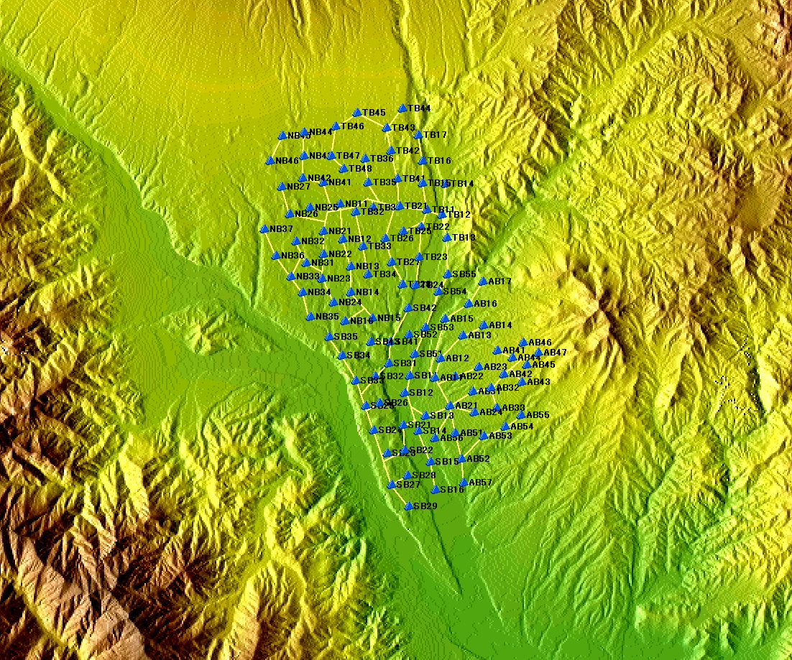
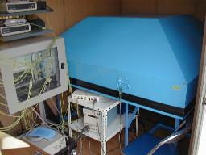
Akeno Giant Air Shower Array operated in 1991~2004
It covers an area of 100 km²
and consists of
111 surface detectors and
27 muon detectors.
0 4km

Slide 16
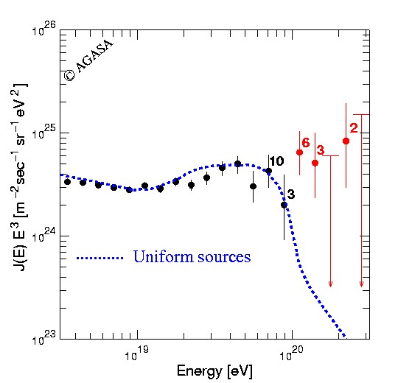
Energy Spectrum by AGASA (θ<45)
Super GZK particles
Preliminary study with recent CORSIKA
If we evaluate energies with the recent CORSIKA
Energy scale shift down by ~10% at 10¹⁹eV and by ~15% at 10²⁰eV
11 events above 10²⁰eV / 1.3~2.6 expected ➔ 5~6 events / 1.0~1.9 expected
Small scale anisotropy of UHECR
The arrival direction of UHECRs is uniform in large scale
But AGASA data shows clusters, 1 triplets and 6 doublets ➔ granularity
Source density ~10⁻⁵/Mpc³ ~ density of AGNs
5.1 x 10¹⁶ m² s sr

Slide 17
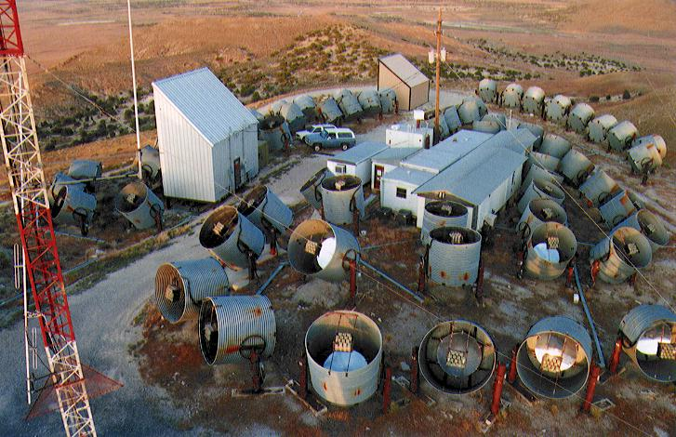
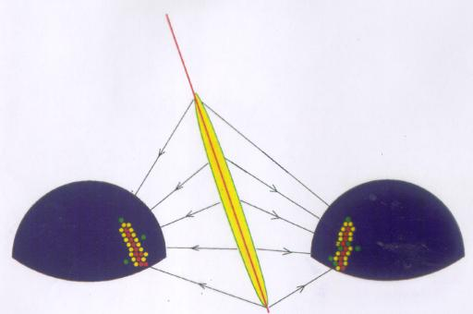
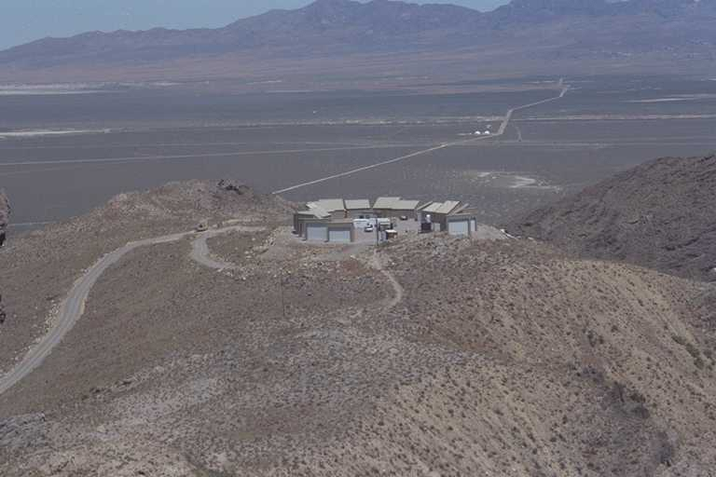
The Fly's Eye Observatory (1981-1993)
The High Resolution Fly's Eye (HiRes)

Slide 18
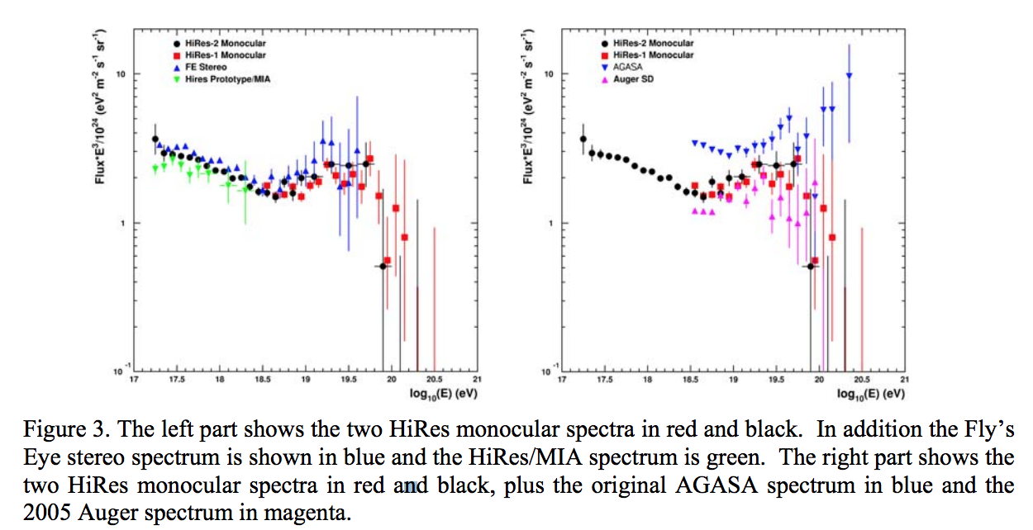

Slide 19
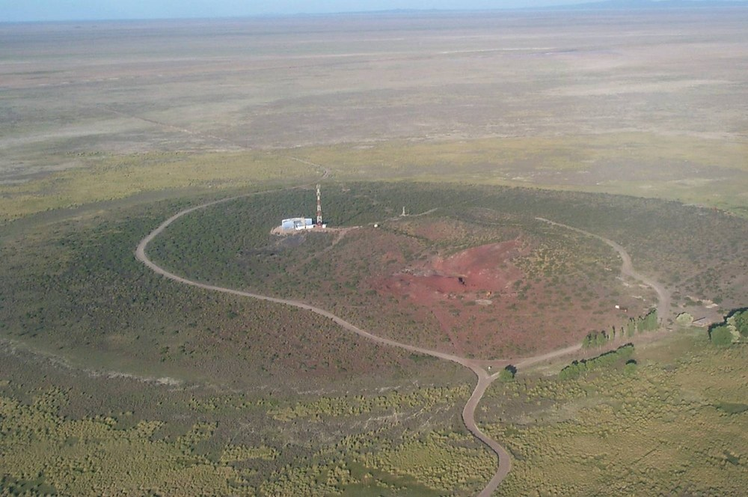
The Pierre Auger Observatory

Slide 20

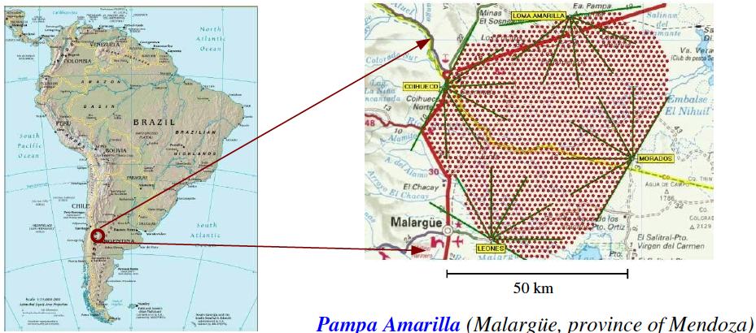
The Pierre Auger Observatory
1400m a.s.l.
latitude: 35°
Physics data since 2004, inauguration November 2008
1600 water Cherenkov tanks (1.5 km distance in a triangular grid) = 3000 km²
24 fluorescence telescopes stations (4 building)

Slide 21
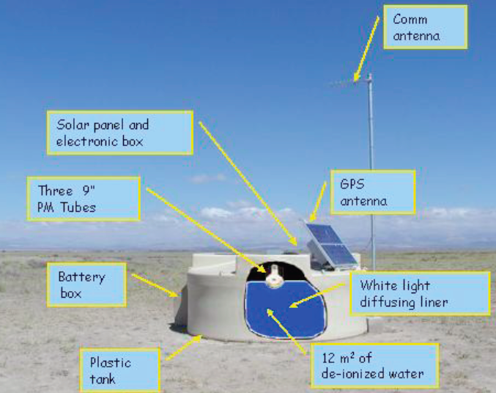
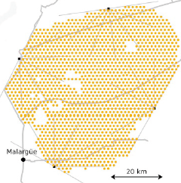
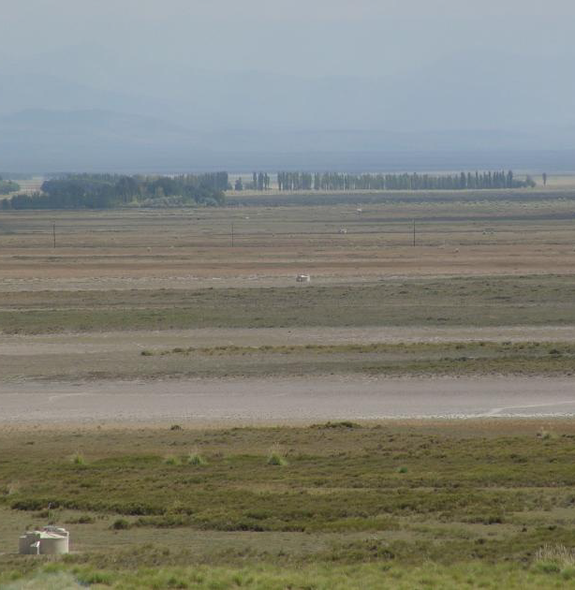
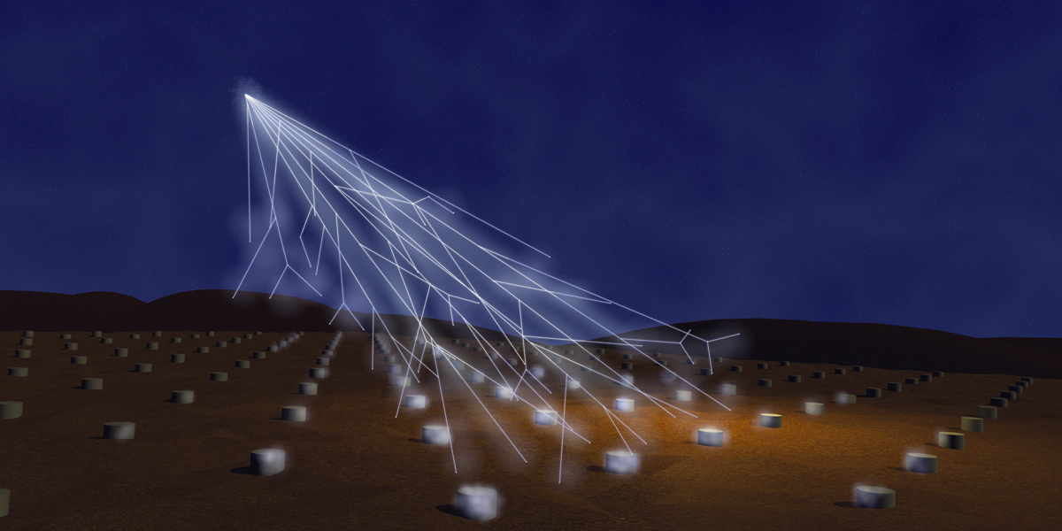

Slide 22
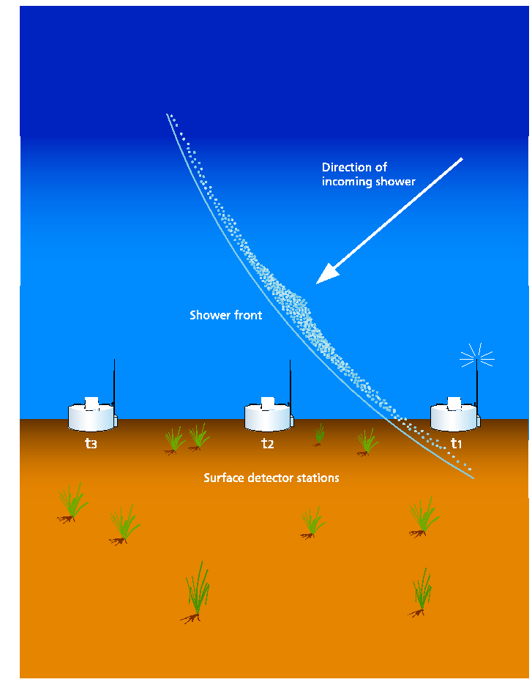
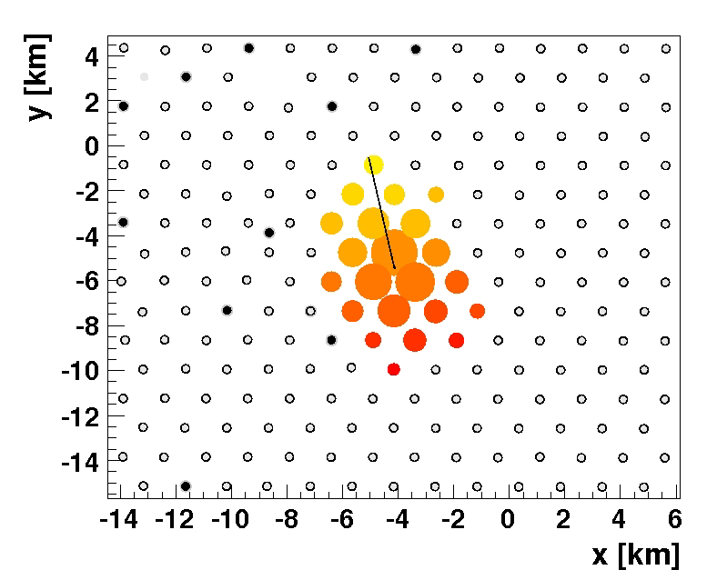
SD geometry reconstruction
The reconstruction of arrival direction of primary cosmic rays is obtained by fitting the arrival times sequence of particles in shower front.
For “SD only” reconstruction the angular resolution is:
Better than 2.2° | 3-fold events | E < 4 EeV
Better than 1.7° | 4-fold events | 3 < E < 10 EeV
Better than 1.4° | For higher multiplicity | E > 8 EeV

Slide 23
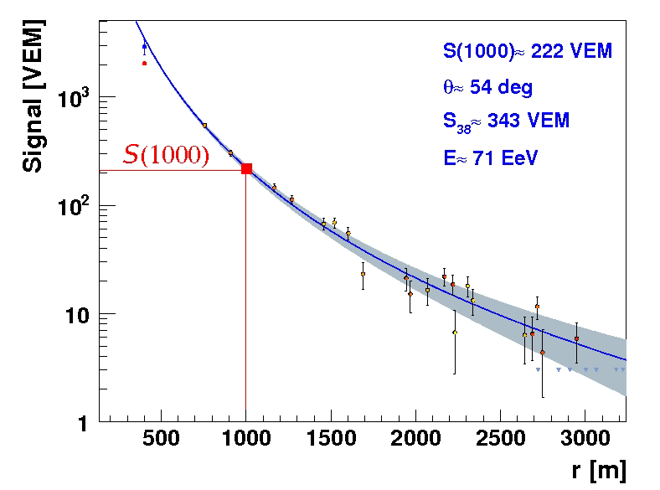
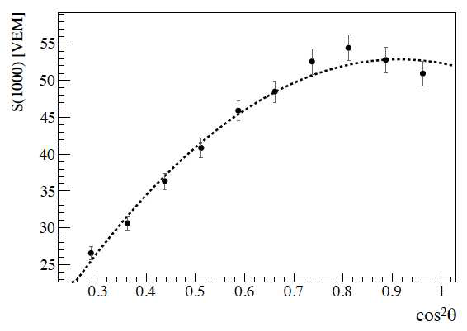
SD energy determination
Energy estimator: S(1000) that is the particle density at 1000 m from shower axis
S(1000) is converted into S38 that is the S(1000) that a shower would have produced if it had arrived with a zenith angle of 38°
Distance from the core
VEM : Vertical Equivalent Muon
Attenuation
curve (CIC)
The SD is full efficient from 3 10¹⁸ eV

Slide 24
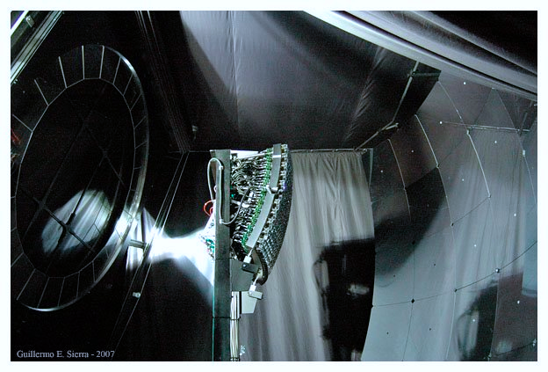
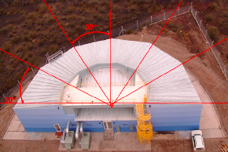
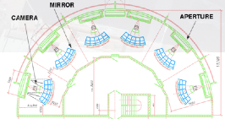
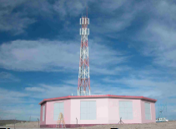
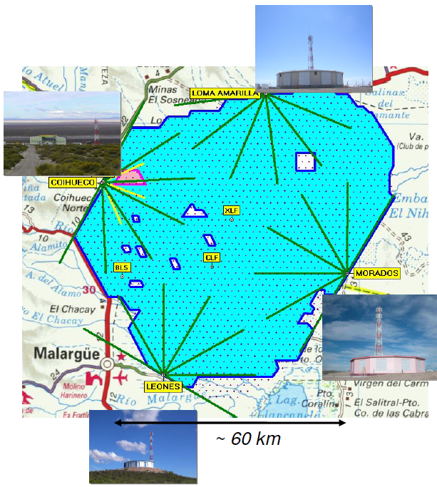
Diaphragm
and
Optical Filter
Camera
(440 PMts)
Mirror
(13 m²)
24 Fluorescence telescopes in 4 buildings:
Mirrors: 3.6 m x 3.6 m with field of view 30° x 30° from 1° to 31° in elevation.
Each telescope is equipped with 440 photomultipliers.

Slide 25
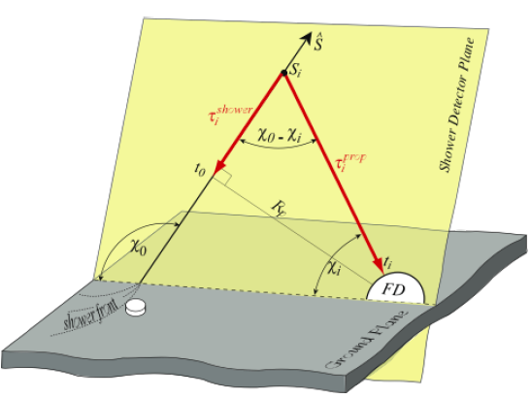
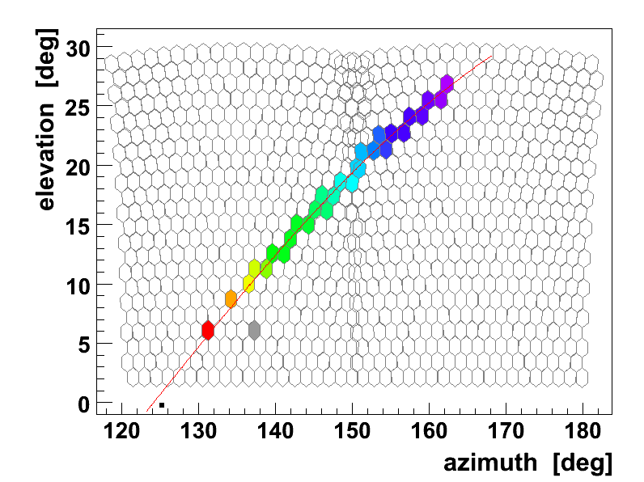
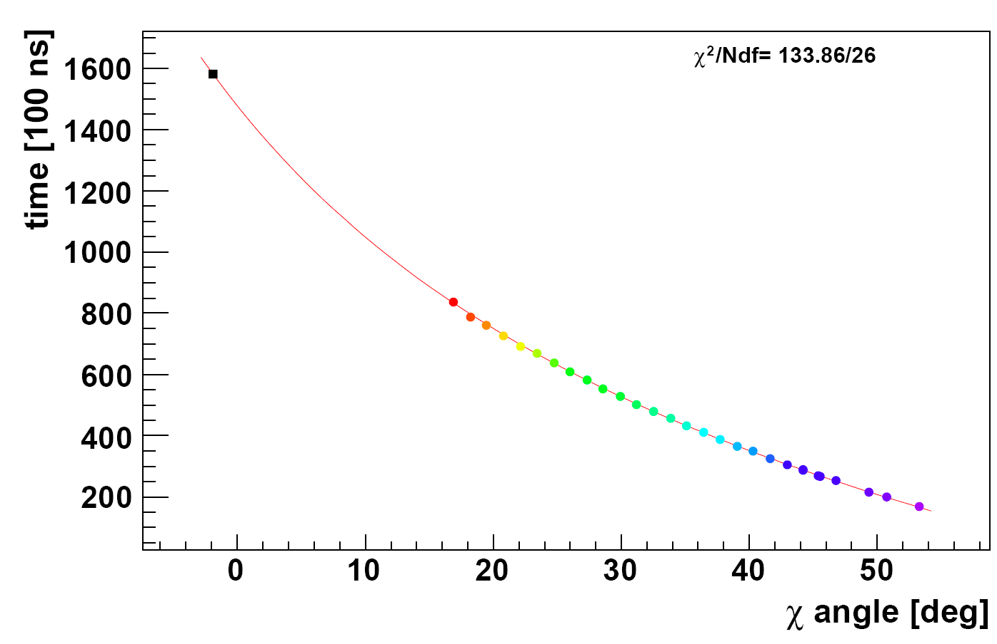
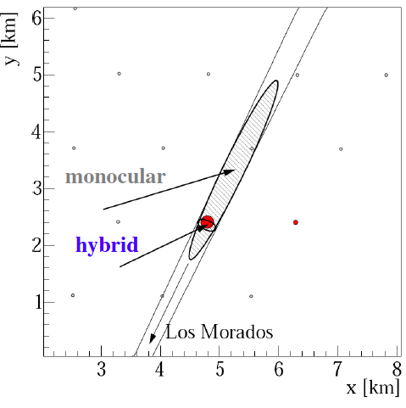
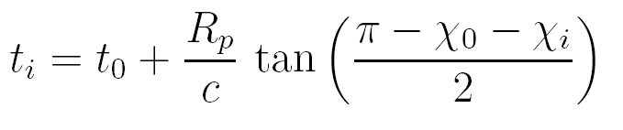
FD geometry reconstruction
Shower Detector Plane (SDP) using the directions of the triggered pixels
In the PAO the reconstruction of direction is performed in hybrid mode (see later)
Time Fit

Slide 26
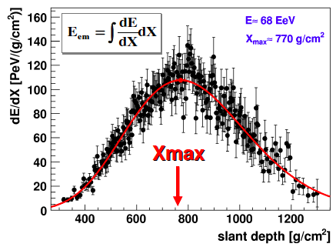
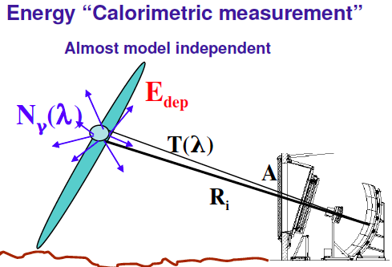

FD energy determination
Longitudinal profile
The number of photons N_{γ}(λ) is proportional to the deposited Energy E_{dep} (from laboratory measurements – Fluorescence yield)
Geometry – n° of photons in the FD FOV depend on A/R_{i}²
Atmosphere– n° of photons at diaphragm depend on T(λ)
The ADC count depend on Detector Calibration
Facilities in the field to monitor the transparency of the air and the cloud coverage

Slide 27




The Hybrid Concept
SD and FD combined in the hybrid mode
(i.e. FD + at least 1 SD station)
Accurate energy and direction measurement
and
Mass composition studies in a complementary way

Slide 28


The Hybrid Concept
Energy Calibration for SD events using golden hybrid data (FD + ≥ 3 SD stations)
Using hybrid events, the SD energy estimator S38 is calibrated without relying on Monte Carlo simulation with an accuracy of 14%
S₃₈: SD signal at 1000m from the core if the shower had θ = 38°
Valerio Verzi – ICRC2013
Geometry Reconstruction
Thanks to hybrid mode:
The Hybrid angular resolution is ≈ 0.6°
and
The core resolution is ≈ 50 meters

Slide 29





The Pierre Auger Enhancements
The SD array is fully efficient at energies above 3 10¹⁸ eV
The transition from galactic to extra-galactic cosmic rays may occur between 10¹⁷ eV and the ankle (4 10¹⁸ eV).
A precise measurement of the flux at energies above 10¹⁷ eV is important for discriminating between different theoretical models
49 additional detectors with 750 m spacing have been nested within the 1500 m array to cover an area of about 25 km²: INFILL has a full efficiency above 3 10¹⁷ eV
HEAT High Elevation Auger Telescopes (near Coihuecuo)
Field of view from 30° to 60°

Slide 30

Results of the Pierre Auger Observatory

Slide 31



The measurement of the energy spectrum of cosmic rays above 3 10¹⁷ eV
Combining the SD regular array data and the INFILL array data (plus the hybrid ones) it is possible to obtain the measurement of the cosmic ray flux starting from 3 10¹⁷ eV.
The dataset extends from 1 January 2004 to 31 December 2012.
The exposure and the calibration are different for the different data sets
Integrated exposure of the different detectors at the Pierre Auger Observatory as a function of energy.
We have to distinguish between vertical events (θ < 60°) and inclined events (62° ≤ θ < 80°)
EXPOSURE
CALIBRATION
Energy estimators: S₃₈ and S₃₅
The equivalent signal at median zenith angle of 38° (35°) is used to infer the energy for the 1500 m (750 m) array
Energy estimator for inclined air-showers: N₁₉
Inclined air-showers are characterized by the dominance of secondary muons at ground, as the electromagnetic component is largely absorbed in the large atmospheric depth traversed by the shower.
The reconstruction is based on the estimation of the relative muon content N₁₉ with respect to a simulated proton shower with energy 10¹⁹ eV
Correlation between the different energy estimators S₃₈, S₃₅ and N₁₉ and the energy determined by FD.

Slide 32


The measurement of the energy spectrum of cosmic rays above 3 10¹⁷ eV
Combined energy spectrum of UHECRs as measured at the Pierre Auger Observatory.
A. Schulz @ ICRC2013
To characterize the spectral features, data are described with a power law below the ankle
and a power law with smooth suppression above
γ₁, γ₂ are the spectral indices below/above the ankle at E_{a}.
E_{½} is the energy at which the flux has dropped to half of its peak value before the suppression, the steepness of which is described with log₁₀W_{c}.
130000 events
The numbers give the total number of events inside each bin. The last three arrows represent upper limits at 84% C.L.
The ankle has been clearly seen
The suppression in the flux of UHECRs has been firmly established with (>20 σ)

Slide 33




The measurements of the depth of shower maximum for the study of mass composition
Mass determination is mandatory to reach reliable conclusion on energy spectrum, sources and acceleration
There are several ways to study the composition of the primary cosmic rays:
a) X_{max} measurement
b) muon production depth
c) rise-time asymmetry measurements
The best way (smallest systematic uncertainties) is to measure the X_{max} distribution using fluorescence telescopes in hybrid mode.
Superposition principle:
Iron shower of energy E “is equal to” 56 proton showers of E/56
• proton showers penetrate deeper ➔ higher X_{max}
• iron showers have less fluctuations ➔ smaller RMS(X_{max})
Data selection and Quality Cuts

Slide 34


The measurements of the depth of shower maximum for the study of mass composition
Compatibile con p e Mixed, ma se si guarda la RMS di Xmax risulta compatibile solo con p.
Compatibile con Fe

Slide 35


The measurements of the depth of shower maximum for the study of mass composition
Vitor de Souza @ ICRC2013
Composition becomes heavier with increasing E
Ankle
Cut off
At low energy data is compatible with a significant fraction of protons
Break on the elongation rate slope seems to indicate a change in composition towards a predominance of heavier nuclei at higher energies
< X_{max} > and RMS(X_{max}) show similar trends towards heavy-like showers at high energies

Slide 36


The measurements of the depth of shower maximum for the study of mass composition

Slide 37

The measurements of the depth of shower maximum for the study of mass composition

Slide 38

The measurements of the depth of shower maximum for the study of mass composition

Slide 39

The measurements of the depth of shower maximum for the study of mass composition

Slide 40

The measurements of the depth of shower maximum for the study of mass composition

Slide 41

Anisotropy studies
If the observed cosmic ray flux suppression is interpreted in term of GZK-effect than the closest sources of UHECRs are situated within the GZK Volume of d_{GZK} < 100 Mpc (Within the GZK VOLUME the matter distribution in the Universe is inhomogeneous, and so must be the distribution of the UHECR sources)
If propagation of UHECRs at these distances is quasi-rectilinear
d_{GZK}
Then anisotropies would be expected.

Slide 42


Slide 43


July 2007
27 events
In 2007, the Pierre Auger Collaboration reported directional correlations of UHECRs at E>55 EeV with AGN from the Véron-Cetty-Véron catalog within 75 Mpc on an angular scale of 3.1° at 99% CL.
From the 27 events collected up to July 2007 with energy greater than 55 EeV
(Period I) the firsts 14 events were used as exploratory scan in order to determine the optimal parameters.
(Period II) among the remaining 13 events 9 events correlating with AGNs (to be compared with 2.7 events if they had been isotropic) corresponding to a correlation of (69⁺¹³₋₁₁)%.
Being the chance correlation p_{iso}= 21% the chance probability of observing such a correlation is 1.7 10⁻³.
The latest update including data up to June 2011 which yields a total of 28 AGNs (to be compared with 17.6 events if they had been isotropic) of 84 events (Period II+III+IV) shows a correlation of (33±5)%.
The chance probability of observing such a correlation remain below 1%.
Inconclusive evidence with current statistics

Slide 44


Slide 45

Proton Cosmic Ray Astronomy
Mass determination is mandatory to reach reliable conclusion on energy spectrum, sources and acceleration
?
The Fluorescence Detector has a very low statistic and “sees” only the e.m. component of the shower.
The Surface Detector is not optimized to study the mass composition:
Rise-time measurements
Cut off
The e.m. component and the muonic component have to be measured separately!

Slide 46






Muon-E.M. Detectors
There are several solutions to measure separately the e.m. component from the muonic component.
MARTA
Muon Auger RPC for Tank Array
Proposal for a Segmented Water Cherenkov Array
Plastic Scintillators such as AMIGA or MuScint
The Collaboration is working to chose the best solution in term of performances and cost.

Slide 47


Slide 48

UHECRs & Hadronic Interactions
Cosmic rays at ultrahigh give a unique opportunity to study particle physics at energies well above those reachable at the LHC.
X_{max} (expressed in g/cm²) may be defined as the sum of the
depth of the first interaction X₁ and a
shower development length 􏰁ΔX:
The X₁ distribution is just a negative exponential, exp(−X₁/Λ􏰟_{η}), where Λ_{􏰟η} is the interaction length which is proportional to the inverse of the cosmic ray–air interaction cross section.

Slide 49


The observed X_{max} distribution is thus the convolution of the
X₁ distribution with the
Δ􏰁X distribution (which has a shape similar to the X_{max} distribution) and a
detector resolution function.
NB: the tail of the X_{max} distribution reflects the X₁ exponential distribution
X_{max} distribution measured by the Pierre Auger Observatory in the energy interval 10¹⁸–10^{18.5} eV. The line represents the likelihood fit performed to extract 􏰟Λ_{η}.

Slide 50

The conversion to proton–proton total and inelastic cross section is then done using the Glauber model which takes into account the multi-scattering probability inside the nuclei

Slide 51


The Telescope Array (TA)

Slide 52


Slide 53




Electron Linear Accelerator (ELS) for Absolute energy calibration of the Telescope Array fluorescence detector
The Electron Light Source (ELS) is an electron linear accelerator, which was installed 100m in front of the Fluorescence Detector (FD) of Telescope Array (TA) experiment
Beam of 40 MeV electrons is vertically injected into the air from the ELS and generated Air Fluorescence (AF) photons are detected by the TA/FD telescope.
A direct calibration of the TA/FD is achieved by comparing the measured ELS signal with the predicted signal by simulation using a model of AF generation.

Slide 54


Slide 55

Tensione nei risultati di Auger e TA sulla composizione di massa alle più alte energie
Mass Composition in <Xmax>
CAVEAT:
Vengono utilizzati differenti modelli di interazione adronica e differenti strategie di analisi.
E’ in corso un’analisi comune

Slide 56

TAUP (Telescope Array Upgrade)

Slide 57

JEM-EUSO experiment, Extreme Universe Space Observatory on the International Space Station (ISS).

Slide 58

JEM-EUSO is, based on a UV telescope, which uses the whole Earth as detector from an altitude of ∼ 400 km,
The fluorescence tracks is produced at (330-400) nm by Extensive Air Showers (EAS)
The launch is foreseen for the 2018 and the mission will last at least 5 years.
JEM-EUSO will be operated for three years in Nadir configuration to maximize statistics at the lowest energies in order to cross calibrate with the current generation of ground-based detectors.
The instrument will be then tilted (about 30°) with respect to Nadir in order to exploit a larger amount of atmosphere and to maximize the statistics of events at the highest energies.
The instantaneous aperture of JEM-EUSO is larger than that of successful Pierre Auger Observatory by a factor of 50 - 250

Slide 59


Slide 60


La rivelazione degli EAS con radio onde
Cosmic-ray air showers emit radio waves in the frequency range few MHz – few 100 MHz.
This effect opens many possibilities in the study of UHE and EHE extensive air showers.
There are two effects known which may produce radio emission by cosmic ray showers:
J.V. Jelley and H.R. Allan proposed the radio emission for air showers to be a geomagnetic mechanism.
The coherent radio Cerenkov emission or Askaryan-Effect.
At present, however, open questions still remain concerning both the emission mechanism and its strength.

Slide 61

Fluorescence detectors with a calorimetric energy measurement allow to directly determine the depth of the air shower maximum -> mass-sensitive parameter, but they achieve duty cycles of only ≈ 10-15%.
Radio detection promises to directly probe the electromagnetic component of the air shower, energy measurement, sensitivity to X_{max}, and a duty cycle of ≈ 100%.
first-generation modern MHz experiments:
LOPES (LOfar PrototypE Station) and CODALEMA experiments measuring in the frequency range between the AM band at ∼ 20 MHz and the FM band at ∼ 80 MHz. Both experiments have access to energies of up to ∼ 10¹⁸ eV.
Radio emission from air showers in the frequency range from 30 to 80 MHz is investigated with AERA.
160 radio antennas on an area of 20 km² to measure air showers with energies above 10¹⁷ eV.
second-generation modern MHz experiments:
the Auger Engineering Radio Array (AERA),
the Tunka radio extension (Tunka-Rex),
the Low Frequency Array (LOFAR).

Slide 62


Slide 63

Upper Limits to the PHOT0N FLUX

