Slide 1
Gamma Astronomy
Corso di Astroparticelle a.a. 2015-16
Testi consigliati (su cui si basano queste lezioni):
Alessandro De Angelis, Mário João Martins Pimenta - Introduction to Particle and Astroparticle Physics (Springer 2015)
Maurizio Spurio – Particles and Astrophysics (Springer 2014)
Claus Grupen - Astroparticle Physics (Springer 2005)

Slide 2
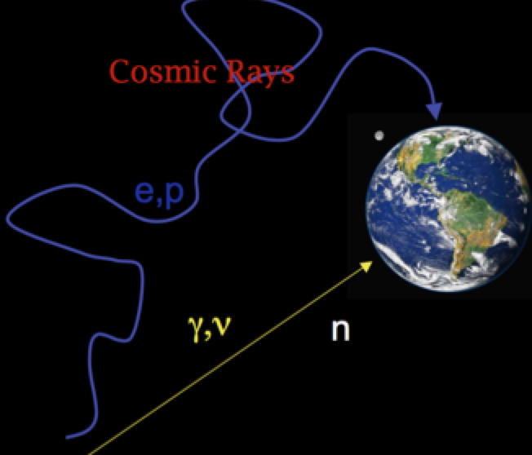
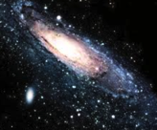
Astronomical messengers

Slide 3
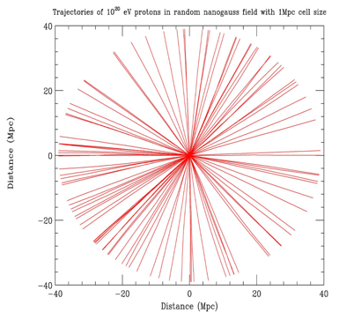
Astronomia con Protoni:
Astronomia Extragalattica
con protoni di energia E > 10²⁰ eV

Slide 4

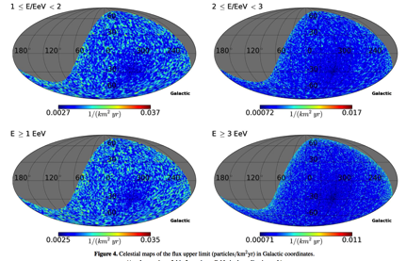
Astronomia con Neutroni
Since free neutrons undergo beta decay with a mean lifetime of about 886 s at rest, the mean travel distance for relativistic neutrons is 9.2 × E kpc, (where E is the energy of the neutron in EeV).
The distance from Earth to the Galactic center is about 8.3 kpc, and the radius of the Galaxy is approximately 15 kpc.
Sources in part of the Galactic disk, including the Galactic center, should be detectable via neutrons above 1 EeV.
Astronomia Galattica
con neutroni di energia E > 10¹⁷ eV
The blind search for a flux of neutral particles using the Auger SD data set finds no candidate point on the sky
A SEARCH FOR POINT SOURCES OF EeV NEUTRONS
The Astrophysical Journal, 760:148 (11pp), 2012

Slide 5
other astronomical messengers?
astronomical messengers should be neutral & stable:
photons (γ,X) and neutrinos satisfy fully to these conditions
Fotoni
PRO: Relativamente facili da rivelare
CONTRO: Interazione con la CBM
Neutrini
PRO: Viaggiano indisturbati
CONTRO: Difficili da rivelare

Slide 6

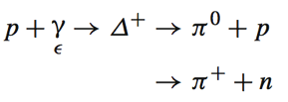
γ-rays sono prodotti in interazione adroniche ed in interazioni EM
ν sono prodotti solo nelle interazioni adroniche
A direct signature of the presence in astrophysical environments of accelerated protons is provided by the presence of neutrinos and of γ-rays. They are mainly generated in the decay of charged pions and neutral pions, respectively
astrophysical beam dump mechanism
(cross section ∼ 40–50mb)
photoproduction
(cross section at the resonance of ∼0.250 mb)
Around astrophysical sources there is usually a high density of radio, infrared, visible, and ultraviolet photons (ambient photons, γ_{ε}).
NB: Although the cross section σ_{γp} is two orders of magnitude smaller than the cross section σ_{pp} of the beam-dump process , in some astrophysical environments the probability that secondary mesons are produced by photoproduction is much higher than the probability due to astrophysical beam dump. This, because the number density of ambient photons, n_{γ}, could be much larger than that of environmental matter number density, n

Slide 7
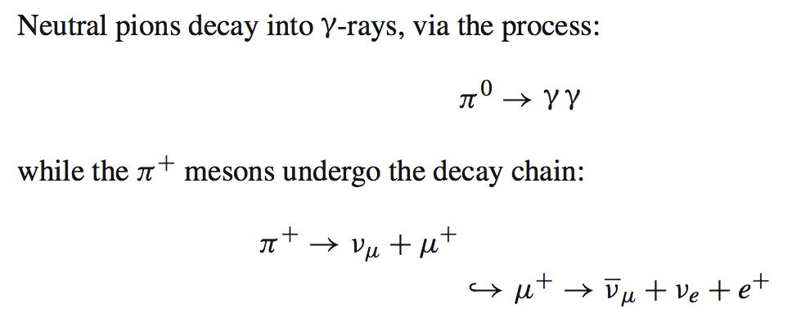
The energy escaping from the source is therefore shared among
high-energy protons (=CRs),
γ-rays
neutrinos
produced by the decay of neutrons, π⁰ and π⁺ (π⁻), respectively.
The mechanisms that produce CRs produce also neutrinos and high-energy photons
neutrino sources are in general also γ-ray sources
Strong relationship between the spectral index of the CR energy spectrum
and that of γ-rays and neutrinos. →
γ-ray and neutrinos measurements give crucial information on primary CRs

Slide 8
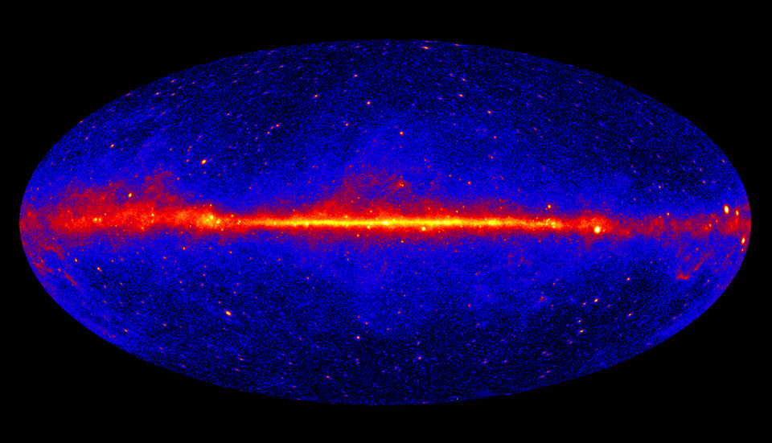
γ-ray Astronomy

Slide 9
La produzione dei raggi γ
I γ-rays possono essere prodotti in due modi:
1) Produzione Adronica (tramite decadimento dei π⁰)
When a E⁻² energy spectrum of accelerated protons at the source is considered, the π⁰-decay spectrum rises steeply below ∼200 MeV and approximately traces the energy distribution of parent protons at energies greater than a few GeV.

Slide 10
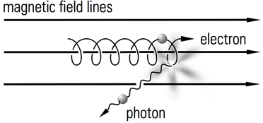
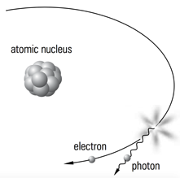
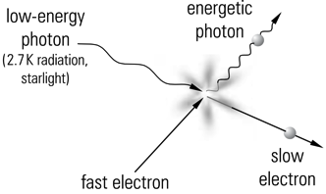
2) Produzione Leptonica
Synchrotron radiation:
The deflection of charged particles in a magnetic field gives rise to an accelerated motion. An accelerated electrical charge radiates electromagnetic waves. This ‘bremsstrahlung’ of charged particles in magnetic fields is called synchrotron radiation.
Bremsstrahlung:
A charged particle which is deflected in the Coulomb field of a charge (atomic nucleus or electron) emits bremsstrah- lung photons. This mechanism is to a certain extent similar to synchrotron radiation, only that in this case the deflection of the particle occurs in the Coulomb field of a charge rather than in a magnetic field.
Inverse Compton Scattering:
Electrons accelerated to high energies in the source collide with the numerous photons of the blackbody radiation (E_{γ} ≈ 250μeV, photon density N_{γ}≈400/cm³) or starlight photons (E_{γ}≈1 eV, N_{γ}≈1/cm³) and transfer part to their energy to the photons which are ‘blueshifted’.

Slide 11
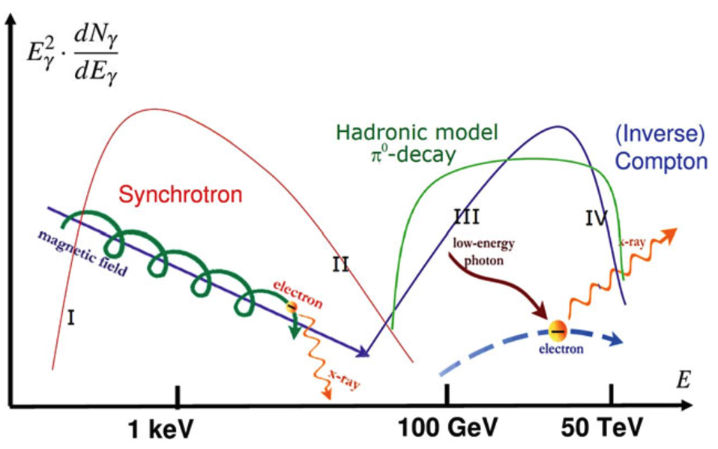

Slide 12
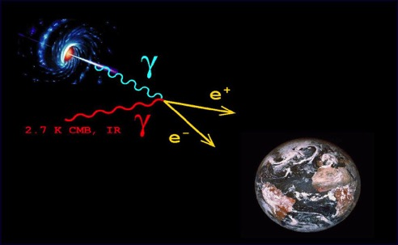


La propagazione dei raggi γ
Una volta che i raggi gamma sono stati prodotti, prima di giungere a noi interagiscono con i fotoni del fondo (CMB, IR, visible, UV ecc..)
Il processo dominante è dato dalla:
E Energia del fotone incidente
ε Energia del fotone bersaglio
φ Angolo di scattering

Slide 13
La sezione d’urto:
raggiunge un massimo per
assumendo una collisione “head-on” segue che la sezione d’urto è massima per fotoni di background di energia
Esempio: Se considero un raggio gamma di 500 GeV il suo maggior nemico sarà un fotone di energia di 1 eV ossia un fotone nell’UV.
Per γ-rays con energie comprese tra (10 GeV - 10⁵ GeV) l’assorbimento maggiore è dato da l’EBL (Extragalactic Background Light)
Per γ-rays con energie comprese tra (10⁵ GeV - 10¹⁰ GeV) l’assorbimento maggiore è dato da l’CMB (Cosmic Microwave Background)

Slide 14
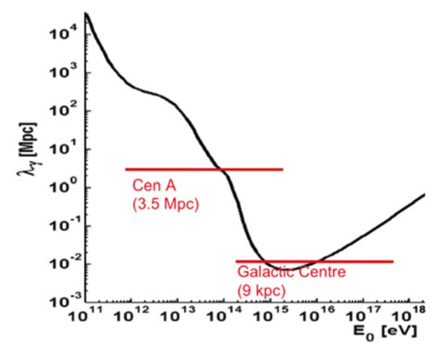
Sappiamo che il libero cammino medio è dato da:
Maggior dell’Universo osservabile
Mean free path as a function of the photon energy, at z = 0. Adapted from A. de Angelis, G. Galanti, M. Roncadelli, MNRAS 432 (2013) 3245
NB: una trattazione più rigorosa deve tenere in conto del red shift z!

Slide 15
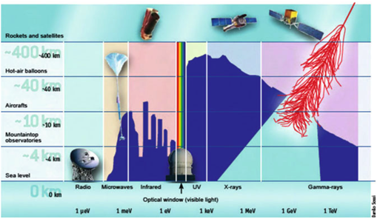
La rivelazione dei γ-rays
The detection of high-energy photons is complicated by the absorption in the atmosphere, and by the faintness of the signal.
HE γ-rays (30 MeV – 30 GeV)
The atmosphere is about 28 radiation length at sea level. Only satellite-based detectors can detect primary X/γ-rays.
VHE γ-rays (30 GeV – 30 TeV)
Since the fluxes of high-energy photons are low and decrease rapidly with increasing energy, this gamma rays can be detected only from the atmospheric showers they produce, i.e., by means of ground-based detectors.

Slide 16
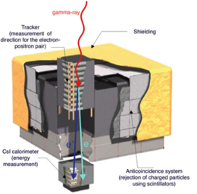
La rivelazione dei HE γ-rays (Satellite-Based Gamma Detectors)
The largest gamma-ray space-based detector ever built is the Fermi observatory, launched in June 2008. It is composed by two instruments:
Large Area Telescope (LAT) 20 MeV to about 300GeV
Fermi Gamma Burst Monitor (GBM) 10–25MeV.
The LAT tracker is done by 16 planes of high-Z material (W) in which incident γ-rays can convert to an e⁺e⁻ pair. The converter planes are interleaved with 18 silicon detectors two-layer planes that measures the tracks of the particles resulting from pair-conversion.
The scientific objectives of the LAT:
understanding of the nature of unidentified gamma-ray sources and origins of diffuse galactic emission.
AGILE (Astro-rivelatore Gamma a Immagini Leggero), the precursor of Fermi, is a completely Italian satellite launched in 2007. Its structure is very similar to Fermi, but its effective area is about one order of magnitude smaller.

Slide 17
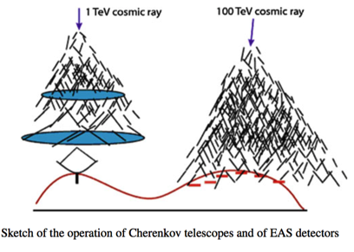
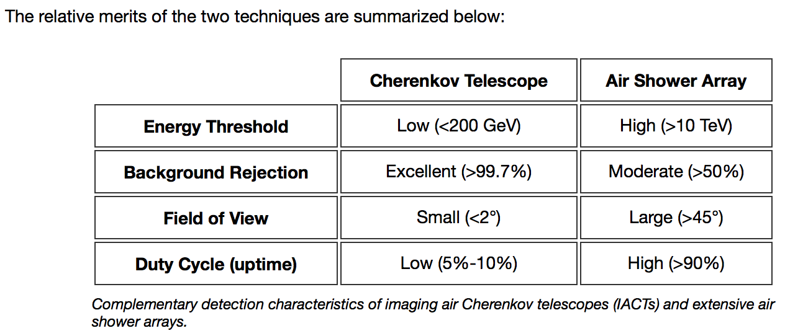
La rivelazione dei UHE & VHE γ-rays (Ground-Based Gamma Detectors)
The satellite detectors and at ground detectors are complementary.
At TeV energies the flux is too low to be detected with satellite-based detectors.
Ground-based detectors have a huge effective area, so their sensitivity is high (they detect a huge amount of background events).
There are two main classes of ground-based VHE gamma detectors:
EAS arrays
Cherenkov telescopes
✔
✔
✔
✔

Slide 18
Extensive Air Shower (EAS) Detectors
EAS are large arrays of detectors sensitive to charged secondary particles generated in the atmospheric showers.
Proprietà degli EAS array
high duty cycle;
large field-of-view;
relatively low sensitivity;
energy threshold rather large (a shower initiated by a 1 TeV photon typically has its maximum at about 8 km a.s.l).
The principle of operation is the same as the one for the UHE cosmic rays detectors like Auger, i.e., direct sampling of the charged particles in the shower.
The energy threshold of EAS detectors is at best in the 0.5–1 TeV range, so they are built to detect UHE photons as well as the most energetic VHE gammas.
The direction of the detected primary particles is computed from the arrival times with an angular precision of about 1◦. The calibration can be performed by studying the shadow in the reconstructed directions caused by the Moon. Energy resolution is poor.

Slide 19
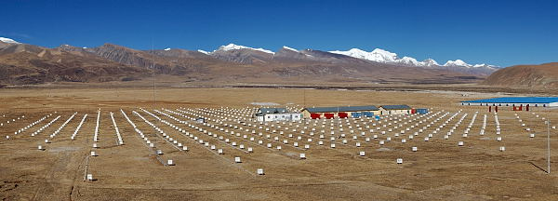
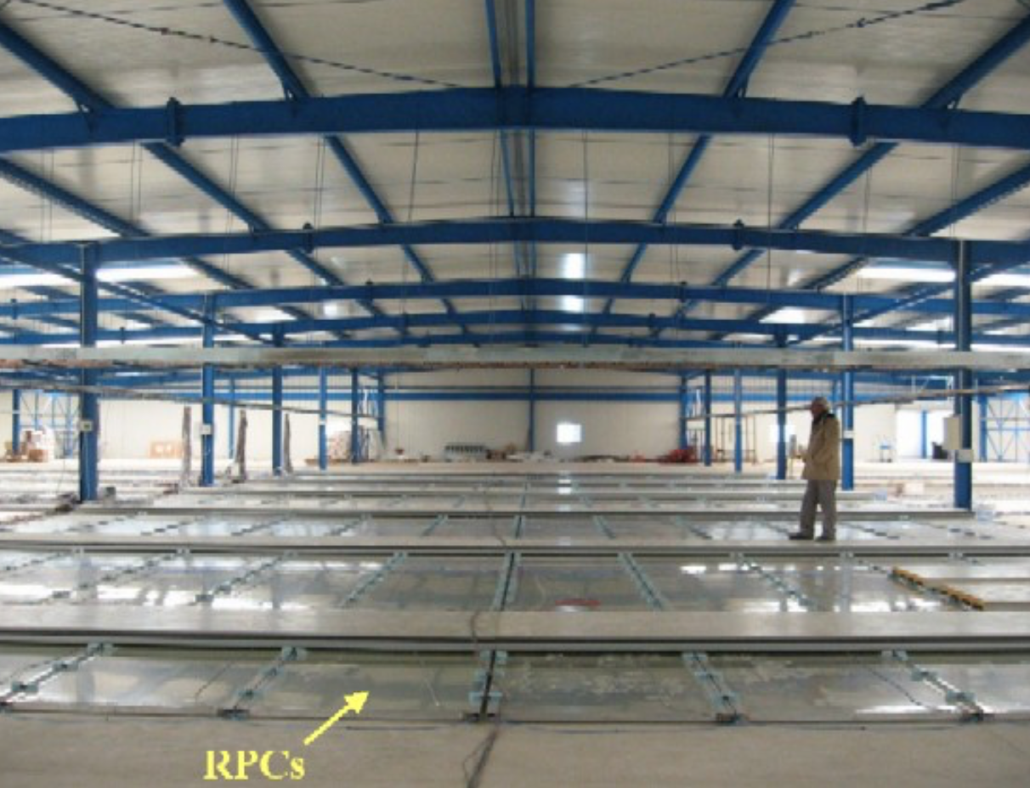
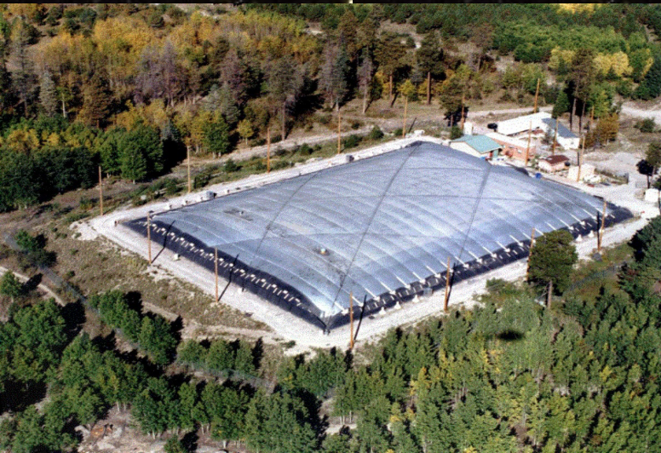
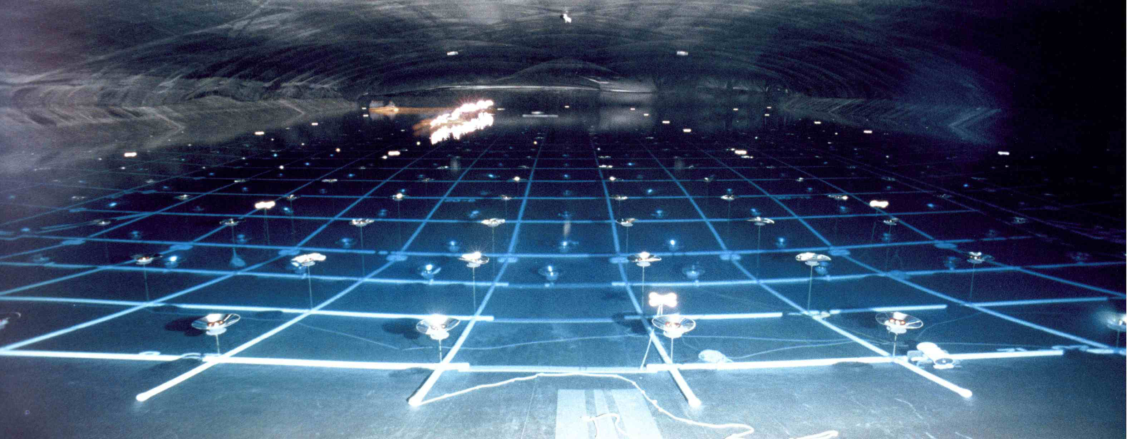
Il sampling delle particelle cariche può essere fatto in due modi:
using a sparse array of scintillator-based detectors
Tibet- AS (4100 m a.s.l.)
by effective covering of the ground
ARGO-YBJ (2600 m a.s.l.)
The ARGO-YBJ experiment is a detector of small air showers,
aimed to study the cosmic radiation with an energy threshold
of ~300 GeV. The detector consists of a single layer of RPCs
(Resistive Plate Counters) covering an area of ~6500 m².
MILAGRO (2600 m a.s.l.)

Slide 20
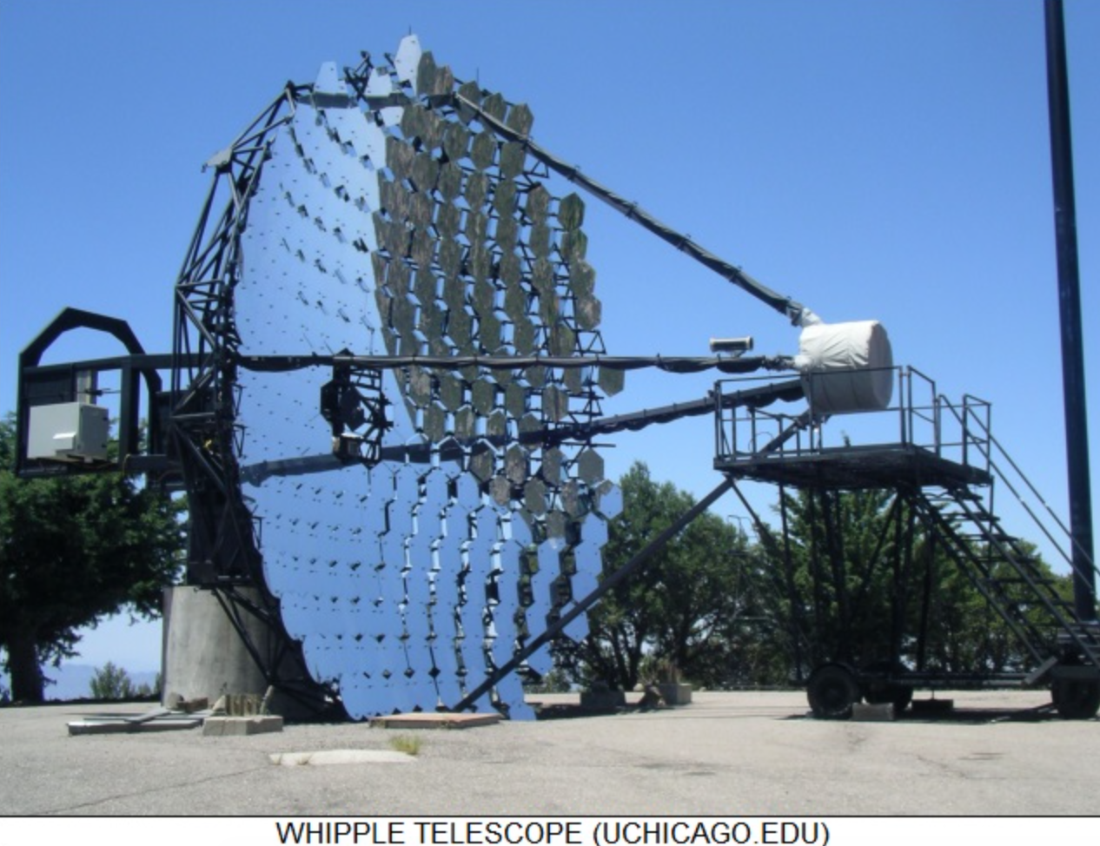
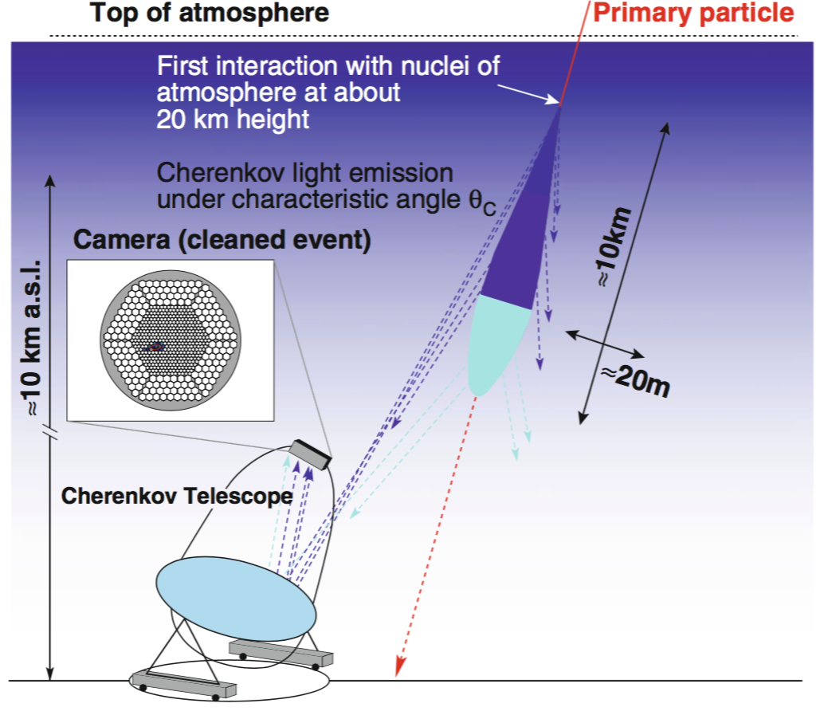
Cherenkov Telescopes
Most of the experimental results on VHE photons are presently due to Imaging Atmospheric Cherenkov Telescopes (IACTs).
first generation: WHIPPLE,
second generation: HEGRA and CANGAROO,
third generation: H.E.S.S., MAGIC and VERITAS
The observational technique used by the IACTs is to project the Cherenkov light collected in a large optical reflecting surface onto a camera which is basically an array of photomultipliers. (FoV of 5◦ × 5◦).
The typical resolution on the arrival time of a signal on a photomultiplier is better than 1 ns.
The shower has a duration of a few ns (about 2–3) at ground; this duration can be maintained by an isochronous (parabolic) reflector.

Slide 21

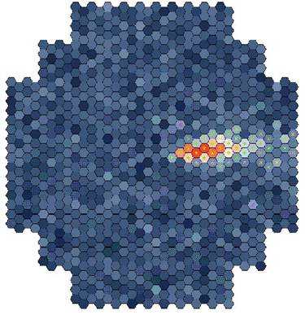


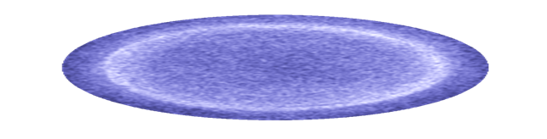
Piano focale
Immagini da M.Spurio

Slide 22

Rivelazione stereoscopica
Immagini da M.Spurio
Notes:
Add sentence about using a 3-D view of a shower
Use angular resolution as transition

Slide 23
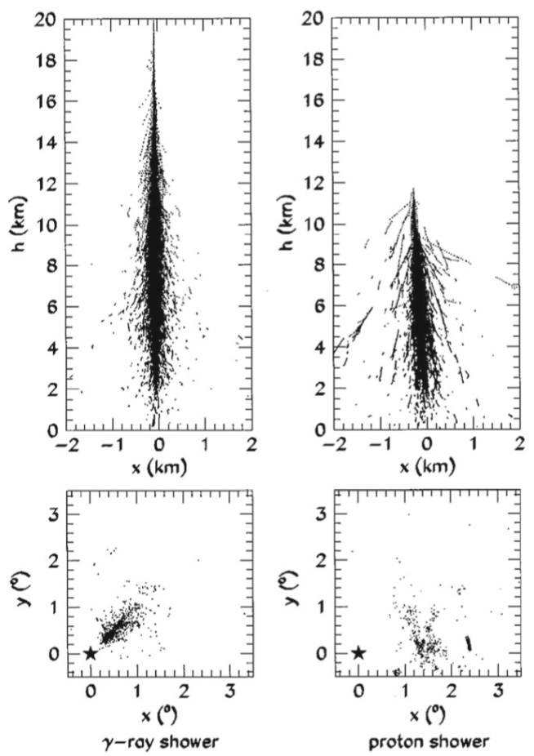
In the GeV-TeV region, the background from charged particles is three orders of magnitude larger than the signal.
Hadronic showers, however, have a different topology, being larger and more subject to fluctuations than electromagnetic showers.
Showers induced by gamma-rays can be separated from the hadronic ones on the basis of the shower shape.

Slide 24
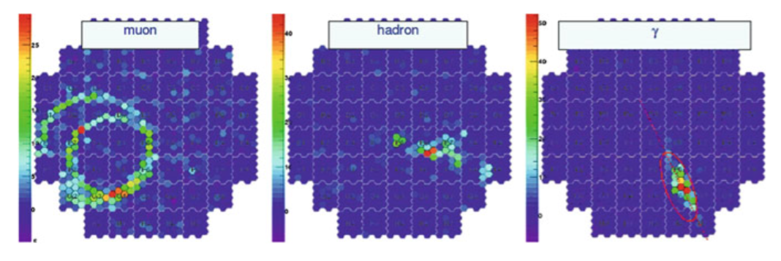
“Hillas parameters” the present identification techniques rely on a technique pioneered by Hillas in the 1980s.
- The intensity (and area) of the image produced is an indication of the shower energy,
- The image orientation is related to the shower direction (photons “point” to emission sources, while hadrons are in first approximation isotropic).
The shape of the image is different for events produced by photons and by other particles; this characteristic can be used to reject the background from charged particles
The time structure of Cherenkov images provides an additional discriminator against the hadronic background, which can be used by isochronous detectors (with parabolic shape) and with a signal integration time smaller than the duration of the shower (i.e., better than 1–2 GHz).

Slide 25
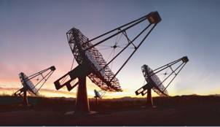
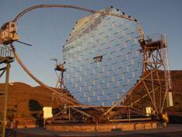
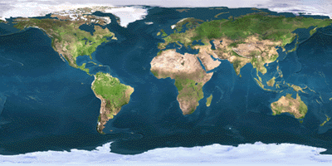
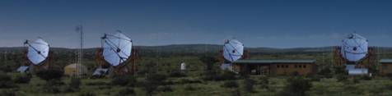
Cherenkov Telescopes (3rd Generation)
Veritas
MAGIC
• H.E.S.S. in Namibia is composed by four telescopes with a diameter of 12 m each, working since early 2003. A fifth large telescope, a surface of about 600m², is located in the center; it has been inaugurated in 2012.
• MAGIC observatory in the Canary Island of La Palma is a twin telescope system; each parabola has a diameter of 17 m and a reflecting surface of 236m², and it is the largest single-dish Cherenkov telescope in operation.
• VERITAS is constituted by an array of four telescopes with a diameter of 12m and is located near Tucson, Arizona. It is operational since April 2007.
H.E.S.S.

Slide 26
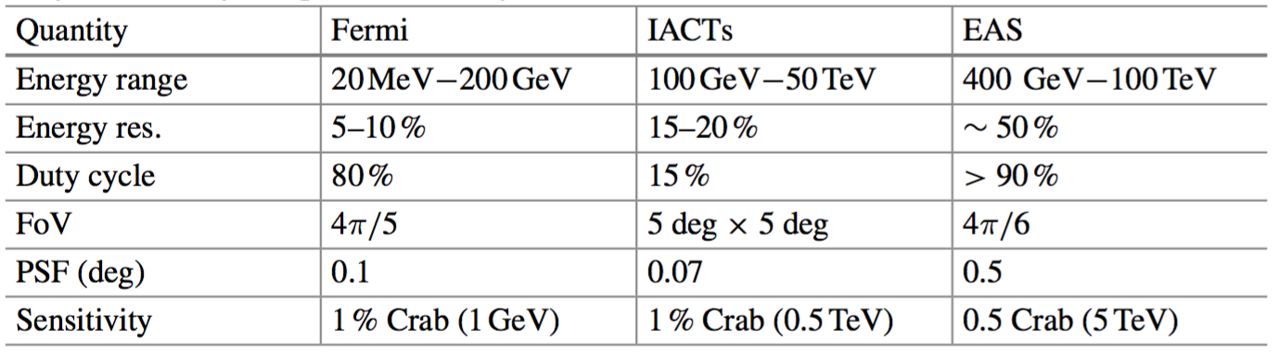
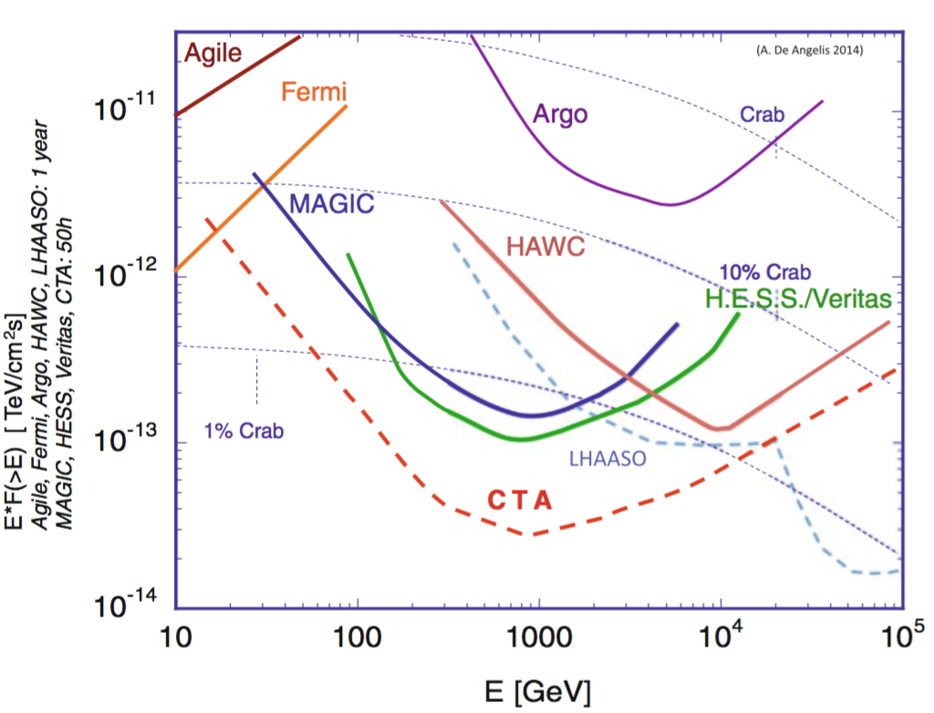
Confronto tra le performances e la sensitività

Slide 27

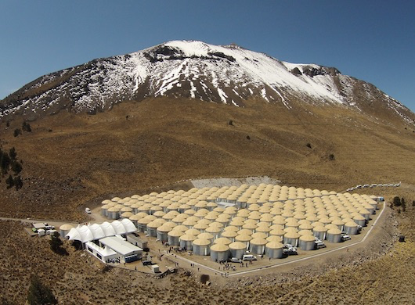
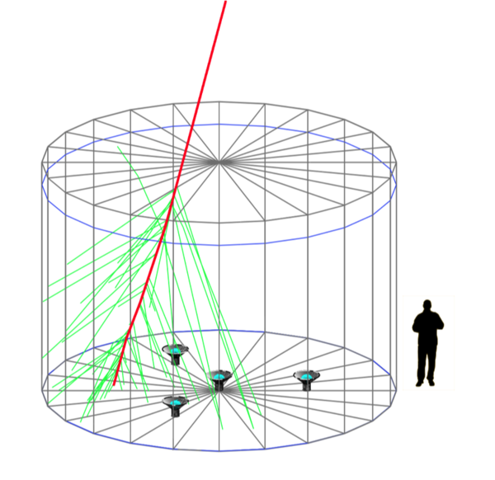
Future Detectors for High-Energy Photons
A new EAS observatory with much larger sensitivity:
the High Altitude Water Cherenkov detector HAWC, inaugurated in 2015.
Very high-energy gamma-ray observatory located in Mexico at an altitude of 4100 m.
It consists of 300 steel tanks of 7.3 m diameter and 4.5m deep (filled with purified water and contains three PMT of 20 cm diameter), covering an instrumented area of about 22,000 m².
HAWC will detect a large ensemble of gamma-ray sources - measuring their spectra and variability to characterize TeV scale acceleration mechanisms.

Slide 28
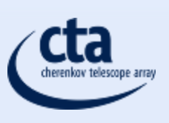
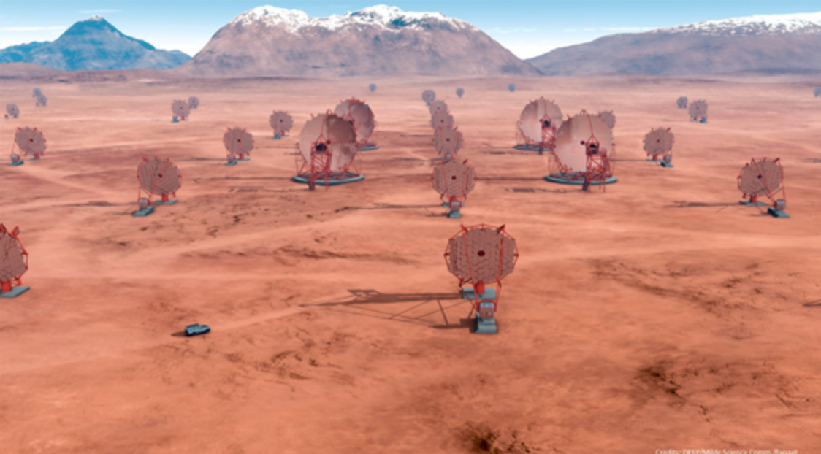
Future Detectors for High-Energy Photons
Cherenkov Telescope Array (CTA).
is expected to provide an order of magnitude improvement in sensitivity.
In the present design scenario, CTA will be deployed in two sites.
CTA Southern Site: 4 large-size telescopes, 24 medium-size telescopes and 72 small-size telescopes (area covered by the array of telescopes: ~4 km2)
CTA Northern Site: 4 large-size telescopes and 15 medium-size telescopes (area covered by the array of telescopes: ~0.4 km2)
low energy instrumentation, between 20 and 200 GeV, will consist of four 23 metre class telescopes with a moderate field of view (FoV) of the order of about 4.5 degrees.
medium energy range, from around 100 GeV to 10 TeV, will be covered by 40 telescopes of the 12 metre class with a FoV of 7 degrees.
high energy instruments, operating between a few TeV to 300 TeV, will consist of about 70 small (6-6.47 metre diameter) telescopes with a FoV ranging from 9.1 to 9.6 degrees.

Slide 29
