Slide 1
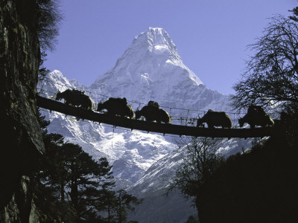
Measurements of Ultra High Energy Cosmic Rays with the Pierre Auger Observatory
INTERNATIONAL CONFERENCE ON "Black holes, jets and outflows” Kathmandu, Nepal, October 2013.
Lino Miramonti
Università degli Studi di Milano
and
Istituto Nazionale di Fisica Nucleare

Slide 2
Outline
Ultra High Energy Cosmic Rays (UHECRs)
How to detect UHECRs?
The Pierre Auger Observatory
Results of the Pierre Auger Observatory

Slide 3
Outline
Ultra High Energy Cosmic Rays (UHECRs)
How to detect UHECRs?
The Pierre Auger Observatory
Results of the Pierre Auger Observatory

Slide 4
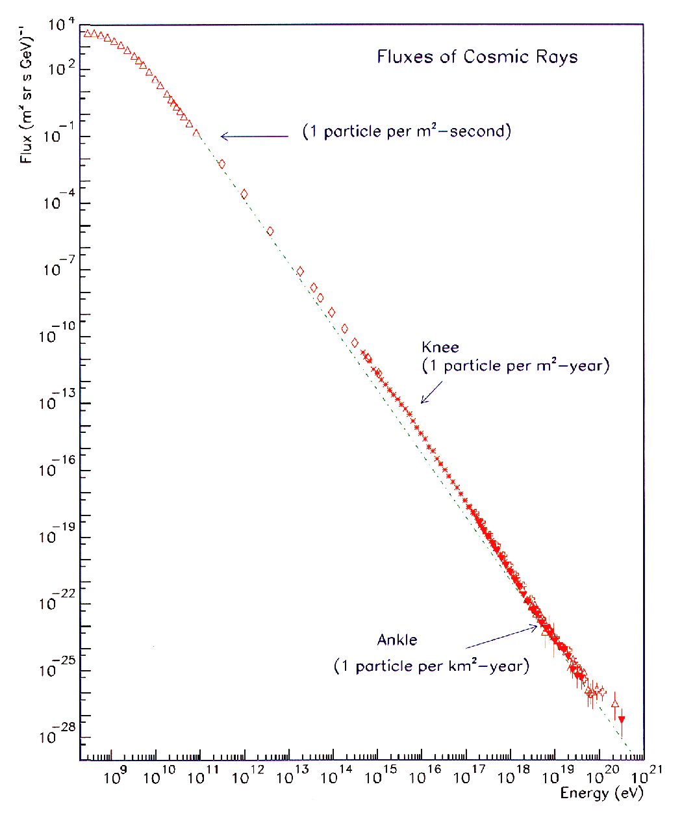
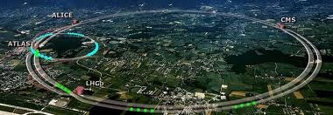
UHECRs: CRs with E> 10¹⁸ eV
OPEN QUESTIONS:
Where and how these cosmic rays are accelerated to these energies
Which are the sources that generated these cosmic rays
The chemical composition is unknown
From a Particle Physics point of view:
UHE Cosmic Rays probe physics at energies out of reach of any man made accelerator
Nearly uniform power-law spectrum E^{-γ}:
  10 orders of magnitude in Energy
  32 orders of magnitude in flux

Slide 5
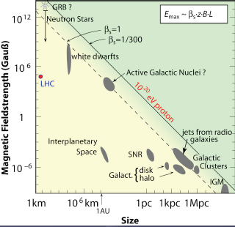
Possible UHECR Sources: 2 scenarios
Bottom-Up Acceleration
(Astrophysical Acceleration Mechanisms)
  UHECR’s are accelerated in extended objects or catastrophic events (supernova remnants, rotating neutron stars, AGNs, radio galaxies)
Experimental evidence:
anisotropy in arrival directions
Photons < ≈1%
Top–Down Decay
(Physics Beyond the Standard Model)
  Decay of topological defects
  Monopoles Relics
  Supersymmetric particles
  Strongly interacting neutrinos
  Decay of massive new long lived particles
  Etc.
Now disfavored
from the measurement of the photon flux with the PAO
Experimental evidence:
isotropy in arrival directions
Photons > ≈10%

Slide 6
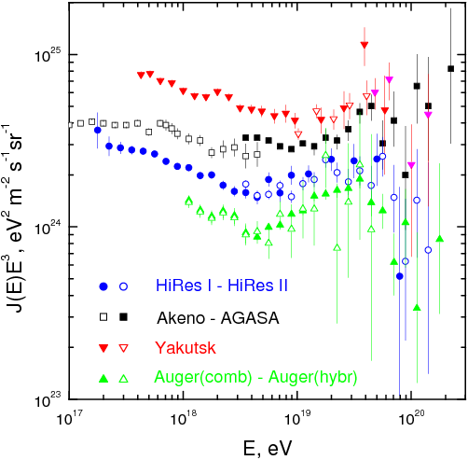
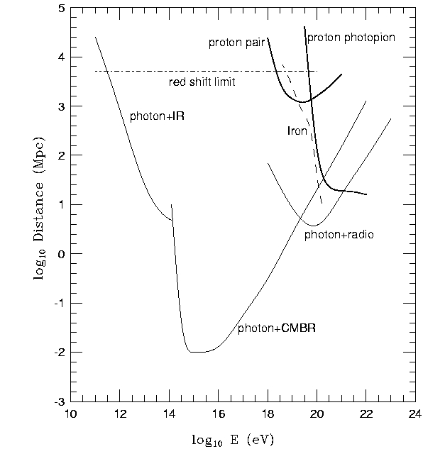
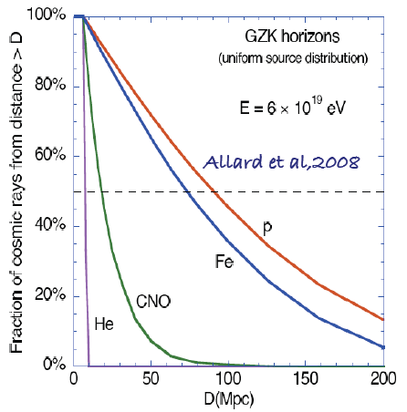
End to the cosmic ray spectrum?
Before AUGER it wasn’t know if there were an end to the CR spectrum or not.
Now, we know (see later) that there is a suppression but we do not know its nature.
The suppression may be due to:
GZK or E_{max}?
Size of the observable Universe ≈ 4.000 MPc
propagation scenario
  the interaction with Cosmic Microwave Background (CBM)
  as forseen by Greisen, Zatsepin, Kuzmin in 1966 (the GZK cutoff)
  The Universe is opaque for protons with energy > 6 10¹⁹ eV
  “horizon” (p and nuclei) ≈100 Mpc (≈10²⁰ eV )
source scenario
to the reach of the maximum energy in the celestial accelerators:
“source exhaustion” (i.e. maximum injection energy)
Intermediate nuclei disappear at UHE: mostly p and Fe

Slide 7
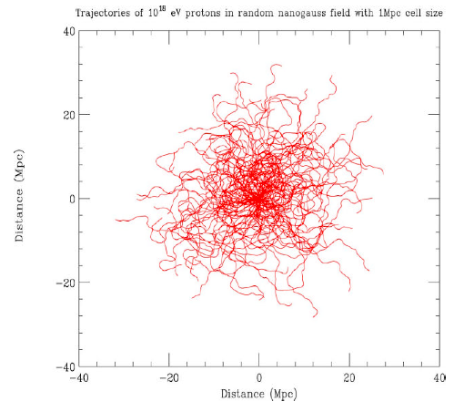
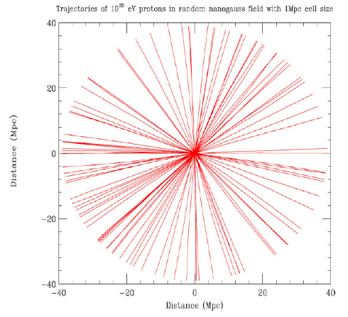
Influence of the Magnetic Field on propagation
Above 10²⁰ eV Δφ < 2° that is larger than the experimental resolution!
A window to Cosmic Rays Astronomy?

Slide 8
Outline
Ultra High Energy Cosmic Rays (UHECRs)
How to detect UHECRs?
The Pierre Auger Observatory
Results of the Pierre Auger Observatory

Slide 9
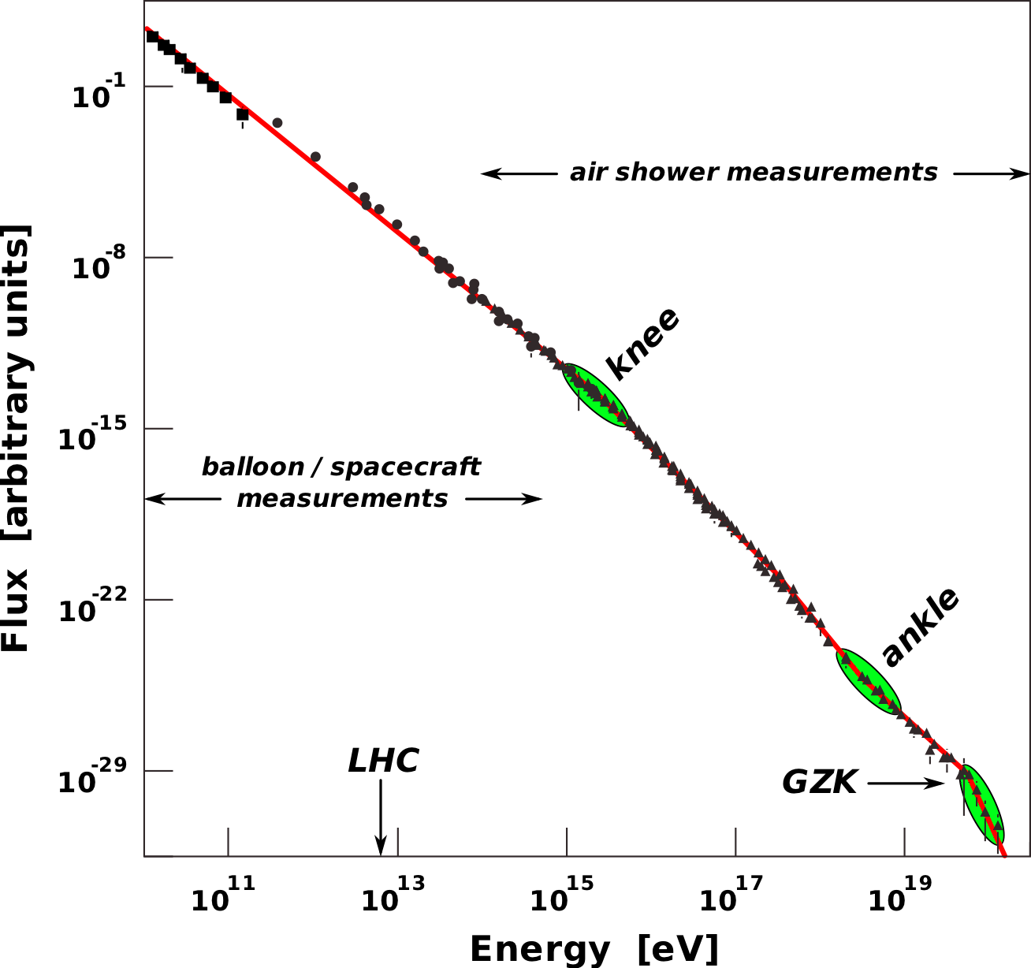
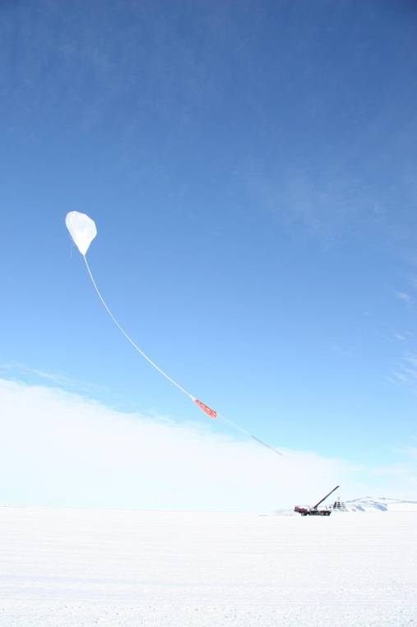
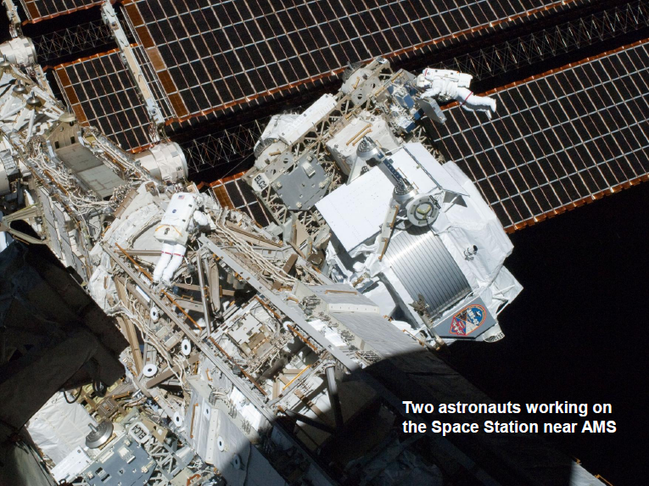
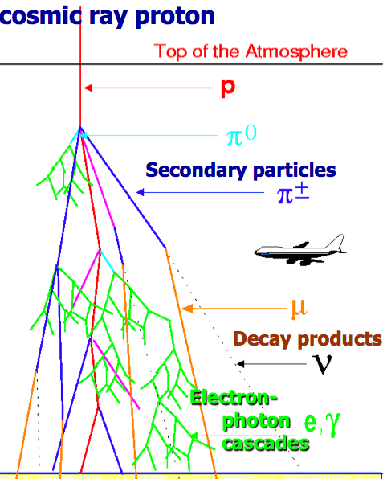
How to detect UHECRs?
Up to 10¹⁴ eV it is possible to detect CR directly putting detectors on balloons or satellites
For higher energy the flux is too poor and we have to study the showers (EAS) generated by primary CRs
  The UHECR flux is less than 1 particle per km² per century
There are two main techniques to detect EAS from UHECRs:
A) To sample the EAS at ground with an Array of surface detectors (Lateral profile)
B) To detect the fluorescence light with Fluorescence telescopes (Longitudinal profile)

Slide 10
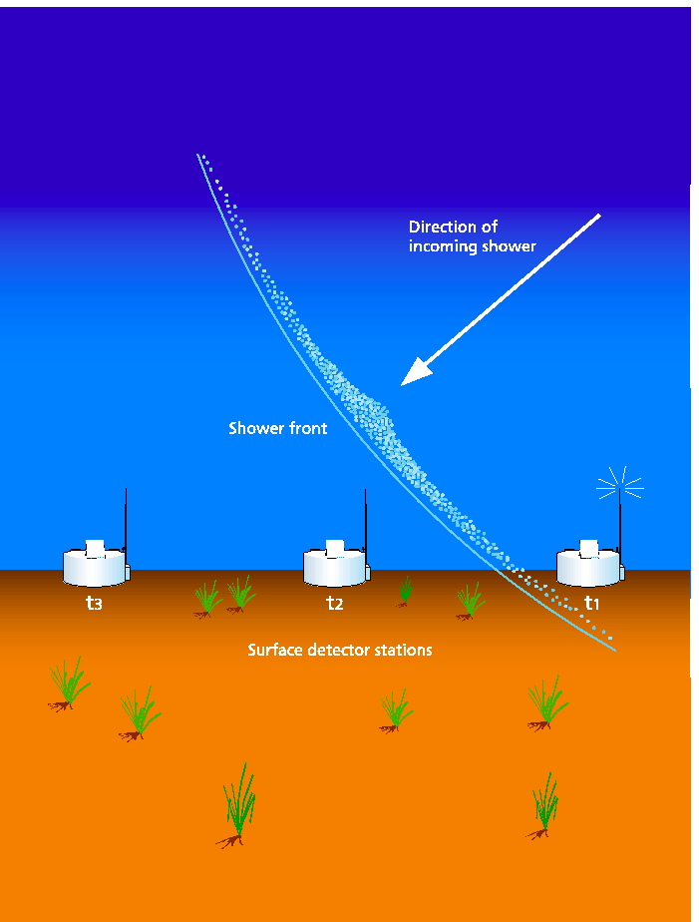
Array of surface detectors (Lateral profile)
The Surface Detector arrays samples the EAS at ground
- Time of arrival at each station
      Thanks to the time of arrival it is possible to deduce the arrival direction of primary cosmic ray.
- Number of particles
          From the number of secondary particles it is possible to infer the energy of primary cosmic ray.
    - Muon number and Pulse rise time
      Thanks to the number of muons and the study of the pulse rise time it is possible to measure the mass of primary cosmic ray.
Scintillators or
Cerenkov water tanks

Slide 11
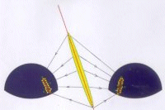
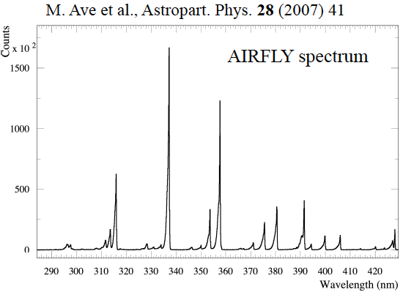
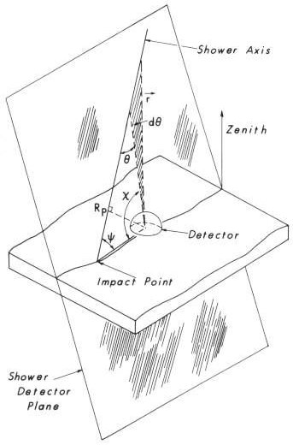
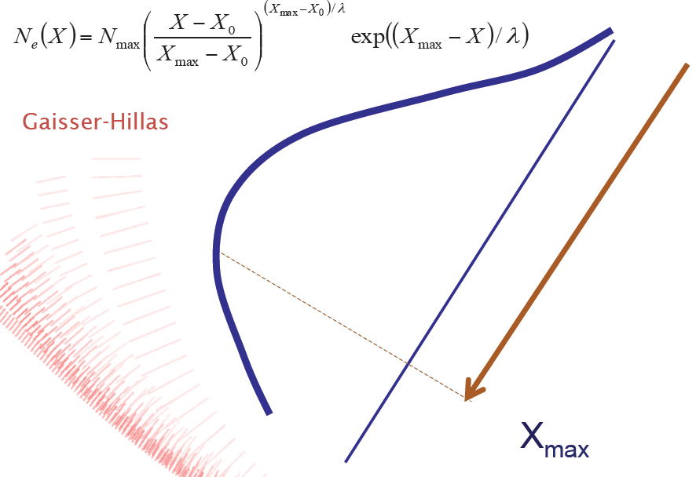
Fluorescence telescopes (Longitudinal profile)
Secondary charged particles excite nitrogen molecules. The de-excitation process occurs in the UV (fluorescence)
The fluorescence technique allows to measure the ionization density of the EAS at different altitudes. This enables to detect the longitudinal development of the shower.

Slide 12
Pros and Cons of two techniques
Array of surface detectors
Pros Duty cycle almost 100%
Cons Very strong dependence of nuclear interaction models (MonteCarlo simulations). Thus a big incertitude on the determination of the primary cosmic ray energy.
Fluorescence telescopes
Pros Less model dependent
Cons Duty cycle of about 10-15 % (clear moonless nights)
The Pierre Auger Observatory
is an Hybrid detector that combines the two techniques.

Slide 13
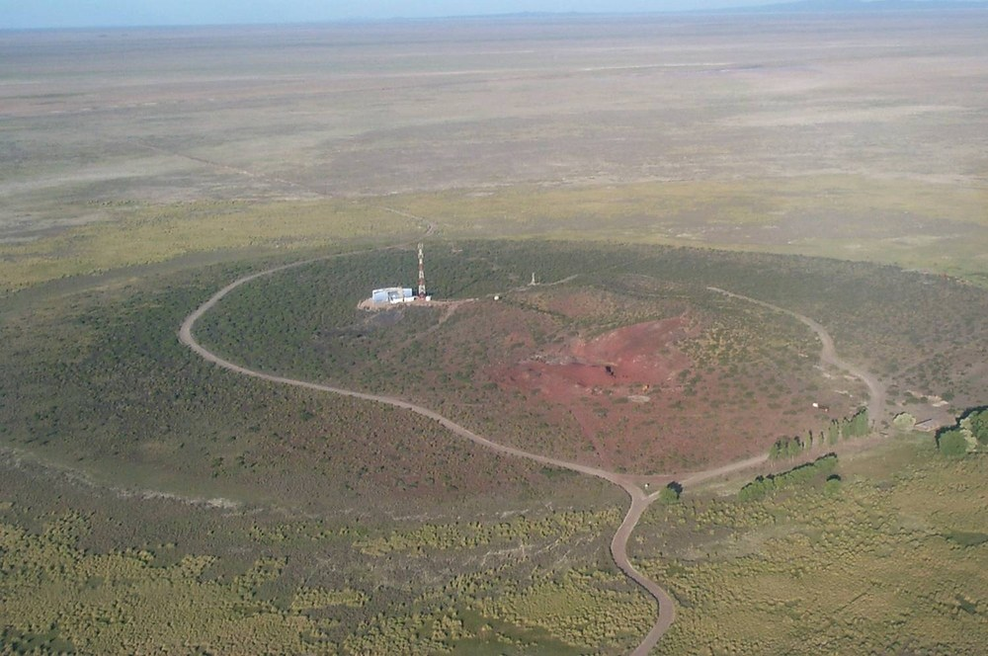
Outline
Ultra High Energy Cosmic Rays (UHECRs)
How to detect UHECRs?
The Pierre Auger Observatory
Results of the Pierre Auger Observatory

Slide 14

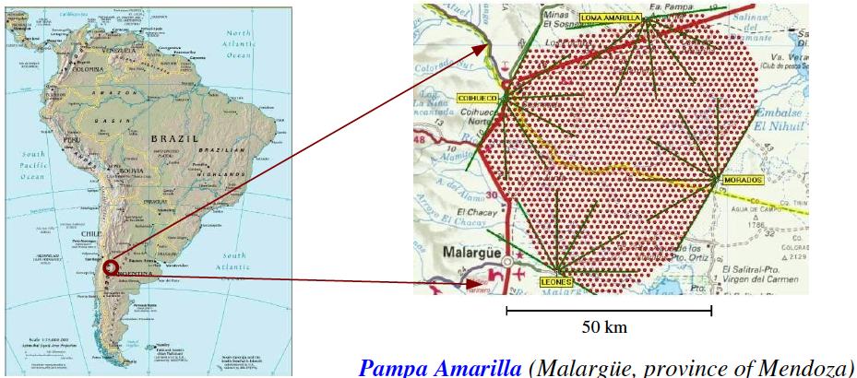
The Pierre Auger Observatory
1400m a.s.l.
latitude: 35°
Physics data since 2004, inauguration November 2008
1600 water Cherenkov tanks (1.5 km distance in a triangular grid) = 3000 km²
24 fluorescence telescopes stations (4 building)

Slide 15
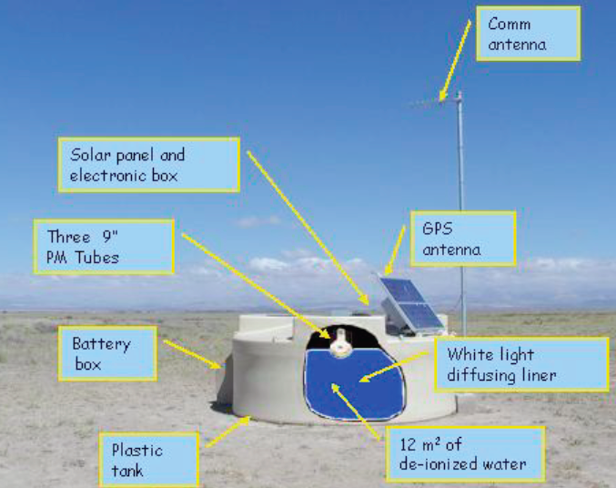
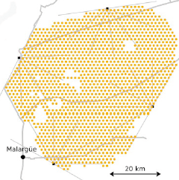
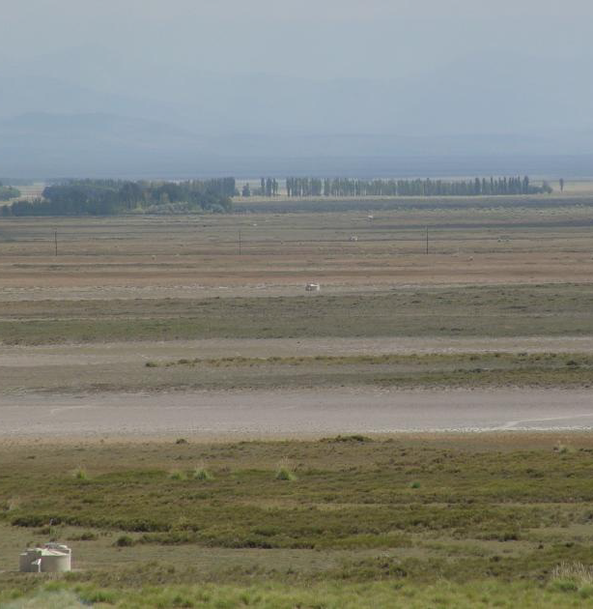
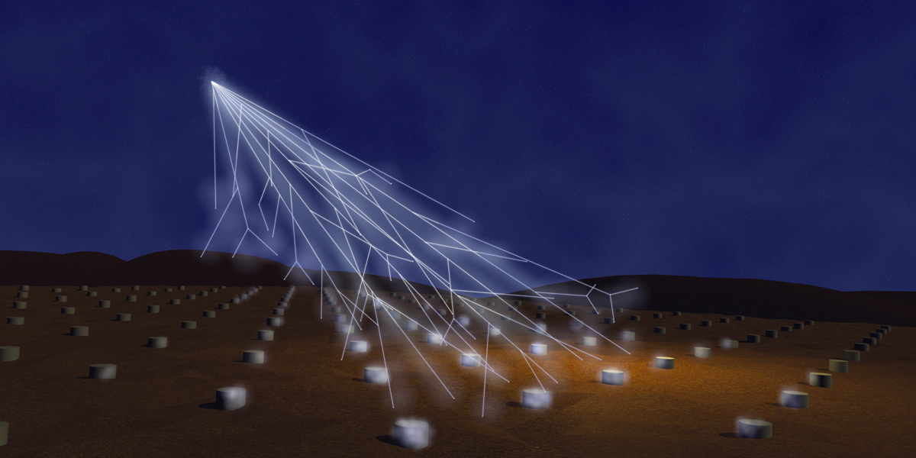

Slide 16
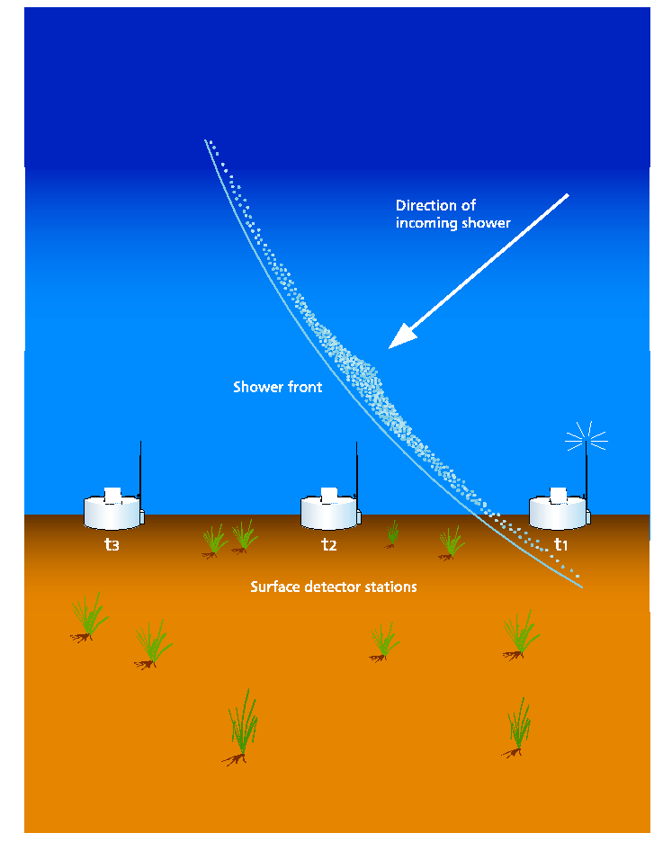
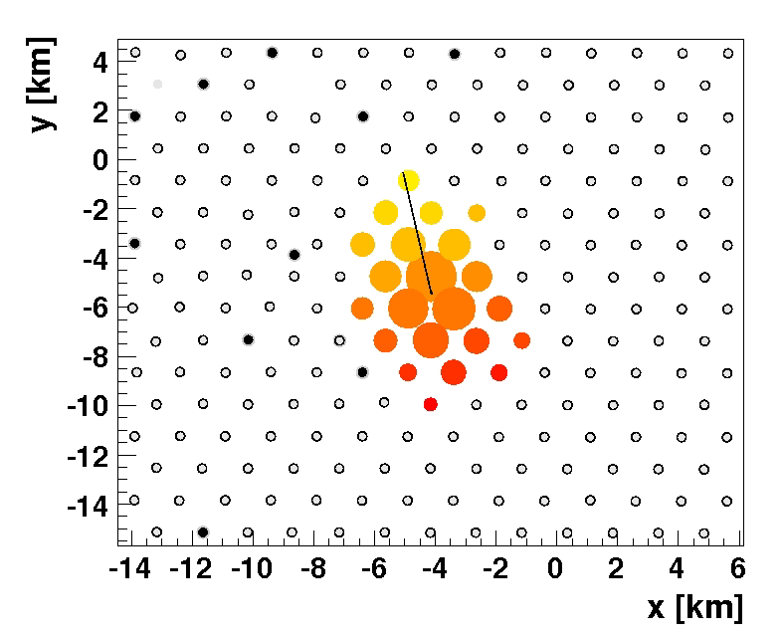
SD geometry reconstruction
The reconstruction of arrival direction of primary cosmic rays is obtained by fitting the arrival times sequence of particles in shower front.
For “SD only” reconstruction the angular resolution is:
Better than 2.2° | 3-fold events | E < 4 EeV
Better than 1.7° | 4-fold events | 3 < E < 10 EeV
Better than 1.4° | For higher multiplicity | E > 8 EeV

Slide 17
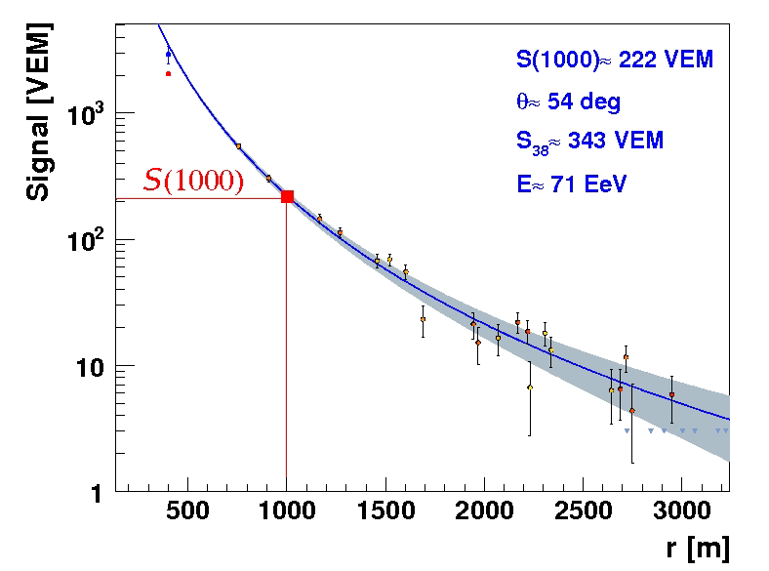
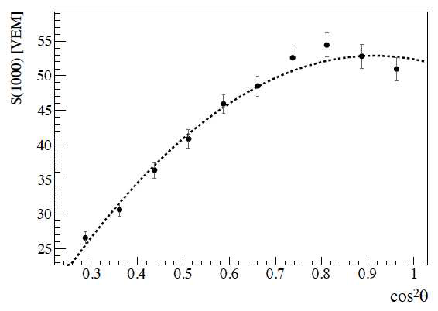
SD energy determination
Energy estimator: S(1000) that is the particle density at 1000 m from shower axis
S(1000) is converted into S38 that is the S(1000) that a shower would have produced if it had arrived with a zenith angle of 38°
Distance from the core
VEM : Vertical Equivalent Muon
Attenuation
curve (CIC)
The SD is full efficient from 3 10¹⁸ eV

Slide 18
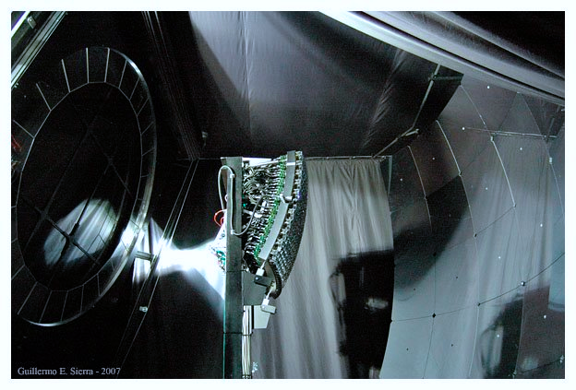
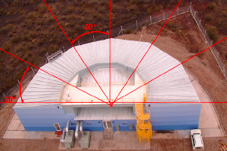
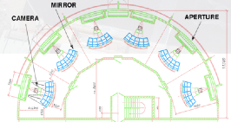
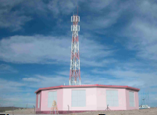
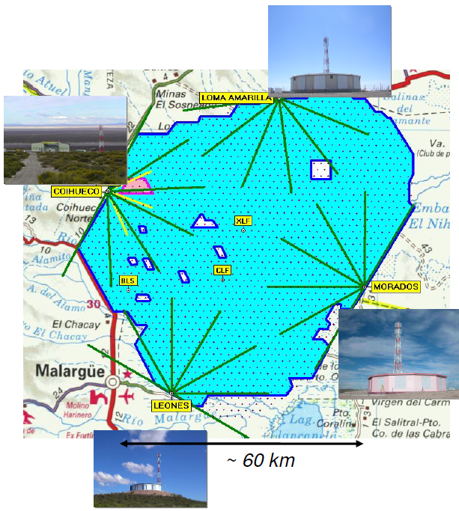
Diaphragm
and
Optical Filter
Camera
(440 PMts)
Mirror
(13 m²)
24 Fluorescence telescopes in 4 buildings:
Mirrors: 3.6 m x 3.6 m with field of view 30° x 30° from 1° to 31° in elevation.
Each telescope is equipped with 440 photomultipliers.

Slide 19
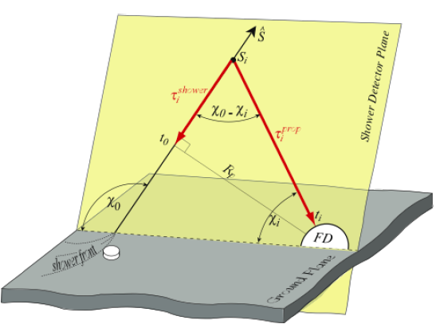
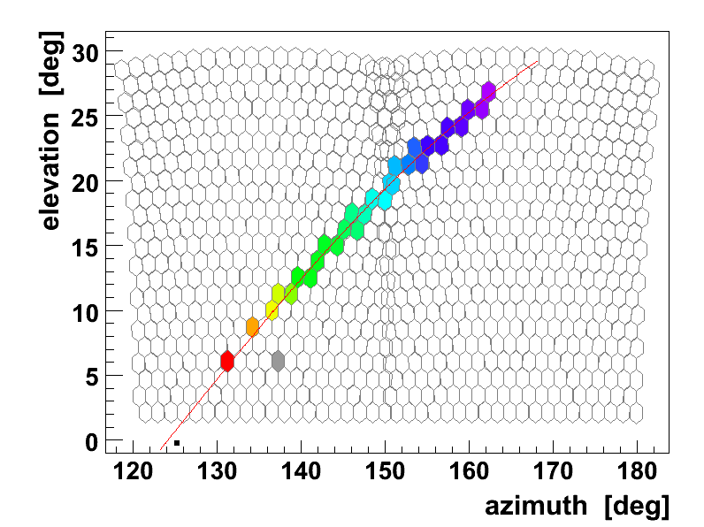
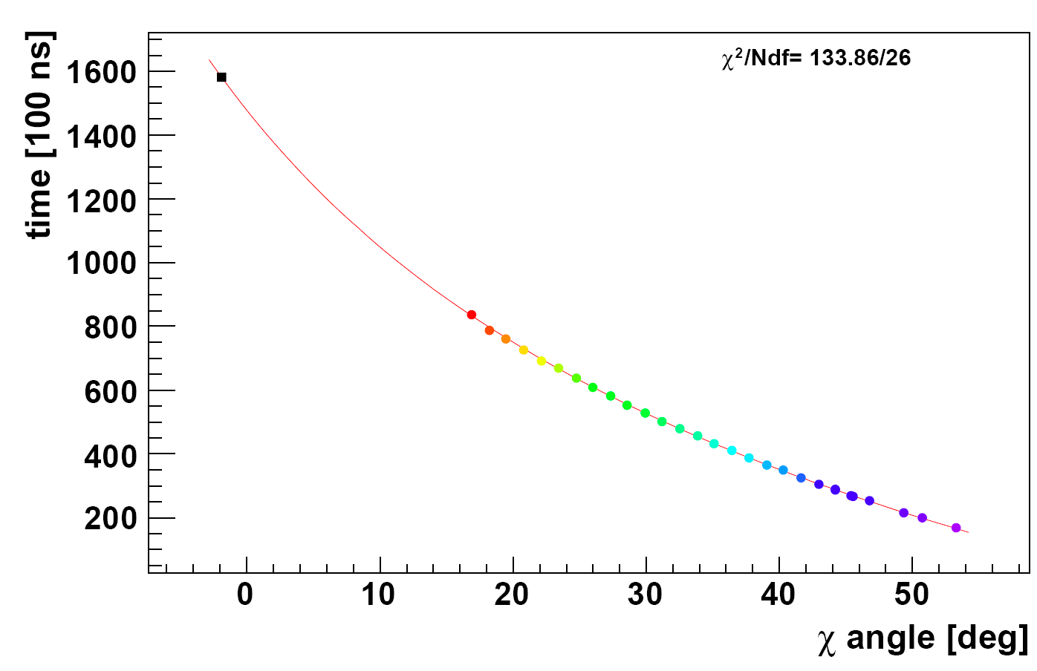
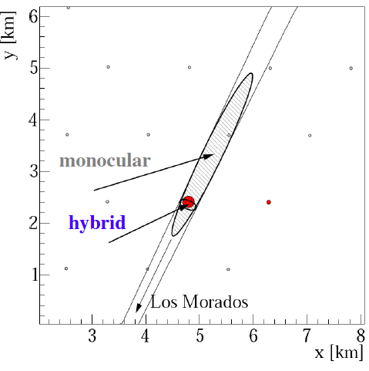
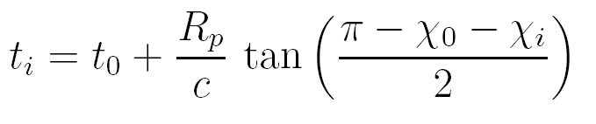
FD geometry reconstruction
Shower Detector Plane (SDP) using the directions of the triggered pixels
In the PAO the reconstruction of direction is performed in hybrid mode (see later)
Time Fit

Slide 20
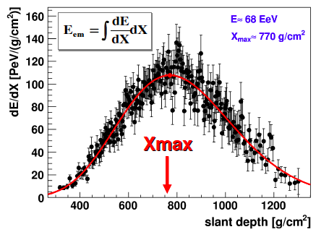
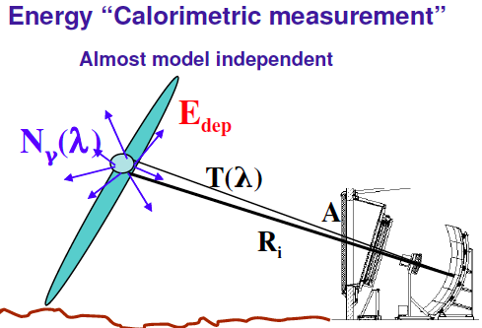
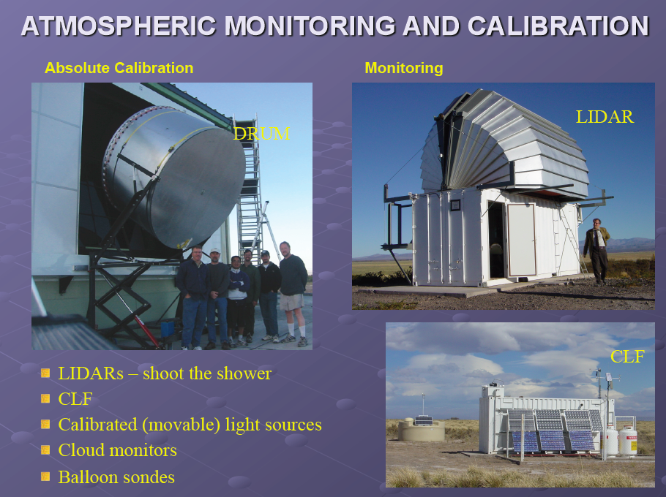
FD energy determination
Longitudinal profile
The number of photons N_{γ}(λ) is proportional to the deposited Energy E_{dep} (from laboratory measurements – Fluorescence yield)
Geometry – n° of photons in the FD FOV depend on A/R_{i}²
Atmosphere– n° of photons at diaphragm depend on T(λ)
The ADC count depend on Detector Calibration
Facilities in the field to monitor the transparency of the air and the cloud coverage

Slide 21
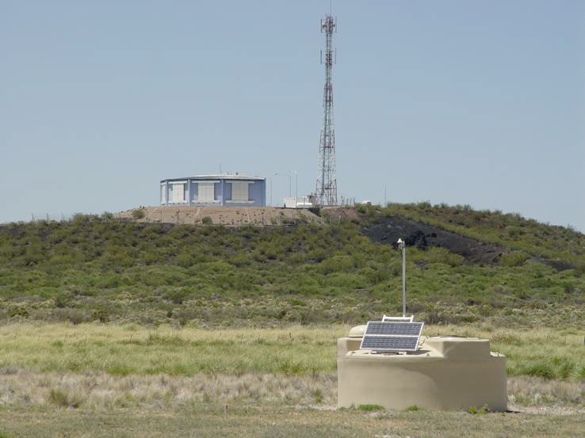
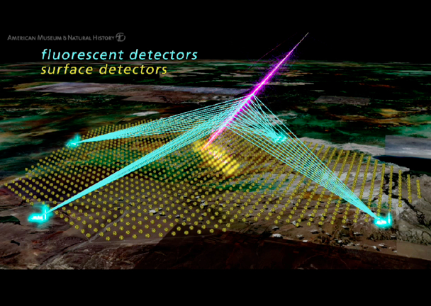
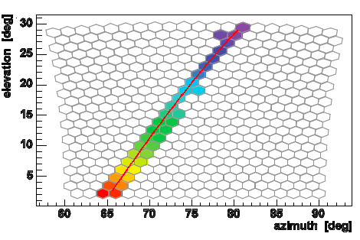
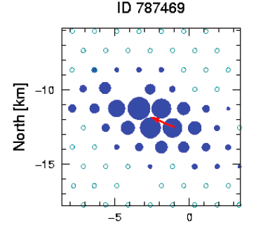
The Hybrid Concept
SD and FD combined in the hybrid mode
(i.e. FD + at least 1 SD station)
Accurate energy and direction measurement
and
Mass composition studies in a complementary way

Slide 22
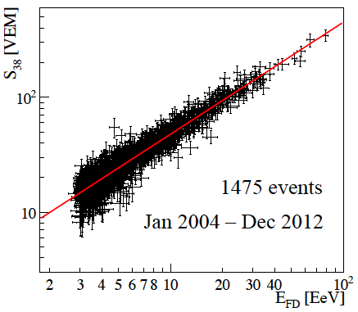
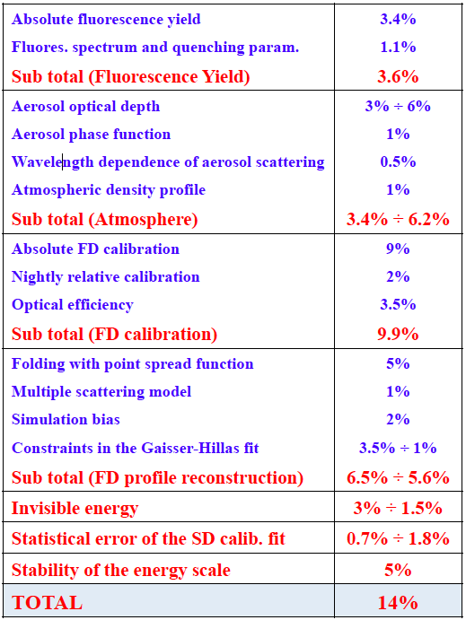
The Hybrid Concept
Energy Calibration for SD events using golden hybrid data (FD + ≥ 3 SD stations)
Using hybrid events, the SD energy estimator S38 is calibrated without relying on Monte Carlo simulation with an accuracy of 14%
S₃₈: SD signal at 1000m from the core if the shower had θ = 38°
Valerio Verzi – ICRC2013
Geometry Reconstruction
Thanks to hybrid mode:
The Hybrid angular resolution is ≈ 0.6°
and
The core resolution is ≈ 50 meters

Slide 23
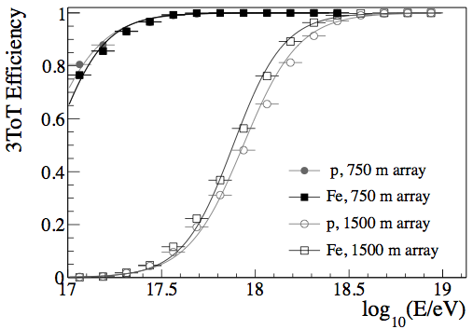
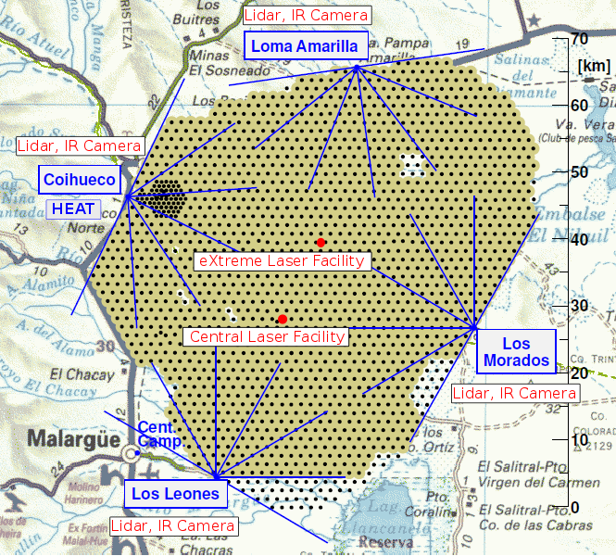
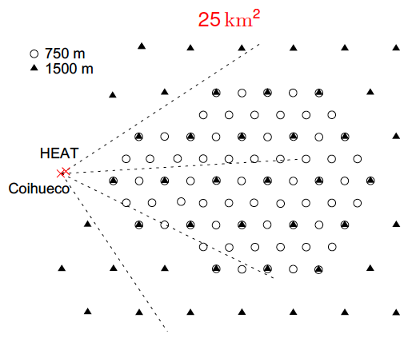


The Pierre Auger Enhancements
The SD array is fully efficient at energies above 3 10¹⁸ eV
The transition from galactic to extra-galactic cosmic rays may occur between 10¹⁷ eV and the ankle (4 10¹⁸ eV).
A precise measurement of the flux at energies above 10¹⁷ eV is important for discriminating between different theoretical models
49 additional detectors with 750 m spacing have been nested within the 1500 m array to cover an area of about 25 km²: INFILL has a full efficiency above 3 10¹⁷ eV
HEAT High Elevation Auger Telescopes (near Coihuecuo)
Field of view from 30° to 60°

Slide 24

Outline
Ultra High Energy Cosmic Rays (UHECRs)
How to detect UHECRs?
The Pierre Auger Observatory
Results of the Pierre Auger Observatory

Slide 25



The measurement of the energy spectrum of cosmic rays above 3 10¹⁷ eV
Combining the SD regular array data and the INFILL array data (plus the hybrid ones) it is possible to obtain the measurement of the cosmic ray flux starting from 3 10¹⁷ eV.
The dataset extends from 1 January 2004 to 31 December 2012.
The exposure and the calibration are different for the different data sets
Integrated exposure of the different detectors at the Pierre Auger Observatory as a function of energy.
We have to distinguish between vertical events (θ < 60°) and inclined events (62° ≤ θ < 80°)
EXPOSURE
CALIBRATION
Energy estimators: S₃₈ and S₃₅
The equivalent signal at median zenith angle of 38° (35°) is used to infer the energy for the 1500 m (750 m) array
Energy estimator for inclined air-showers: N₁₉
Inclined air-showers are characterized by the dominance of secondary muons at ground, as the electromagnetic component is largely absorbed in the large atmospheric depth traversed by the shower.
The reconstruction is based on the estimation of the relative muon content N₁₉ with respect to a simulated proton shower with energy 10¹⁹ eV
Correlation between the different energy estimators S₃₈, S₃₅ and N₁₉ and the energy determined by FD.

Slide 26


The measurement of the energy spectrum of cosmic rays above 3 10¹⁷ eV
Combined energy spectrum of UHECRs as measured at the Pierre Auger Observatory.
A. Schulz @ ICRC2013
To characterize the spectral features, data are described with a power law below the ankle
and a power law with smooth suppression above
γ₁, γ₂ are the spectral indices below/above the ankle at E_{a}.
E_{½} is the energy at which the flux has dropped to half of its peak value before the suppression, the steepness of which is described with log₁₀W_{c}.
130000 events
The numbers give the total number of events inside each bin. The last three arrows represent upper limits at 84% C.L.
The ankle has been clearly seen
The suppression in the flux of UHECRs has been firmly established with (>20 σ)

Slide 27




The measurements of the depth of shower maximum for the study of mass composition
Mass determination is mandatory to reach reliable conclusion on energy spectrum, sources and acceleration
There are several ways to study the composition of the primary cosmic rays:
a) X_{max} measurement
b) muon production depth
c) rise-time asymmetry measurements
The best way (smallest systematic uncertainties) is to measure the X_{max} distribution using fluorescence telescopes in hybrid mode.
Superposition principle:
Iron shower of energy E “is equal to” 56 proton showers of E/56
• proton showers penetrate deeper ➔ higher X_{max}
• iron showers have less fluctuations ➔ smaller RMS(X_{max})
Data selection and Quality Cuts

Slide 28


The measurements of the depth of shower maximum for the study of mass composition
Vitor de Souza @ ICRC2013
Composition becomes heavier with increasing E
Ankle
Cut off
At low energy data is compatible with a significant fraction of protons
Break on the elongation rate slope seems to indicate a change in composition towards a predominance of heavier nuclei at higher energies
< X_{max} > and RMS(X_{max}) show similar trends towards heavy-like showers at high energies

Slide 29

Anisotropy studies
If the observed cosmic ray flux suppression is interpreted in term of GZK-effect than the closest sources of UHECRs are situated within the GZK Volume of d_{GZK} < 100 Mpc (Within the GZK VOLUME the matter distribution in the Universe is inhomogeneous, and so must be the distribution of the UHECR sources)
If propagation of UHECRs at these distances is quasi-rectilinear
d_{GZK}
Then anisotropies would be expected.

Slide 30


July 2007
27 events
In 2007, the Pierre Auger Collaboration reported directional correlations of UHECRs at E>55 EeV with AGN from the Véron-Cetty-Véron catalog within 75 Mpc on an angular scale of 3.1° at 99% CL.
From the 27 events collected up to July 2007 with energy greater than 55 EeV
(Period I) the firsts 14 events were used as exploratory scan in order to determine the optimal parameters.
(Period II) among the remaining 13 events 9 events correlating with AGNs (to be compared with 2.7 events if they had been isotropic) corresponding to a correlation of (69⁺¹³₋₁₁)%.
Being the chance correlation p_{iso}= 21% the chance probability of observing such a correlation is 1.7 10⁻³.
The latest update including data up to June 2011 which yields a total of 28 AGNs (to be compared with 17.6 events if they had been isotropic) of 84 events (Period II+III+IV) shows a correlation of (33±5)%.
The chance probability of observing such a correlation remain below 1%.
Inconclusive evidence with current statistics

Slide 31

Proton Cosmic Ray Astronomy
Mass determination is mandatory to reach reliable conclusion on energy spectrum, sources and acceleration
?
The Fluorescence Detector has a very low statistic and “sees” only the e.m. component of the shower.
The Surface Detector is not optimized to study the mass composition:
Rise-time measurements
Cut off
The e.m. component and the muonic component have to measured separately!

Slide 32






Muon-E.M. Detectors
There are several solutions to measure separately the e.m. component from the muonic component.
MARTA
Muon Auger RPC for Tank Array
Proposal for a Segmented Water Cherenkov Array
Plastic Scintillators such as AMIGA or MuScint
The Collaboration is working to chose the best solution in term of performances and cost.

Slide 33
Thanks you

Slide 34


Slide 35


Slide 36


Slide 37


Slide 38

Upper Limits to the PHOT0N FLUX

