Slide 1
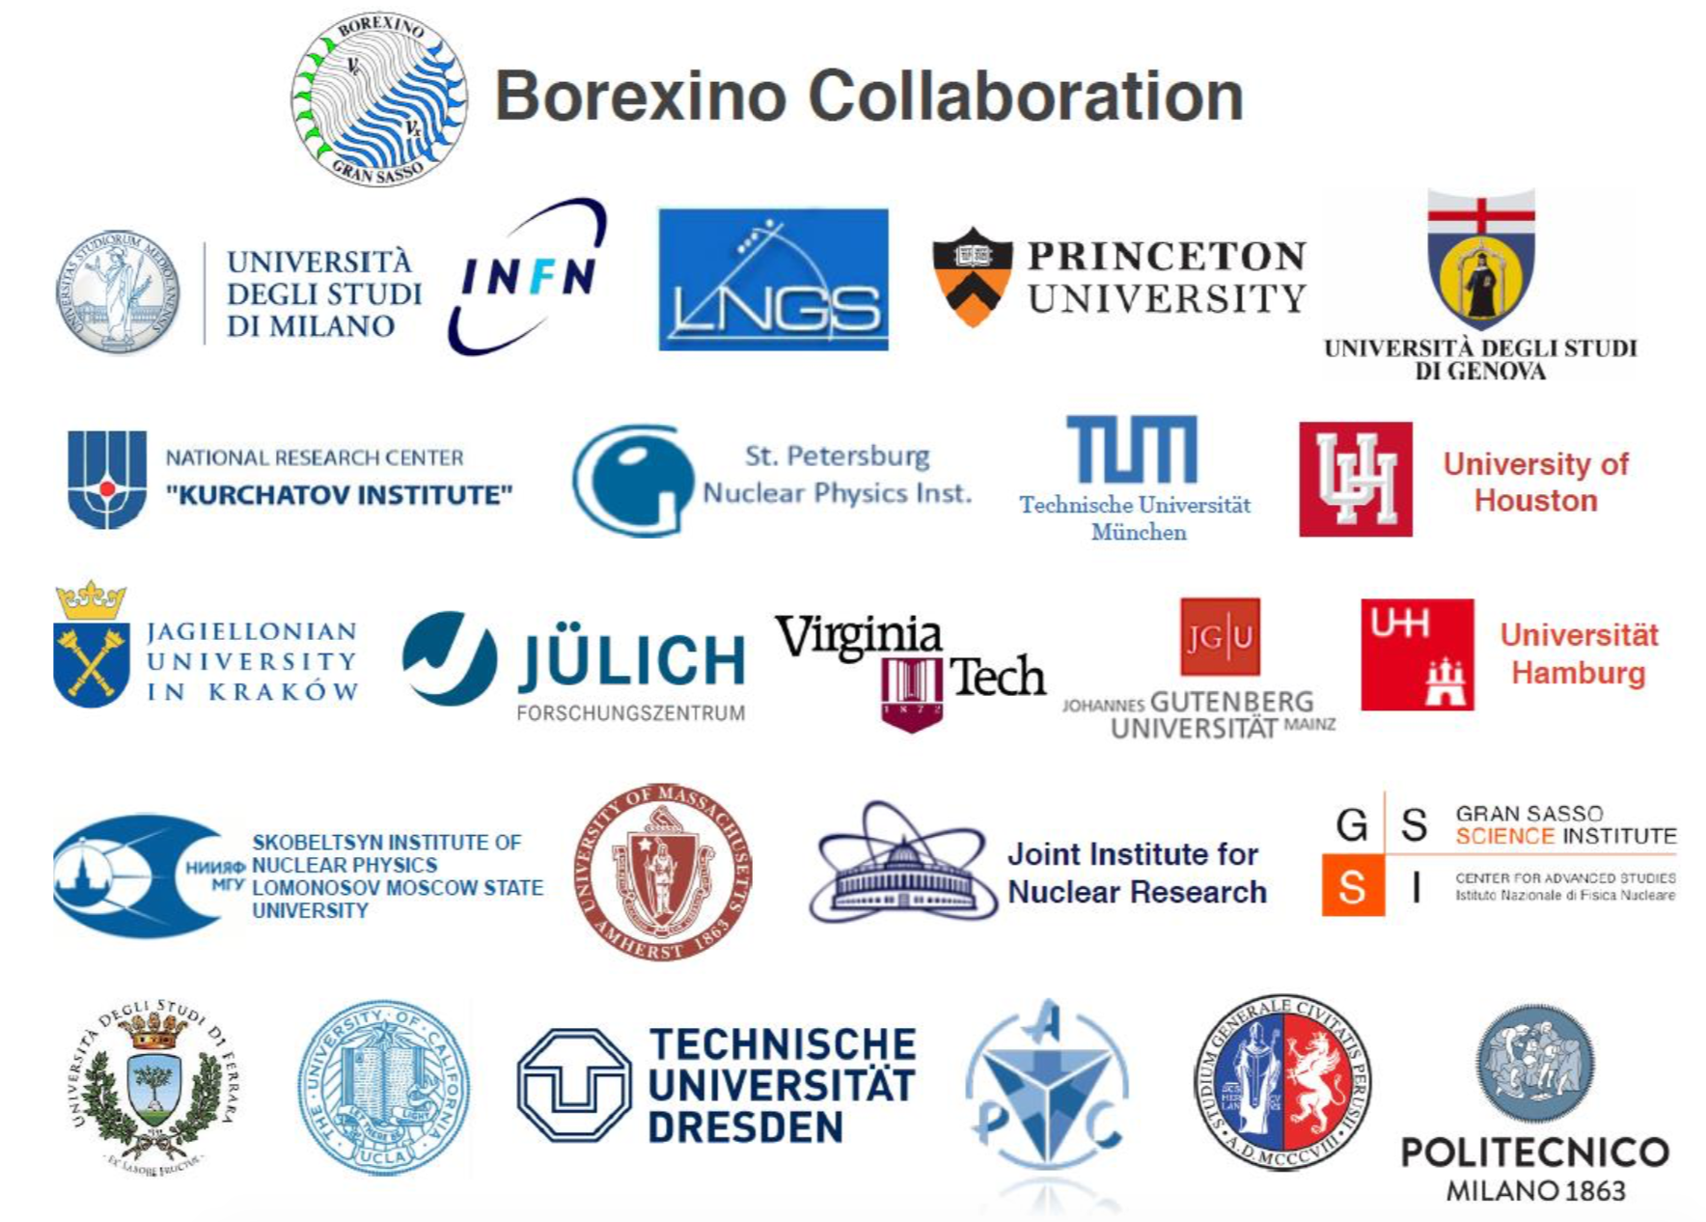
Results and perspectives in solar neutrino detection with Borexino
Lino Miramonti on behalf of the Borexino Collaboration Dipartimento di Fisica, Università degli Studi di Milano & INFN-Sezione di Milano

Slide 2
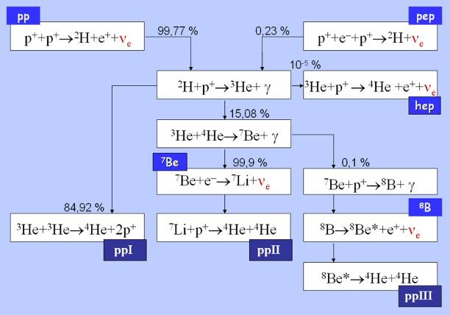
Solar neutrinos fluxes
Electron neutrinos (ν_{e}) are copiously produced by thermonuclear processes that power the Stars
In the Sun about 99 % of of the energy is produced in the pp chain
ν_{e} from:
pp
pep
⁷Be
⁸B
hep

Slide 3
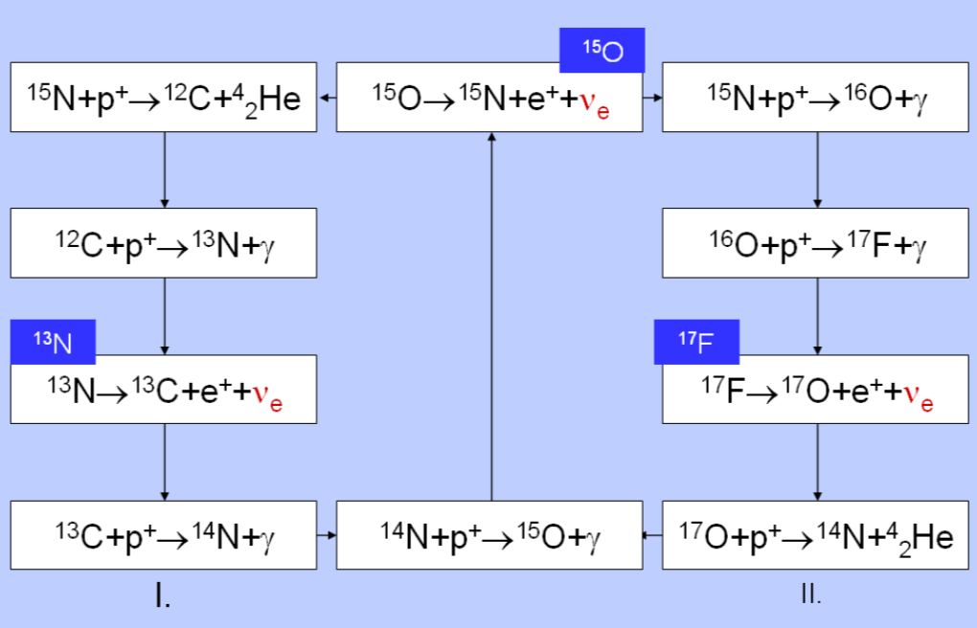
Solar neutrinos fluxes
Beside the pp chain there is also the CNO cycle which represents ∼1-2 % of the Sun energy
CNO cycle is important for massive stars
ν_{e} from:
¹³N
¹⁵O
¹⁷F
CNO
So far CNO ν_{e} have never been detected!

Slide 4
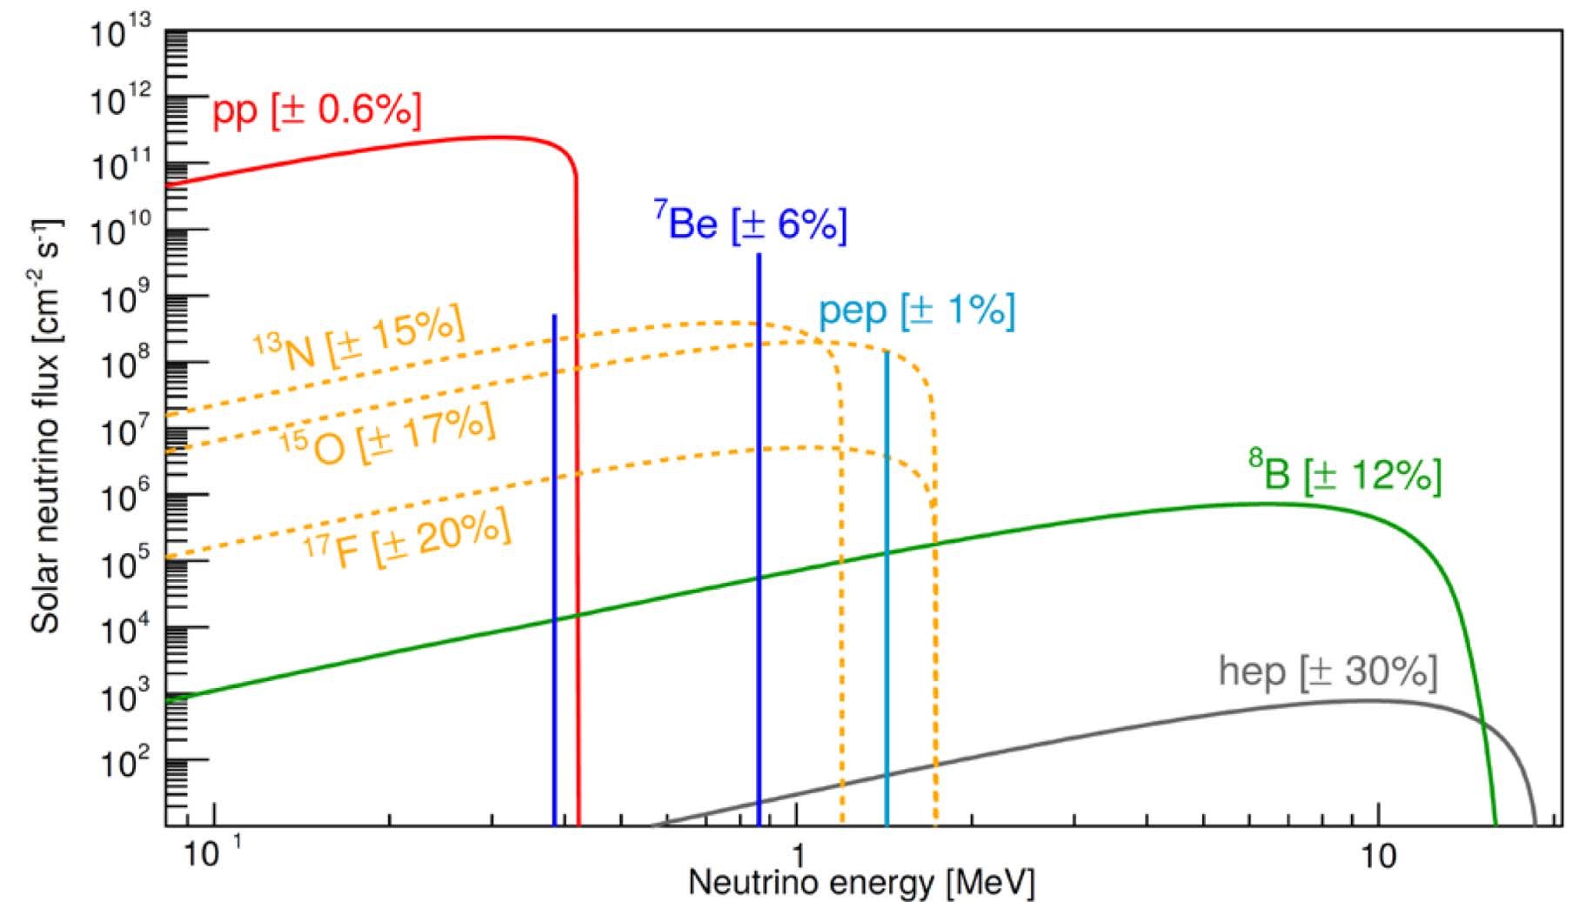
Solar neutrinos fluxes
Expected ν fluxes from the Standard Solar Model (SSM)
In the middle of ’60s a solar neutrino detector was built in order to test the validity of the Standard Solar Model (SSM).

Slide 5
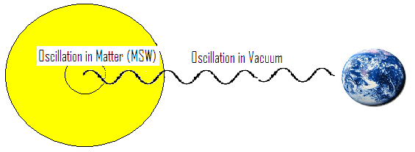
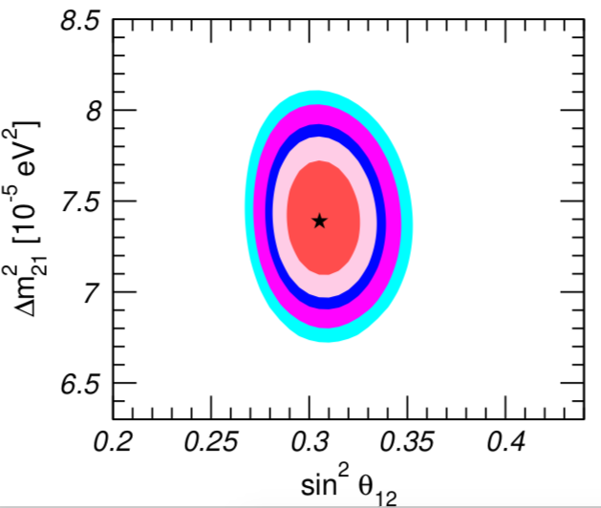
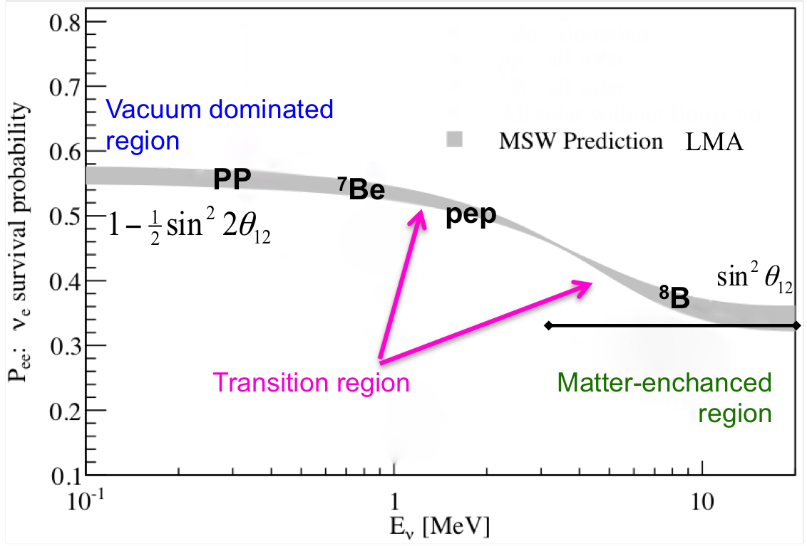
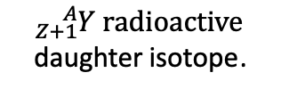
Solar neutrinos detection – SSM and Neutrino Oscillations
There are two ways to detect solar neutrinos:
radiochemical experiments
(Inverse Beta Decay)
real time experiments
(Elastic Scattering)
$${}_{Z+1}^{A}Y \text{radioactive} \text{daughter} \text{isotope}\text{.}$$
More than 40 years of solar neutrino experiments have successfully detected solar neutrinos and validate the SSM.
We know that solar neutrinos oscillates in vacuum at low energy and for high energy (multi-MeV) the conversion is enhanced by the high electron density in the core of the Sun (MSW effect Mikheyev-Smirnov-Wolfenstein).
Global 3ν oscillation analysis
NuFIT 3.2 (2018)
regions at 1σ, 90%, 2σ, 99%, 3σ CL

Slide 6
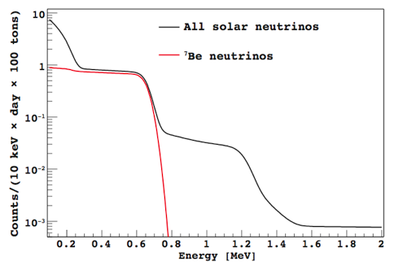
Solar Spectroscopy with Borexino from 200 keV
Radiochemical experiments (Homestake, Gallex, SAGE) integrate in time and energy.
Water based real time experiments (Kamiokande, SuperK, SNO) can detect solar neutrinos starting from about 3-4 MeV.
ν flux as predicted by SSM
⁷Be monochromatic line at 0.862 MeV
With a Liquid Scintillator Detector is possible to measure solar neutrinos in real time with a low energy threshold.
Detection principle: elastic scattering (ES) on electrons
It is impossible to disentangle electrons from beta decay (BKG) from scattered electrons induced by solar neutrinos (Signal).
Compton shoulder
ν signal in Borexino
10 orders of magnitude!
Maximum ES of e⁻ 0.662 MeV
Ex. The concentration of ²³⁸U in standard materials is of the order of ppm (10⁻⁶ g/g) and we have to reach at least 10⁻¹⁶ g/g !

Slide 7
≈270 tons
Liq. Scint. PC+PPO
The target mass consists in about 270 tons of liquid scintillator composed by pseuducumene PC as solvent and PPO as solute (1.5 g/l) to enhance the scintillation properties.
In order to reach such a low radioactivity level several techniques
have been developed
and applied:
Distillation,
Water extraction,
Nitrogen stripping,
ecc…..
Unprecedented low levels of background

Slide 8
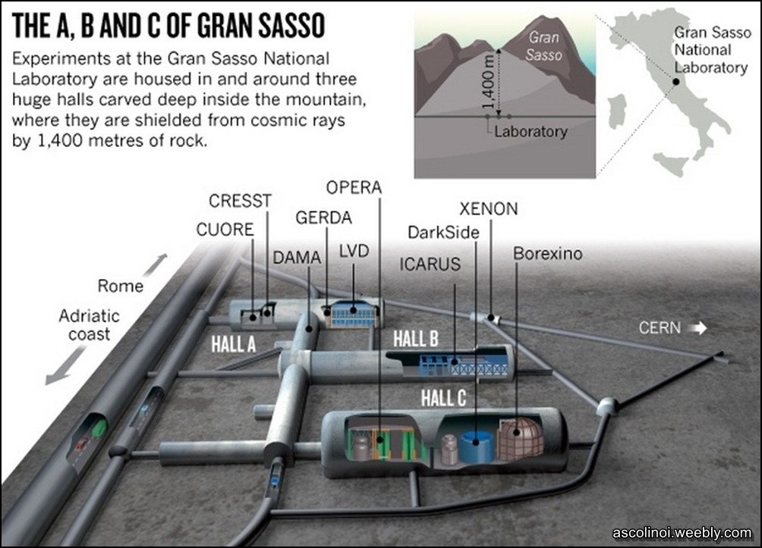

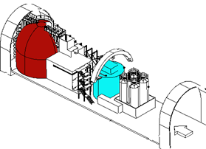
Laboratori Nazionali
del
Gran Sasso

Slide 9
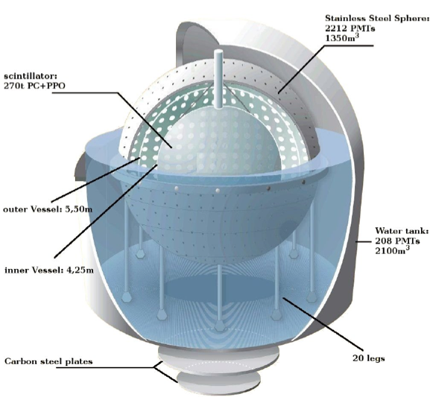
Borexino
design
Core of the detector: 270 tons of liquid scintillator (PC+PPO) contained in a nylon vessel of 8.5 m diameter. The thickness of nylon is 125 µm.
1st shield: 1000 tons of ultra-pure buffer liquid (PC+DMP) contained in a stainless steel sphere of 13.7 m diameter (SSS).
ν
2200 photomultiplier tubes pointing towards the center to view the light emitted by the scintillator.
2nd shield: 2400 tons of ultra-pure water contained in a cylindrical dome.
200 photomultiplier tubes mounted on the SSS pointing outwards to detect Cerenkov light emitted in the water by muons.
e⁻
Scintillation light detected by PMT’s
N. of photons → energy
Time of flight → position
Pulse shape → α/β β⁺/β⁻ discrim.
Light yield: ~500 phe⁻/MeV
Energy resolution: 5% @ 1MeV
Space resolution: 10 cm @ 1MeV
ν

Slide 10
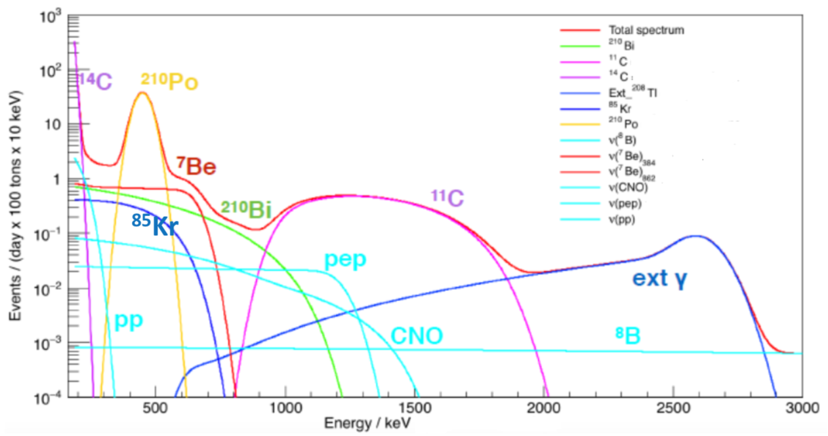
How to extract the neutrino signal: example of pp, ⁷Be and pep-ν
Simulated energy spectrum - solar neutrino signals and main background component in Borexino
Simulation

Slide 11
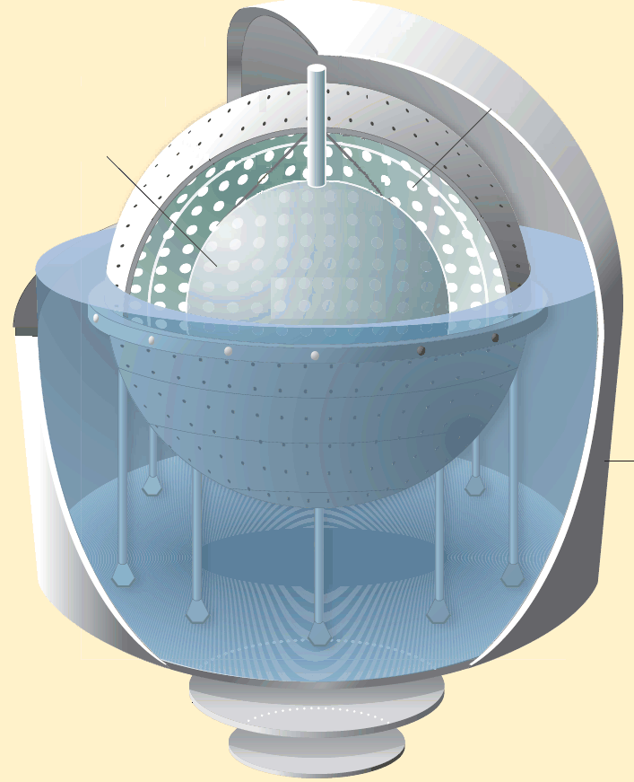
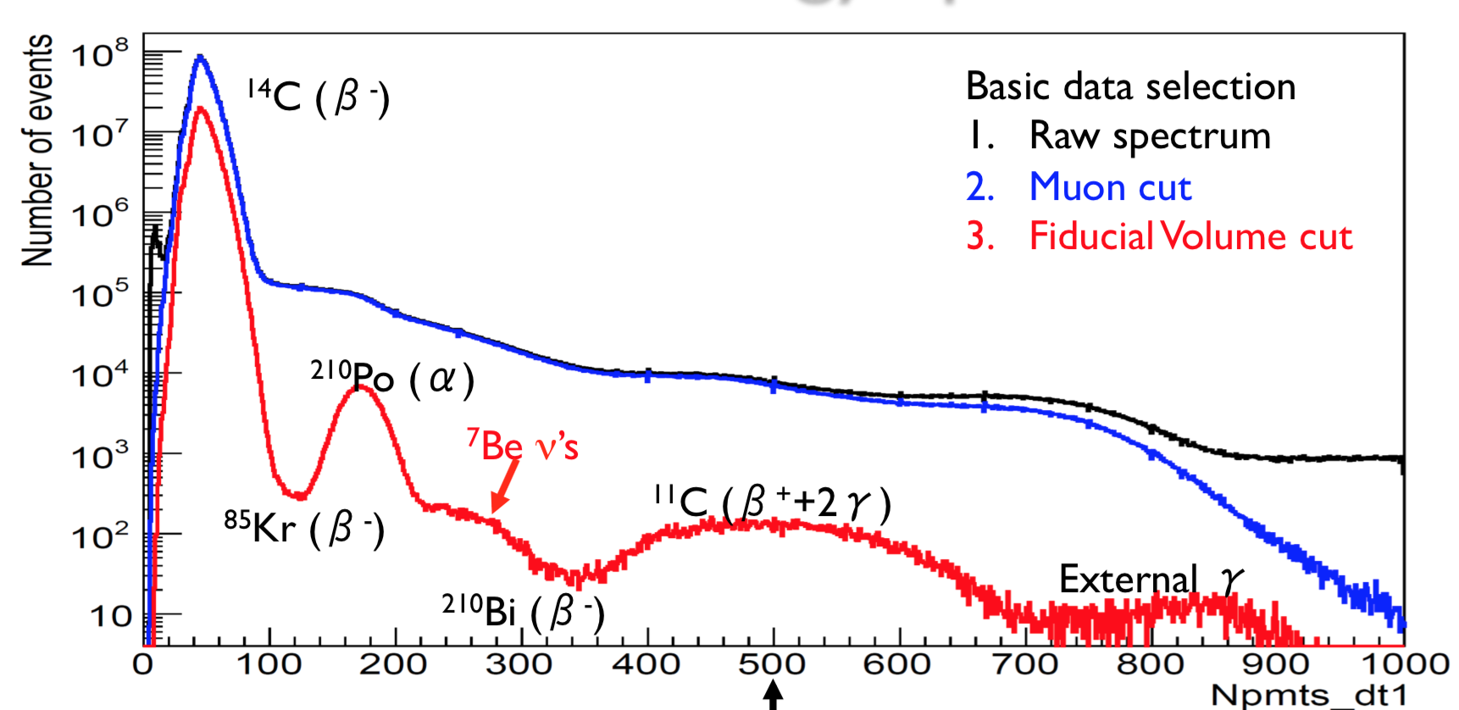
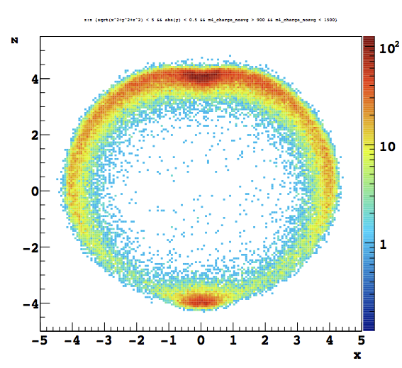
μ
From raw data to neutrino signal
External and internal muon veto
(veto of 300 ms after a muon in OD)
Data
Fiducial Volume cut for removing external background
(R<2.8 m and -1.8<z<2.2 m)
500 Npmts_dt1 ≈ 1 MeV
FV
190 keV
2930 keV

Slide 12
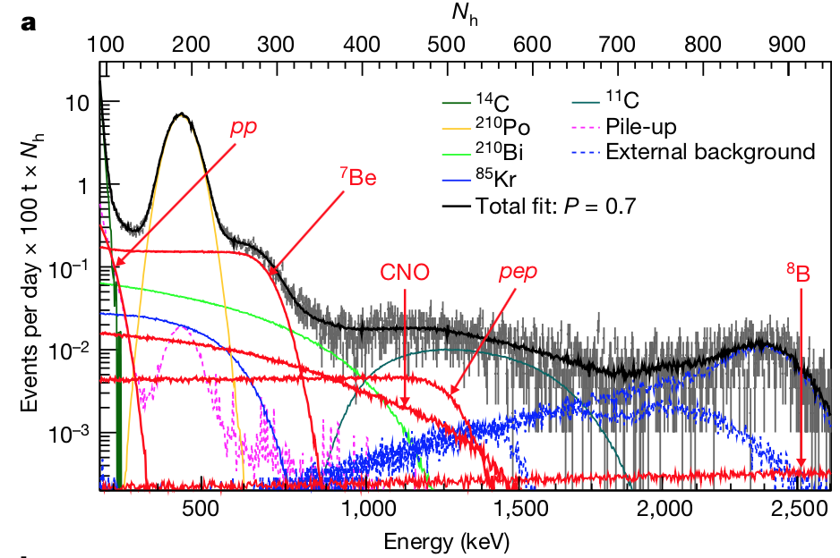
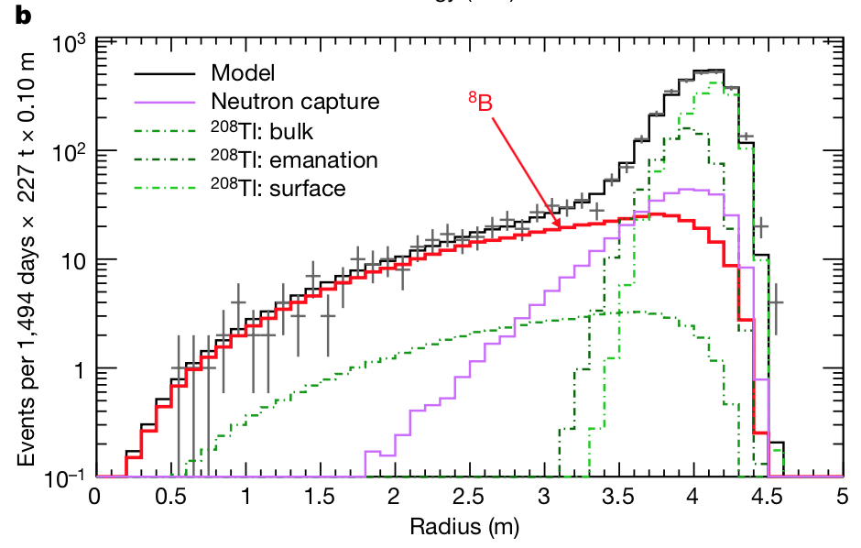
Analysis procedure:
In order to maximize the signal-to-background ratio we apply a different set of cuts in 3 energy regions.
to measure the pp, ⁷Be, pep neutrinos
1) Low-Energy Region (LER) [0.19–2.93 MeV]
to measure ⁸B neutrinos
2) High-Energy Region I (HER-I) [3.2–5.7 MeV]
3) High-Energy Region II (HER-II) [5.7–16 MeV]
In order to extract the neutrino signal from backgrounds we adopt 2 different fitting strategies for the LER and the HER:
For LER analysis we follow a multivariate approach, in which we simultaneously fit the energy spectrum, the spatial distribution and the pulse-shape estimator distribution.
For HER-I and HER-II we perform a radial distribution fit in order to separate the ⁸B neutrino signal (uniformly distributed in the scintillator) from the external background.
Energy spectrum with suppressed ¹¹C background in LER
Radial distribution of events in HER-I

Slide 13
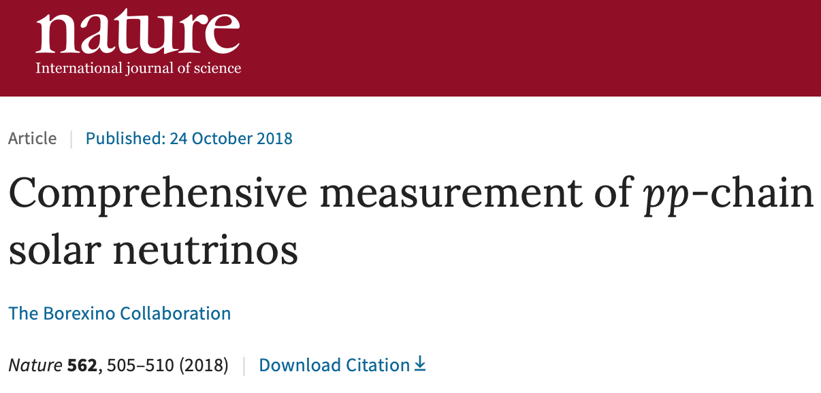
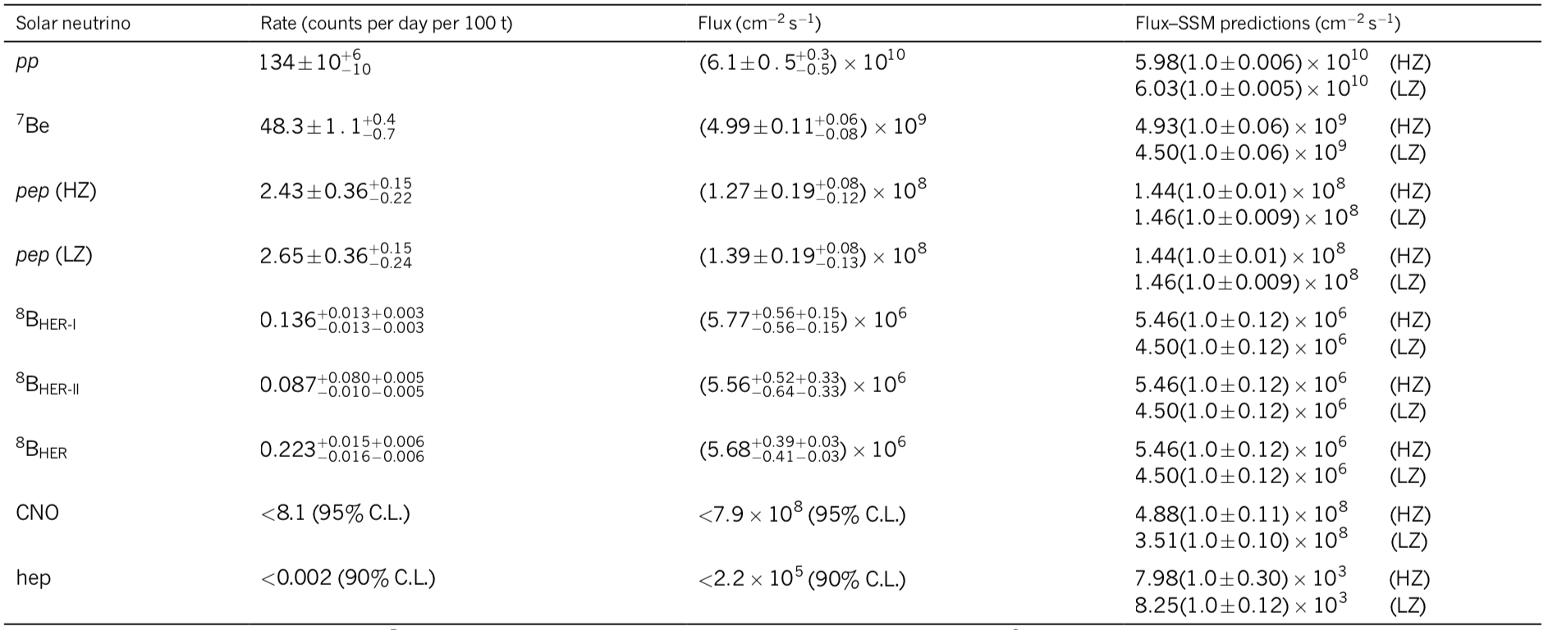
Borexino experimental solar-neutrino results
The total uncertainty of the
pp ≈10%
⁷Be ≈2.7%
pep ≈16%
⁸B ≈8%
Upper limit on the
CNO flux
hep flux
HZ & LZ (High & Low Metallicity) – see later

Slide 14
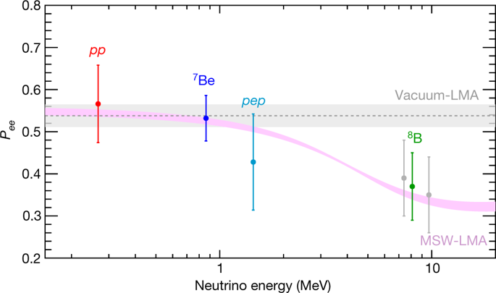
Electron neutrino survival probability
We obtain the electron neutrino survival probabilities for each solar-neutrino component (assuming the HZ-SSM fluxes and standard neutrino-electron cross-sections):
Borexino is the only experiment that can at the same time test neutrino flavour conversion both in the vacuum and in the matter-dominated regime.
The pink band is the ±1σ prediction of MSW-LMA
The grey band is the vacuum-LMA case

Slide 15
Total power generated by nuclear reactions
The neutrino fluxes determined experimentally can be used to derive the total power generated by nuclear reactions in the Sun’s core.
We find
in agreement with the luminosity calculated using the well measured photon output
This confirms experimentally the nuclear origin of the solar power with the best precision obtained by a single solar-neutrino experiment.
Considering that it takes around 10⁵ years for radiation to flow from the energy-producing region to the surface of the Sun, this comparison proves also that the Sun has been in thermodynamic equilibrium over 100 thousands years.
Ratio R_{PPI/PPII}
We derive the ratio R_{I/II} between the ³He–⁴He (PPI) and the ³He–³He (PPII) fusion rates, which quantifies the relative intensity of the two primary terminations of the pp chain
We find in agreement with the predicted
values of R_{I/II} = 0.180±0.011 (HZ) and 0.161±0.010 (LZ)

Slide 16
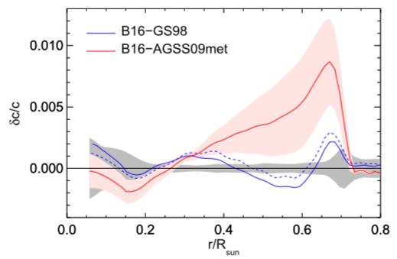
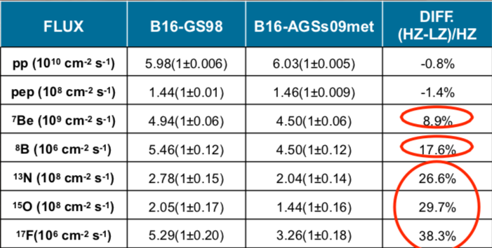
The Solar Metallicity Problem
(*) In astronomy, metallicity is used to describe the abundance of elements present in an object that are heavier than Lithium
Measurements in 2009 (AGS09 Low-Z) suggest that the solar metallicity^{(*)} might be lower than previously assumed (GS98 High-Z).
With this assumption SSMs are less in agreement with helioseismology.
Solar Metallicity Problem
Solar neutrino measurements could provide a solution of this problem!
High Z
Low Z
Low Z
Fractional sound speed difference
High Z
New Generation of Standard Solar Models.
N.Vinyoles et al. The Astrophysical Journal, 835:202, 2017

Slide 17
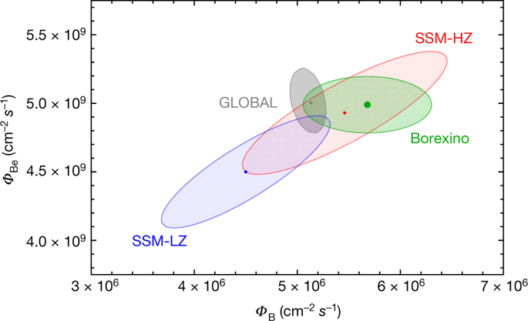
Study the solar metallicity with ⁷Be and ⁸B fluxes
We performed a global fit including the results presented in this work together with all the other solar + KamLAND data.
The Borexino results are compatible with the temperature profiles predicted by both High-Metallicity and Low-Metaliccity SSMs. However, the ⁷Be and ⁸B solar-neutrino fluxes measured by Borexino provide an interesting hint in favor of the High-Metallicity SSM prediction.

Slide 18
Toward the CNO neutrino detection
Motivations:
CNO neutrinos have never been detected
According to astrophisical models, CNO cycle is responsible of ~1% of the solar luminosity and it is the main mechanism of energy generation in massive stars. This would complete the demonstration of energy production mechanism in main sequence stars.
A solution for the solar metallicity problem.
Relative species predicted by nuclear physics absolute abundance still unknown.
Experimental challenges:
Low rate expected in Borexino:
~5 cpd/100t (HZ) or
~3 cpd/100t (LZ)
Similar to ²¹⁰Bi beta spectrum

Slide 19
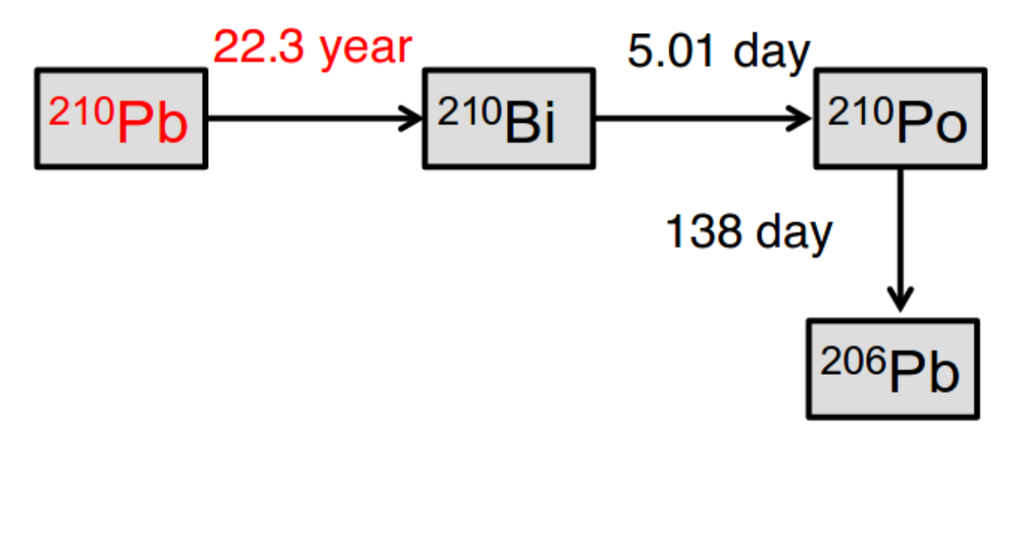
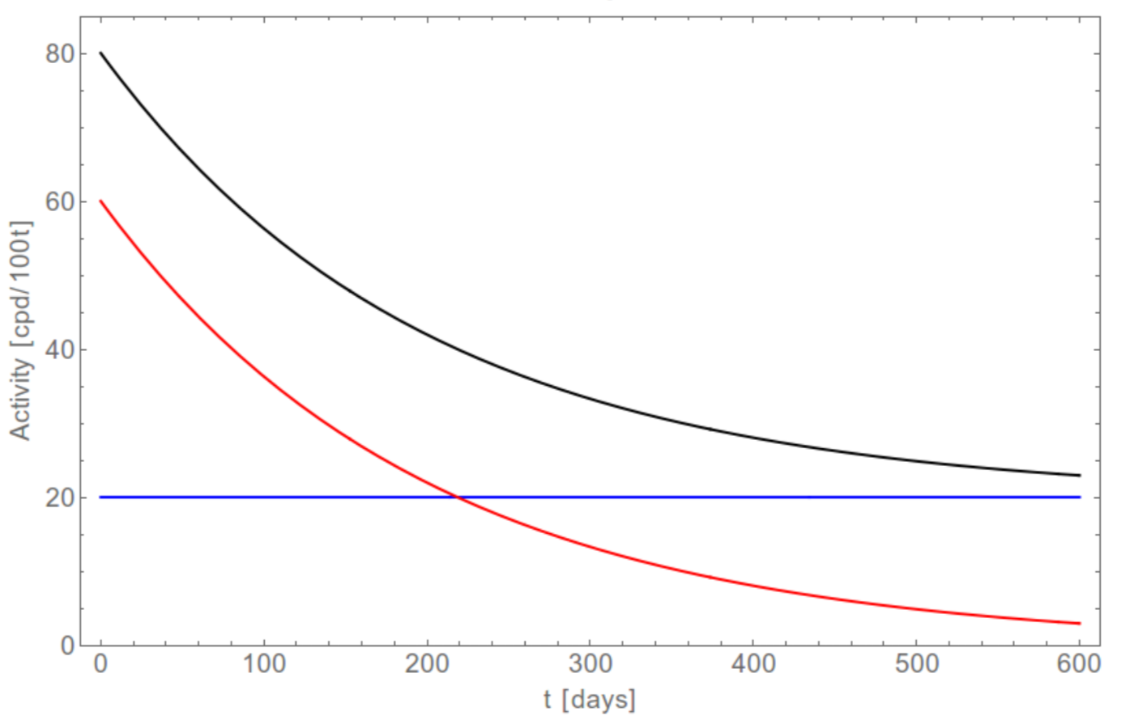
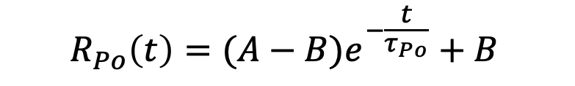
It is possible to infer the ²¹⁰Bi rate studying the 𝝰 particles from ²¹⁰Po.
$$R_{Po}\left(t\right)=(A−B)e^{−\frac{t}{τ_{Po}}}+B$$
– Total rate R_{Po}
– A is Unsupported ²¹⁰Po out of equilibrium
– B ²¹⁰Bi-supported ²¹⁰Po bound to ²¹⁰Bi
In order to determine the ²¹⁰Po rate the contaminants must be homogeneous distributed in the vessel and we have to have no motions of the contaminants (due to convention motions) -> stable temperature

Slide 20
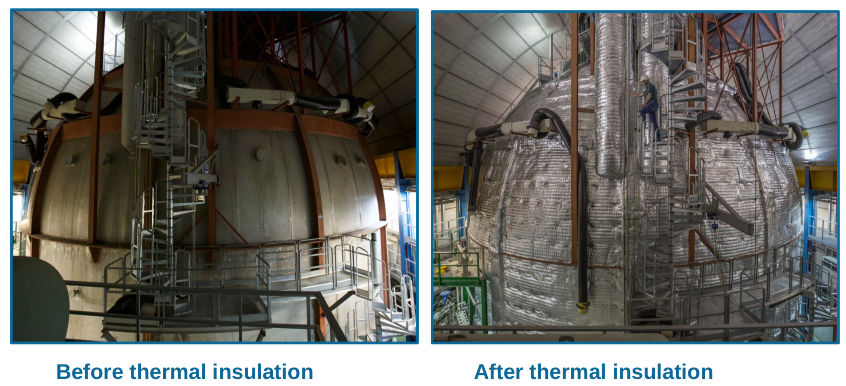
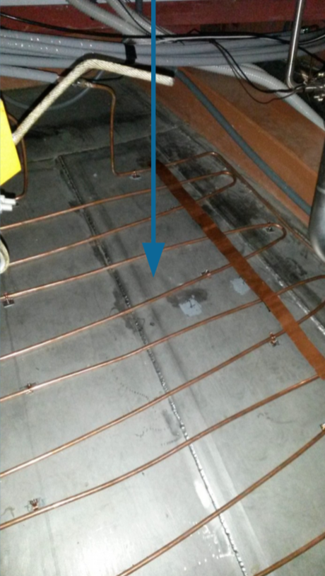
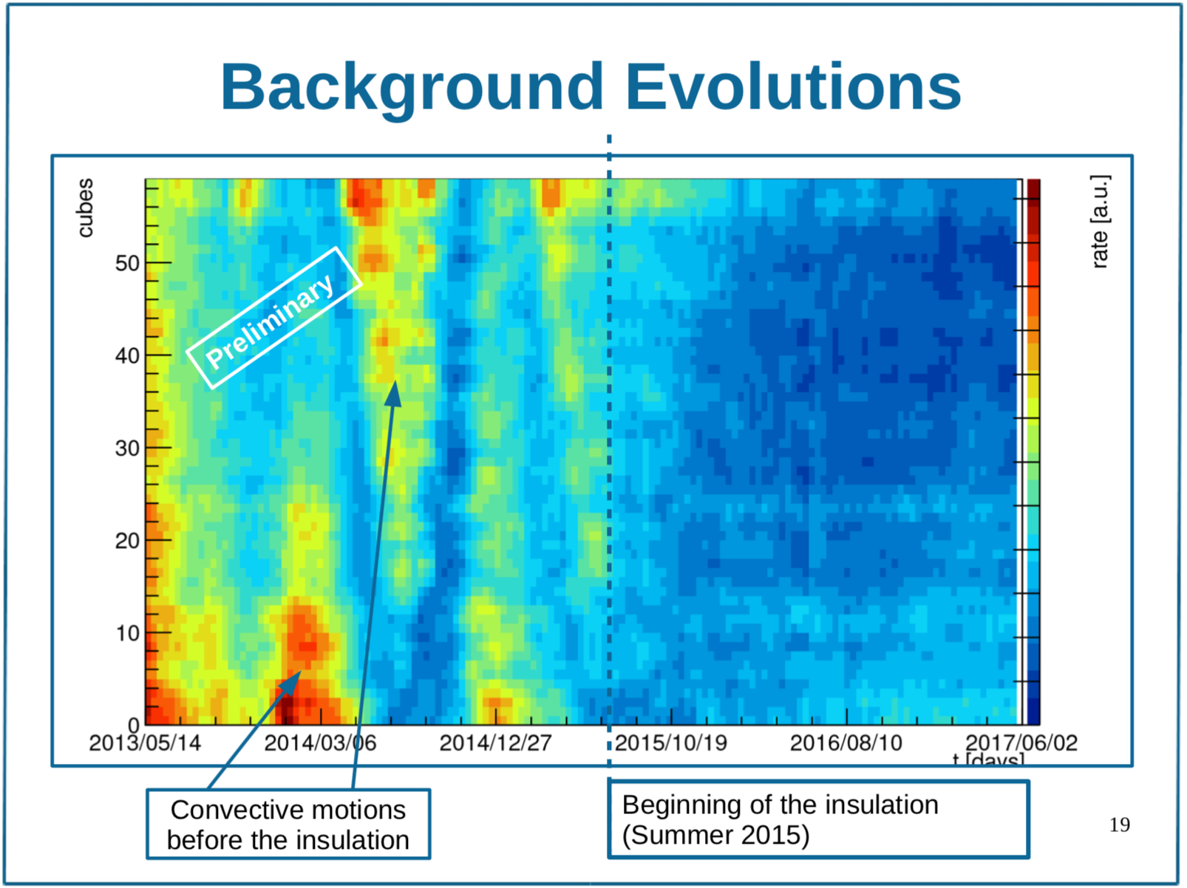
The thermal insulation and temperature active control system
Since the end of 2015 the detector is surrounded by a thick layer of rock wool.
The dome of Borexino is equipped with a water coil able to provide heat for compensating the heat sink from the bottom (rock at ~6°C)
Thanks to a more stable temperature condition the Borexino Collaboration will fix the ²¹⁰Bi rate and will try to extract the CNO neutrino flux.

