Slide 1


20th International Workshop on
Next generation Nucleon Decay
and Neutrino Detectors
University of Medellin (Colombia), November 7-9, 2019.
Status and the perspectives of the
Jiangmen Underground Neutrino Observatory (JUNO)
Lino Miramonti on behalf of the JUNO Collaboration Dipartimento di Fisica, Università̀ degli Studi di Milano & INFN-Sezione di Milano

Slide 2
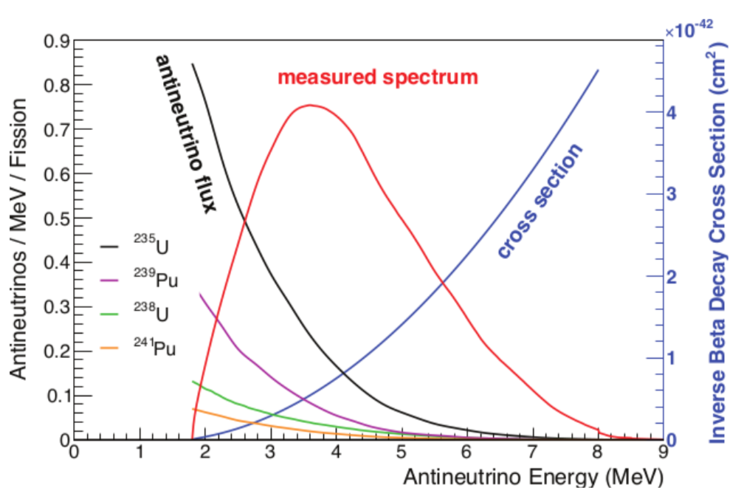
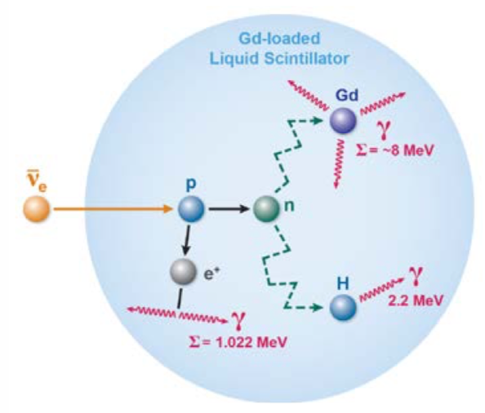
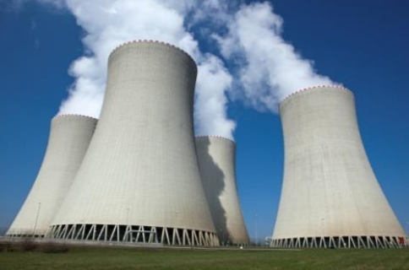
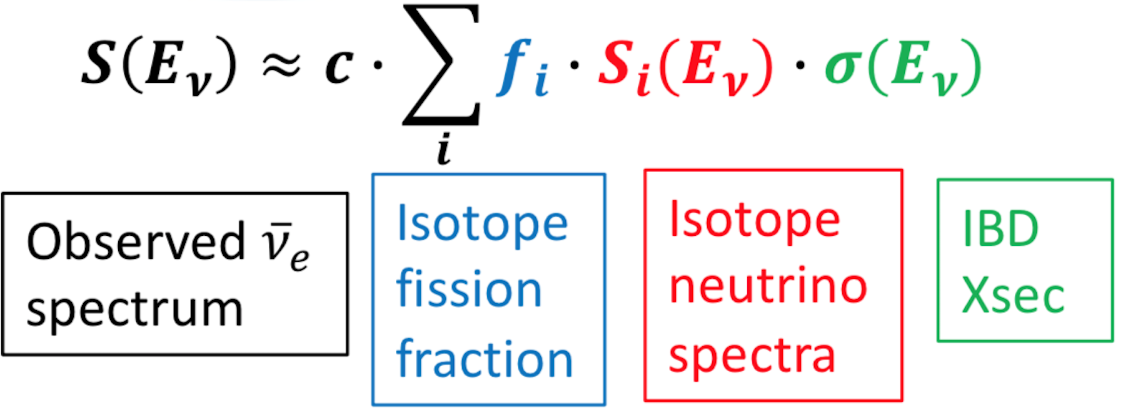
Reactor anti-ν_{e} Production & Detection
Nuclear power plants
are an intense source of electron antineutrinos
Antineutrino are detected through IBD (Inverse Beta Decay)
Coincidence signals to suppress background
Threshold: 1.8 MeV

Slide 3
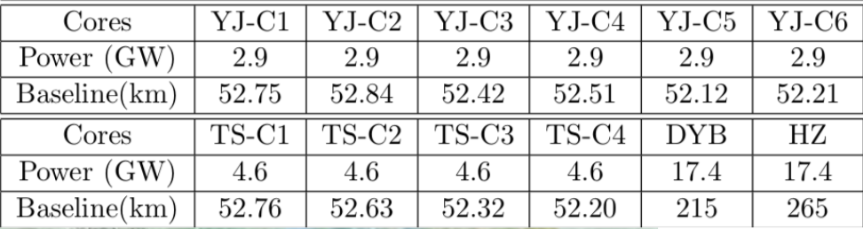
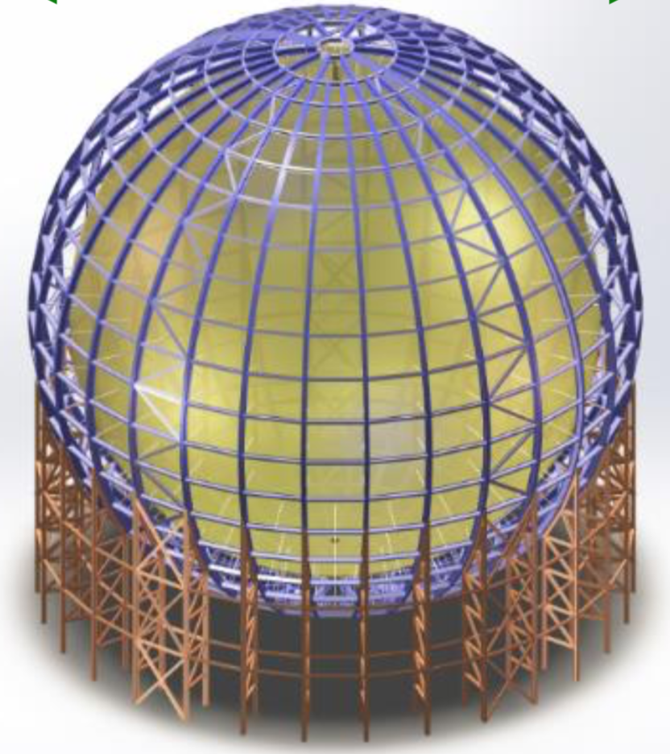
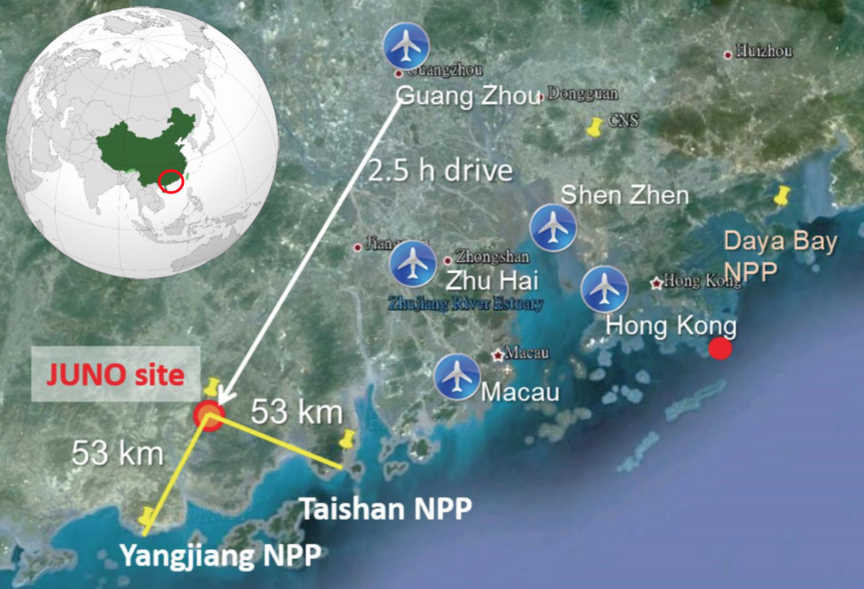
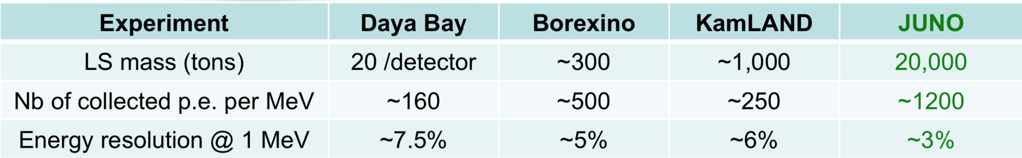
The JUNO Detector
The Jiangmen Underground Neutrino Observatory (JUNO)
will be the largest liquid scintillator detector an it is under construction in China.
∼ 20 ktons of liquid scintillator contained in an Acrylic Sphere of 35.4 m in diameter
∼53 km from two nuclear power plants: Yangjian and Taishan
Total power: 35.8 GW
by 2020: 26.6 GW

Slide 4
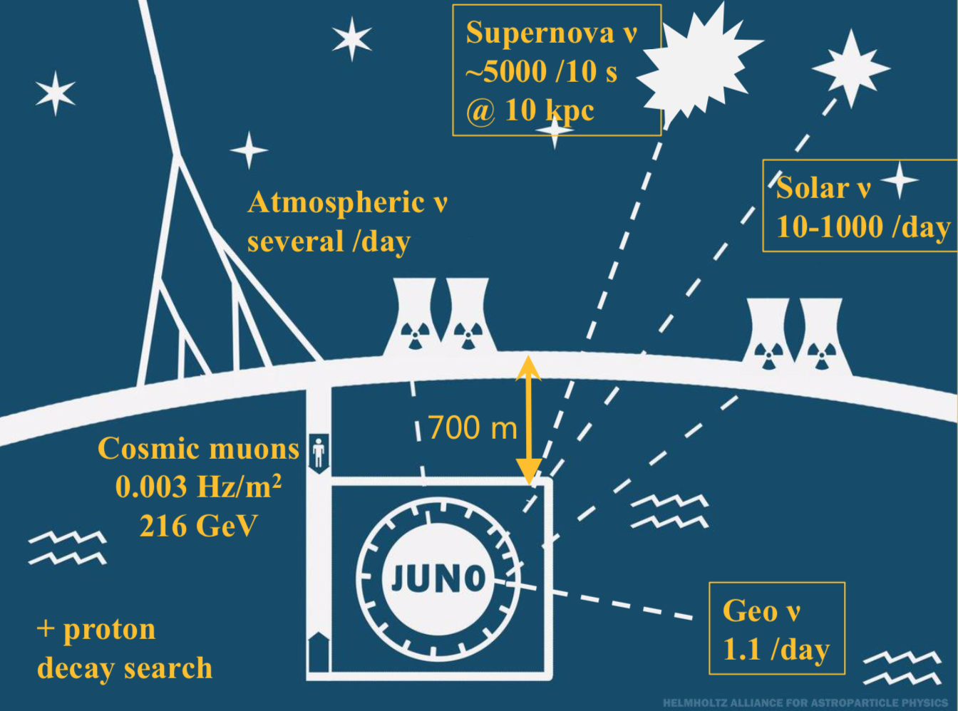
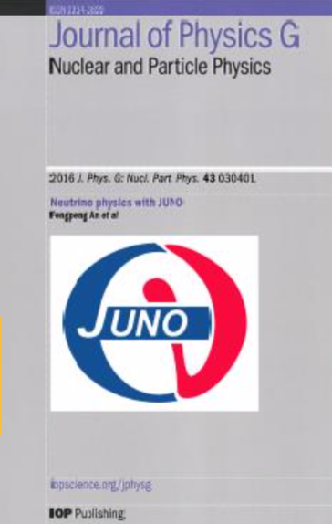
A Multipurpose Neutrino Observatory
…..not only anti-ν_{e} from reactors
Neutrino Physics with JUNO
J. Phys. G 43 (2016) n.3 030401
Reactor ν’s
≈ 60/day (26.6 GW_{th})

Slide 5
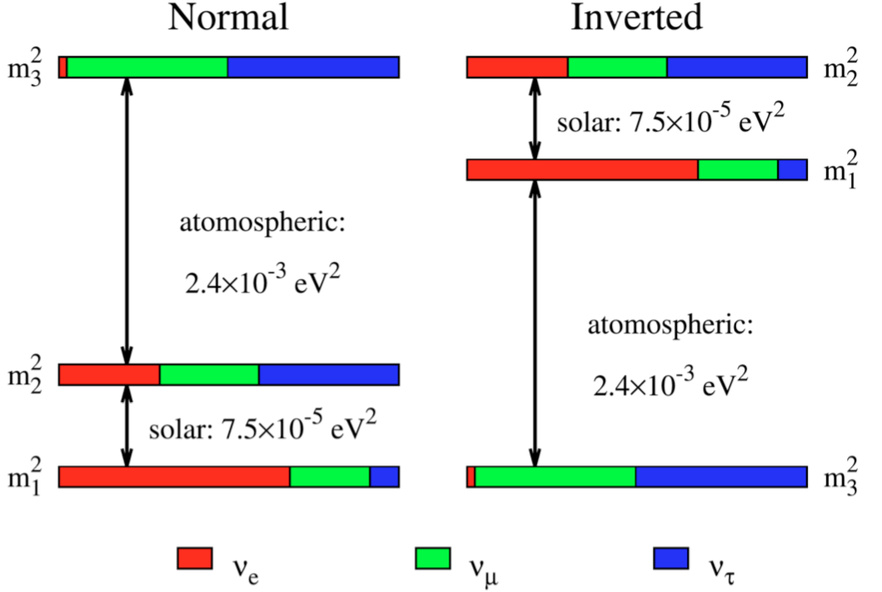
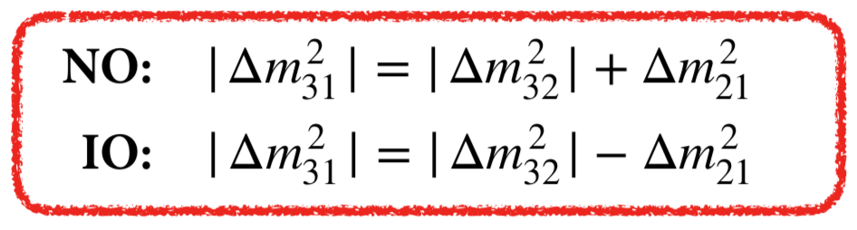
Oscillation Physics with Reactor anti-ν_{e}
Determination of the Neutrino Mass Ordering (NMO)
• ν₁, ν₂, ν₃ defined according to fraction of ν_{e}
• ν₂ is heavier than ν₁ (sun+MSW)
• We do not know if ν₃ is
heavier (Normal Ordering) or
lighter (Inverted Ordering) than ν₂
It is possible to infer the Neutrino Mass Ordering studying the interference effect between the oscillations driven by Δm²_{sol} and Δm²_{atm} using reactor experiments (2002 Petcov and Piai)
Furthermore measuring the Neutrino Mass Ordering enables the study of further unknown parameters in neutrino physics:
Resolving δ_{CP}
Octant of θ₂₃
Parameter space for 0νββ decay

Slide 6
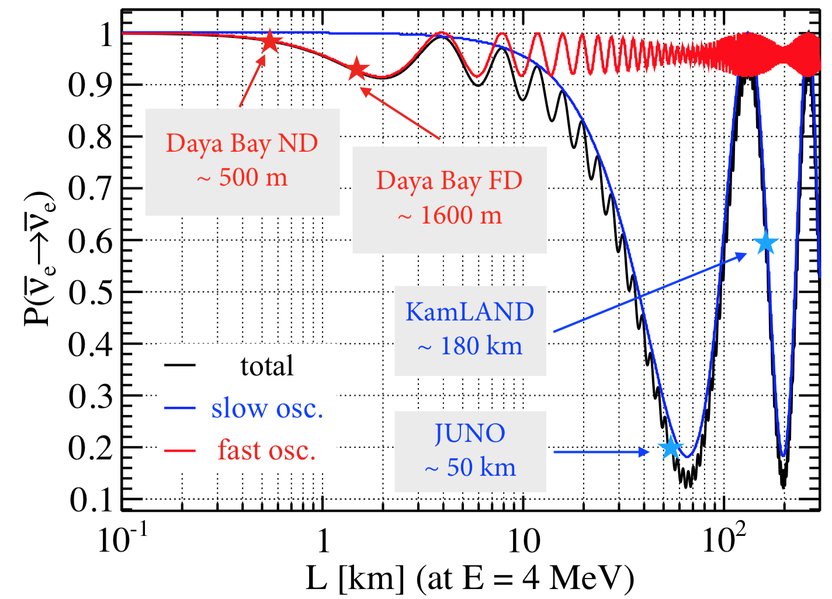
Oscillation Physics with Reactor anti-ν_{e}
Determination of the Neutrino Mass Ordering (NMO)
Electron antineutrino survival probability:
(slow)
(fast)
Solar (slow)
Atmospheric (fast)
Mass ordering is measurable because θ₁₃ is ‘large’.
Best L/E ratio for maximum interference is ~10 km/MeV, i.e. ~50-60 km distance for reactor antineutrinos energy.
JUNO will be the first experiment able to measure simultaneously the fast (Δm²₃₁) and slow (Δm²₂₁) oscillations

Slide 7
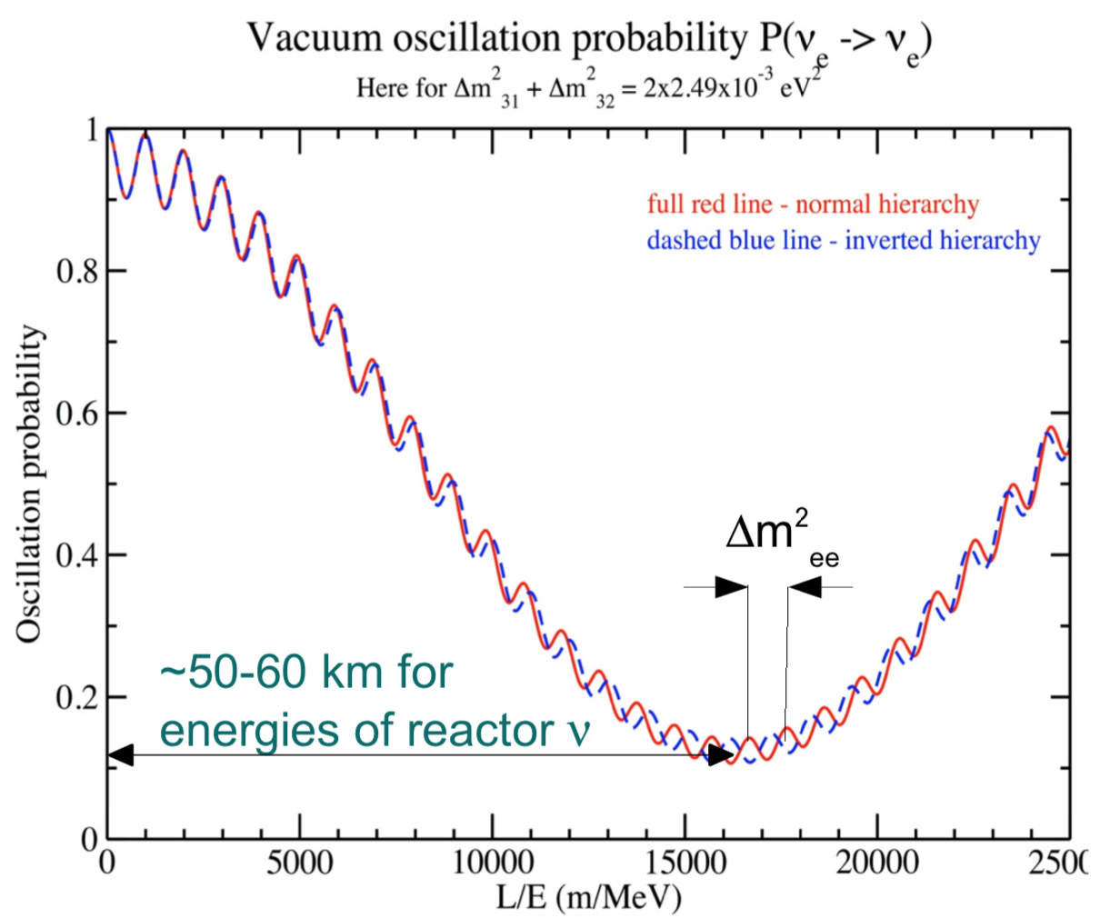
Oscillation Physics with Reactor anti-ν_{e}
Determination of the Neutrino Mass Ordering (NMO)
(slow)
(fast)
Effective neutrino mass-squared difference:
(beat frequency)
$${Δm}_{ee}^{2}=\left(\cos^{2}θ_{12}{Δm}_{31}^{2}+\sin^{2}θ_{12}{Δm}_{32}^{2}\right)$$
Difference between:
Normal Ordering
Inverted Ordering

Slide 8
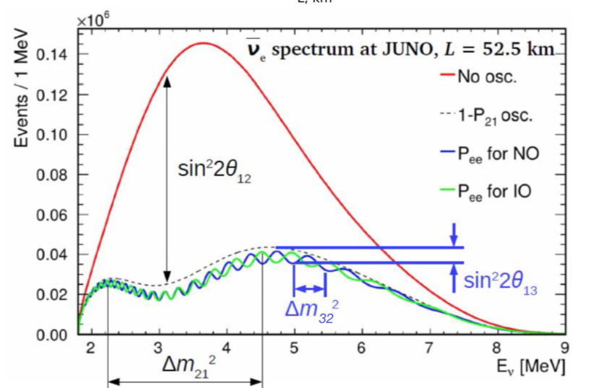
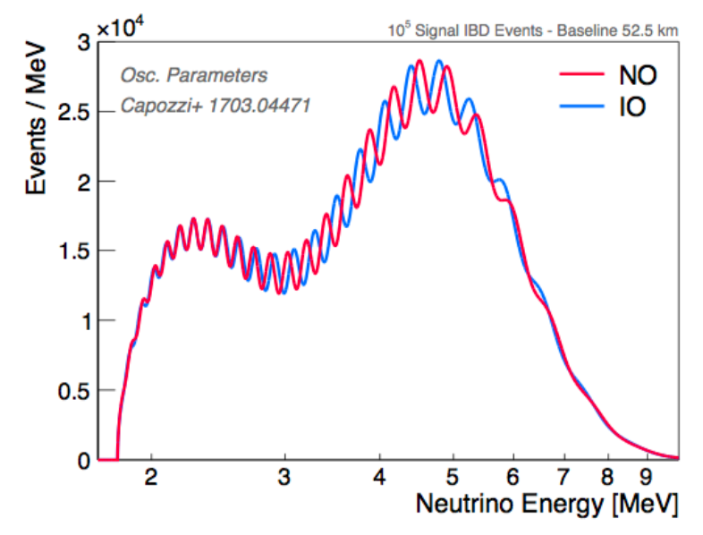
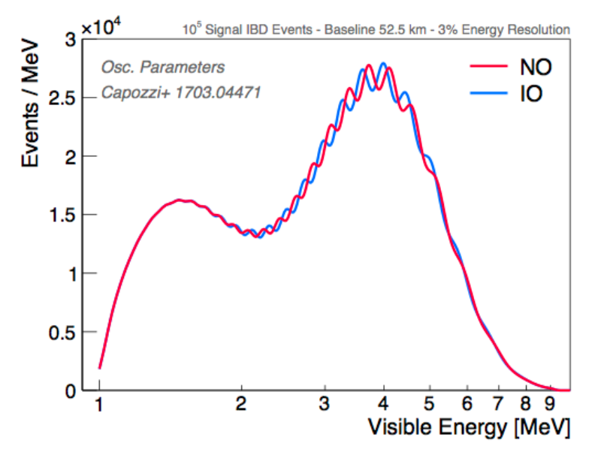
Oscillation Physics with Reactor anti-ν_{e}
Determination of the Neutrino Mass Ordering (NMO)
To distinguish between NO/IO at 3σ, one needs:
at least 100,000 events (nominal luminosity)
an energy resolution of 3%/√E(MeV)
baseline ~53 km with core dispersion <0.5 km
an energy scale uncertainty < 1%
E_{res} 3%/√E(MeV)

Slide 9
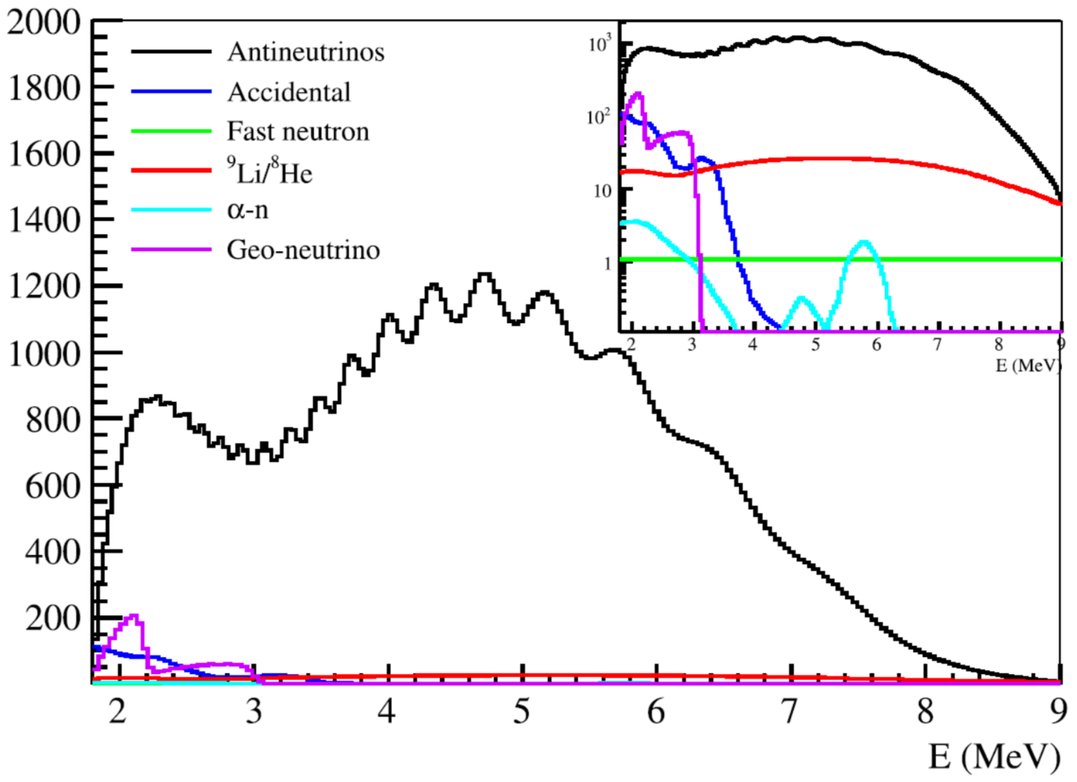
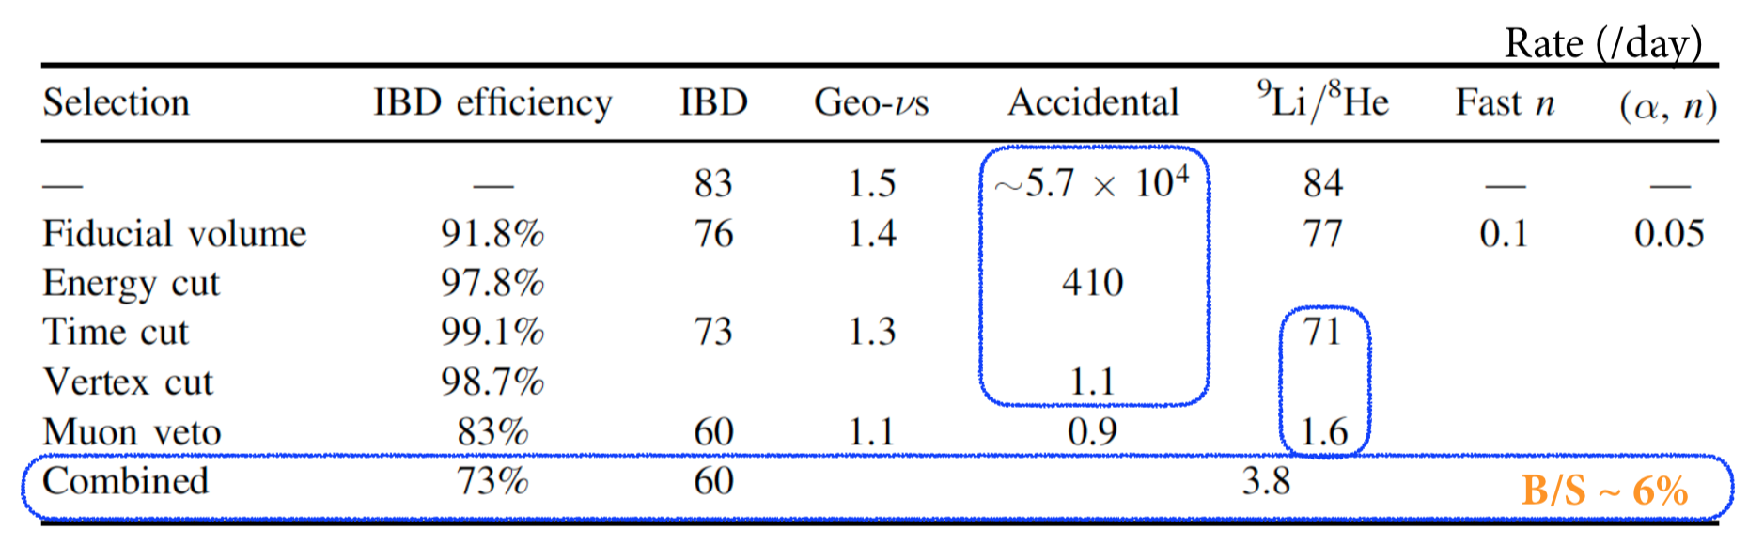
Oscillation Physics with Reactor anti-ν_{e}
Signal vs. Backgrounds
Backgrounds
• Uncorrelated
- Accidental: (radioactivity, radioactivity), (radioactivity, cosmogenic isotope), (radioactivity, spallation neutrons)
• Correlated
- ⁸He/⁹Li: muon-induced isotopes, β − n decays
- Fast neutron: cosmic muons passing surrounded rock, non-tagged
- ¹³C(α, n)¹⁶O: U/Th-chain radioactivities
- Geo-νs: U/Th antineutrinos from the earth
Antineutrino selection criteria
• fiducial volume cut r < 17 m;
• prompt energy cut 0.7 MeV <E_{p}< 12 MeV;
• delayed energy cut 1.9 MeV <E_{d}< 2.5 MeV;
• time cut between the prompt and delayed signal ΔT_{p-d} < 1.0 ms;
• distance cut between the prompt and delayed signal R_{p-d} < 1.5 m;
• Muon veto.

Slide 10
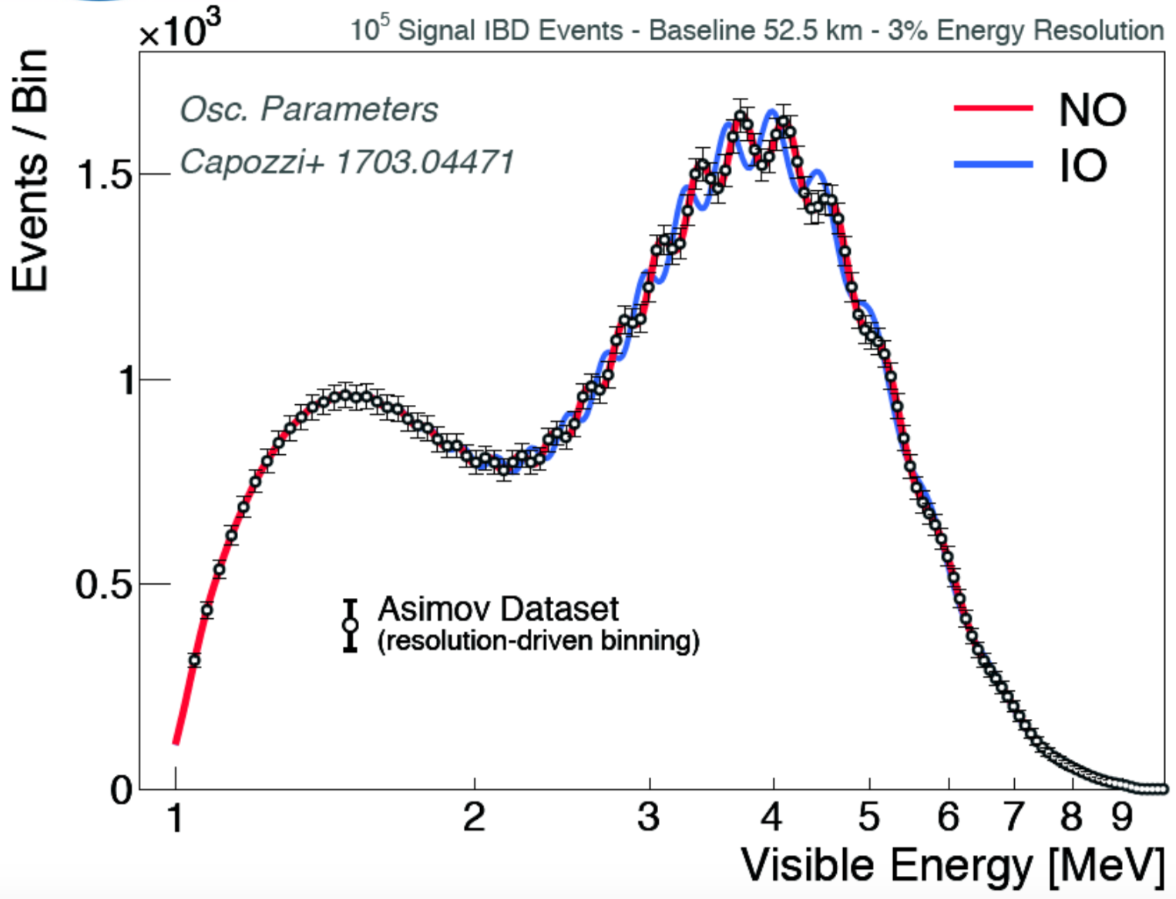
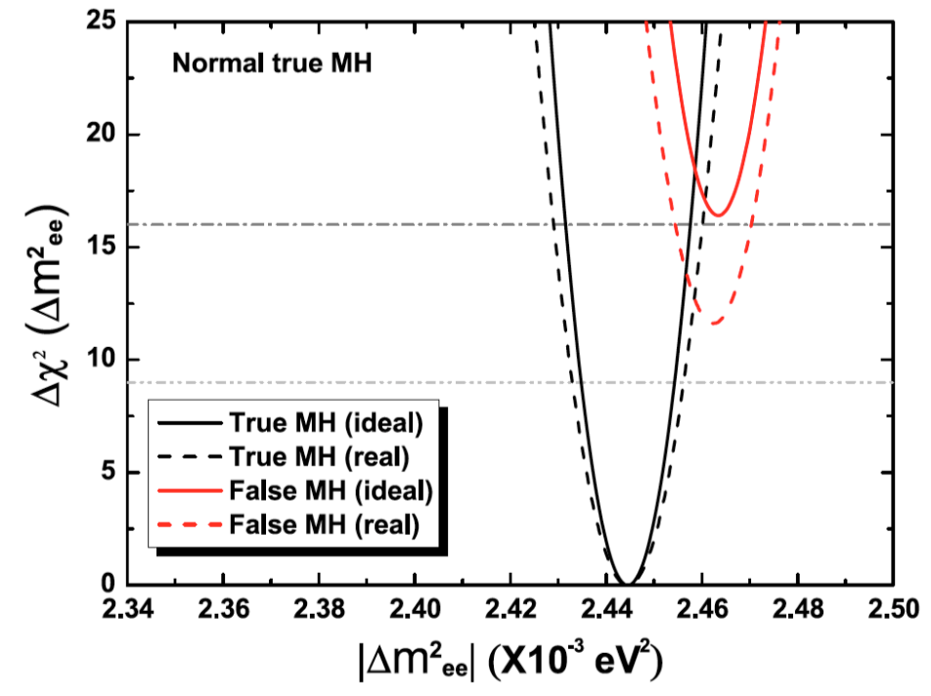
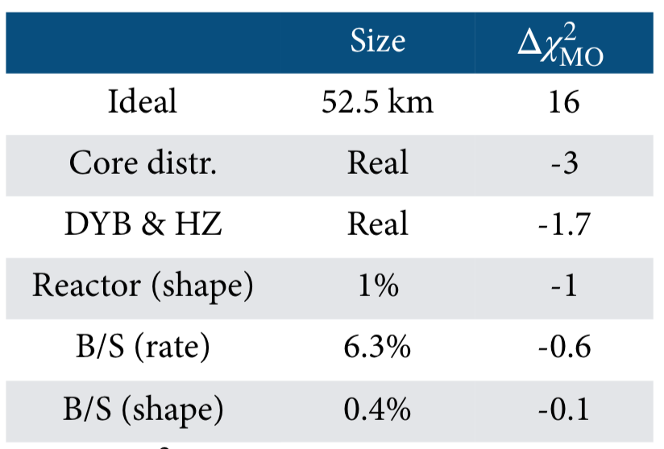

Oscillation Physics with Reactor anti-ν_{e}
Sensitivity to NMO determination
Systematics induced by:
● Distribution of reactor cores
● Energy resolution
● Energy linearity
● ...
Sensitivity estimation
In order to determine the NMO we fit data against both models
Assume NO as true Mass Ordering, and fit the spectrum with false and true Mass Ordering cases respectively, to get:
$${Δχ}_{MO}^{2}=\left|χ_{min}^{2}(N)−χ_{min}^{2}(I)\right|$$
degradation from real reactor core distribution

Slide 11
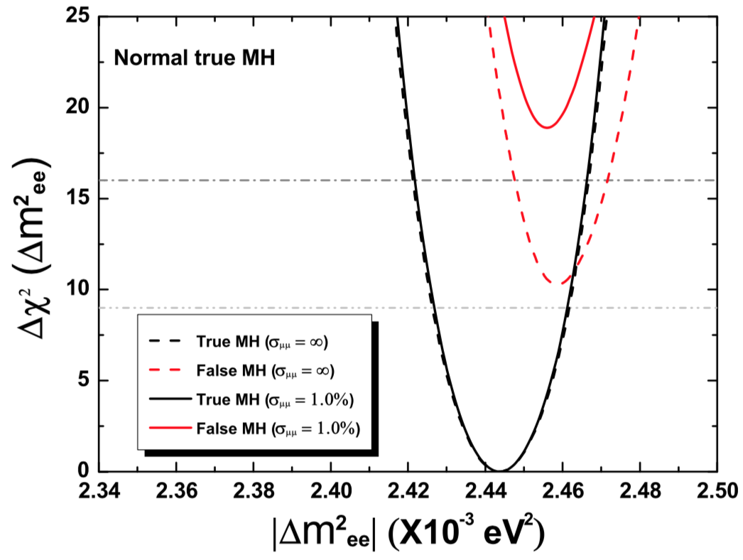

Oscillation Physics with Reactor anti-ν_{e}
Sensitivity to NMO determination
Total degradation: ∼9.6
External constraints
Sensitivity can be improved from from long baseline experiments
if we combine T2K+NOvA (assuming a precision ~1%) with JUNO the sensitivity improves to 4σ.
$${Δm}_{atm}^{2}$$

Slide 12
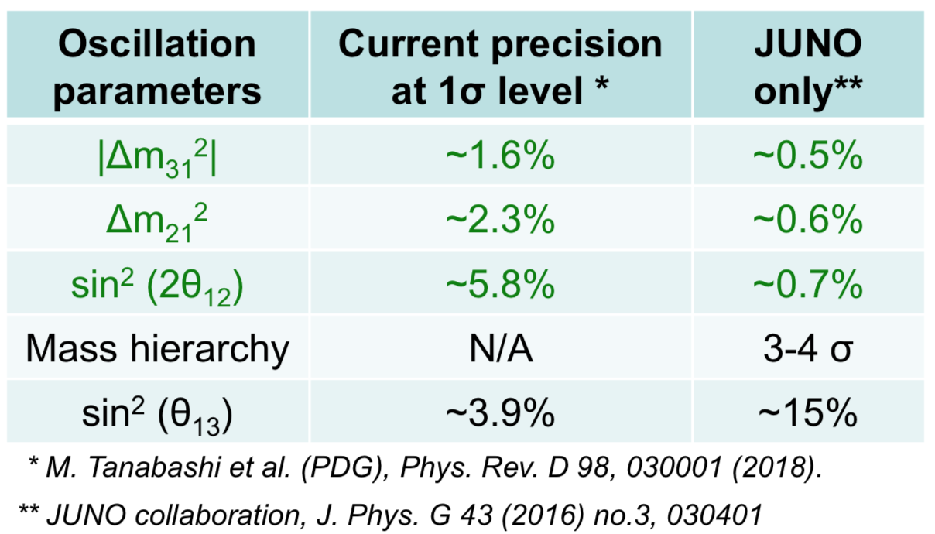
Oscillation Physics with Reactor anti-ν_{e}
Precision measurement of neutrino oscillation parameters
JUNO will measure the 3 Oscillation parameters at a subpercent precision level
In particular the solar oscillation parameters [Δm²₂₁ and sin²(2θ₁₂)] in order to solve the tension between solar ν_{e} and KamLAND results

Slide 13
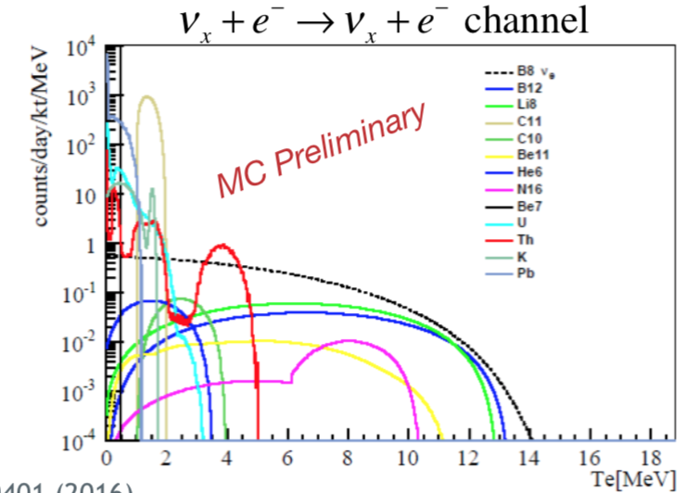
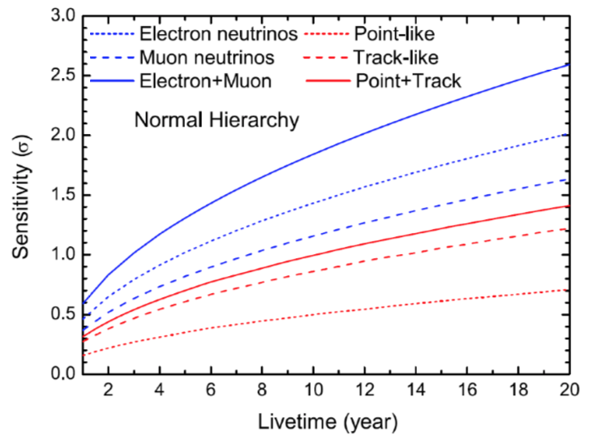
Solar & Atmospheric Neutrinos
JUNO will measure ⁷Be and ⁸B Solar Neutrinos
10-1000 solar ν_{e}/day
Study the Solar Metallicity Problem
(i.e. High Z vs. Low Z version of the SSM)
Studying Atmospheric Neutrinos it will be possible to measure independently the NMO via matter effect - Complementary information to that from other experiments (e.g. IceCube).
Measurement of the θ₂₃ at 6° level

Slide 14
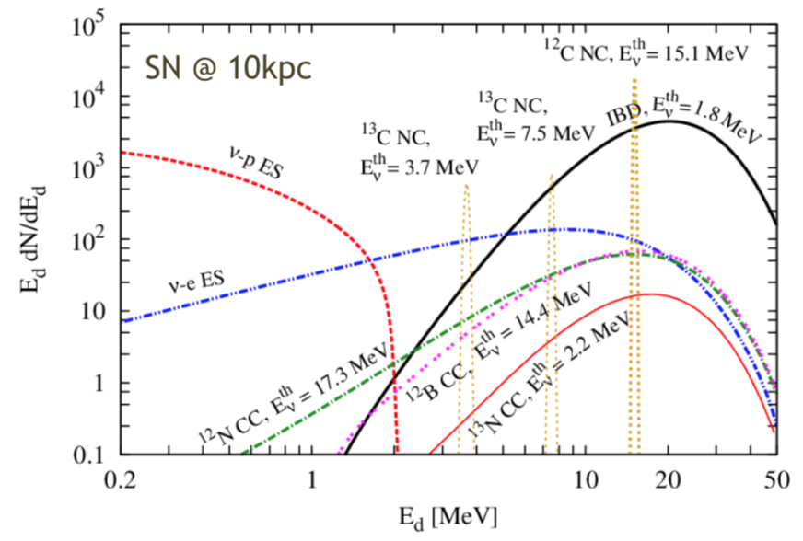
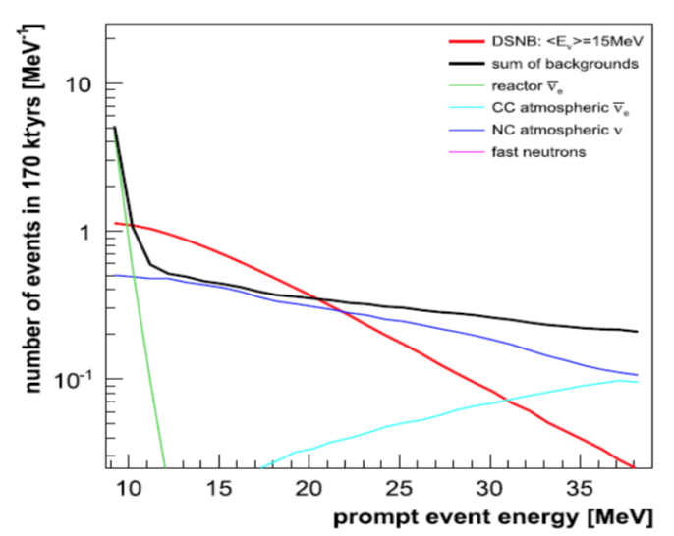
Supernovae Neutrinos & DSNB
JUNO will be able to determine the
flavor content
energy spectrum
time evolution
of SuperNovae burst neutrinos
10⁴ detected events (5000 IBD’s) for a SN at 10 kpc
Low threshold ~ 200 keV or even lower with the multi-messanger trigger.
Complementary to other detectors with unique contribution (e.g.ν_{x} from ν-p ES channel)
JUNO will be also sensitive to diffuse SN neutrino background (DSNB)
Expected detection significance of ~3σ after 10 years of data
Provide leading constraint if DSNB is not observed

Slide 15
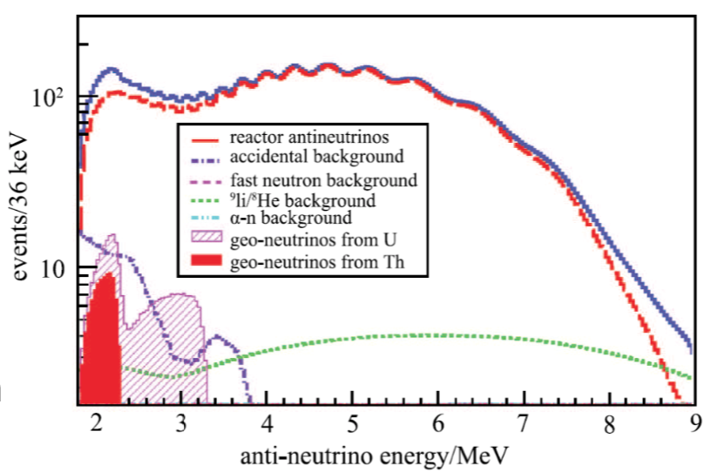
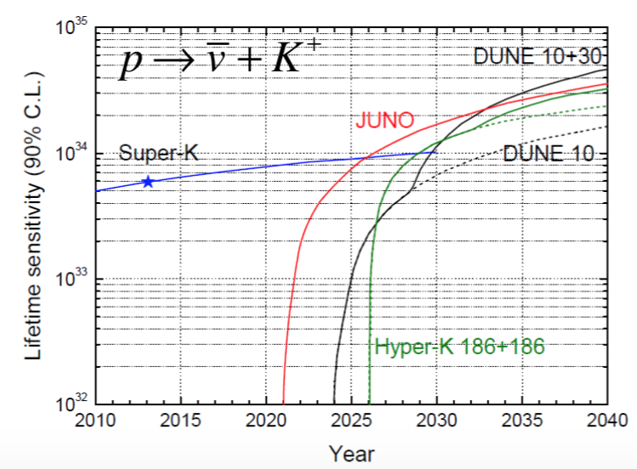
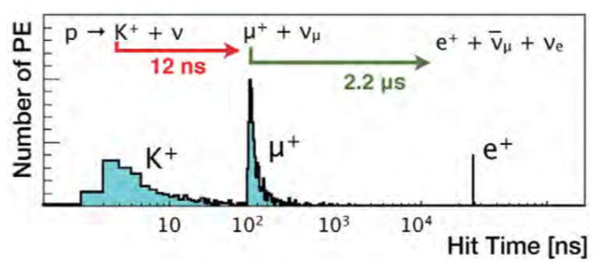
Geoneutrinos & Nucleon Decay
JUNO will detects 400-500 geoneutrinos per year
With a precision of:
~13% in 1 year
~5% in 10 years
The local crust model is under development by interdisciplinary team
JUNO will have a competitive sensitivity to
proton decay searches. In particular the channel
Triple coincidence in liquid scintillator

Slide 16
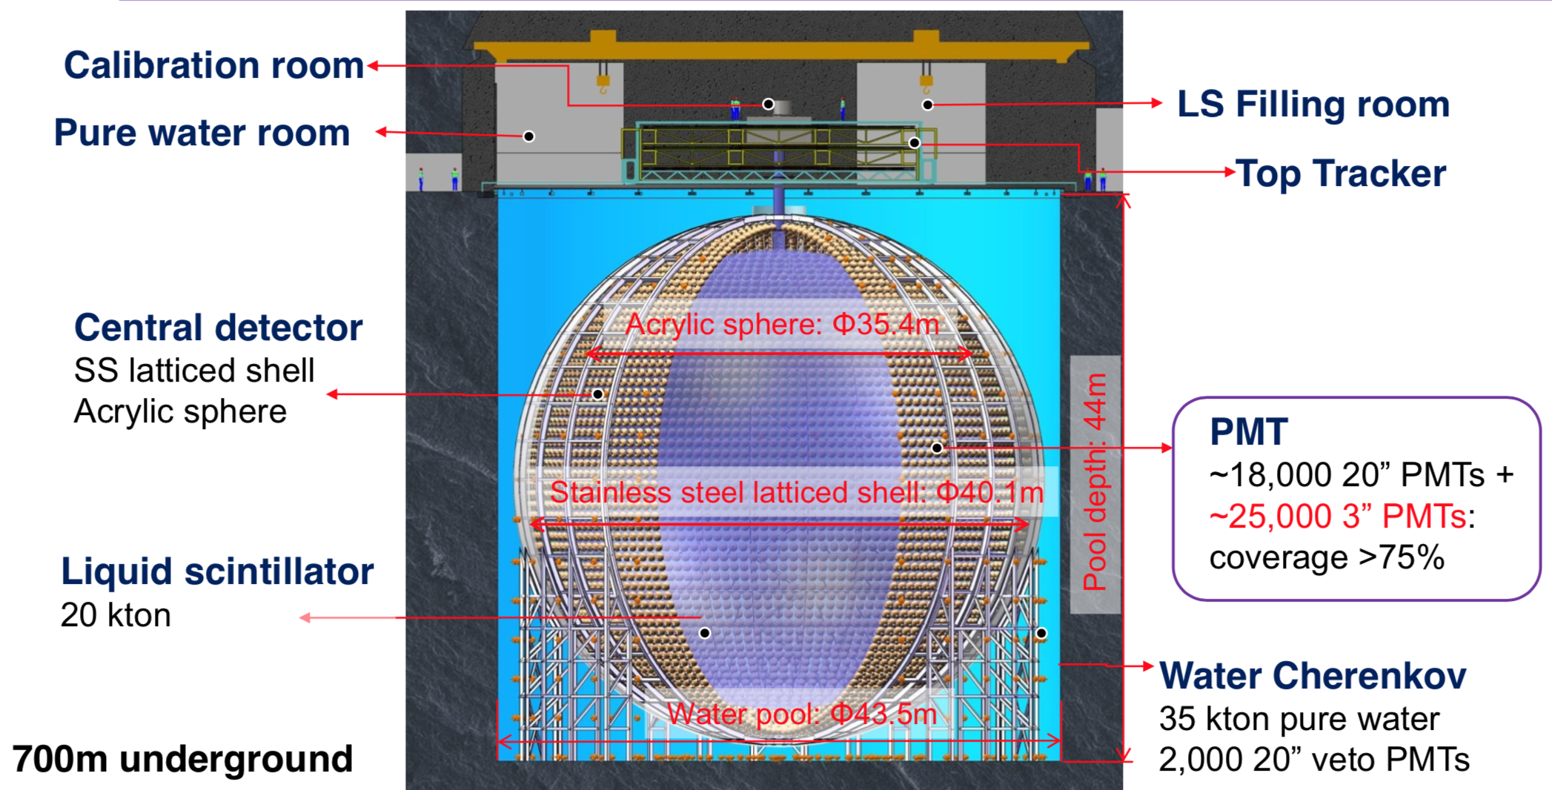
JUNO Detector Concept
Central Detector
Acrylic Sphere
Stainless Steel Shell
Cylindrical Water Pull
35 kton pure water
∼2000 20” veto PMTs
700 m underground

Slide 17
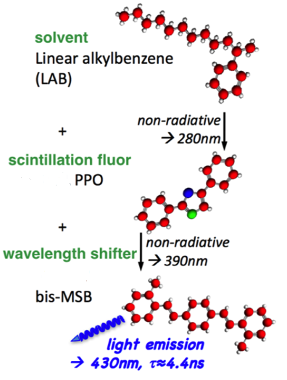
JUNO Liquid Scintillator
Composition:
LAB
PPO (2.5 g/l)
bis-MSB (3 mg/l)
(60 ton of PPO and 72 kg of bis-MSB needed in total)
Requirements:
High light yield (10⁴ photons/MeV)
Attenuation length: > 20 m @ 430 nm
Good radiopurity:
²³⁸U/²³²Th < 10⁻¹⁵ g/g, ⁴⁰K < 10⁻¹⁶ g/g.
Purification:
Distillation (remove heavy metals and increase transparency)
Filtration with Al₂O₃ column purification (remove impurities and increase attenuation length)
Water extraction (remove U/Th/K)
Gas stripping (remove Ar/Kr/Rn)
LS & purification are being tested in a Daya Bay detector

Slide 18
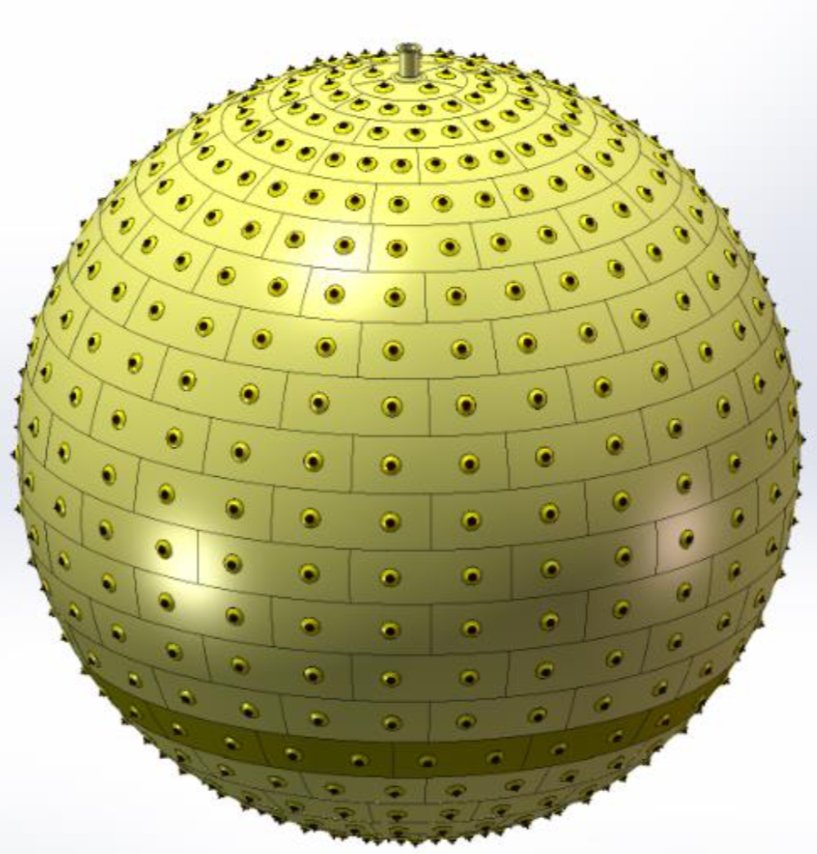
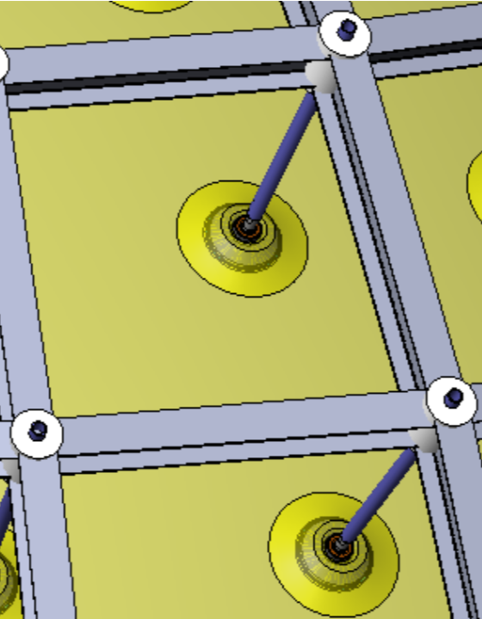
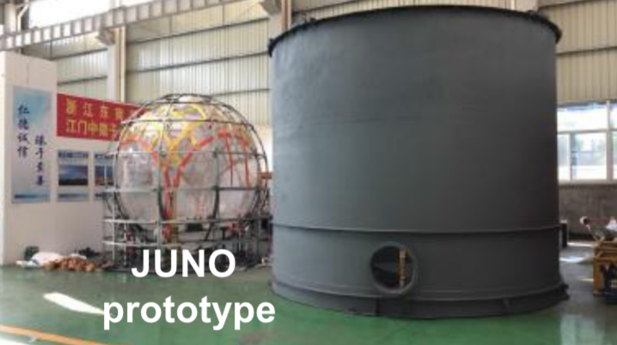
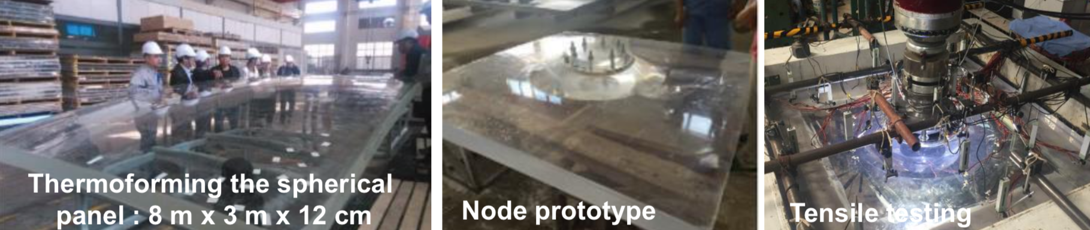
JUNO Acrylic and CD Prototype
The Central Detector is composed by 260 acrylic panels with 12 cm thickness (total weight of ~600 tons)
A JUNO 1:12 prototype has been successfully built at IHEP !

Slide 19
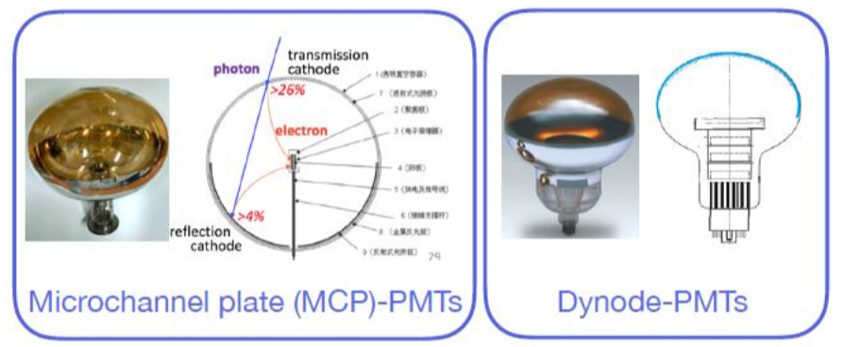
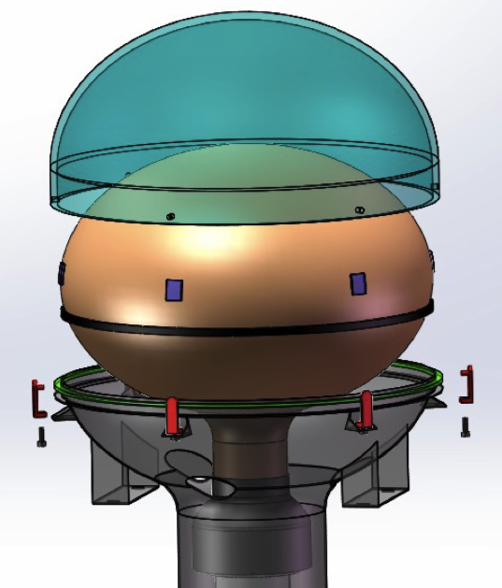
Photodetection System - Large PMT System
JUNO will use 2 types of large 20-inch PMTs as its main photodetection system
15000 MCP-PMTs from NNVT (Northern Night Vision Technology)
5000 dynode-PMTs from Hamamatsu (R12860 HQE)
All PMTs are equipped with an implosion protection cover.
In production since 2016
PMT testing:
Finished for the 5000 dynode PMTs
∼10000 MCP-PMTs already tested

Slide 20
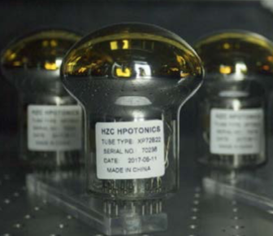
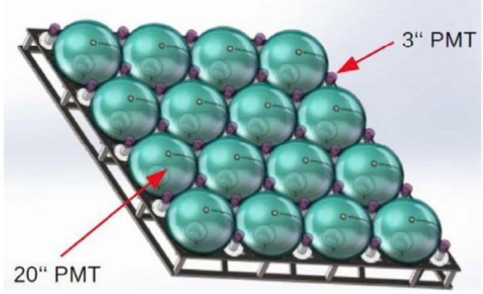
Photodetection System - Small PMT System
JUNO will also have to control the non-stochastic term of the energy resolution at an unprecedented level below ( <1% )
JUNO will use also 3-inch PMTs as a complementary photodetection system in order to
improve the control of systematics
increase the dynamic range
Helps with large signals
(e.g. muons, supernova)
They will be operate in photon-counting mode.
25600 PMTs from HZC Photonics (Hainan, PR China) 2.5% coverage
JUNO custom design: XP72B22
QE 24%, Peak / Valley 3.0, TTS 2-5 ns
21000 already produced and in great part tested.
Arrangement of large and small PMTs

Slide 21
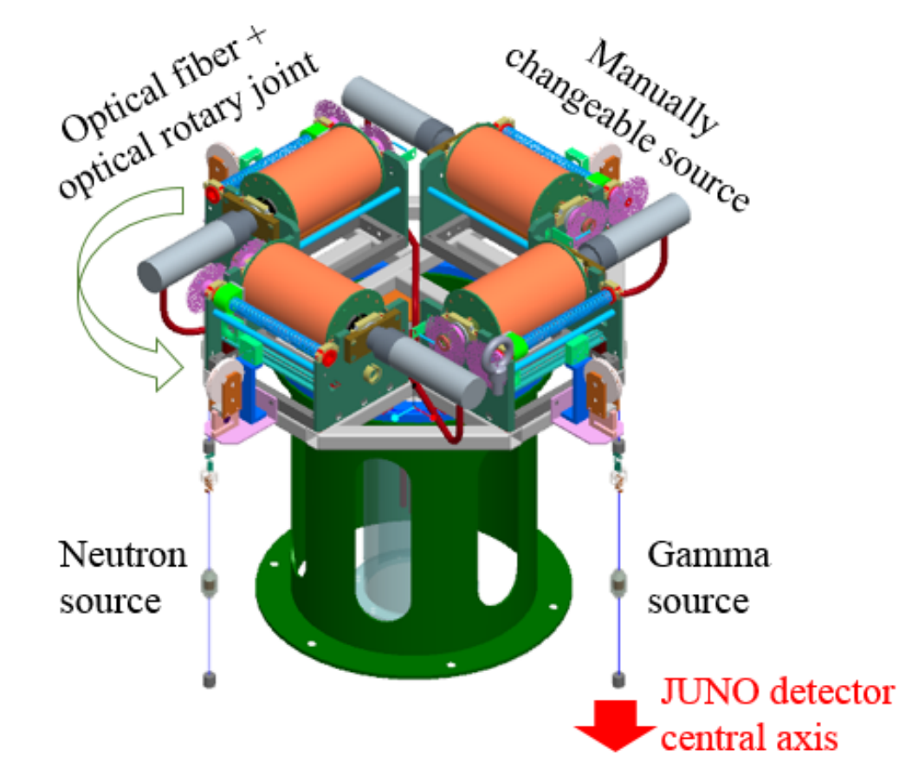
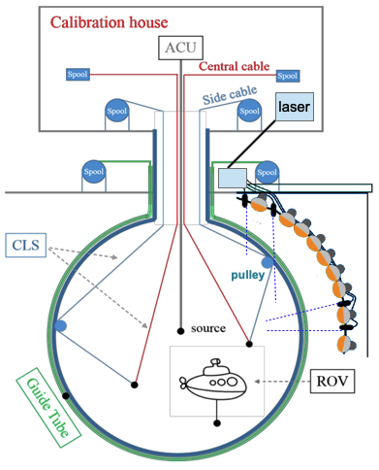
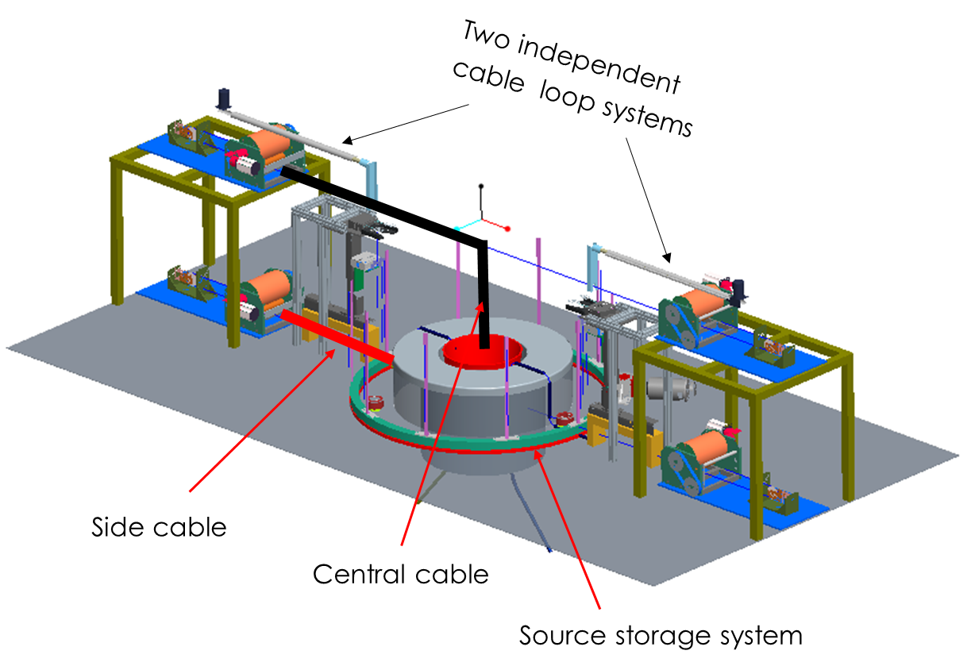
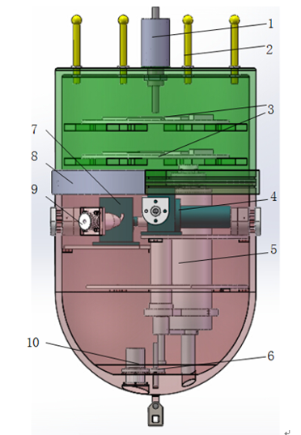
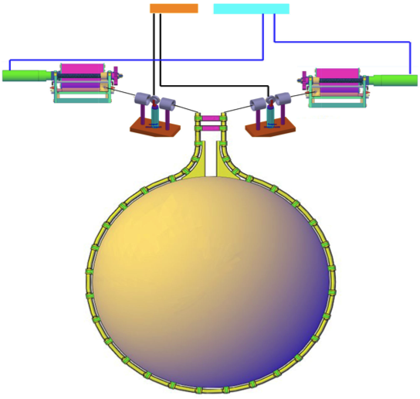
In order to obtain:
Energy Resolution 3% @ 1MeV
Energy Scale Uncertainty < 1%
JUNO has developed 4 complementary calibration systems
Calibration Systems
Overview of JUNO‘s Calibration Systems
(including LASER calibration system)
Automatic Calibration Unit
ACU
Cable Loop System CLS
LASER
Remotely Operated Vehicle
ROV
Guide Tube System

Slide 22
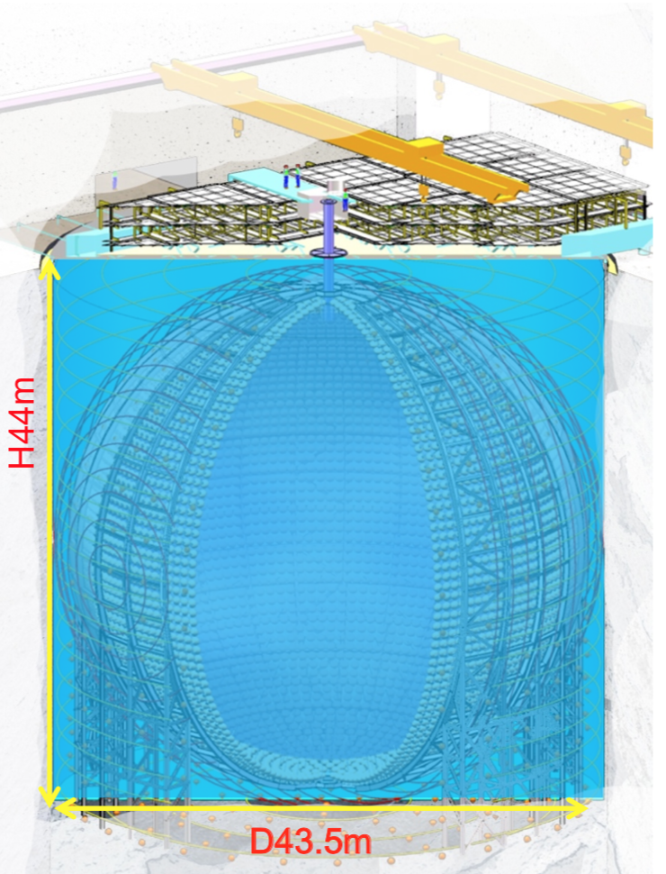
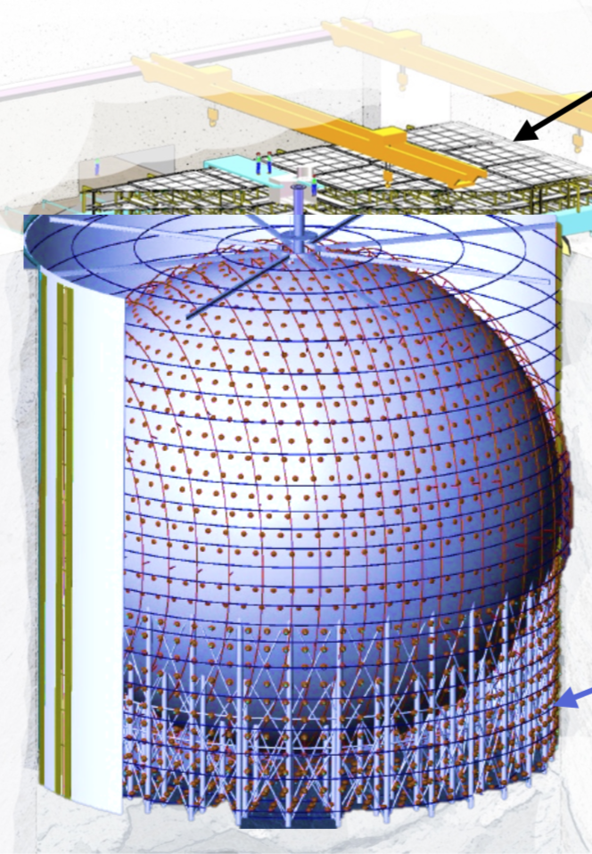
Muon Veto System
The acrylic sphere will be immersed in a cylindrical water pool containing 35 kton ultrapure water instrumented with 2400 20-inch PMTs
Double- purpose:
Shield central detector against radioactivity from rock and neutrons from cosmic rays
Veto cosmic-ray muons (most backgrounds are of cosmic ray origin)
The muon veto system will also have a top tracker composed by 3-layers of plastic scintillators.
Detection efficiency > 95%
There will also be a compensation magnetic field (EMF) shielding system

Slide 23
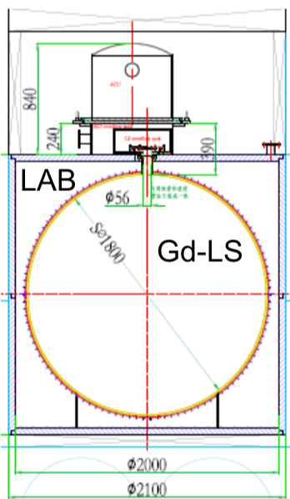
JUNO-TAO
See Wang Wei talk
Reactor shape uncertainties
“Standard” reactor shape uncertainties have minor impact on the MO sensitivity
But reactor spectrum might have not yet observed micro-structures
These micro-structures degrade the MO sensitivity by mimicking periodic oscillation pattern
→ reference detector needed for JUNO
Taishan Antineutrino Observatory (TAO) has several physics motivation:
• To measure precisely the 4-6 MeV bump and the fine structure of reactor antineutrino spectrum with unprecedented energy resolution.
• Provide a benchmark for investigation of nuclear database
• Measure antineutrino spectra from ²³⁵U and ²³⁹Pu
• Search for sterile neutrino with good vertex reconstruction capability
JUNO-TAO detector design
1 ton fiducial volume Gd-LS detector at 30 m from core
Full coverage 10 m² SiPM with 50% PDE operated at -50°C
Energy resolution of 1.7%/√E(MeV)

Slide 24
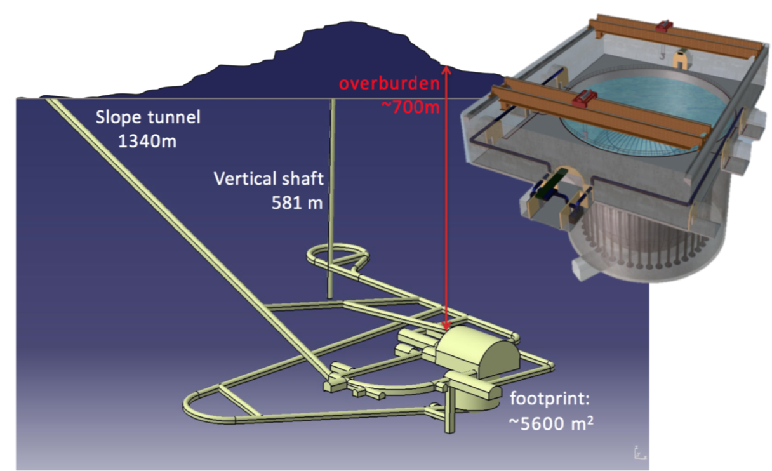



Civil Construction
Since 2015 a new underground laboratory with a 700 m overburden and infrastructure at the surface is under construction

Slide 25

Timeline

Slide 26


