Slide 1
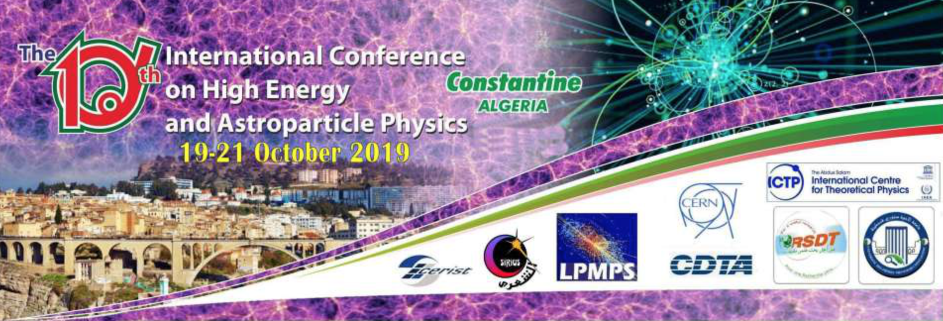
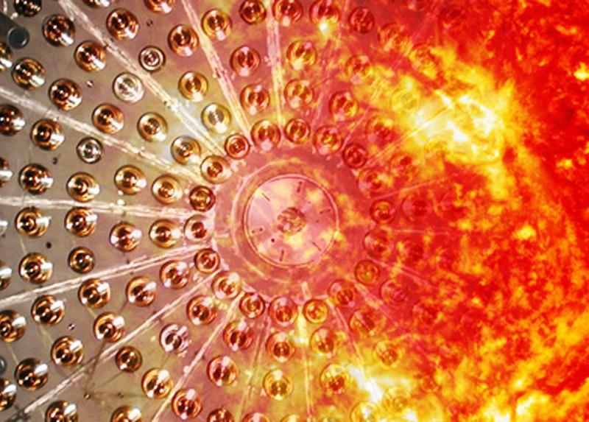


Solar neutrino results and future prospects with the Borexino detector
Lino Miramonti on behalf of the Borexino Collaboration Dipartimento di Fisica, Università̀ degli Studi di Milano & INFN-Sezione di Milano

Slide 2
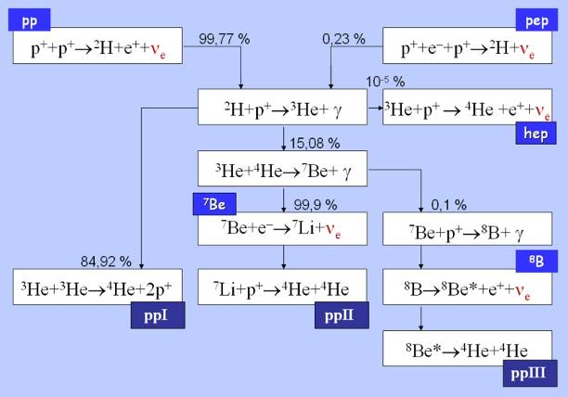
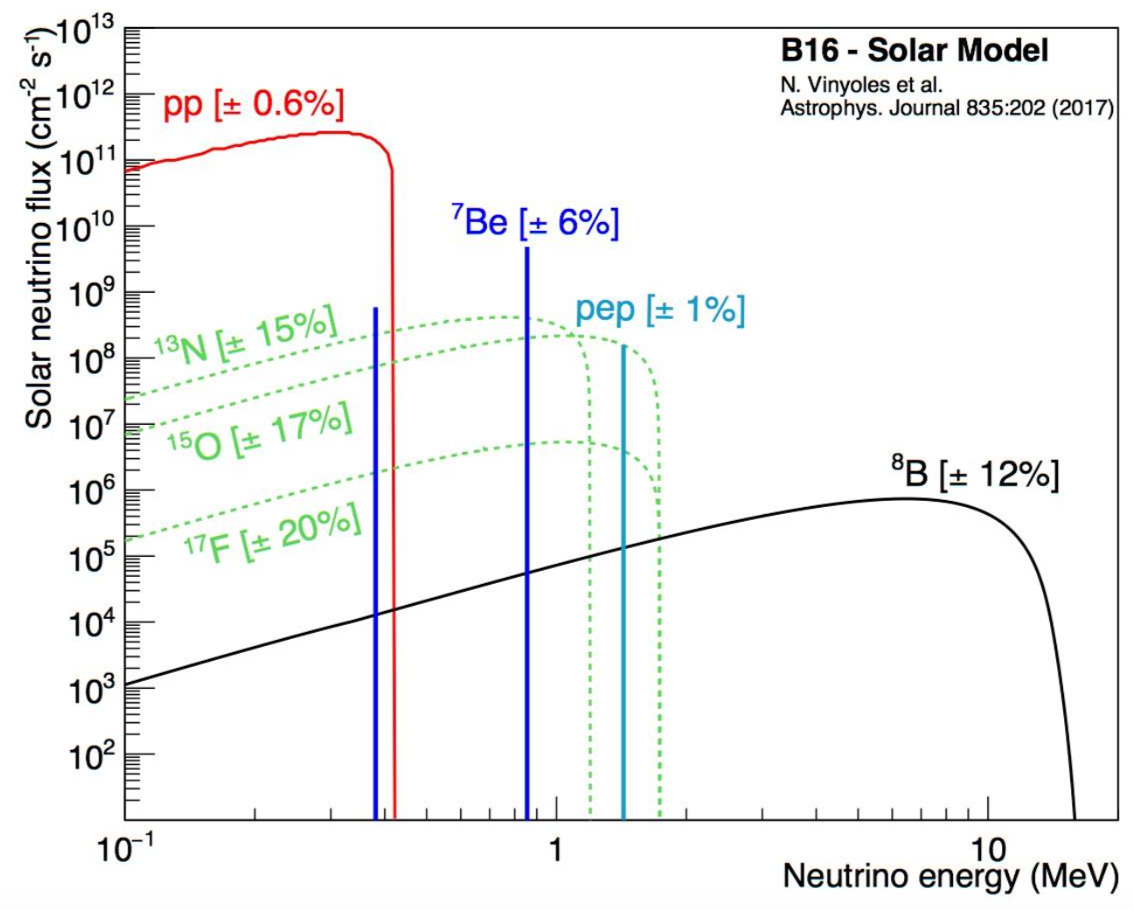
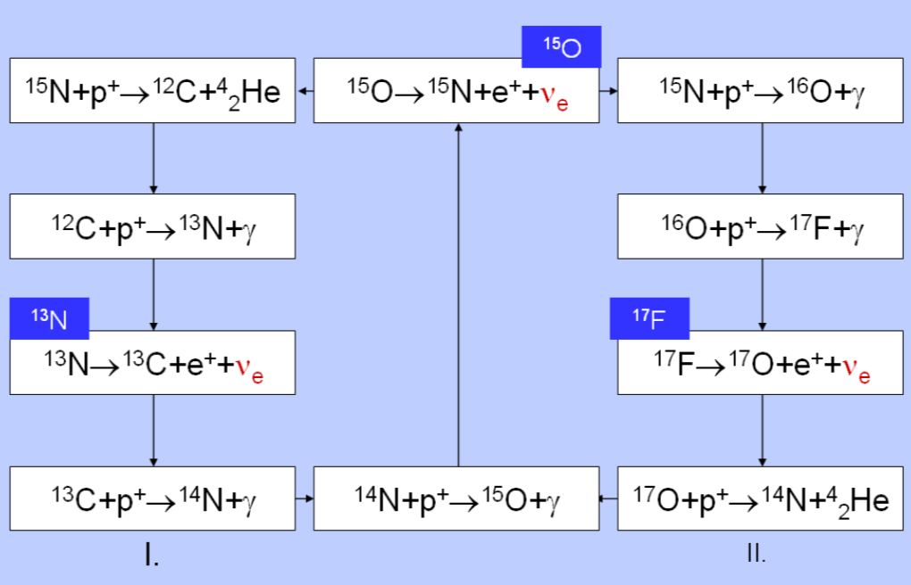
Solar neutrinos fluxes
ν_{e} are copiously produced by thermonuclear processes that power the Sun and the others stars
The motivation of the first experiments on solar ν was to test the Standard Solar Model (SSM)
pp chain 99 % of Sun Energy
ν from:
pp
pep
⁷Be
⁸B
hep
expected ν fluxes from the SSM
flux to low to be detected in current experiments
CNO cycle <1 % of Sun Energy
ν from:
¹³N
¹⁵O
¹⁷F
CNO

Slide 3
How to detect Solar Neutrinos?
There are 2 possible ways to detect solar neutrinos:
radiochemical experiments
real time experiments
In radiochemical experiments people uses isotopes which, once interacted with an electron neutrino, produce radioactive isotopes.
In real time experiments people detect the light created from the electron scattered by the impinging neutrinos

Slide 4
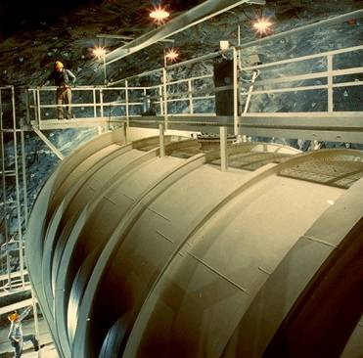
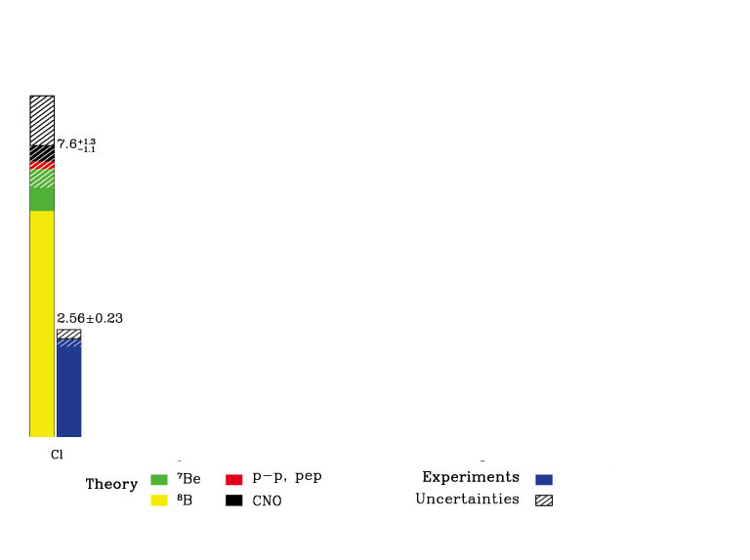
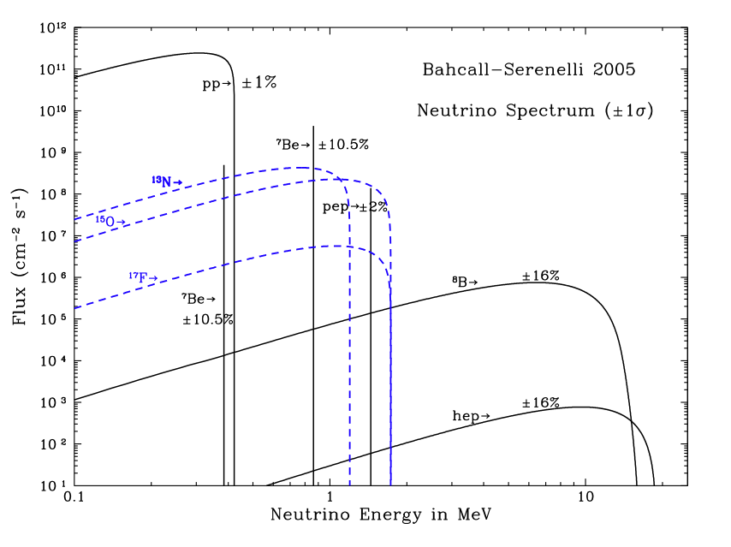
The rise of Solar Neutrino Problem
(middle ‘60):
Homestake (Cl)
Large tank of 615 tons of liquid containing ³⁷Cl.
ν_{e}+ ³⁷Cl → ³⁷Ar + e⁻
³⁷Ar is radioactive and decay by EC with a τ_{1/2} of 35 days into ³⁷Cl*
³⁷Ar + e⁻ → ³⁷Cl* + ν_{e}
E_{th} = 814 keV
The number of detected neutrino was about 1/3 lower than the number of expected neutrino → Solar Neutrino Problem (SNP)

Slide 5
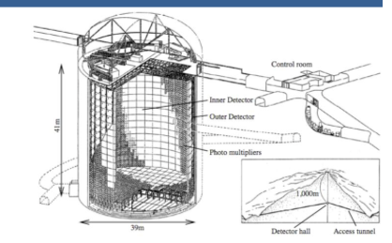
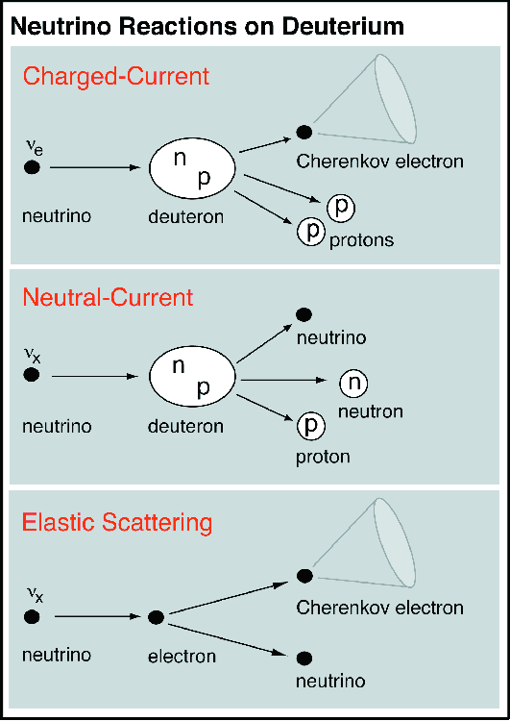
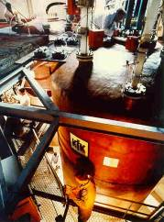
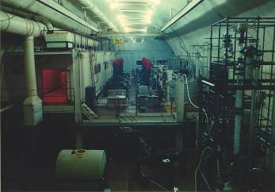
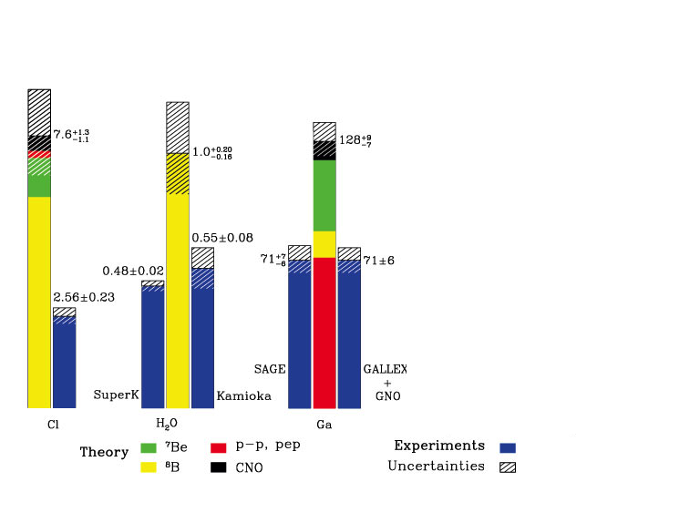
The Solar Neutrino Problem
Kamiokande
3000 tons of pure water
1000 PMTs
SuperKamiokande
50000 tons of pure water
11200 PMTs
(from 1980 to 2000):
Kamiokande-SuperKamiokande (H₂O)
Gallex-Sage (Ga)
30 tonnes of natural
gallium
(at LNGS Italy)
50 tons of metallic
gallium
(at Baksan Russia)
E_{th} = 233 keV
SAGE
Gallex
ν_{e}+ ⁷¹Ga → ⁷¹Ge + e⁻
E_{th} = 5.5 MeV
Neutrino fluxes 1/2 or 1/3 of expectations!

Slide 6
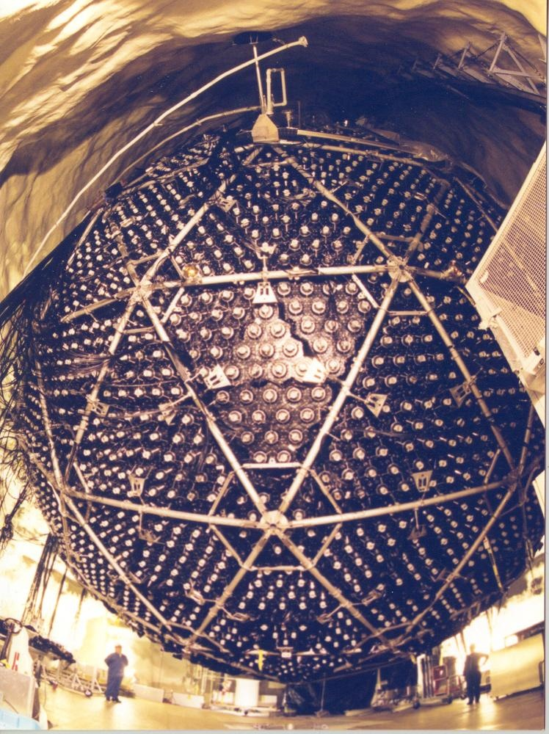
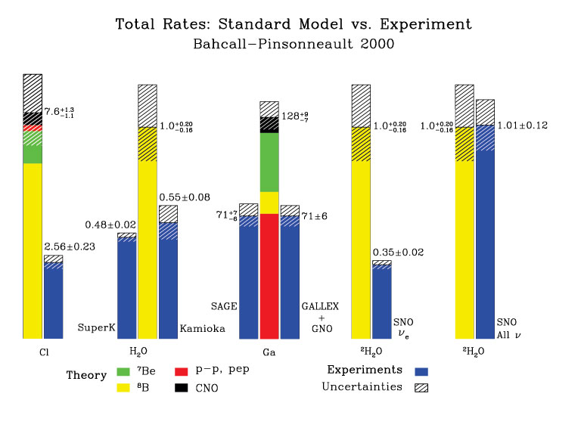
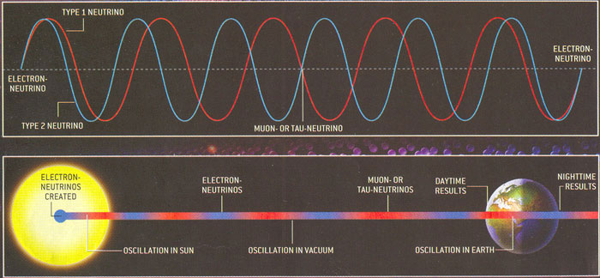
The solution of the Solar Neutrino Problem
(2000):
SNO (D₂O)
1000 tonnes D₂O (Heavy Water)
12 m diameter Acrylic Vessel
9500 PMTs
At Sudbury Ontario Canada (since 1999)
oscillate into
ν_{e} → ν_{μ}/ν_{τ}
The Solar Neutrino Problem can be considered solved!

Slide 7
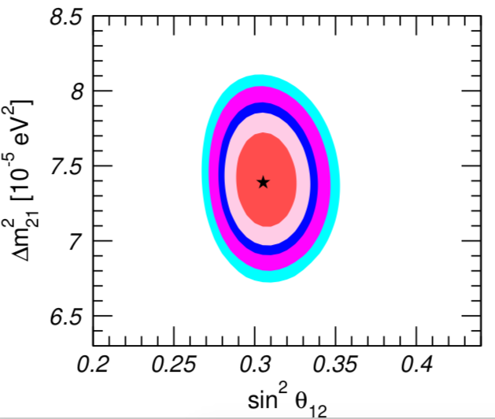
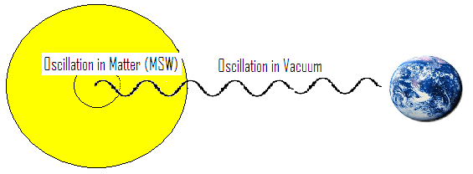
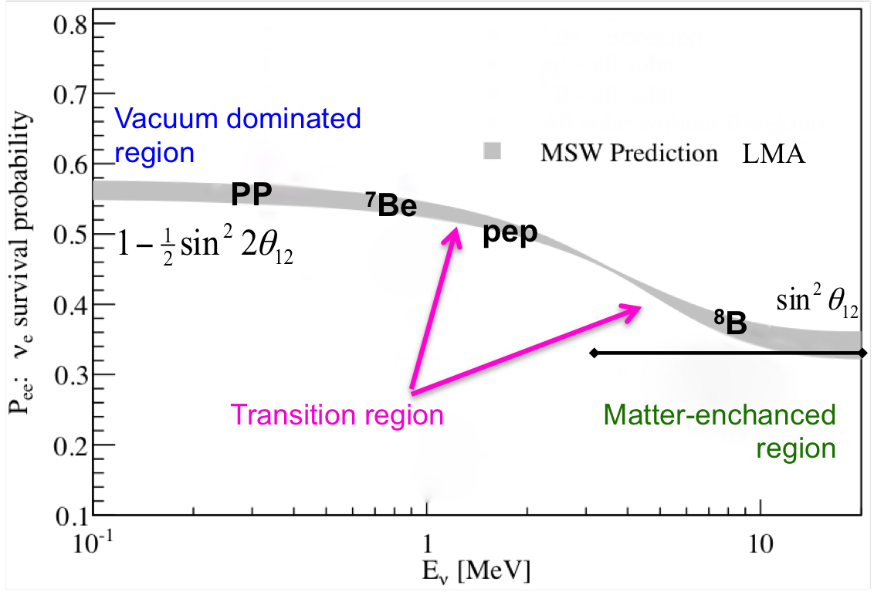
The MSW-LMA solution
Global 3ν oscillation analysis
NuFIT 3.2 (2018)
- Low Energy ν_{e} oscillate in vacuum;
- For High Energy ν_{e} (multi-MeV) the conversion is enhanced in the Sun because of ν_{e} forward scattering process with electrons (MSW effect) Mikheyev-Smirnov-Wolfenstein.
The solution to the SNP is the (Large Mixing Angle) LMA solution
regions at 1σ, 90%, 2σ, 99%, 3σ CL
http://www.nu-fit.org/?q=node/8

Slide 8
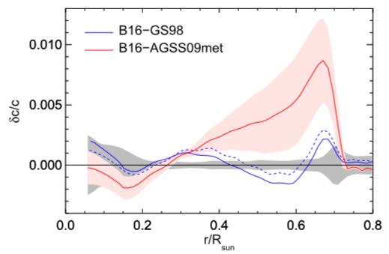
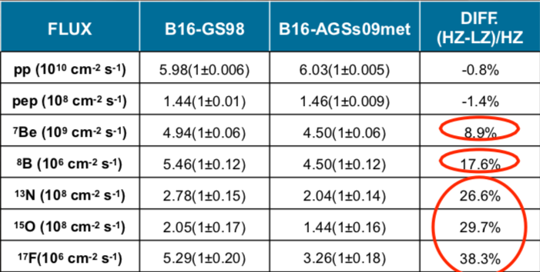
Why it is still interesting to study Solar Neutrinos?
(Astrophysics)
Recent measurements suggest that the solar metallicity might be lower than previously assumed. With this assumption SSMs are less in agreement with helioseismic data:
Solar Metallicity Problem
Solar neutrino measurements could provide a solution of this problem!
Studying the Sun with Neutrinos
Metallicity problem
Testing stability of the Sun
Energy production/loss mechanisms
Fusion rates (pp, CNO)
High Z
Low Z
Low Z
Fractional sound speed difference
High Z
New Generation of Standard Solar Models.
N.Vinyoles et al.
The Astrophysical Journal, 835:202, 2017

Slide 9
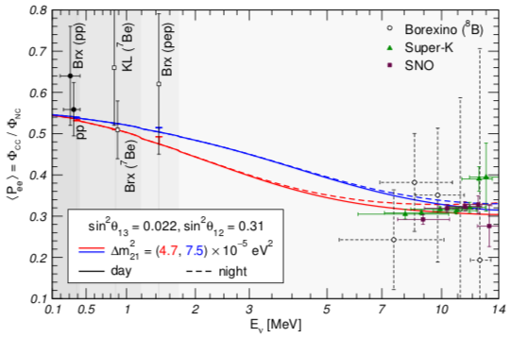
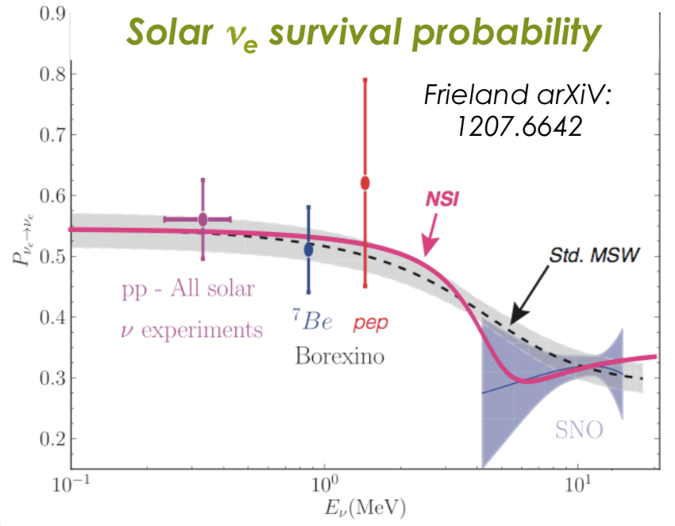
Why it is still interesting to study Solar Neutrinos?
(Particle Physics)
Studying Neutrinos proprieties with the Sun
Improve the precision of the neutrino oscillation parameters (θ₁₂ and Δm₁₂²)
Searching for deviations from MSW-LMA (e.g. NSI - non-standard neutrino interactions models, sub-leading effects, mixing with light sterile neutrinos)
Anomalous magnetic moment neutrinos

Slide 10
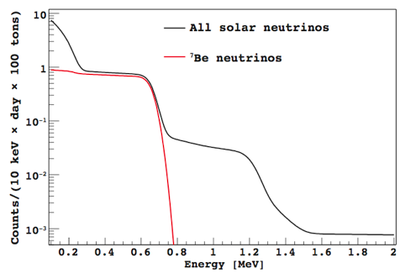
Solar Spectroscopy with Borexino from 200 keV
Radiochemical experiments (Homestake, Gallex, SAGE) integrate in time and energy.
H₂O & D₂O Real time experiments (Kamiokande, SuperK, SNO) can detect solar neutrinos starting from about 3-4 MeV.
ν flux as predicted by SSM
⁷Be monochromatic line at 0.862 MeV
Liquid Scintillator Detector are able to measures solar neutrinos in real time with a low energy threshold.
Detection principle: elastic scattering (ES) on electrons
ν signal in Borexino
Neutrino signal:
is on the order of ≈ 50 events/day/100 tons above threshold. This means 10⁻⁹ events/(kg s)
Compton shoulder
Maximum ES of e⁻ 0.662 MeV
Radioactive background (ex: ²³⁸U):
The typical concentration of ²³⁸U in standard material is of the order of ppm (10⁻⁶ g/g). 1 g of ²³⁸U corresponds to about 12500 Bq
This means that in 1 kg of material we have about 10 Bq of radioactivity. This means 10 events/(kg s)
10 orders of magnitude!
It is impossible to disentangle electron from beta decay from scattered electron from neutrino.

Slide 11
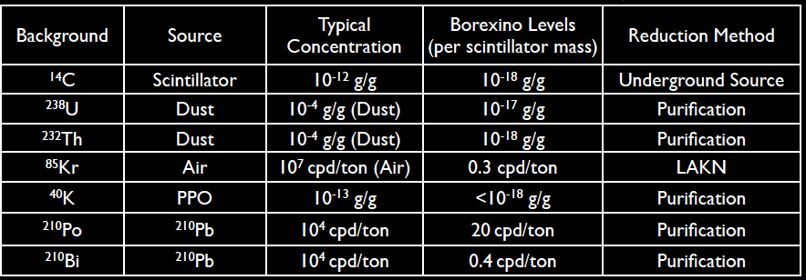
≈300 tons
Liq. Scint. PC+PPO
The 300 tons target mass (liquid scintillator) is composed of pseuducumene PC as solvent and PPO, to enhance the scintillation property, as solute (1.5 g/l) .
In order to reach such a low radioactivity level several techniques have been applied:
Distillation,
Water extraction,
Nitrogen stripping,
ecc…..
Unprecedented low levels of background

Slide 12
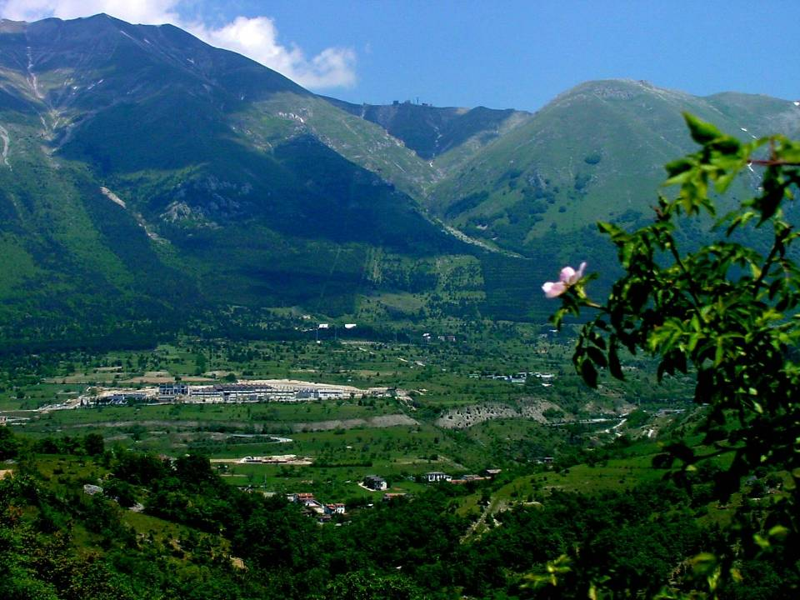
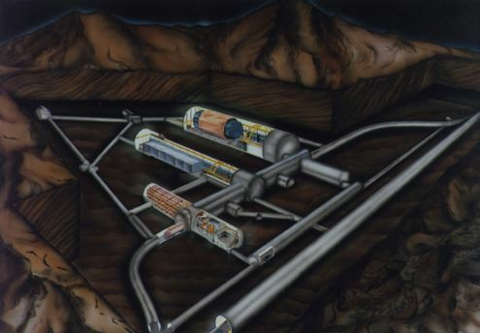
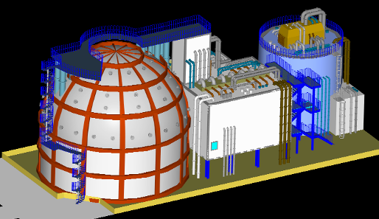
Laboratori Nazionali
del Gran Sasso
(LNGS)
Borexino Detector and Plants
CTF
Borexino

Slide 13
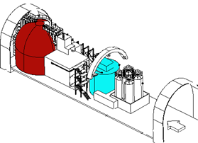
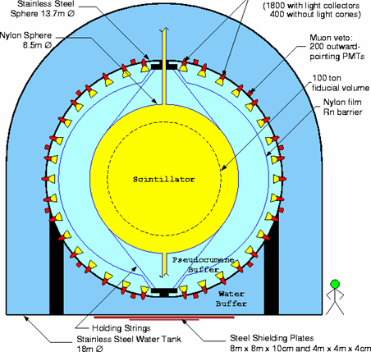
Borexino
design
Core of the detector: 300 tons of liquid scintillator (PC+PPO) contained in a nylon vessel of 8.5 m diameter. The thickness of nylon is 125 µm.
1st shield: 1000 tons of ultra-pure buffer liquid (PC+DMP) contained in a stainless steel sphere of 13.7 m diameter (SSS).
2200 photomultiplier tubes pointing towards the center to view the light emitted by the scintillator.
ν
2nd shield: 2400 tons of ultra-pure water contained in a cylindrical dome.
200 photomultiplier tubes mounted on the SSS pointing outwards to detect Cerenkov light emitted in the water by muons.
e⁻
Scintillation light detected by PMT’s
# of photons ➔ energy
time of flight ➔ position
pulse shape ➔ α/β β⁺/β⁻ discrim.
Light yield: ~500 phe/MeV
Energy resolution: 5% @ 1MeV
Space resolution: 10 cm @ 1MeV
ν

Slide 14
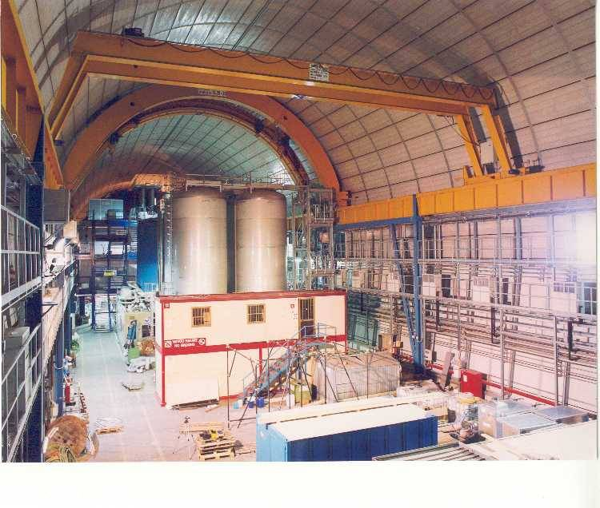
Experimental Hall C

Slide 15
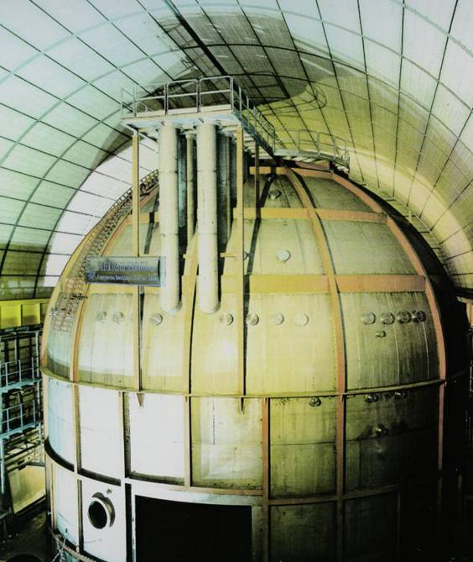
External dome
18 m

Slide 16
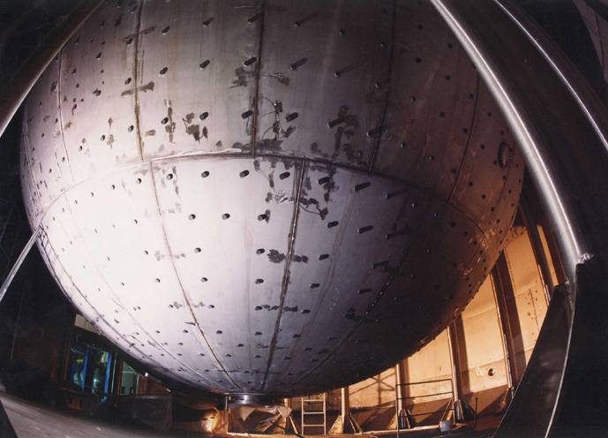
Stainless Steel Sphere (SSS)

Slide 17
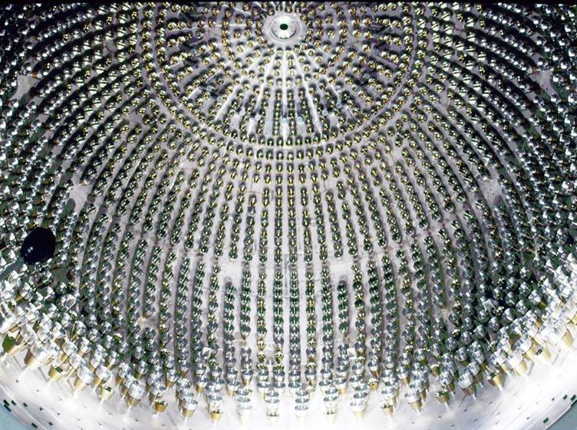
Borexino inner detector

Slide 18
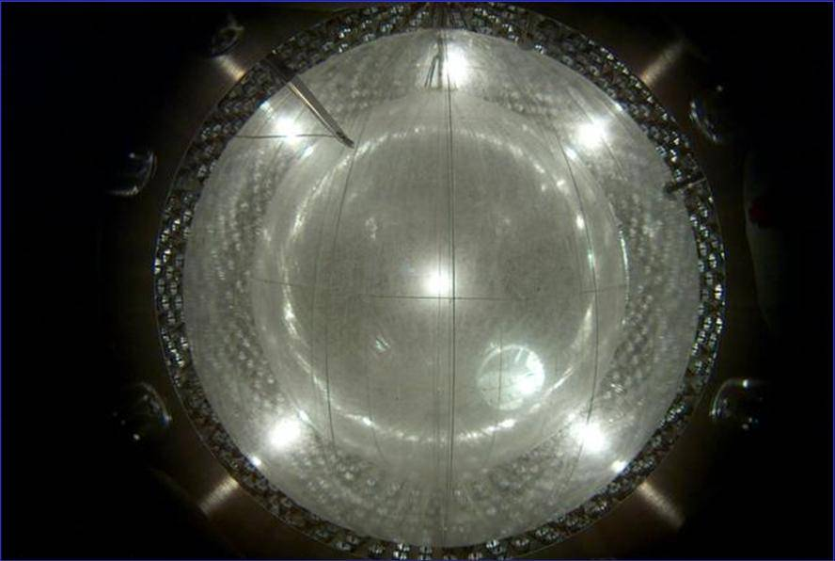
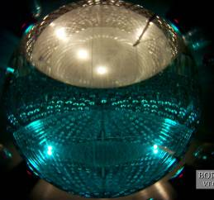
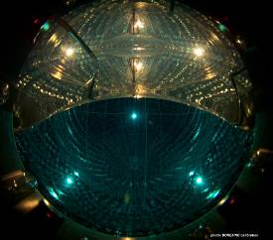
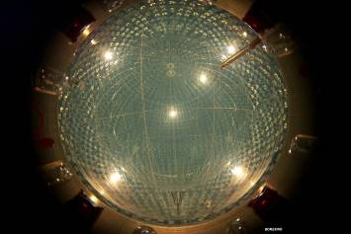
Nylon vessels inflated, filled with water and replaced with scintillator
Nylon vessels
(Princeton Univ.)
water filling
Scintillator filling
May 15th, 2007
Low Ar and Kr N₂
Liquid scintillator
Hight purity water
From Aug 2006
From Jan 2007

Slide 19
Borexino Phase II
Construction
Phase I
Purification
Phase II
…… 2005 2006 2007 2008 2009 2010 2011 2012 2013 2014 2015 2016 2017 2018 …
⁷Be, pep, ⁸B,
geo ν,
Rare process.
Improved radiopurity:
⁸⁵Kr: reduced by ~4.6
²¹⁰Bi: reduced by ~2.3
²³⁸U: < 9.4 . 10⁻²⁰ g/g (95% C.L.)
²³²Th: < 5.7 . 10⁻¹⁹ g/g (95% C.L.)
The New phase II data consists in a:
• Background reduction;
• Larger exposure;
• More accurate description of detector response
Spectral measurement of the pp rate (Nature, Vol. 512 2014)
Seasonal modulations of the ⁷Be solar neutrino signal (Astr.Phys. 92 (2017) 21)
First Simultaneous Precision Spectroscopy of pp, ⁷Be and pep Solar Neutrinos (arXiV:1707.09279)
Improved measurement of ⁸B solar neutrinos with 1.5 kt.y of Borexino exposure (arXiV: 1709.0075)
New upper limit on neutrino magnetic moment (arXiV:1707.09355)

Slide 20
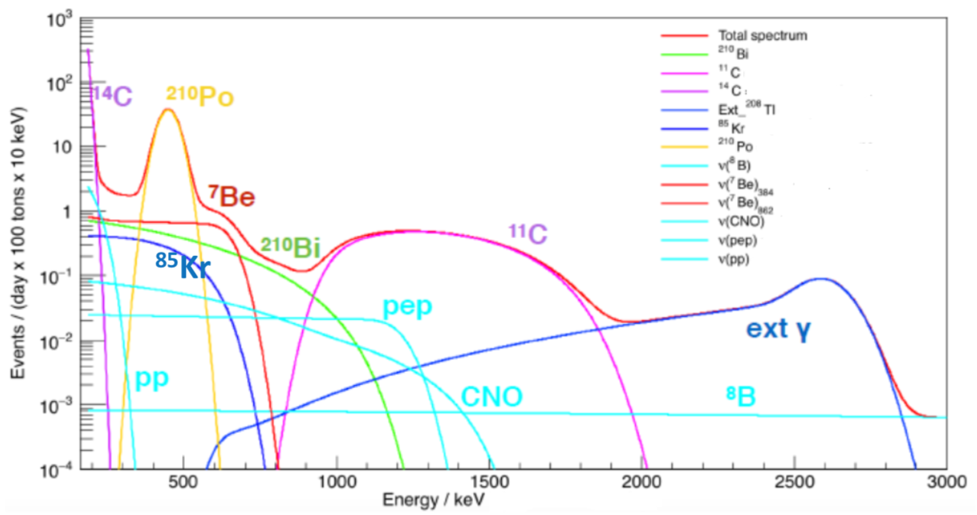
How to extract the neutrino signal: example of pp, ⁷Be and pep-ν
Simulated energy spectrum - solar neutrino signals and main background component in Borexino
Simulation

Slide 21
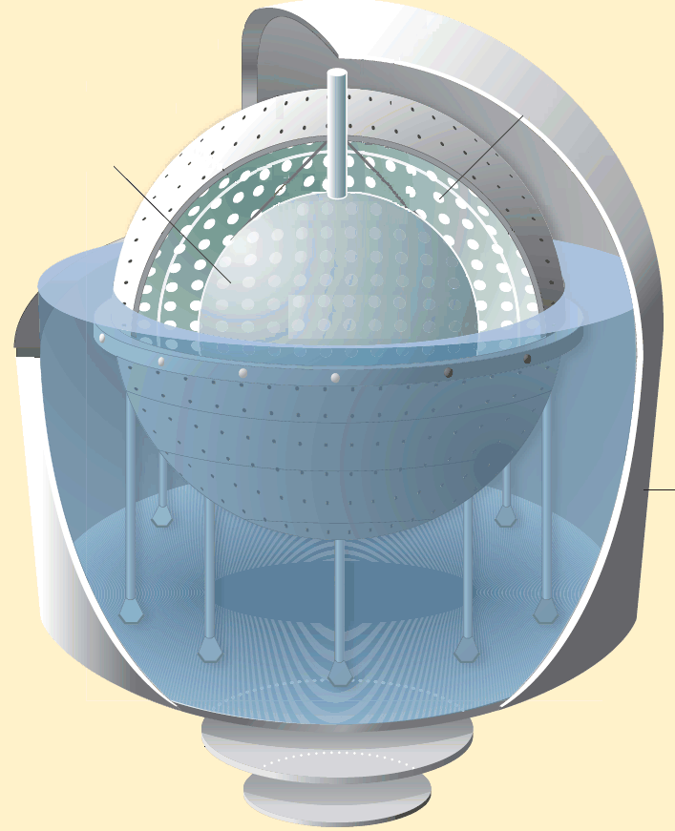
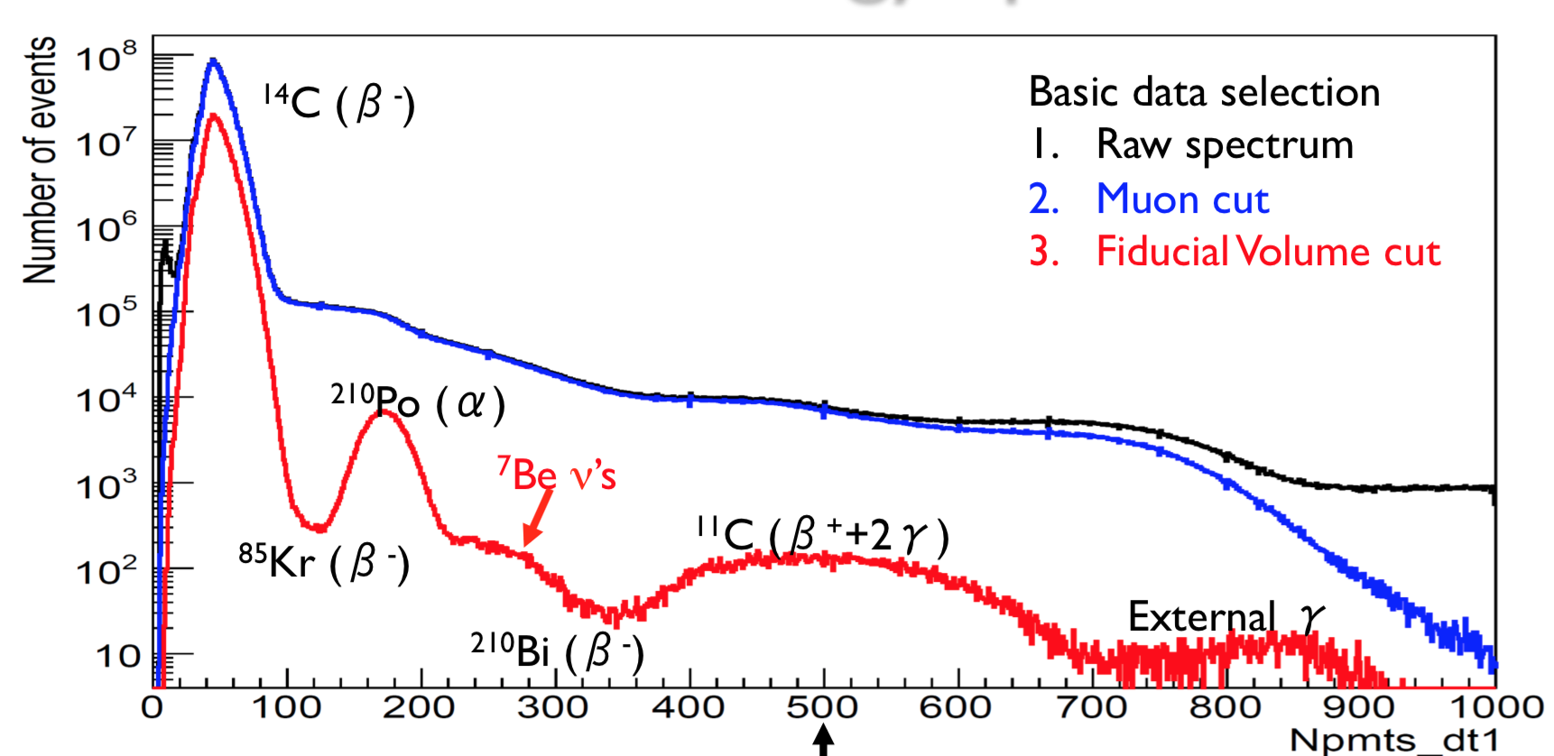
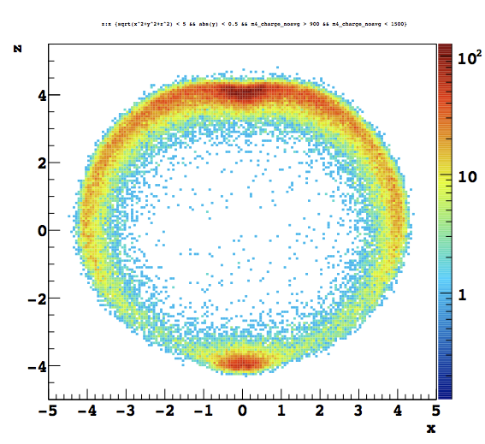
μ
From raw data to neutrino signal
External and internal muon veto
(veto of 300 ms after a muon in OD)
Data
Fiducial volume cut for removing external background
(R<2.8 m and -1.8<z<2.2 m)
FV
500 Npmts_dt1 ≈ 1 MeV
190 keV
2930 keV

Slide 22
Analysis energy regions and dataset:
Low-energy region (LER) [0.19–2.93 MeV]
to measure the pp, ⁷Be, pep neutrinos
Phase-II data collected between Dec 2011 and May 2016
The total LER exposure is 1,291.51 days × 71.3 t.
High-energy region (HER) [3.2–16 MeV]
to measure ⁸B neutrinos
larger dataset, collected between Jan 2008 and Dec 2016
HER is further divided into two subregions:
below and above 5.7 MeV (HER-I and HER-II)
Total exposure of 2,062.4 days × 227.8 (266.0) t for HER-I (or HER-II), respectively.
Selection of the events
In order to maximize the signal-to-background ratio we apply a different set of cuts in 3 energy regions.

Slide 23
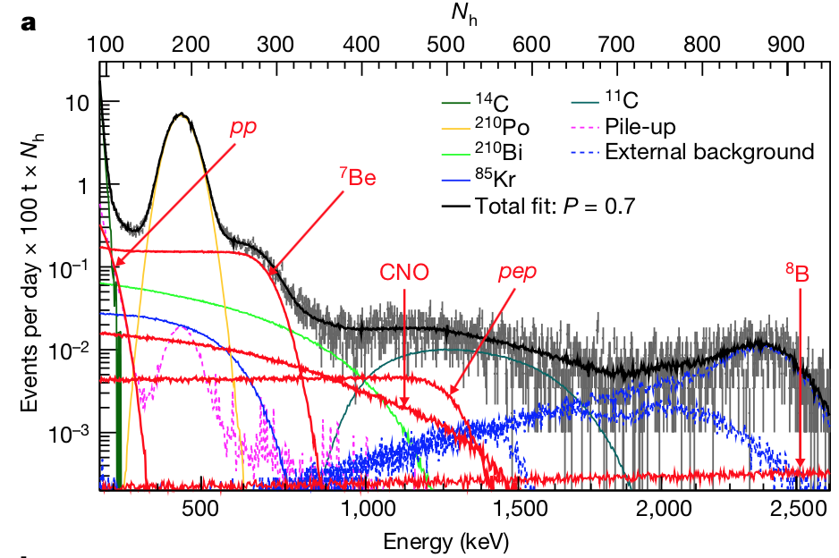
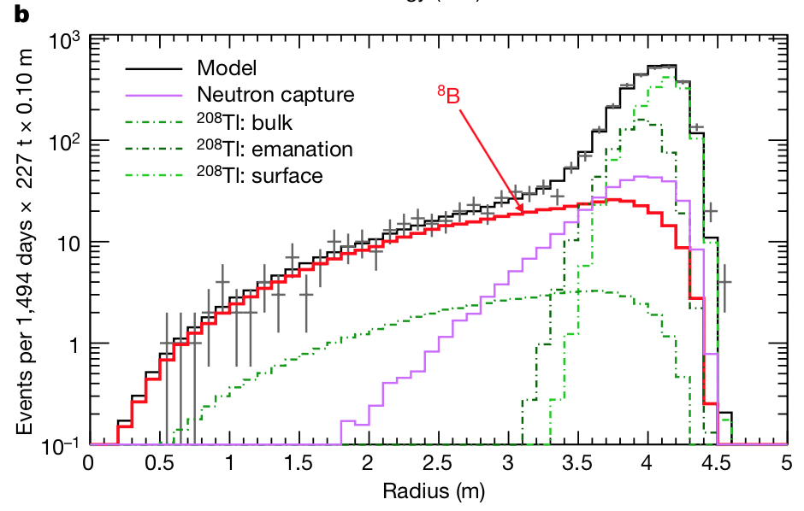
Analysis procedure:
To disentangle the neutrino signal from backgrounds we adopt 2 different fitting strategies for the LER and the HER:
For LER analysis we follow a multivariate approach, in which we simultaneously fit the energy spectrum, the spatial distribution and the pulse-shape estimator distribution.
For HER-I and HER-II we perform a radial distribution fit in order to separate the ⁸B neutrino signal (uniformly distributed in the scintillator) from the external background.
Energy spectrum with suppressed ¹¹C background in LER
Radial distribution of events in HER-I

Slide 24
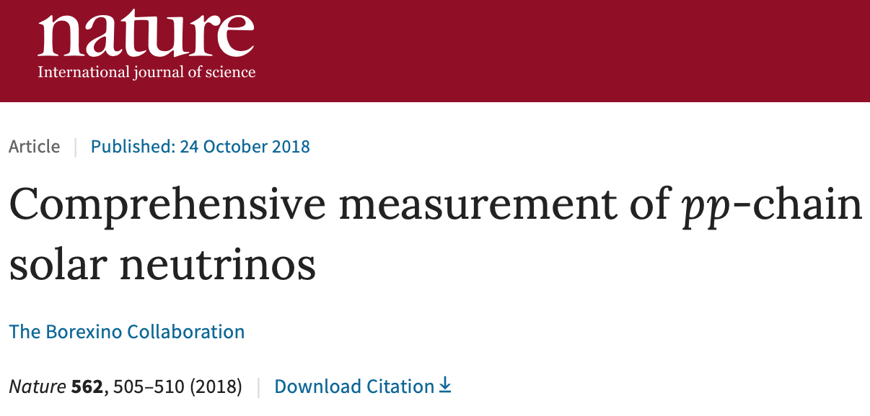
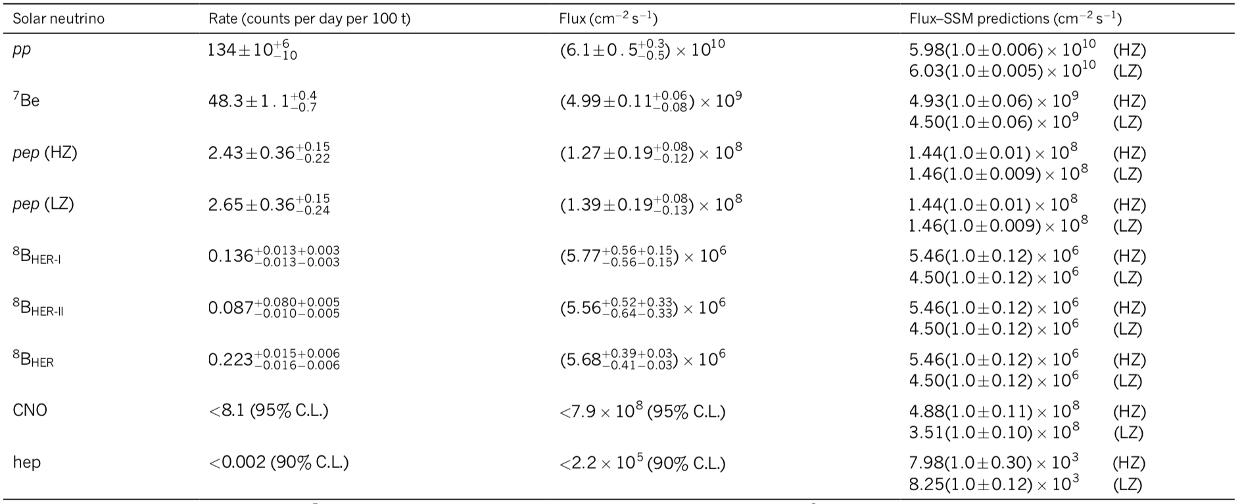
Borexino experimental solar-neutrino results
The total uncertainty of the pp is ≈10%
The total uncertainty of the ⁷Be is ≈2.7%
Evidence of pep ν at 5σ
The precision on the ⁸B rate is ≈8%
Upper limit on the CNO flux
Upper limit on the hep flux

Slide 25
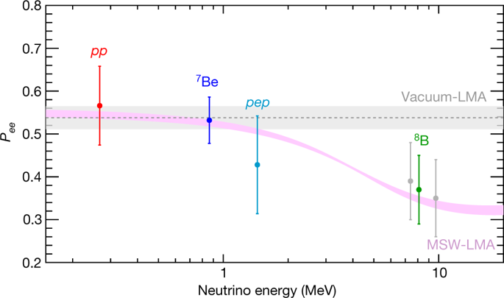
Electron neutrino survival probability
Assuming the HZ-SSM fluxes and standard neutrino-electron cross-sections, we obtain the electron neutrino survival probabilities for each solar-neutrino component:
Borexino is the only experiment that can simultaneously test neutrino flavour conversion both in the vacuum and in the matter-dominated regime.
The pink band is the ±1σ prediction of MSW-LMA
The grey band is the vacuum-LMA case

Slide 26
Total power generated by nuclear reactions
The neutrino fluxes determined experimentally can be used to derive the total power generated by nuclear reactions in the Sun’s core.
We find
in agreement with the luminosity calculated using the well measured photon output
This confirms experimentally the nuclear origin of the solar power with the best precision obtained by a single solar-neutrino experiment.
Considering that it takes around 10⁵ years for radiation to flow from the energy-producing region to the surface of the Sun, this comparison proves also that the Sun has been in thermodynamic equilibrium over 100 thousands years .
Ratio R_{I/II}
We derive the ratio R_{I/II} between the ³He–⁴He (PPI) and the ³He–³He (PPII) fusion rates, which quantifies the relative intensity of the two primary terminations of the pp chain
We find in agreement with the most up-to-date predicted values of R_{I/II} = 0.180±0.011 (HZ) and 0.161±0.010 (LZ)

Slide 27
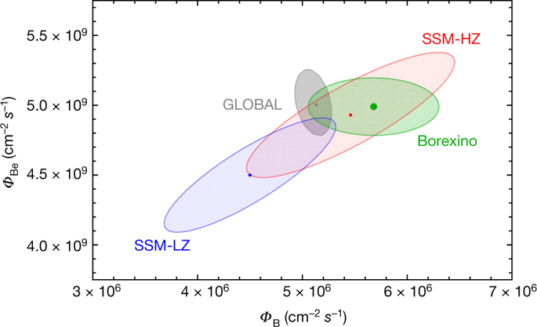
Test the predictions of SSMs with different metallicity
To perform this test, we use only the results for ⁷Be and ⁸B neutrinos which fluxes are very different in the HZ- and the LZ-SSM theoretical predictions. (differences of 9% and 18%, respectively)
The theoretical error budget is dominated by uncertainties on the astrophysical factor S₃₄ of the ³He + ⁴He reaction, on the opacity of the Sun, and on the astrophysical factor S₁₇ of the p + ⁷Be reaction.
We performed a global fit including the results presented in this work together with all the other solar + KamLAND data.
The Borexino results are compatible with the temperature profiles predicted by both HZ- and LZ-SSMs. However, the ⁷Be and ⁸B solar-neutrino fluxes measured by Borexino provide an interesting hint in favor of the HZ-SSM prediction.

Slide 28
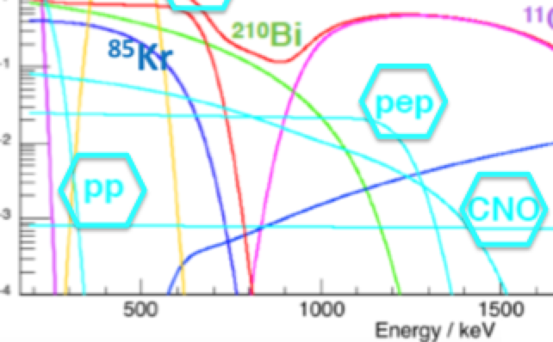
Sensitivity to CNO
Motivations:
CNO neutrinos have never been detected
According to astrophisical models, CNO cycle is responsible of ~1% of the solar luminosity and it is the main mechanism of energy generation in massive stars.
A solution for the solar metallicity problem.
Relative species predicted by nuclear physics, absolute abundance still unknown.
Experimental challenges:
Low rate expected in Borexino: ~5 cpd/100t (HZ) or ~3 cpd/100t (LZ)
Similar to ²¹⁰Bi beta spectrum

Slide 29
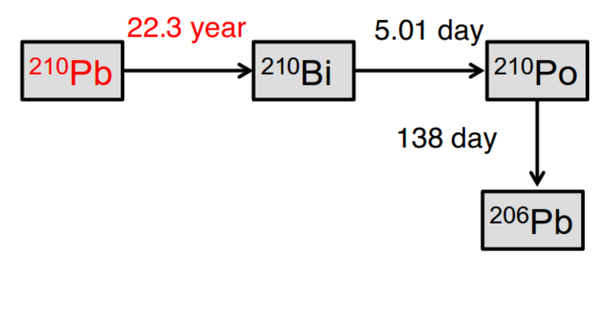

Assuming the secular equilibrium the
²¹⁰Bi rate can be determined by the ²¹⁰Po rate
Example:
– Total rate A(t)
– Unsupported ²¹⁰Po term A
– ²¹⁰Bi-supported ²¹⁰Po term B
But, in order to determine the ²¹⁰Po rate:
The contaminants must be homogeneous and we have to have no motions of the contaminants in the FV (due to convention motions) -> stable temperature

Slide 30




The thermal insulation and temperature active control system
Since the end of 2015 the detector is surrounded by a thick layer of rock wool.
The dome of Borexino is equipped with a water coil able to provide heat for compensating the heat sink from the bottom (rock at ~6°C)

Slide 31
Conclusion and Outlook
Borexino Phase II results are based on a cleaner data set; the analysis contain many methodical improvements: Improved precision on pp, ⁷Be, pep and ⁸B neutrinos.
Still missing: combined analysis of Phase I + Phase II data set.
Attempt to measure the CNO neutrinos.
Others non solar neutrino measurement:
Geo-neutrinos,
Supernova neutrino,
unknown anti-neutrinos fluxes,
non-standard searches (neutrino magnetic moment, Non Standard Interaction, ecc…)
Thank you

Slide 32


Slide 33
Backup slides

Slide 34



First simultaneous spectroscopy of pp, ⁷Be and pep-ν
¹¹C Tag: Three Fold Coincidence and β⁺/β⁻ discrimination
1) the three fold coincidence (TFC)
¹¹C are always produced with neutrons thus their signals are correlated in space and time with a muon and a neutron
¹¹C rejection efficiency: 92 + 4 %
Residual life time: 64%
The data set is divided in two spectra: one depleted in ¹¹C (TFC - subtracted) and one enriched in ¹¹C (TFC-tagged) which are then simultaneously fit
2) The β⁺/β⁻ pulse-shape variable PS-LPR
¹¹C decays β⁺ : the probability density function (PDF) of the scintillation time profile is different for e⁻ and e⁺ for two reasons:
• in 50% of the case e⁺ annihilation is delayed by ortho-positronium formation (τ≈3ns);
• e⁺ energy deposit is not point-like because of the two annihilation gammas;

Slide 35


First simultaneous spectroscopy of pp, ⁷Be and pep-ν
Fit strategy
Radial distribution
In order to extract the neutrino signal from data we adopted a strategy that consists in maximize a binned likelihood through a multivariate approach
Pulse Shape
to disentangle ¹¹C
to disentangle
external BKG
In the likelihood is included:
• Energy spectrum (¹¹C-tagged and ¹¹C-subtracted)
• Pulse-shape distribution PS-LPR
• Radial distribution
Checks for systematical effects:
Fit performed in different conditions (energy range, energy variable, binning..);
Developed a Toy-MC to:
Build MC data set with the same exposure as in the data
Fit with pdf used to fit the data
Check bias, sensitivity, correlations
Energy fit performed both with the MonteCarlo and the Analytical methods.
¹¹C Subtracted
¹¹C Tagged

