Slide 1

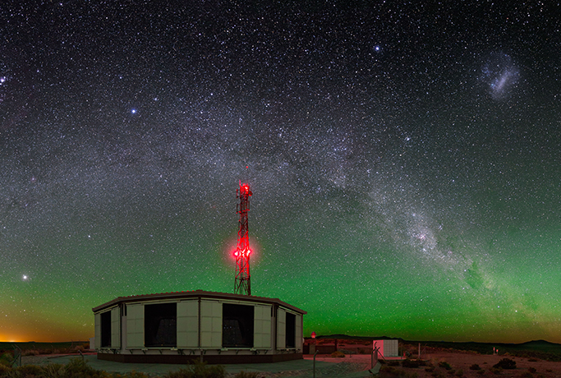
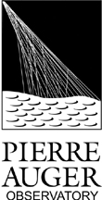

Latest results and future prospects of the
Pierre Auger Observatory
Lino Miramonti on behalf of the Pierre Auger Collaboration Dipartimento di Fisica, Università̀ degli Studi di Milano & INFN-Sezione di Milano

Slide 2
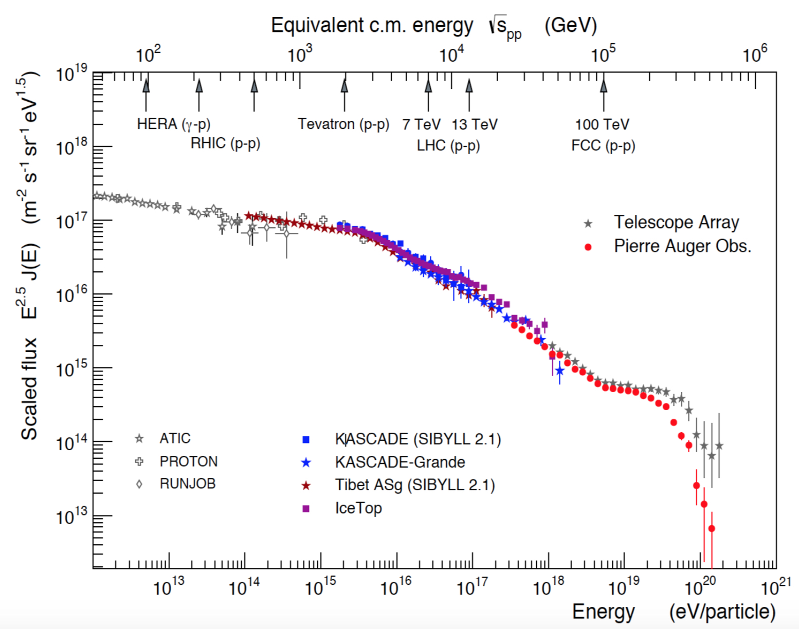
Ultra High Energy Cosmic Rays (UHECR)
E > 10¹⁸ eV (1 EeV , 0.16 J)
Open questions:
Where do they come from?
What is their composition?
In which way they reach these energies?
The flux is very low
few CR per km² per century

Slide 3
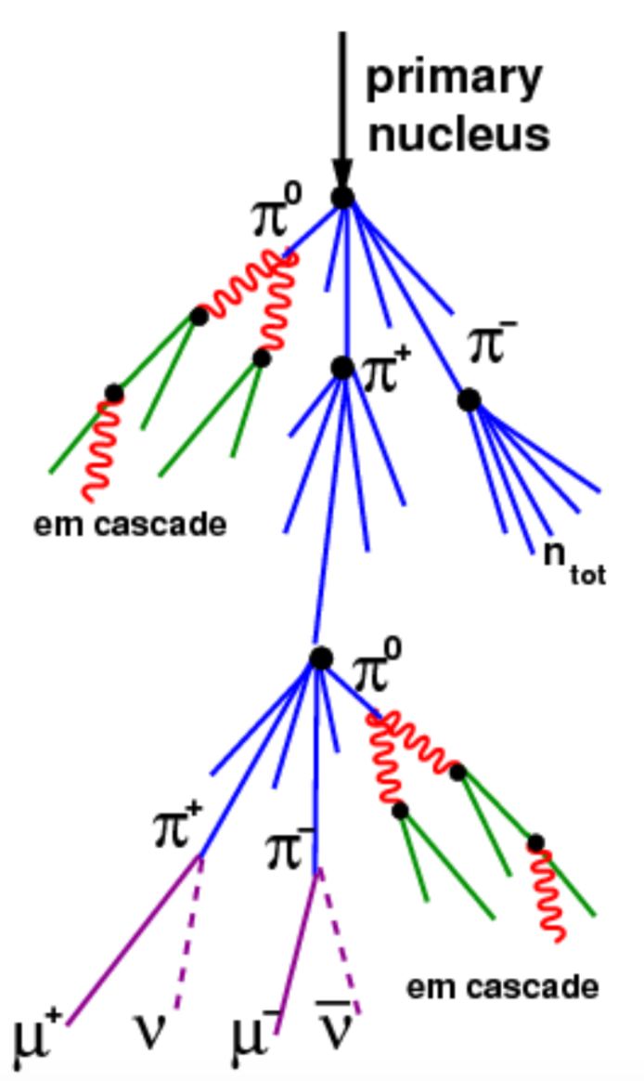
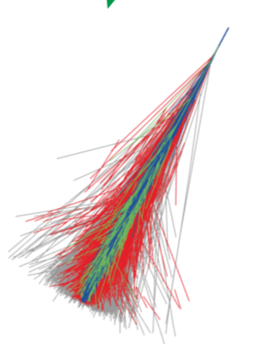
Due to the low flux, UHECR are detected indirectly via the Extensive Air Shower (EAS)
UHECR –– ^{detected via} ––> EAS
EAS properties are used to infer the characteristics of the primary cosmic ray!
large shower of particles in Earth’s atmosphere (calorimeter)
@ 10 EeV: ∼ 10¹⁰ particles,
spread over an area of ∼ 20 km²

Slide 4
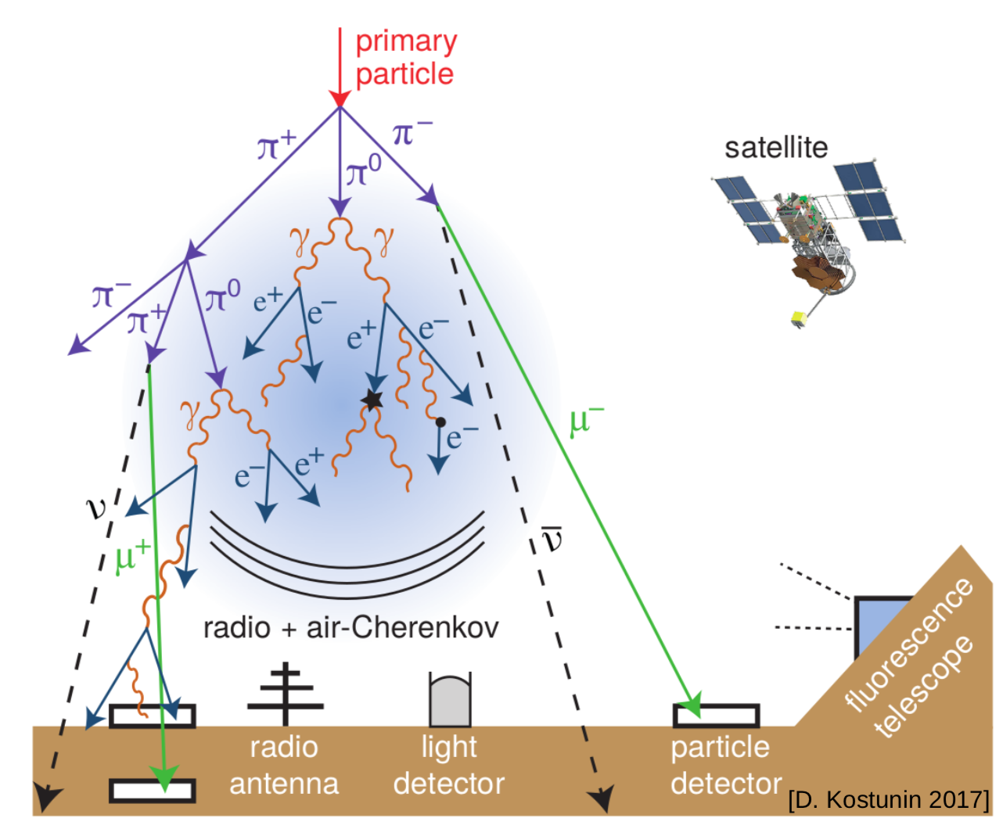
There are several ways to detect EAS
The two main techniques are:
A) To sample the EAS at ground with an Array of surface detectors (Lateral profile)
B) To detect the fluorescence light with Fluorescence telescopes (Longitudinal profile)
Surface Detector
- Time of arrival at each station
Thanks to the time of arrival it is possible to deduce the arrival direction of primary cosmic ray.
- Number of particles
From the number of secondary particles it is possible to infer the energy of primary cosmic ray.
- Muon number and Pulse rise time
Thanks to the number of muons and the study of the pulse rise time it is possible to measure the mass of primary cosmic ray.
Fluorescence telescopes
Secondary charged particles excite nitrogen molecules. The de-excitation process occurs in the UV (fluorescence)
The fluorescence technique allows to measure the ionization density of the EAS at different altitudes. This enables to detect the longitudinal development of the shower.

Slide 5
Pros and Cons of two techniques
Array of surface detectors
Pros Duty cycle almost 100%
Cons Very strong dependence of nuclear interaction models (MonteCarlo simulations). Thus a big incertitude on the determination of the primary cosmic ray energy.
Fluorescence telescopes
Pros Less model dependent
Cons Duty cycle of about 10-15 % (clear moonless nights)
The Pierre Auger Observatory
is an Hybrid detector that combines the two techniques.

Slide 6
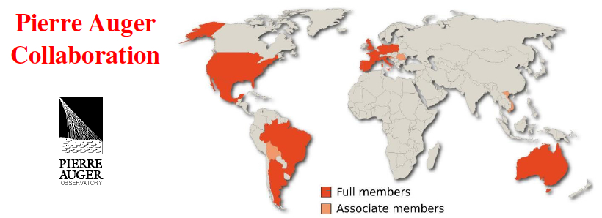
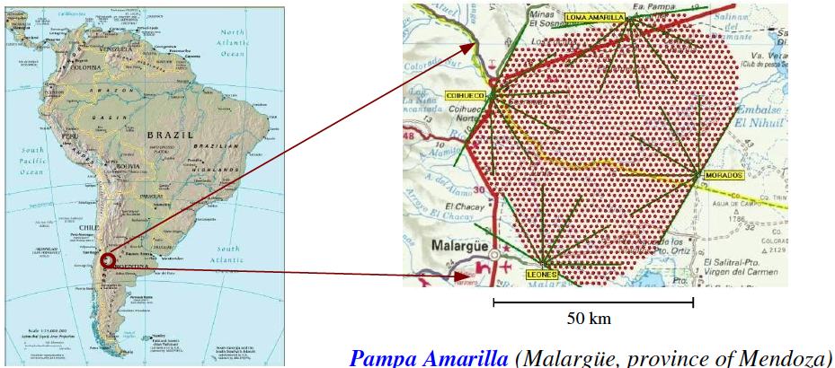
The Pierre Auger Observatory
1400m a.s.l.
latitude: 35°
Physics data since 2004, inauguration November 2008
1600 water Cherenkov tanks (1.5 km distance in a triangular grid) = 3000 km²
24 fluorescence telescopes stations (4 building)

Slide 7
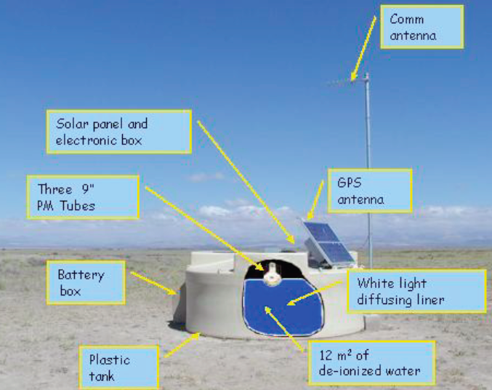
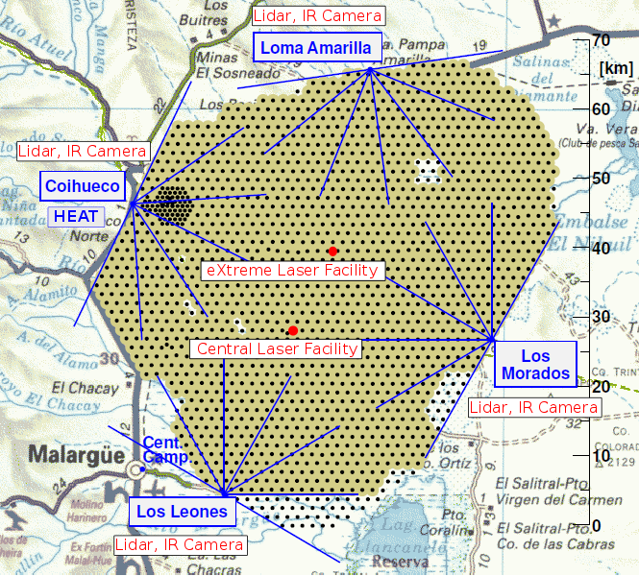
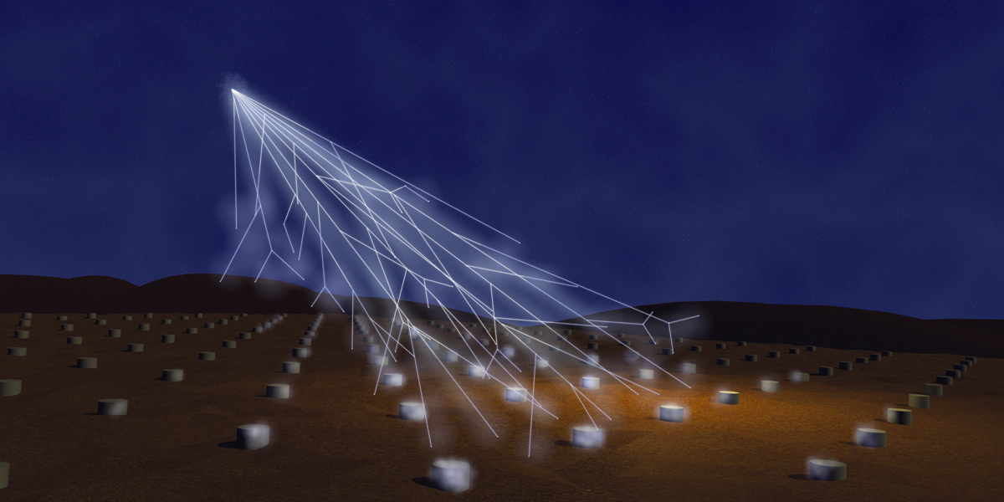
The REGULAR SD array is fully efficient at energies above 3 10¹⁸ eV
49 additional detectors with 750 m spacing have been nested within the 1500 m array to cover an area of about 25 km²
The INFILL SD array is fully efficient above 3 10¹⁷ eV

Slide 8
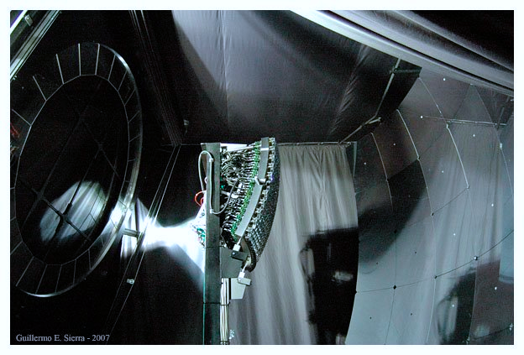
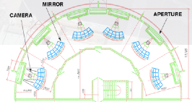
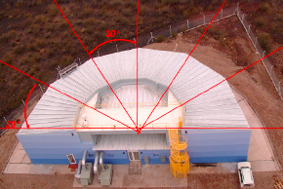
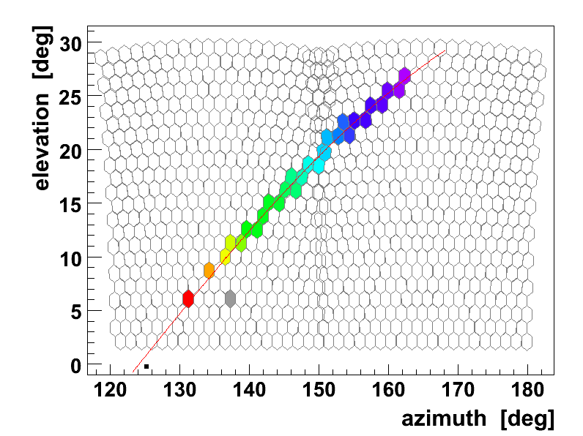
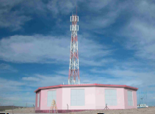
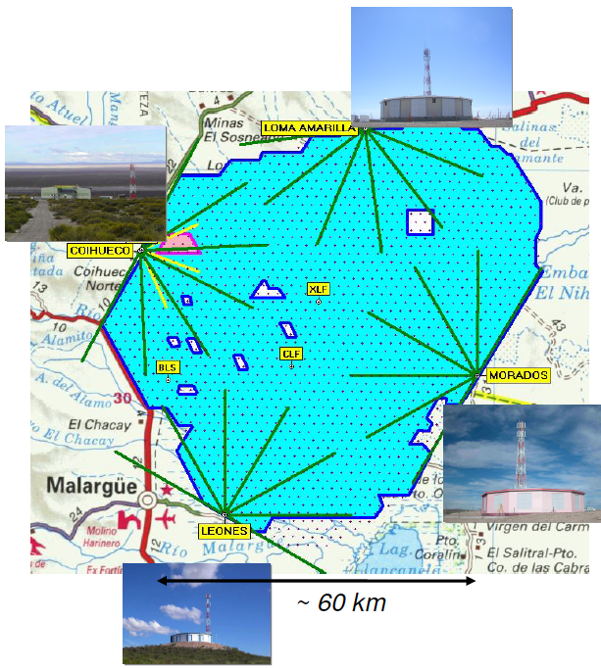
Diaphragm
and
Optical Filter
Mirror
(13 m²)
Camera
(440 PMts)
24 Fluorescence telescopes in 4 buildings: Mirrors: 3.6 m x 3.6 m with field of view 30° x 30° from 1° to 31° in elevation.
3 Fluorescence telescopes HEAT High Elevation Auger Telescopes (near Coihuecuo) with field of view from 30° to 60°

Slide 9
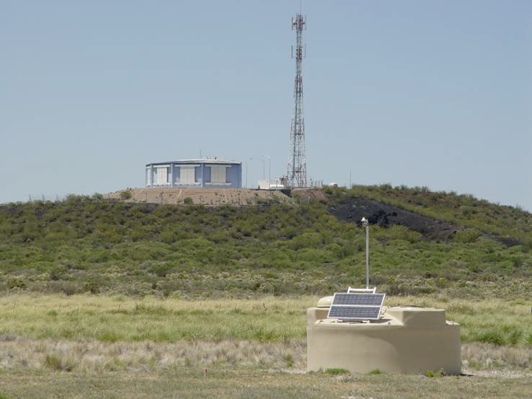
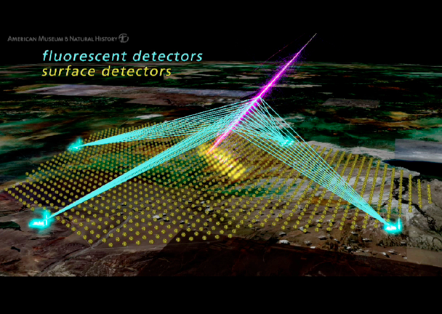
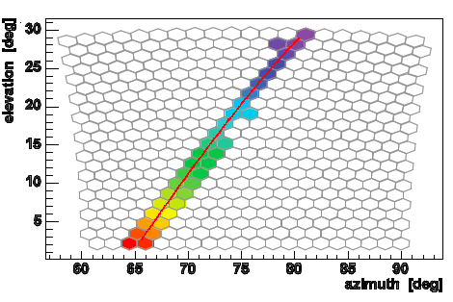
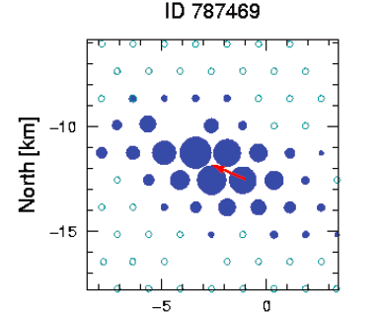
The Hybrid Concept

Slide 10
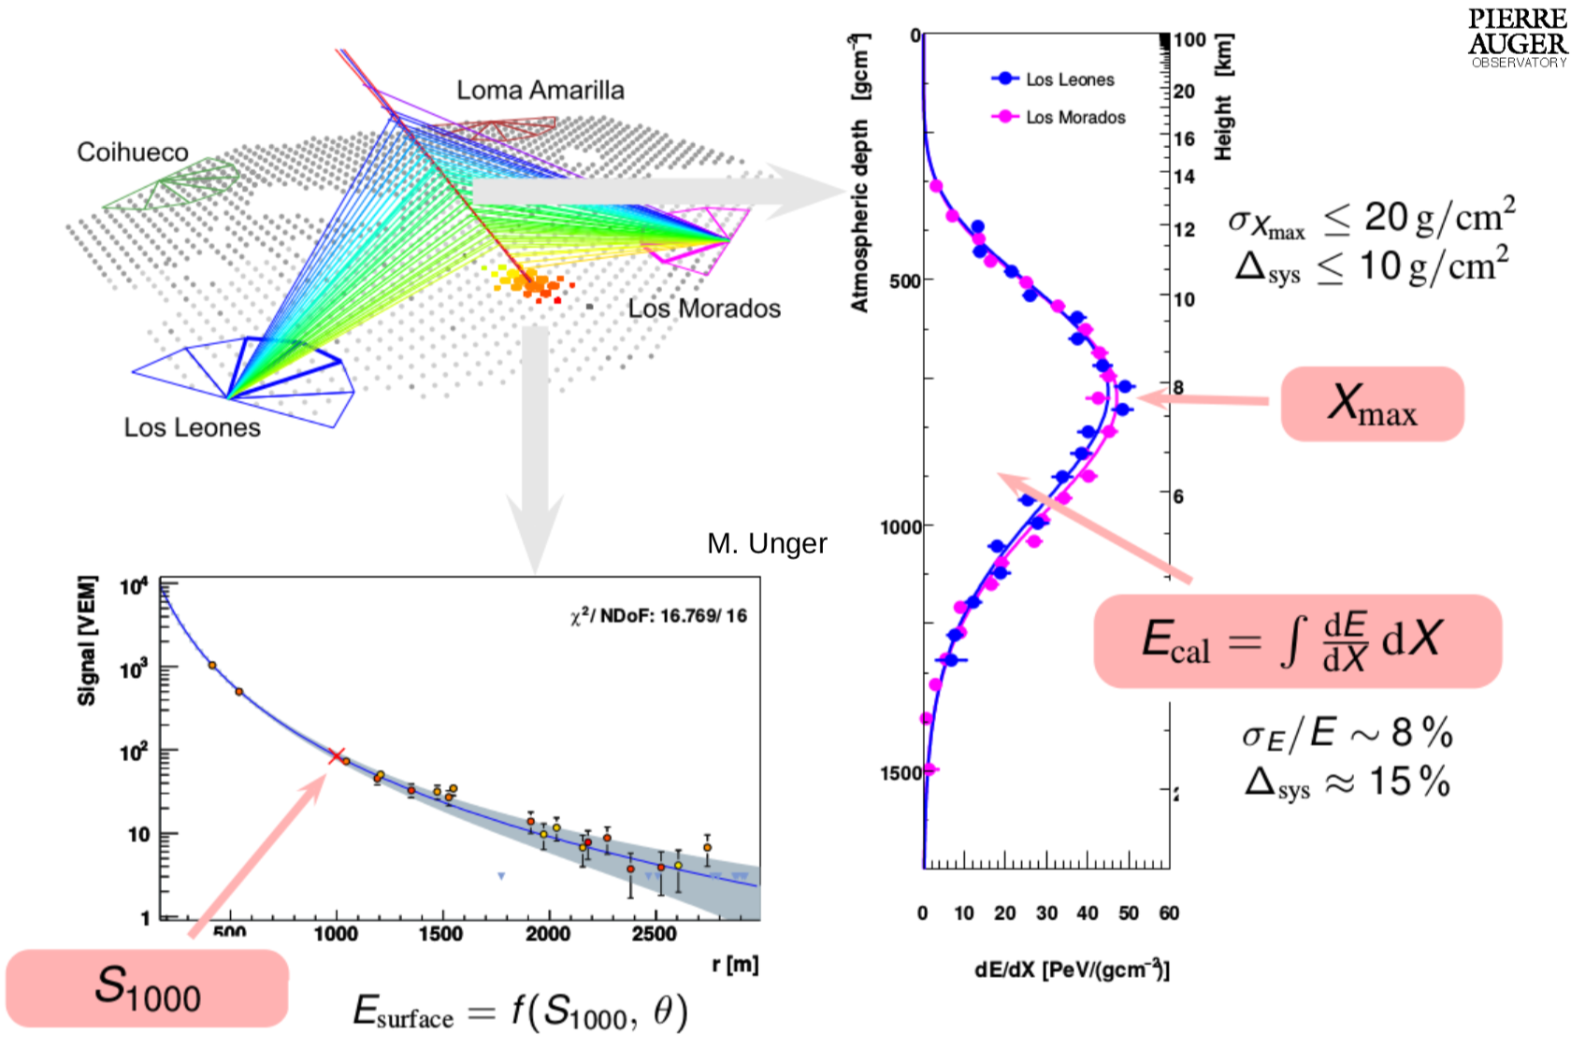
Energy estimator of EAS

Slide 11
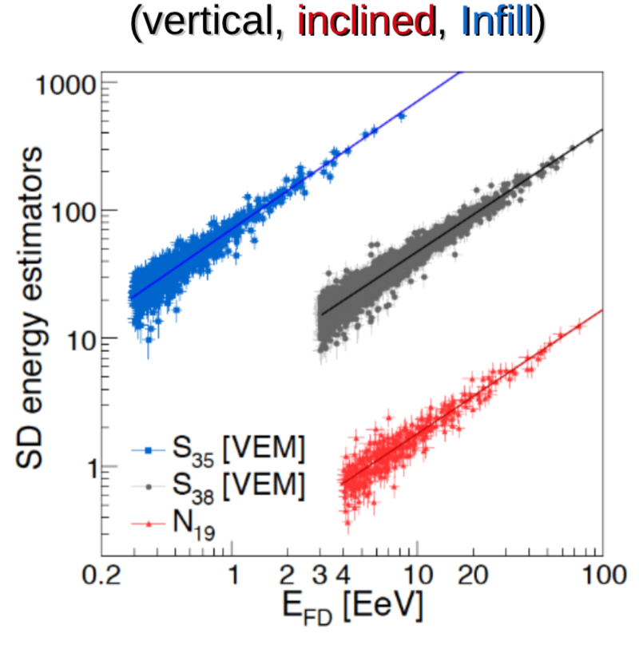
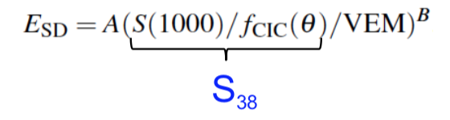
Energy Calibration
For 750 m array, zenith<55: S(450m) → S₃₅
For 1500 m array, zenith<60: S(1000m) → S₃₈
For zenith>60: N₁₉ (muonic signal normalization compared to that from protons at 10 EeV)
Hybrid events are used to calibrate the SD energy estimators with E_{FD}

Slide 12
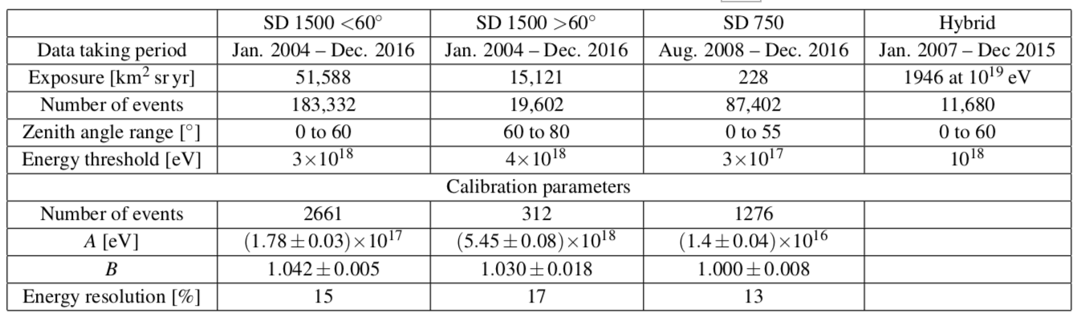
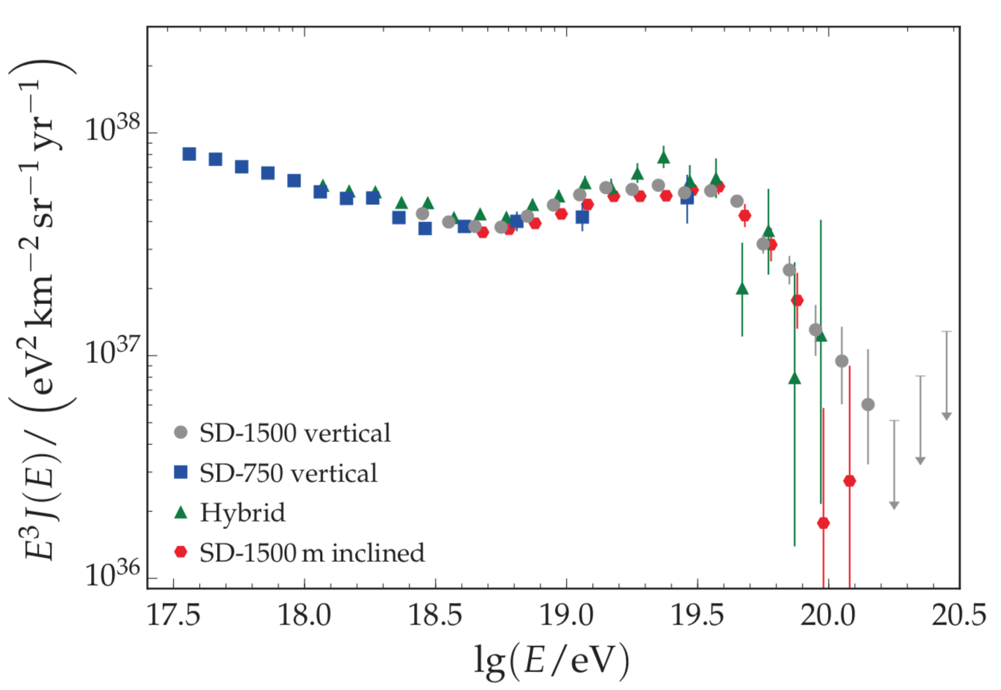
Energy Spectrum
N. of collected events ≈ 300 thousand

Slide 13
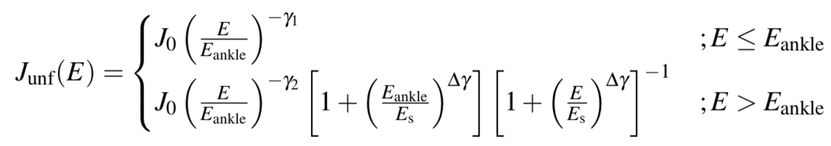
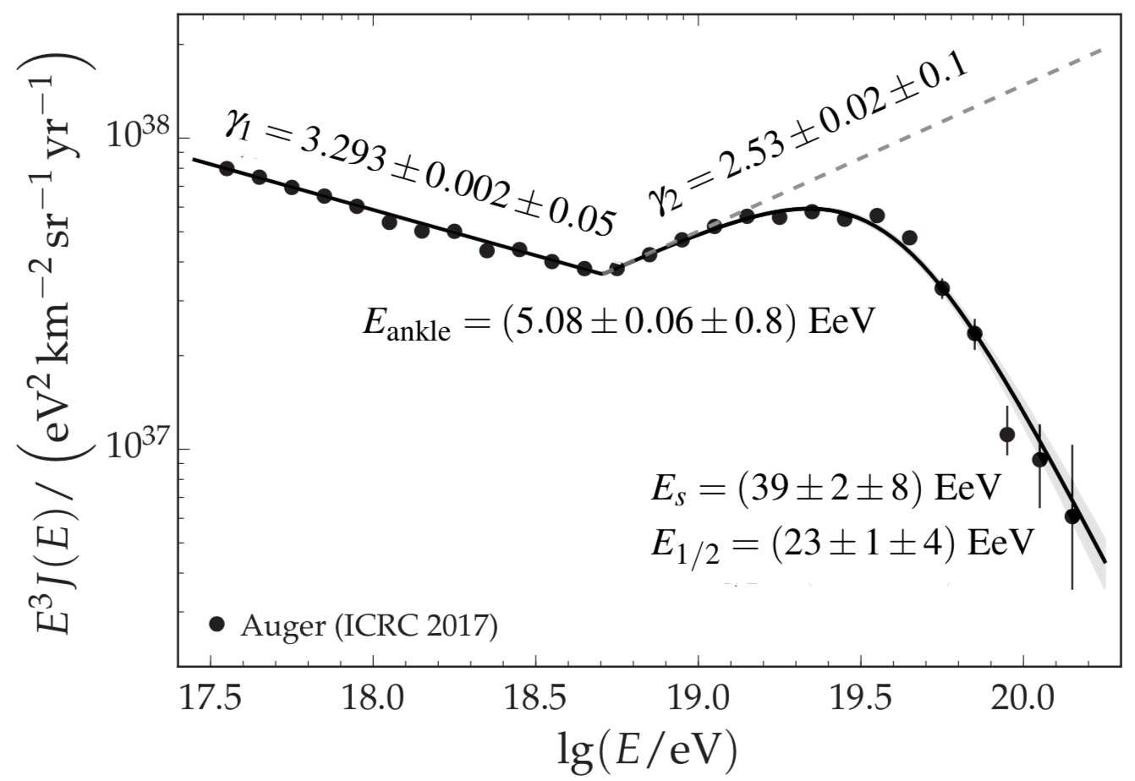
Energy Spectrum
Broken power law fit + suppression
E_{ankle} ≈ 5 EeV
(precision 1%)
Cut-off ≥ 20 σ
The energy E_{1/2} at which the integral spectrum drops by a factor of two

Slide 14
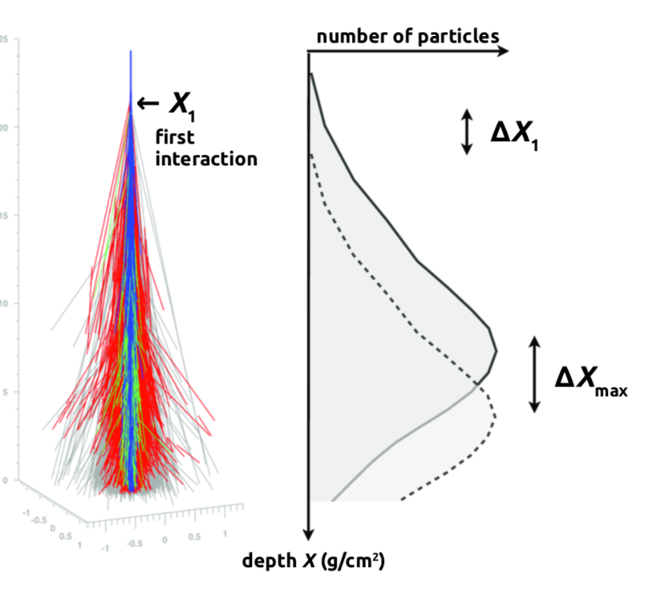
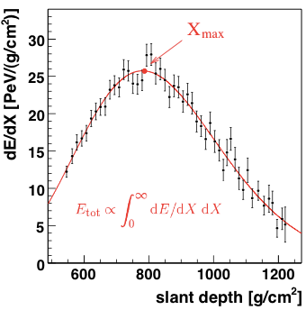
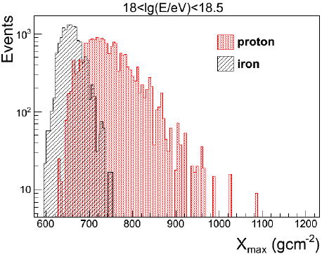
Mass Composition
For the study of mass composition we measure the depth of shower maximum: X_{max}
<X_{max}> depend on
Energy E and
Atomic mass A
• proton showers penetrate deeper ➔ higher X_{max}
• iron showers have less fluctuations ➔ smaller σ(X_{max})

Slide 15
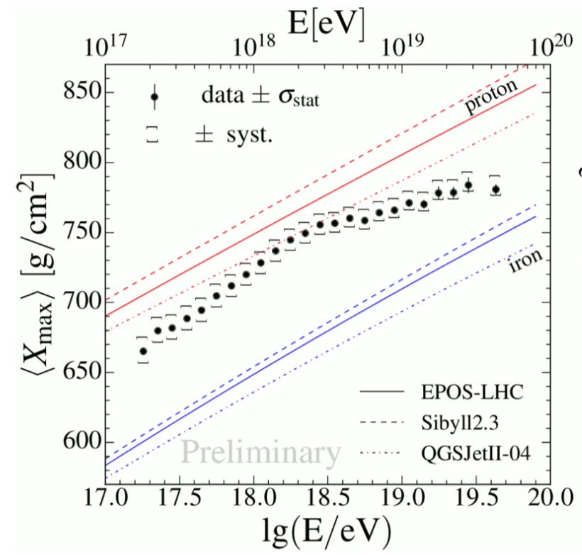
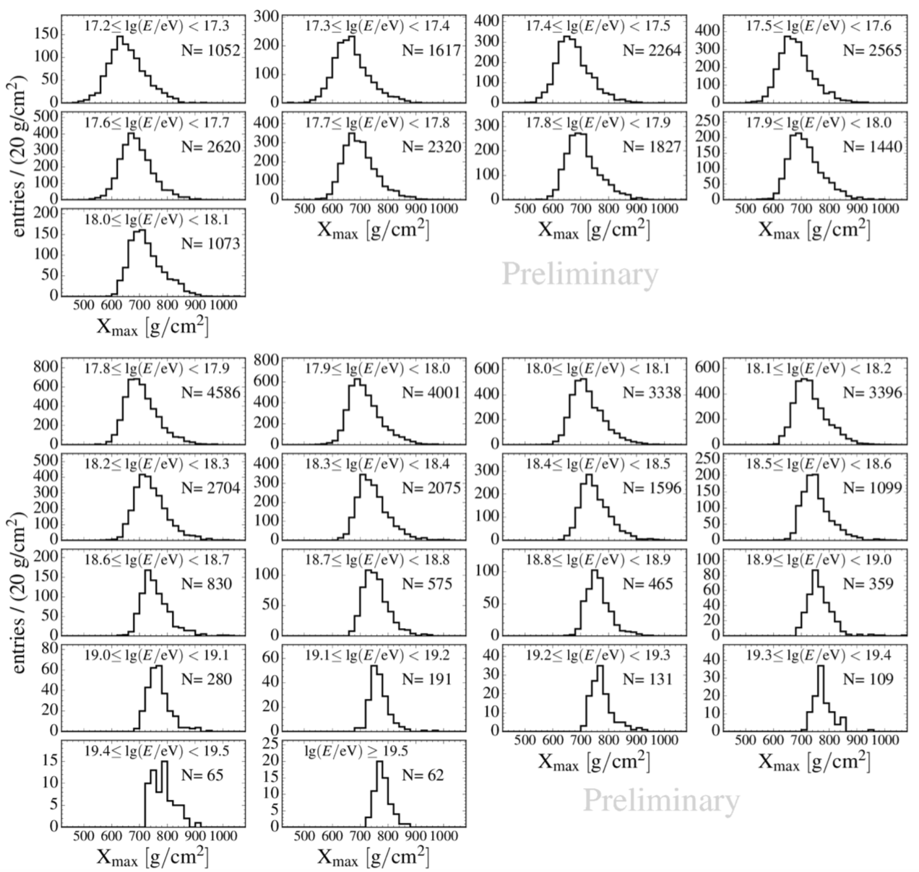
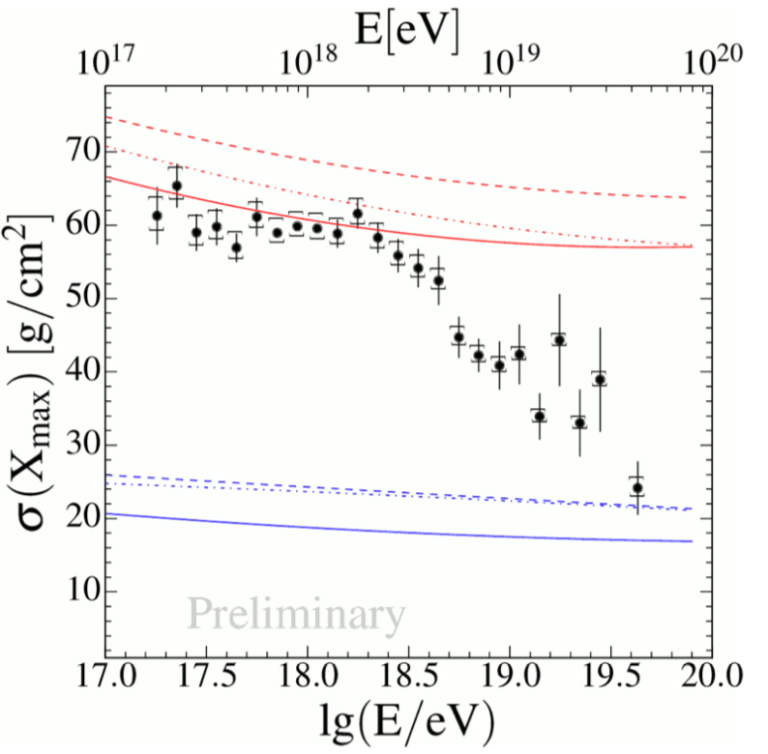
Mass Composition
X_{max} distributions for different energy intervals
HEAT+ Coihueco
17.2 ≤ lg(E/eV) ≤ 18.1
Standard FD
lg(E/eV) ≥ 17.8
2 EeV
Below 2 EeV nuclear mass composition is lighter
Above 2 EeV mass composition became heavier with increasing energy

Slide 16
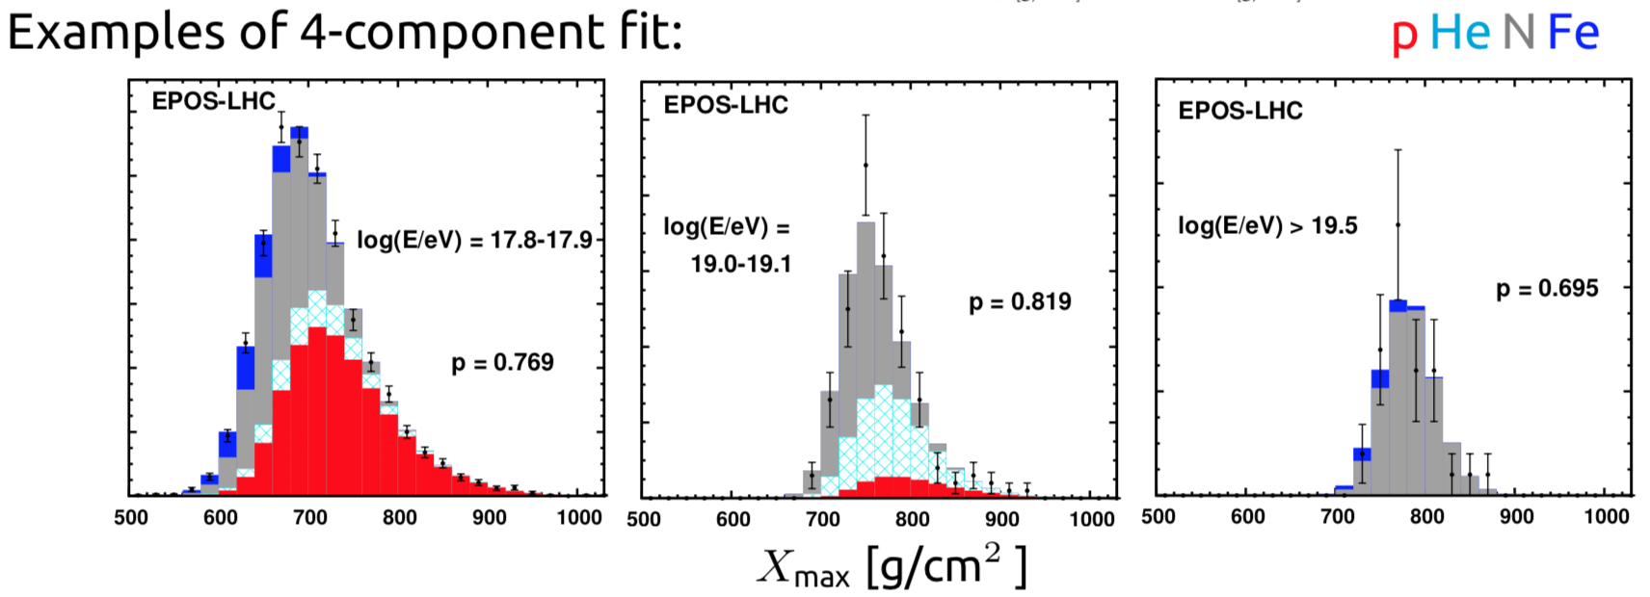
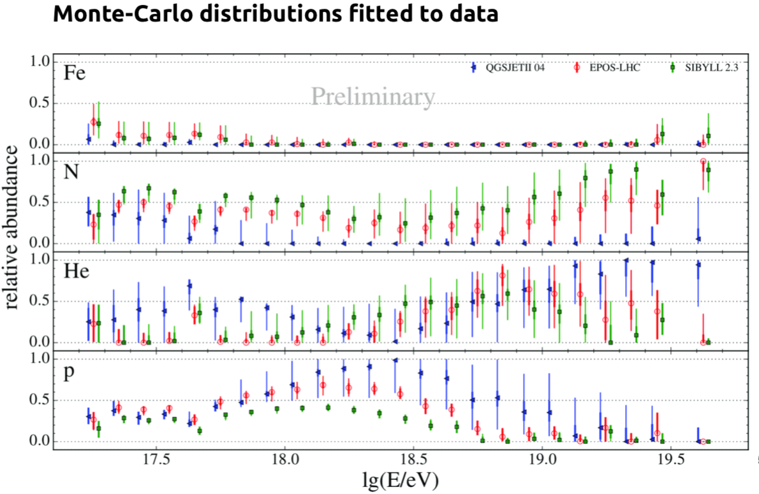
Mass Composition
Data are fitted with
3 different Monte-Carlo Models
Composition
At 10¹⁸ eV proton-like
Above 10¹⁹ eV He-like and N-like
No model requires any significant fraction of iron at any energy.
The composition which best describes Auger data is a mix of p, He and N nuclei, i.e. AugerMix

Slide 17
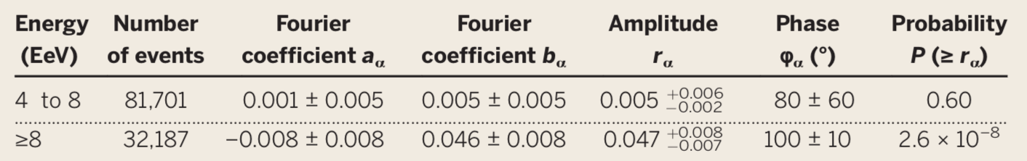
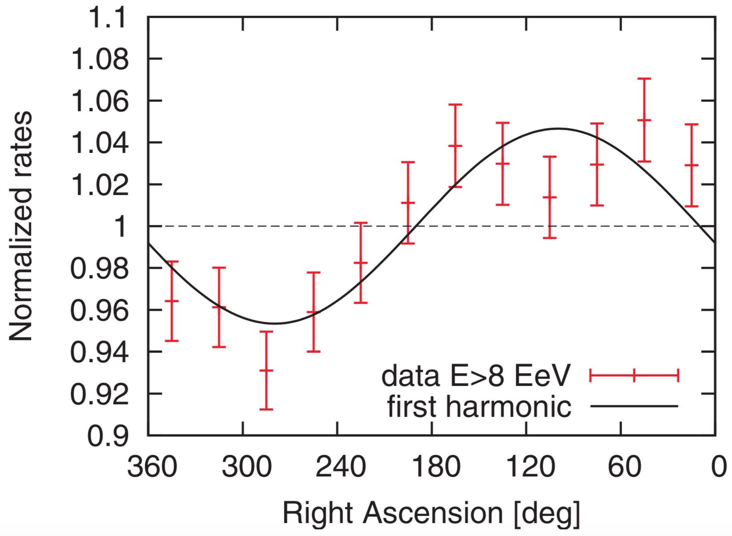
Large Anisotropy Studies
The Auger Collaboration performed a weighted^{(*)} harmonic analysis using more than 10 years of data with 85% sky coverage (θ < 80°) with E > 4EeV (full trigger efficiency)
^{(*)} Events weighted to account for exposure nonuniformity, tilt, etc; effect is negligible
Correction of systematic effects (atmospheric changes, geomagnetic field)
Studying the first harmonic in right ascension for the two energy bins it was found a distribution compatible with a dipolar modulation for E ≥ 8 EeV
consistent with isotropy
significant modulation (5.2σ)

Slide 18
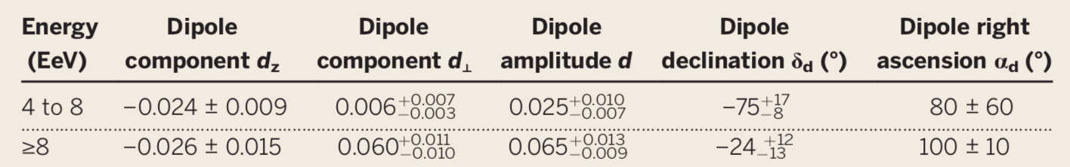
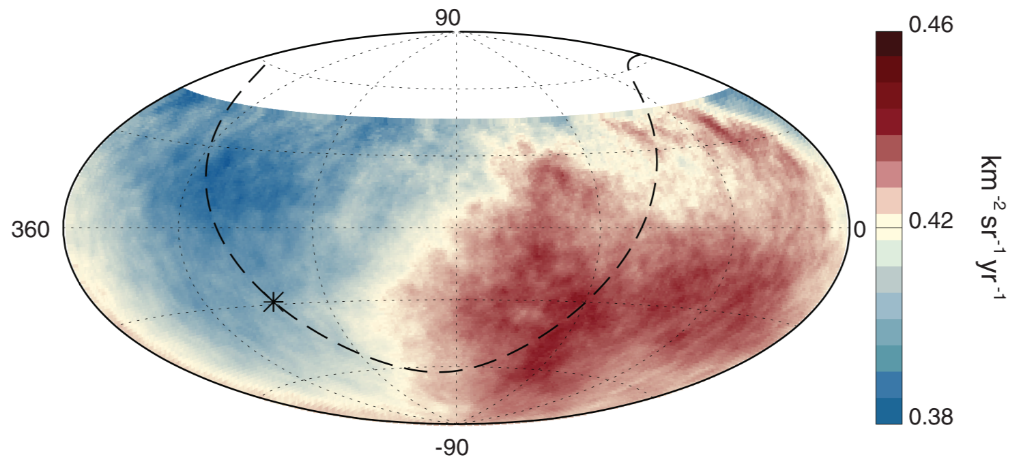
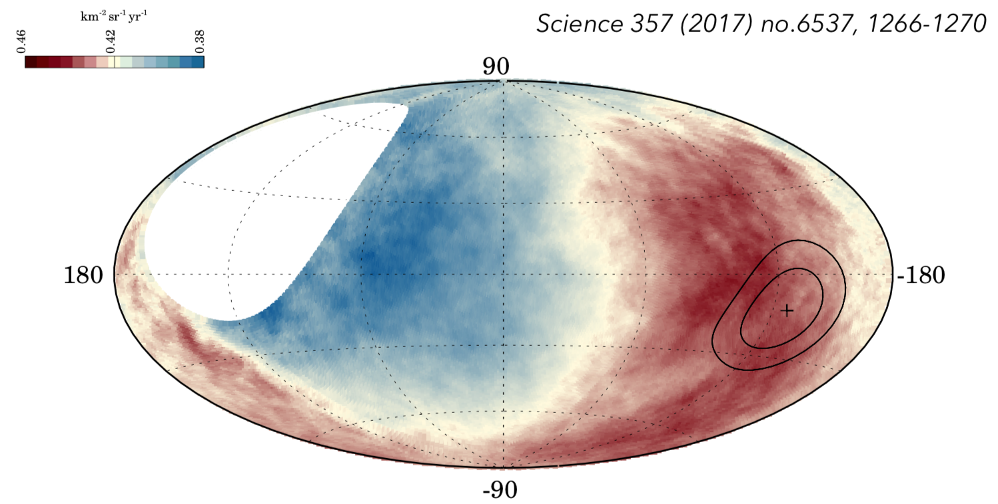
Anisotropy Studies
Three-dimensional dipole reconstruction
The directions of the dipole components (in equatorial coordinates) are:
Fluxes of particles in equatorial coordinates
3D dipole above 8 EeV
Fluxes of particles in galactic coordinates
Dipole direction ∼ 125° from GC
→ Strong evidence for extragalactic origin!

Slide 19
AugerPrime
Where we stand:
Spectrum Existence of a Cut-Off above 40 EeV; its nature still not fully understood: propagation effect? maximum energy at the sources? both?
Composition Light and mixed composition around the ankle; a trend towards a heavier composition at the highest energies.
Anisotropy At large scale, a dipole is observed, its direction indicates an extragalactic origin.
What we wish:
We wish to obtain mass composition information in the flux suppression region in order to select light primary Cosmic Rays and pointing back to the astrophysical sources.

Slide 20
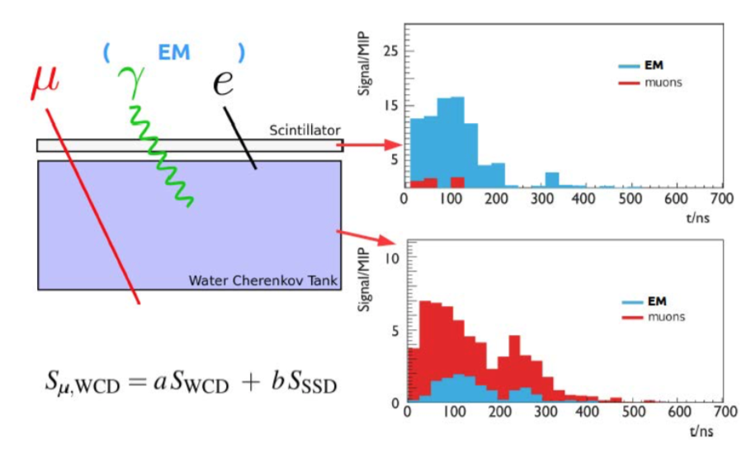
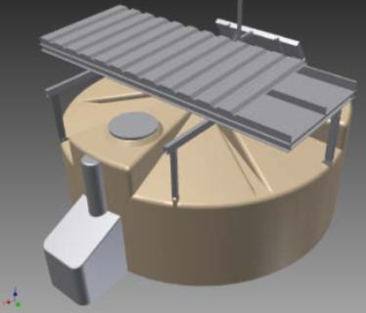
What we need:
In order to improve the knowledge on mass composition we have to discriminate the electromagnetic and muonic components from the SD with a further and independent measurement. ---> Plastic Surface Scintillator Detector (SSD) above the existing Water-Cherenkov Detectors (WCD)
Equip each SD tank with a 3.8 m²
(1 cm thick) scintillator layer on top
Complementary response
2018: Design finalized and tested production of SSDs started
2018-20: Deployment of the SSDs in the full SD array
2020-25: Data taking
Moreover
Upgraded and faster electronics
Extension of the dynamic range
Cross check with buried μ detectors
Extension of the FD duty cycle

