Slide 1
NUSPIN 2017 Workshop
GSI, June 26 - 29, 2017
Gamma decay of pygmy states from inelastic scattering of ions
Fabio Crespi
Università degli Studi di Milano - INFN
Notes:
1

Slide 2
Outline
Motivation
E1 strength at particle threshold: the Pygmy Dipole Resonance
Heavy Ion (¹⁷O) Inelastic scattering
Results of experiments with AGATA at LNL-INFN (⁹⁰Zr, ¹²⁴Sn, ²⁰⁸Pb,¹⁴⁰Ce)
Light Ion (α, p) Inelastic Scattering
Preliminary results from experiments at RCNP (Osaka) with CAGRA (+LaBr:Ce) and Grand Raiden
Conclusions

Slide 3
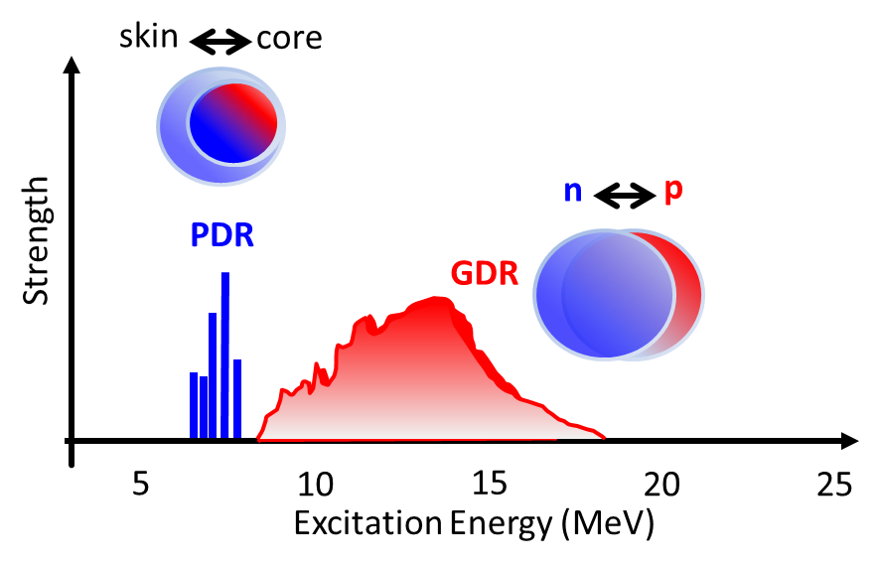
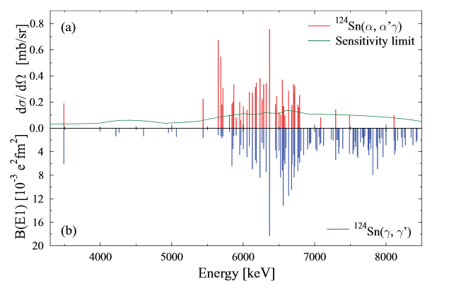
Nuclear Structure information from the E1 response in Nuclei
The splitting in the population of the states reveals a different underlying structure
low energy part → isoscalar character (neutron-skin oscillations)
high-energy states → isovector nature (transition towards the GDR)
(*) figure from J. Endres et al., Phys. Rev. Lett. 105, 212503 (2010)
See also e.g. ”Experimental studies of the Pygmy Dipole Resonance”
D. Savran, T. Aumann, A. Zilges – Prog. Part. Nucl. Phys., 70(2013)210
One interesting problem for pygmy states is the cross section sensitivity to transition densities containing the nuclear structure information…
Notes:
it is expected to reflect the properties of the neutron skin in nuclei. The neutron skin plays an important role in the nuclear polarizability [REI10, ROC13] and these quantities are relevant to constrain nuclear equation of state of neutron-rich matter [CAR10]. In addition, the excess of the E1 strength around the neutron separation energy is affecting the predictions for the r-process Comparing results of photon scattering, proton scattering and alpha scattering experiments a clear selectivity in the population of these PDR states has been observed
This splitting in the population of the states reveals a different underlying structure: the low energy part seems to have a more isoscalar character dominated by neutron-skin oscillations, while the high-energy states are mainly of isovector nature associated to a transition towards the GDR.

Slide 4
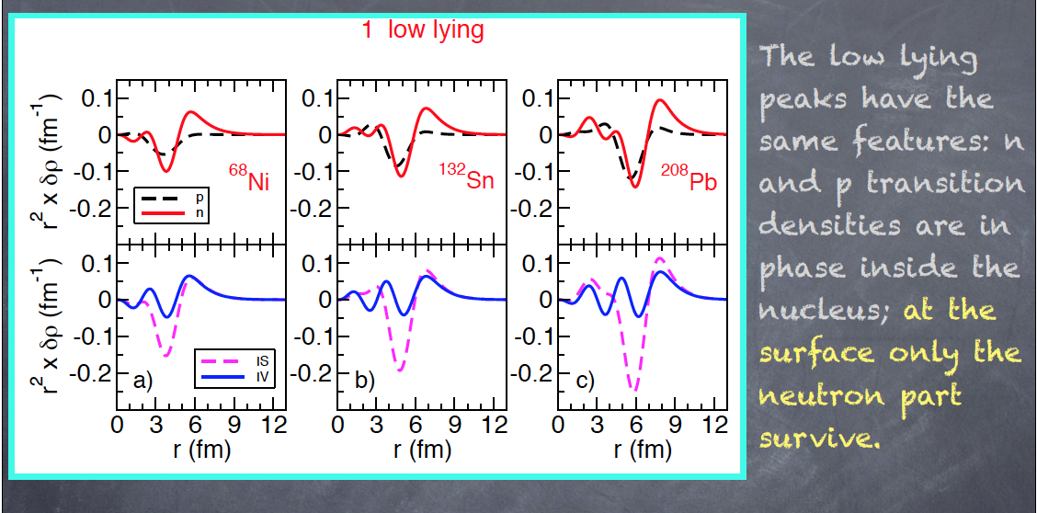
Transition Densities
Interesting to use a probe interacting mainly at the surface !!!
*E. G. Lanza et al., Phys. Rev. C 79 (2009) 054615.
**E. G. Lanza et al., Phys. Rev. C 84 (2011) 064602.
Notes:
These PDRstates showup when a consistent neutron excess
is present in the nucleus; therefore their appearance is more
pronounced in nuclei far from the stability line but its presence
has been established also for very stable nuclei as 208Pb.
Indeed, by studying their transition densities, we have shown
that the same feature that characterize the PDR state for the
132Sn are duplicated in the 208Pb case.
We have shown that valuable informations on the nature
of the PDR can be obtained by excitation processes involving
also the nuclear part of the interaction.
Color online) RPA transition densities for the low-lying
dipole states for 208Pb (lower frame) and 132Sn (upper frame)
calculated with the SGII interaction. As indicated in the legend we
plot the proton, neutron, isoscalar and isovector components

Slide 5
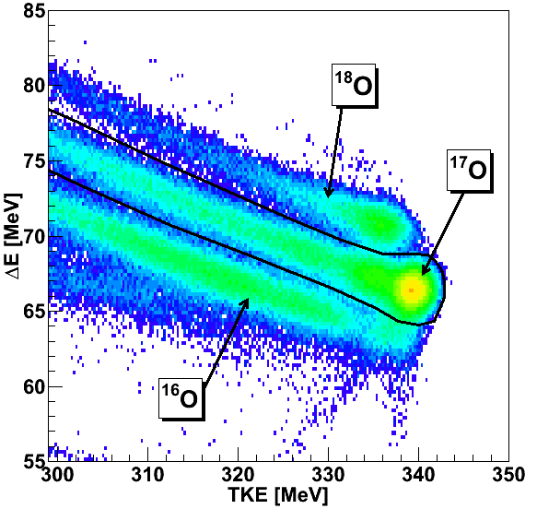
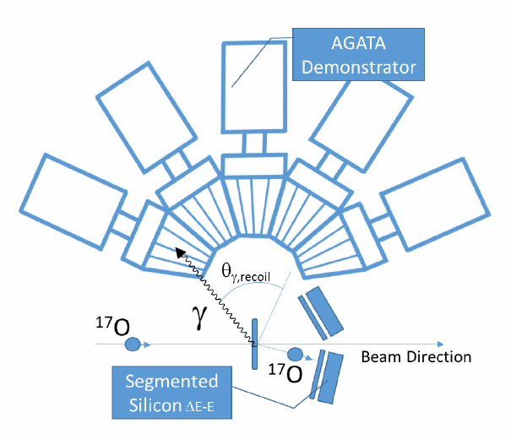
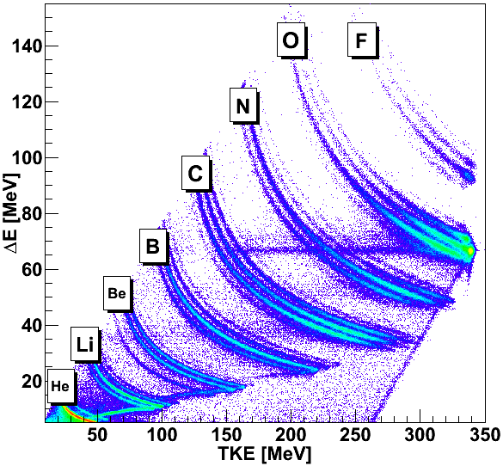
Experimental Technique
Inelastic scattering of ¹⁷O @ 20 MeV/u on different targets + γ-rays in coincidence
Large cross-section for the population of the giant resonance region
¹⁷O is loosely bound (S_{n} = 4.1 MeV)
Clean removal of projectile excitation
Experiments at Legnaro,
Proposals: Univerisity of Milan-INFN
IFJ-PAN Cracow
University of Padova-INFN
Silicon Detectors, D. Mengoni NIMA 764(2014)241

Slide 6
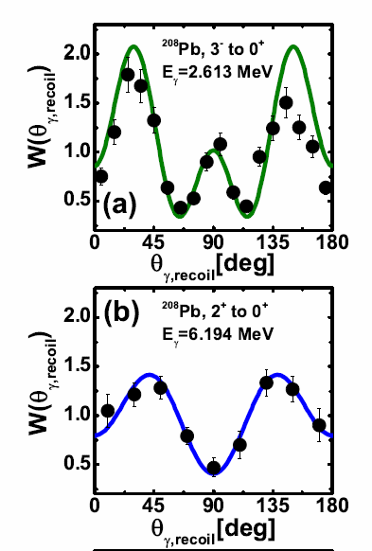
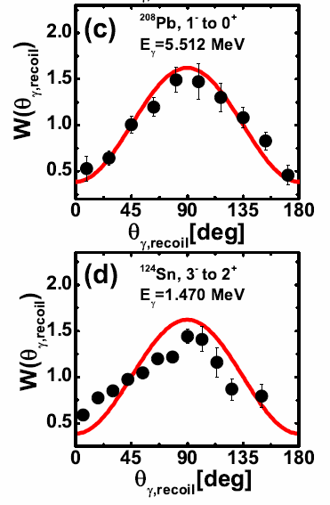
Angular distribution of γ-rays
Angular Distribution of γ’s obtained exploiting position sensitivity of AGATA
and E-ΔE Si telescopes (pixel type)

Slide 7
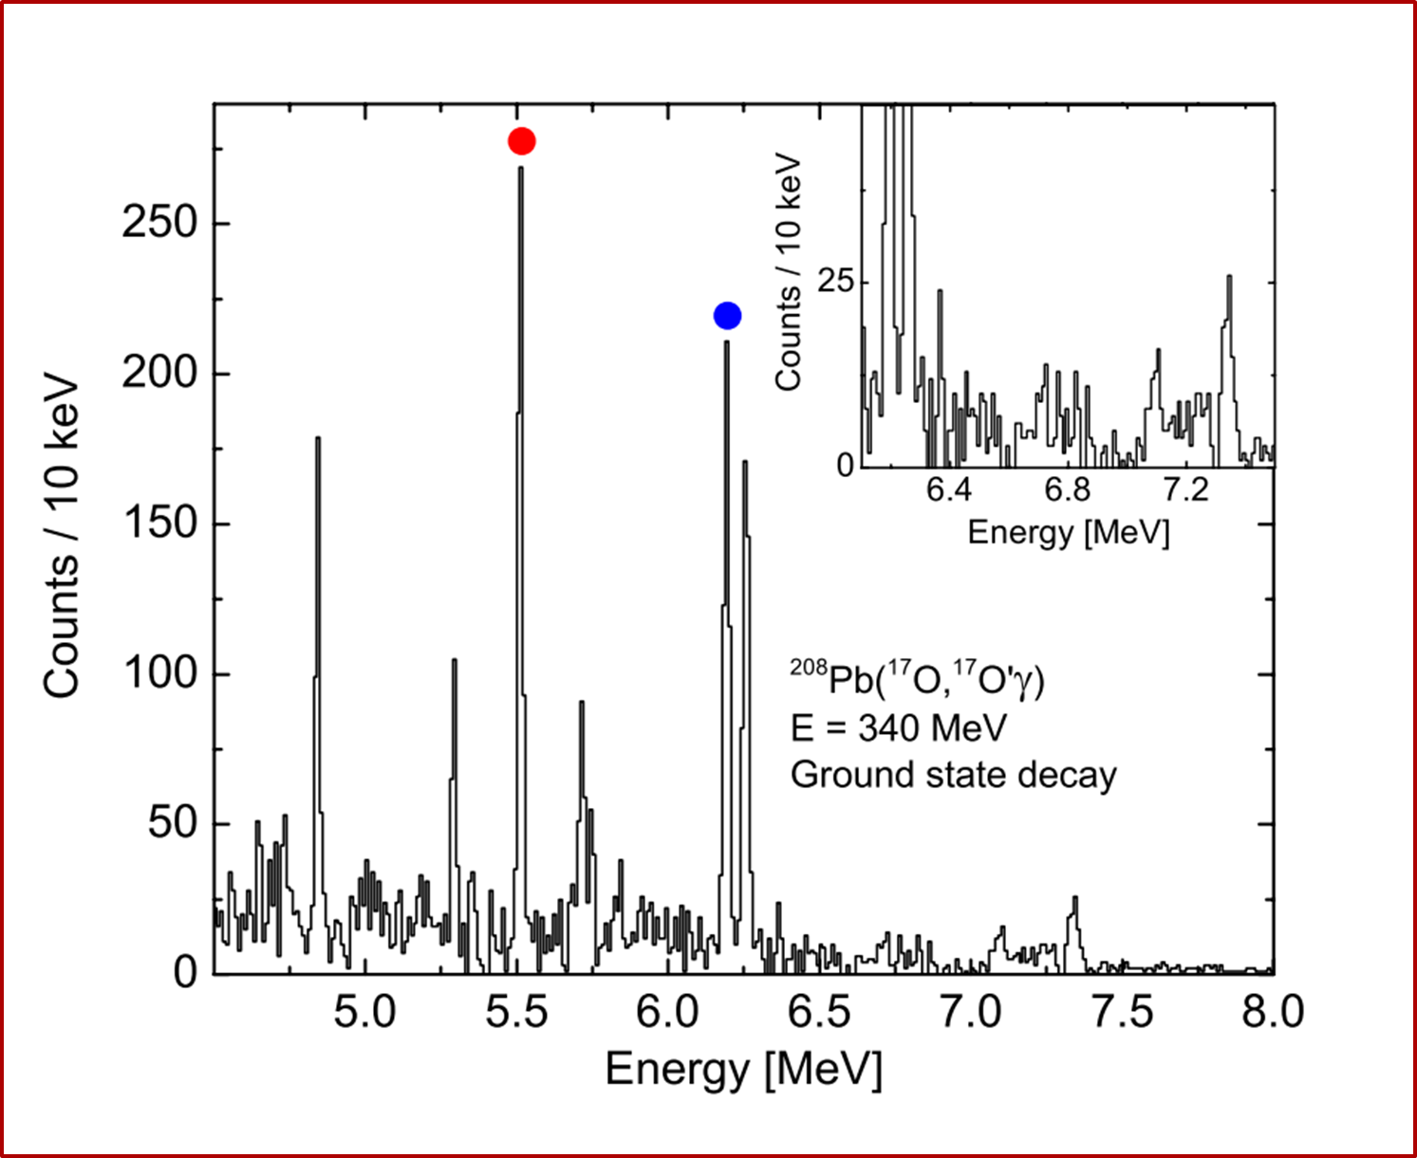
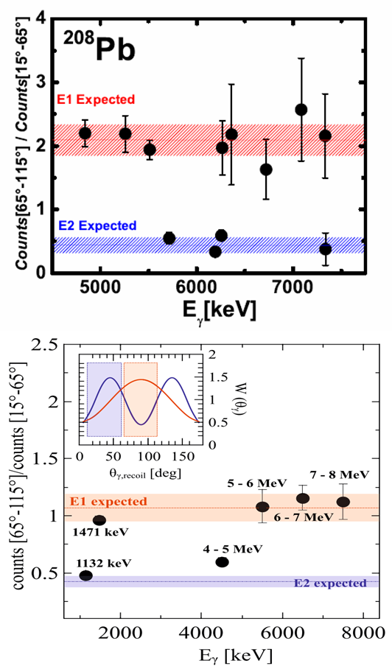
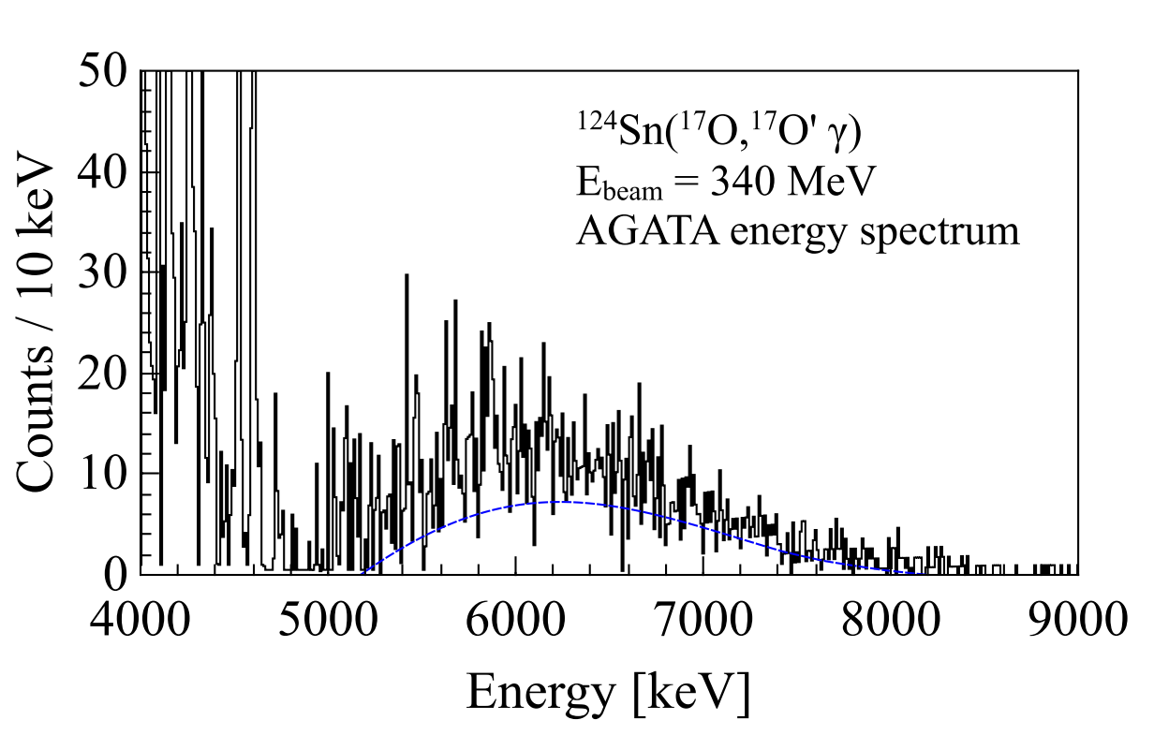
Identification of the Multipolarity
In contrast with light ions, for ¹⁷O the pattern of the differential cross section for inelastic scattering as a function on angle does not characterize well the multipolarity of the excited states → angular dist. of gamma-rays
F.C.L. Crespi, et al., PRL113 (2014) 012501
L. Pellegri, et al., PLB738 (2014)519
¹²⁴Sn

Slide 8
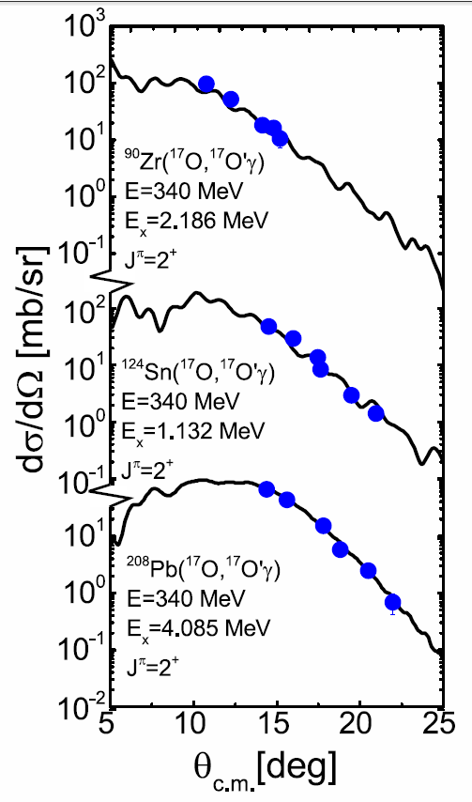
Angular distributions of the scattered ¹⁷O ions–INELASTIC SCATTERING
Differential cross sections were determined for
excitation of the 2⁺ states in ⁹⁰Zr,¹²⁴Sn,²⁰⁸Pb
The solid curve results from DWBA
calculations using optical model
potential parameters determined from
the elastic data
In agreement with measurements
at similar beam energy**
The B(E2) is known from other works*
These calculations were obtained assuming pure isoscalar excitation implying that the ratio of the neutron matrix element and the proton matrix element is given by M_{n} / M_{p} = N/Z
* (e,e’) and (γ,γ’) experiments, see e.g.: http://www.nndc.bnl.gov/ensdf/
**for the case of ²⁰⁸Pb: D.J. Horen et al. PRC44(1991)128

Slide 9
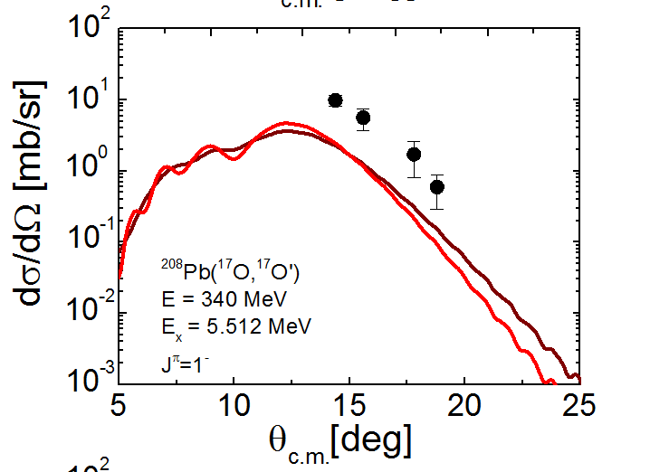
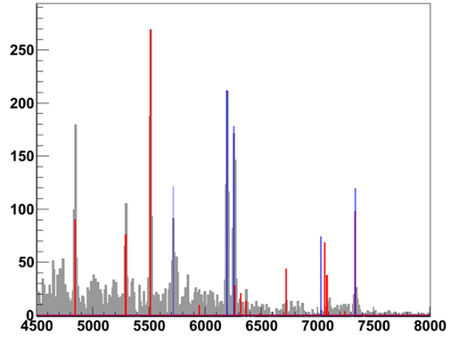
Results on the Low-Lying E1 Strength
1⁻ states in ²⁰⁸Pb
The calculation accounts
only for a fraction of the
measured yield
Why?
Calculations obtained
using a standard form factor are found to be very similar to the Coulomb excitation alone
known**
E1 / E2
The Coulomb excitation cross section based on the B(E1)↑ values known from (γ,γ)** have been calculated
To understand the measured E1 cross sections, we have
to perform DWBA calculations with a different type of
nuclear form factor
** photon scattering experiments:
N. Ryezayeva
et. al PRL89(2002)272502,
T. Shizuma et al. PRC78(2008)061303
Energy [keV]

Slide 10
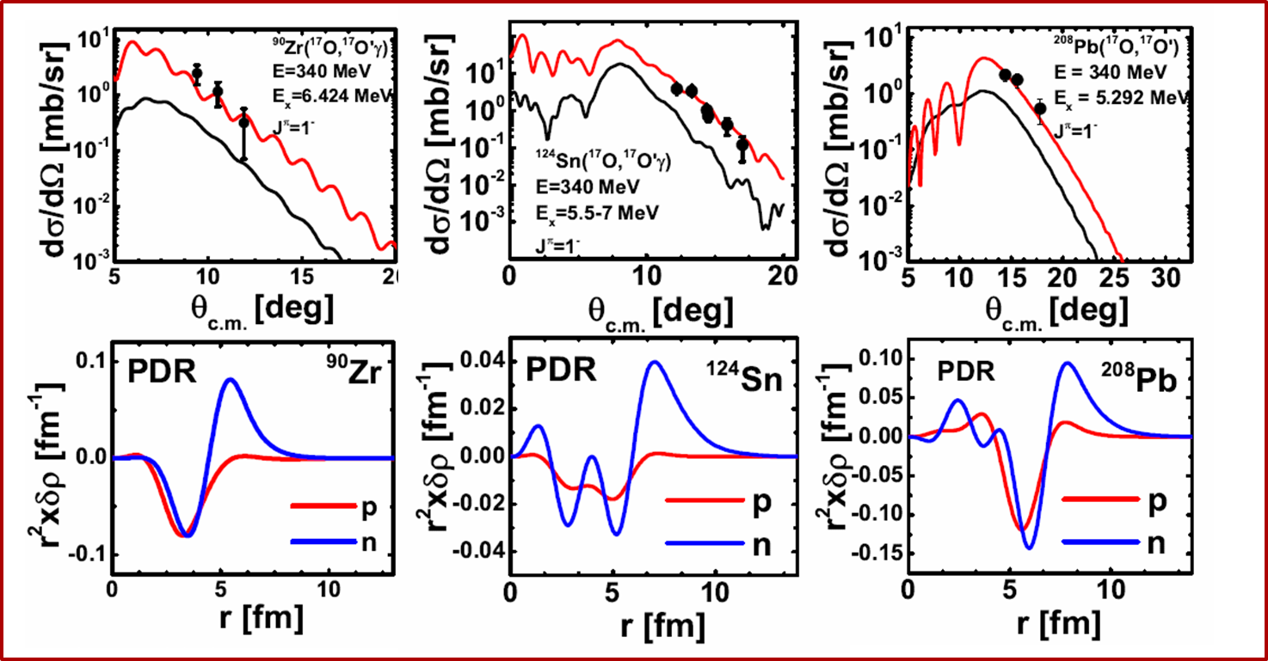
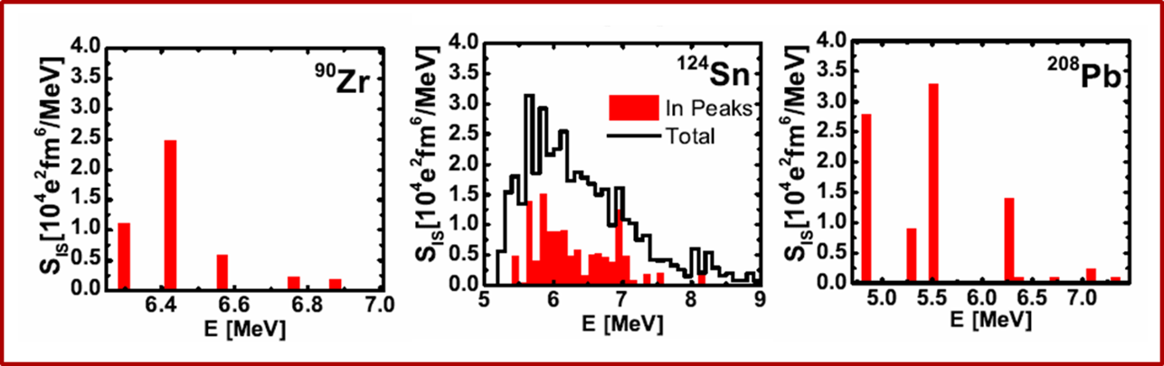
Results on the Low-Lying E1 Strength
DWBA calculation were performed (red solid lines) using microscopic form factors based on the transition density associated to the E1 PDR states
The main objective of the data analysis was the extraction of the values of the isoscalar strength from the measured cross section
F.C.L. Crespi, et al., PRL113 (2014) 012501
L. Pellegri, et al., PLB738 (2014)519
F.C.L. Crespi et al, PRC 91 (2015) 024323
A. Bracco, F.C.L. Crespi and E.G. Lanza, EPJA(2015)51:99

Slide 11
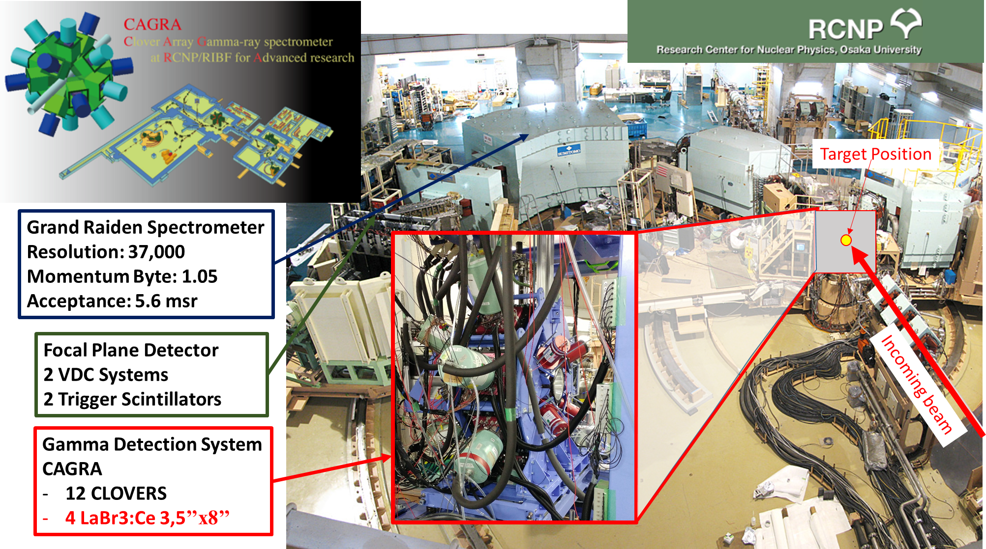
Experimental campaign at RCNP Osaka (October-December 2016)
Study of the Structure of the Pygmy Dipole Resonance States via the (p, p’ γ) and (α,α’γ) Reactions in [in ^{90,94}Zr] E_{proton} = 80 MeV, E_{alpha}=130MeV
- Spokespersons A. Bracco, F. Crespi and N. Pietralla
Notes:
studying the PDR states by measuring light-ion inelastic scattering with the high-resolution spectrometer Grand-Raiden in coincidence with high-resolution gamma-ray detection by the germanium clover array CAGRA
the (α,α’γ) reaction (isoscalar character, surface-sensitive), (p,p’γ) reaction (mainly isoscalar character, better sensitivity to the inner transition density), and (g,g’) (mainly isovector character)

Slide 12
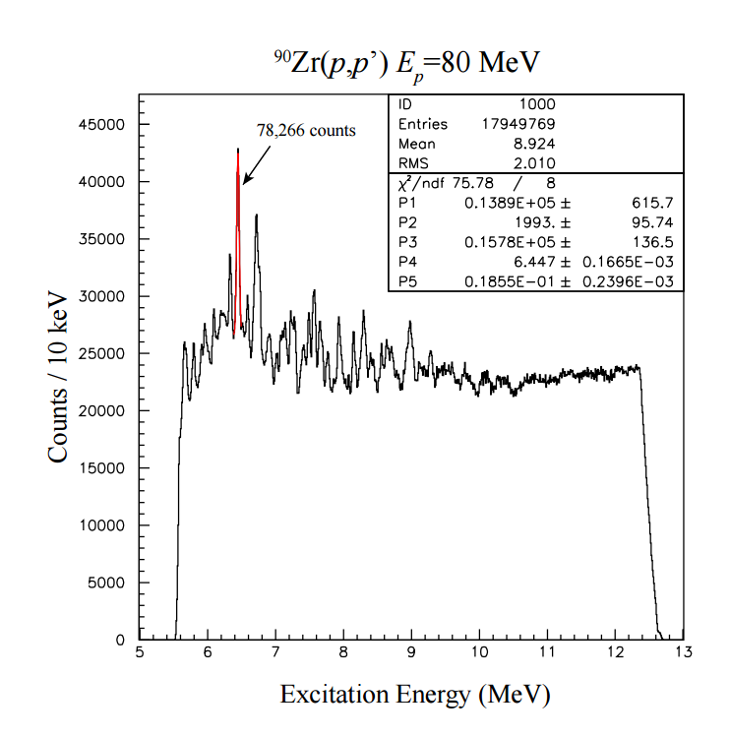
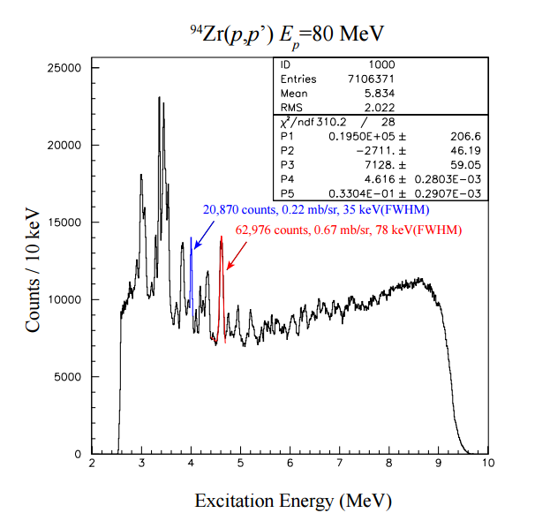
Experimental campaign at RCNP Osaka (october-December 2016)
Study of the Structure of the Pygmy Dipole Resonance States via the (p, p’ γ) and (α,α’γ) Reactions in [in ^{90,94}Zr] E_{proton} = 80 MeV, E_{alpha}=130MeV
- Spokespersons A. Bracco, F. Crespi and N. Pietralla
⁹⁴Zr(p,pʼ)
• Grand Raiden 6.63 deg
• Target thickness: 4.0 mg/cm2
• Solid angle: ~4 msr
• Energy resolution: 44 keV
• DAQ Live: 99%
⁹⁰Zr(p,pʼ)
• Grand Raiden 6.63 deg
• Target thickness: 1.95 mg/cm2
• Solid angle: ~4 msr
• Energy resolution: 44 keV
• DAQ Live: 98%
preliminary
preliminary

Slide 13
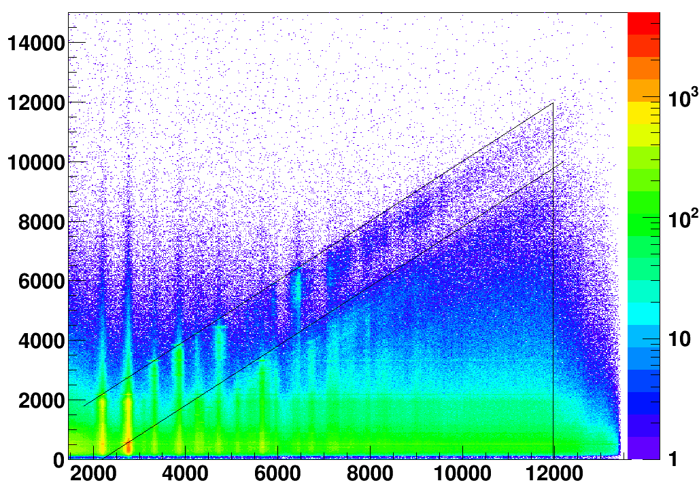
(α,α’γ) Reaction in ⁹⁰Zr, E_{alpha}=130MeV
light-ion inelastic scattering with the high-resolution spectrometer Grand-Raiden in coincidence with gamma-ray detection
Preliminary
Sn
Decay to the Ground State
Energy Measured in Gamma (Ge) Detectors [keV]
Decay to the first 2⁺ excited state
Excitation Energy Measured in Grand Raiden [keV]

Slide 14
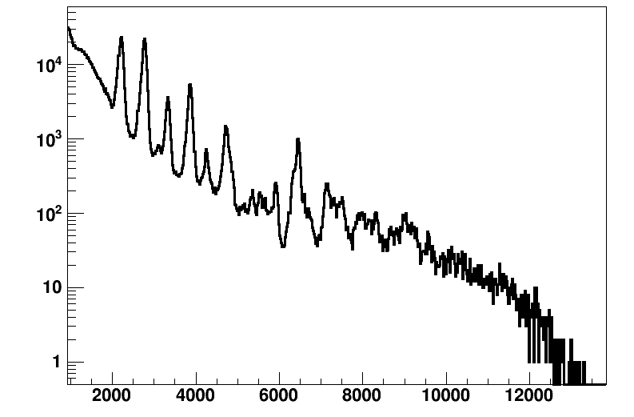
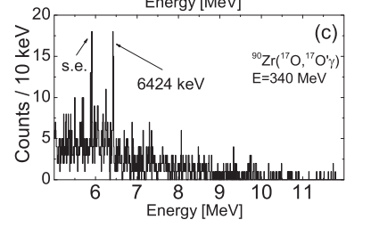
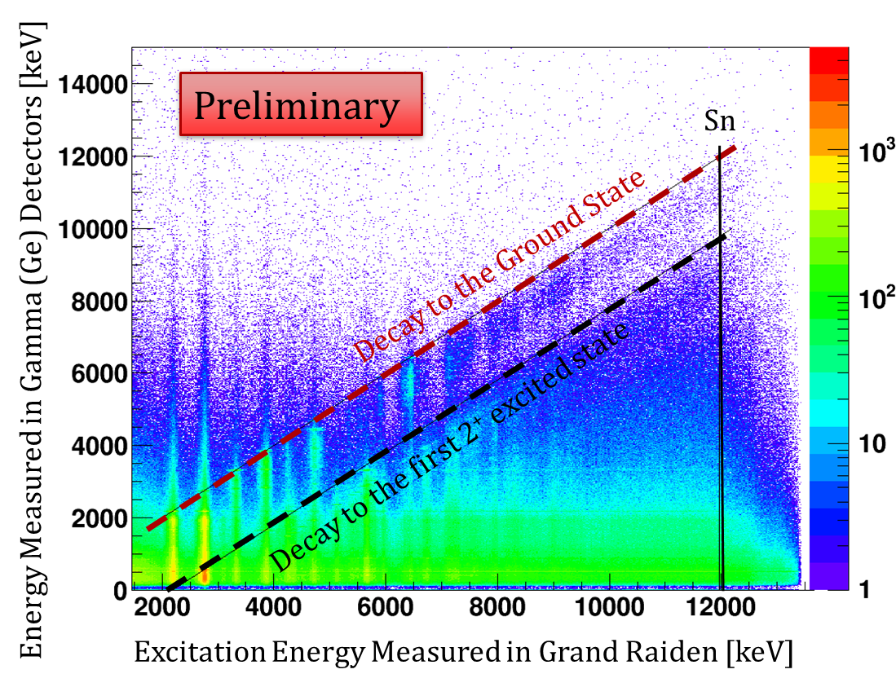
(α,α’γ) Reaction in ⁹⁰Zr, E_{alpha}=130MeV
PDR Energy Region
1⁻ @ 6424 keV
Counts
Preliminary
Excitation Energy [keV]
F.C.L. Crespi et al.
Phys. Rev. C 91, 024323 (2015)

Slide 15
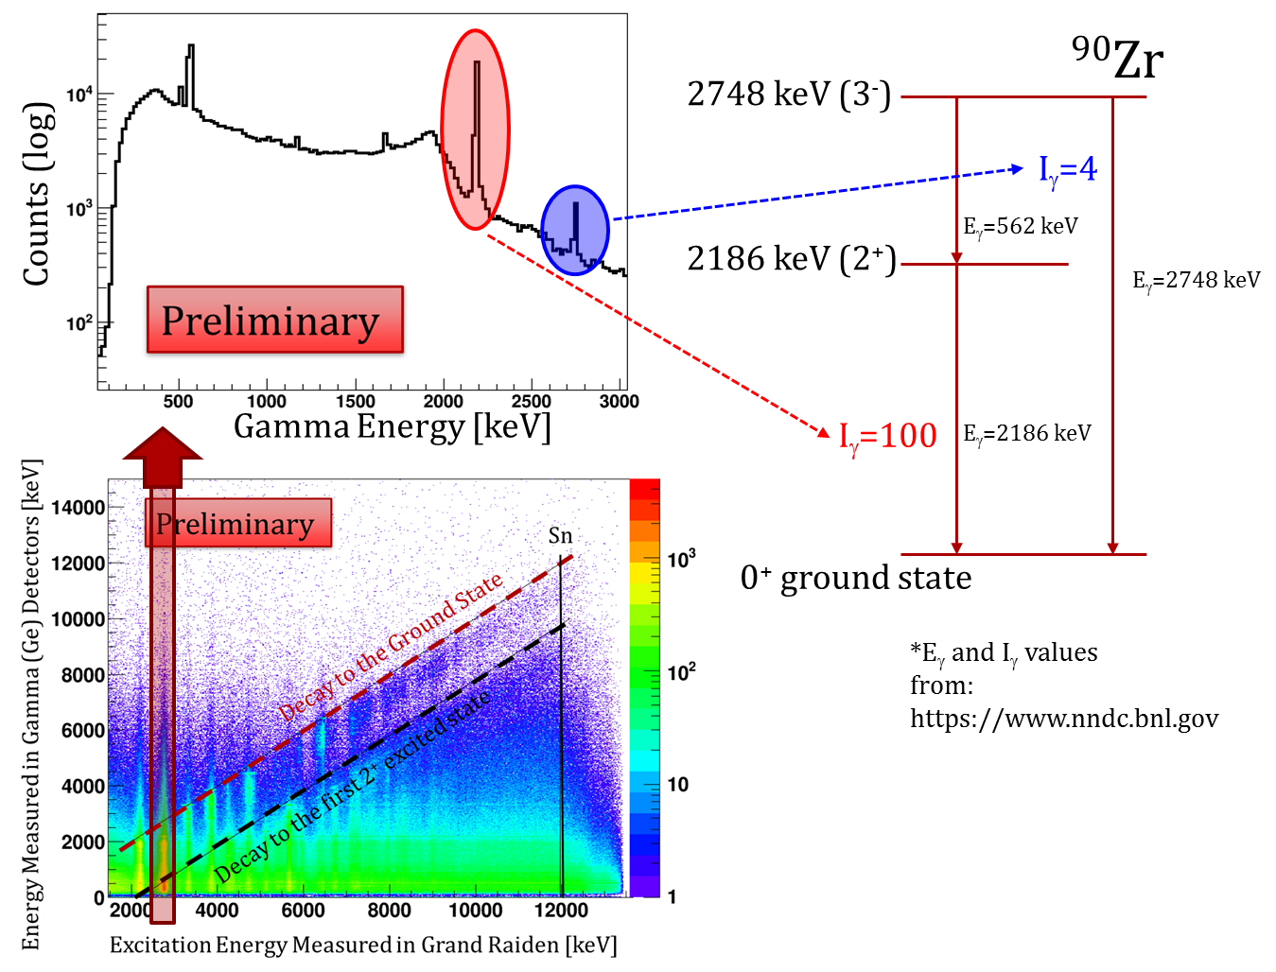
(α,α’γ) Reaction in ⁹⁰Zr, E_{alpha}=130MeV
Branching Ratio

Slide 16
Conclusions and Future Work
Isospin Properties of pygmy dipole states investigated using the
(17O, 17O’γ) reaction at 340 MeV
For 1⁻ transitions a form factor obtained by folding a microscopically
calculated transition density (PDR) allowed to reproduce the data remarkably well
Extracted the isoscalar component of the 1⁻ excited states
Preliminary results from light-ion inelastic scattering experiments at RCNP
Population of the PDR states
Analysis still in preliminary phase (Ge and LaBr data for all the runs, background subtraction, add-back for Ge,…)

Slide 17
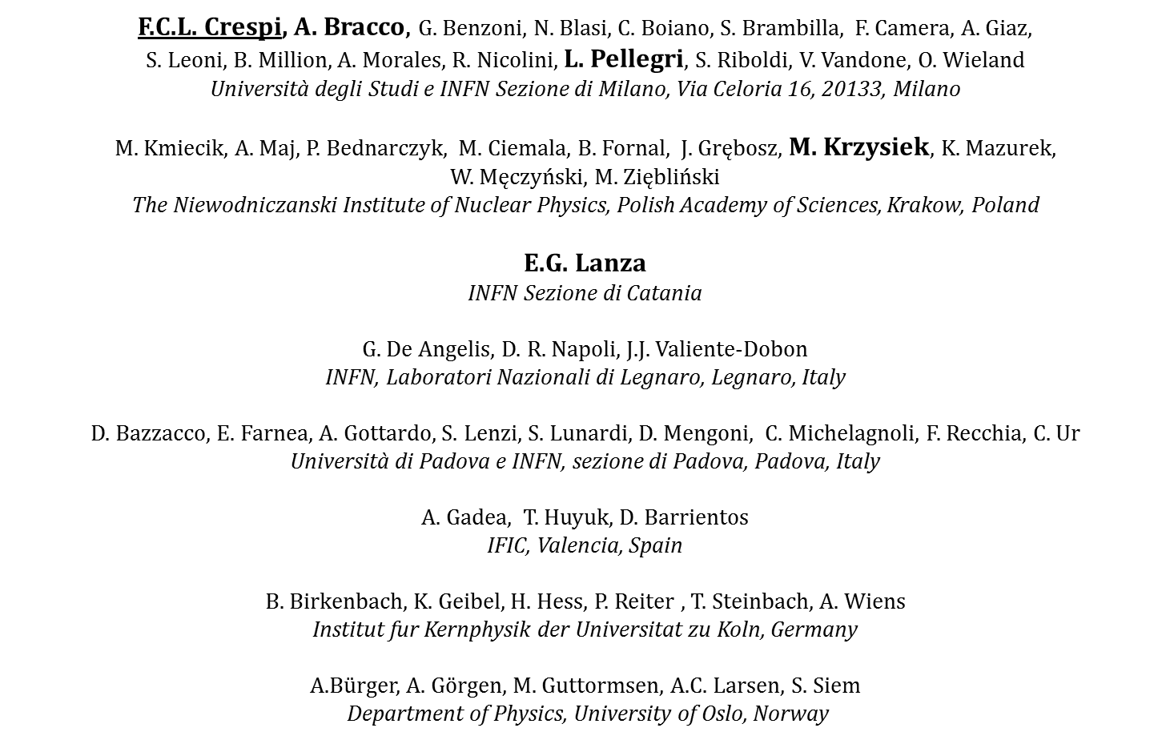
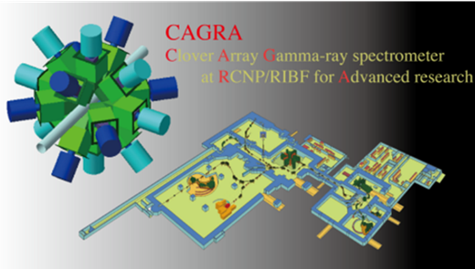
Collaborations
Experiments performed with AGATA at LNL-INFN
Inelastic scattering of ¹⁷O @ 20 MeV/u on different targets + γ-rays in coincidence
Experiments at RCNP (Osaka) – CAGRA Collaboration

