Slide 1
Exotic nuclei and drip lines Part II

Slide 3
Neutron-rich and proton rich nuclei in HF with effective forces:
Reminder: the pp and nn force is active only in the T=1 channel (on average, not so much attractive), whereas the pn force is active also in the T=0 channel which provides stronger attraction. This is known from the existence of the deuteron as a bound system, and the non-existence of the di-neutron.
Therefore, neutrons feel more the proton attraction than the attraction of the other neutrons. In a system with increasing N-Z, the neutrons become much less bound with respect to the protons.
For analogous reasons, in a system which is neutron deficient, the protons become much less bound with respect to the neutrons.

Slide 4
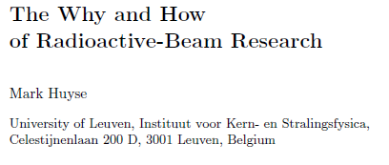

Slide 5
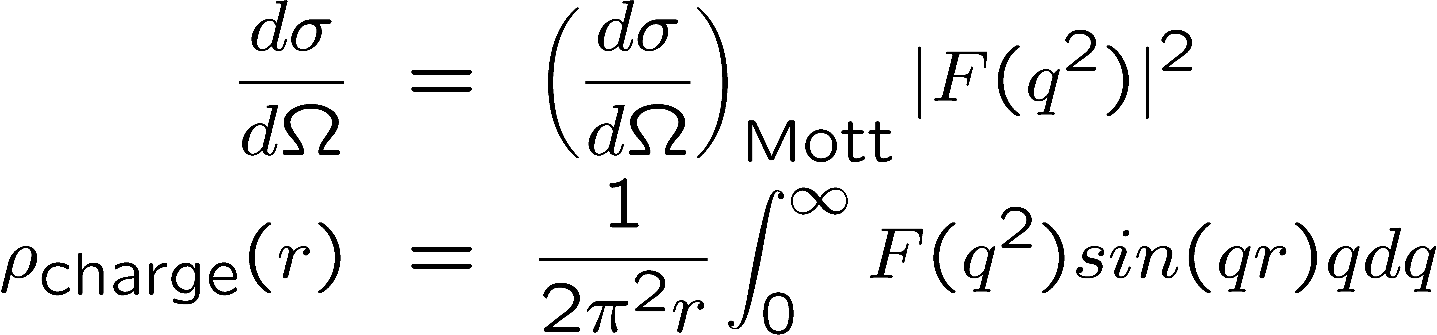
Measurements of masses and densities of radioactive nuclei
Masses (or equivalently binding energies) can be measured with good accuracy by means of mass spectrometry.
The difference between stable and unstable nuclei comes at the level of density measurements. In the case of stable nuclei, electron scattering has been the main source of information. The electromagnetic interaction is known, and this has allowed to interpret the data since the differential elastic cross section for electron scattering is expected to be the Mott cross section (corresponding to the diffusion on a point charge) multiplied by the form factor F(q²) squared, that is, the Fourier transform of the nuclear charge density,
In the case of unstable nuclei, this is not possible. Sizes and densities have been measured using hadron scattering → with the associated uncertainities !

Slide 6
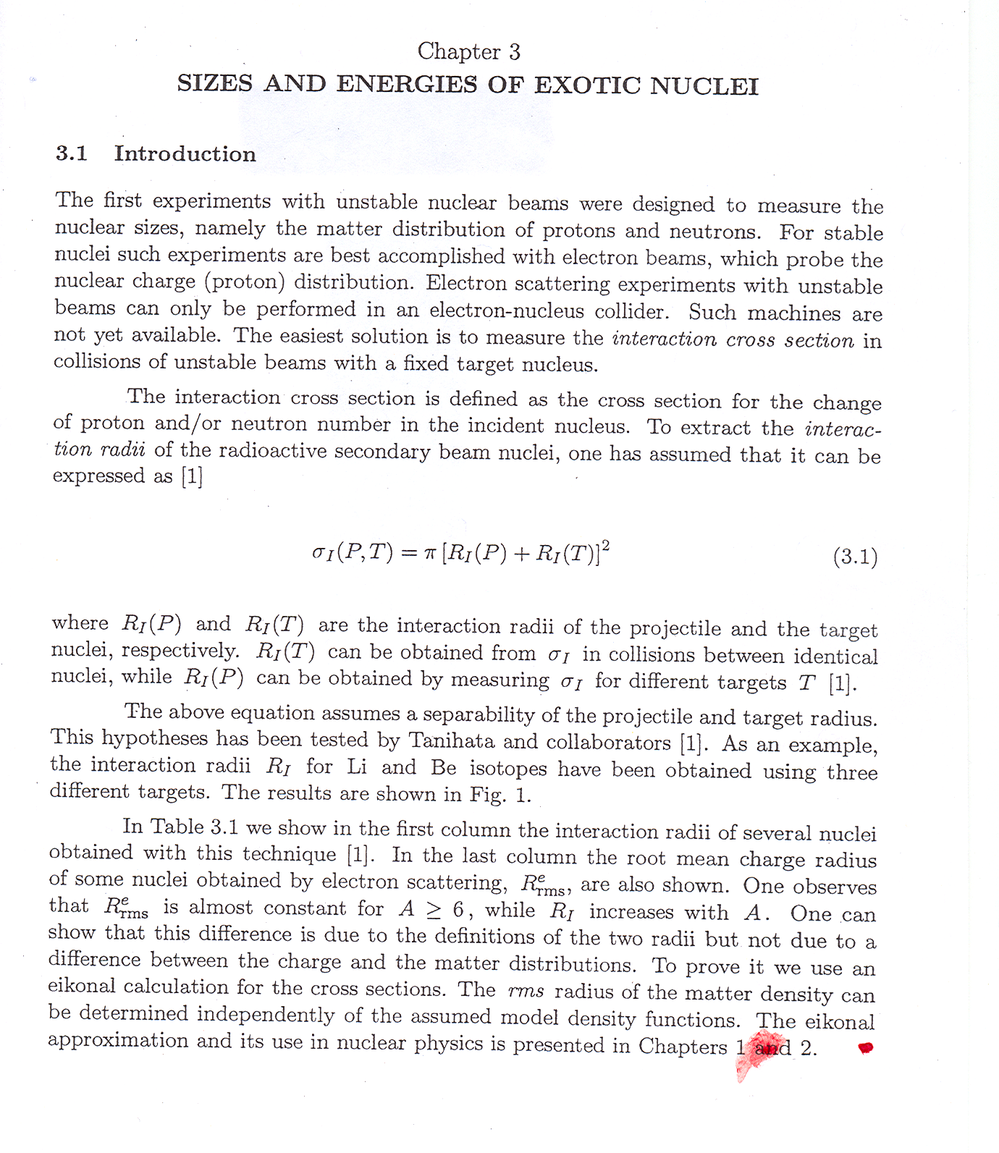
Table 3.1: cf. next page

Slide 8
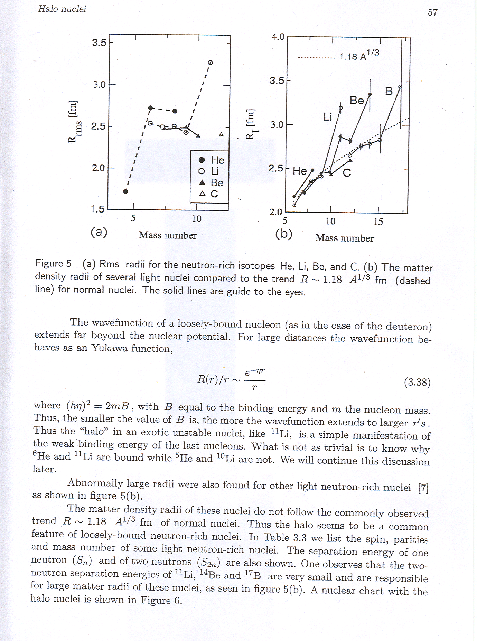

Slide 9
Examples: ¹¹Li and ¹¹Be (courtesy: T. Nakamura)
Ne
F
O
N=20
N
C
Neutron halos
Z
B
Be
Neutron Dripline
He
Li
H
N=8
¹¹Li
¹⁹C
N
¹¹Be
¹⁴Be
2n halo nucleus
1n halo nucleus
n
¹¹Li
n
⁹Li
¹¹Be
¹⁰Be
n
S_{n}=504 keV
S_{2n}=300 keV

Slide 11
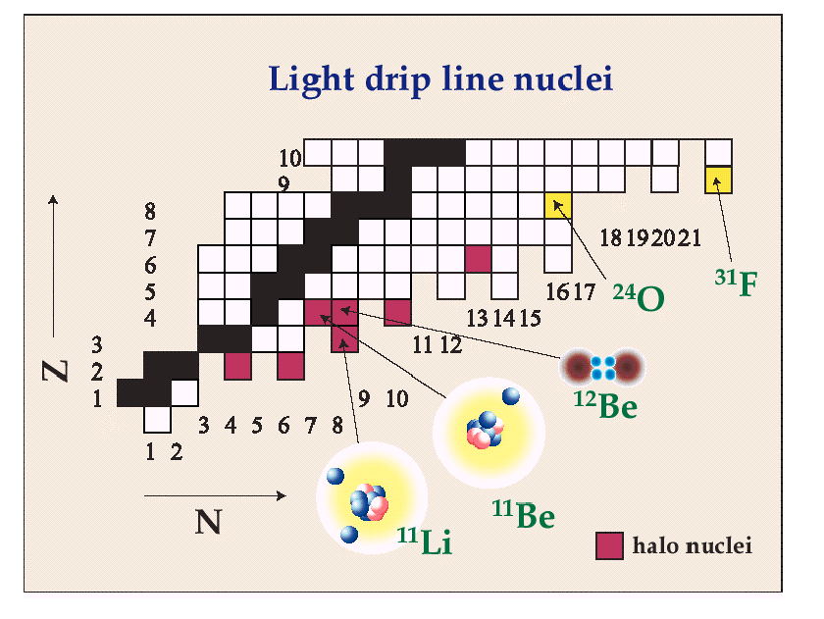
Let us the model (oversimplified !) for the case of ¹¹Be, which is a one-neutron halo.
We know S_{n} is about 0.5 MeV, so that η~1/6 fm⁻¹.
The size of the neutron orbit in ¹¹Be is two times the core size
R₀ A^{1/3} = 2.67 fm

Slide 12
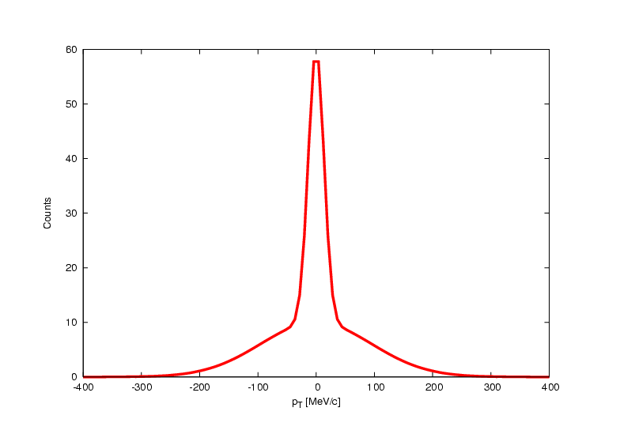
Other evidences
Other experiments which have been historically important, to make the character of halo nuclei evident, are: (i) momentum distributions of projectile fragments, and (ii) electromagnetic dissociation.
These are reviewed in papers e.g. by I. Tanihata.
The idea of the momentum distribution experiments is quite simple. If we hit, e.g., ¹¹Li on a C target at 800 MeV/u we can measure the transverse momentum of the fragments and we find a “double” distribution.
The component with “small width” has a Δp of about 19 MeV/c. From the uncertainity principle
Δx ~ hc/Δp ~ 12 fm,
that is, the narrow component is arising from the halo.

