Slide 1
Exotic nuclei and drip lines Part I

Slide 2
Unstable vs. stable nuclei: neutron-rich and proton-rich systems
Limit of nuclear stability and definition of drip lines

Slide 3
From: Exotic Nuclei, J. Enders, TU Darmstadt, Summer 2003

Slide 4
neutron-rich nuclei
proton-rich nuclei
82
β⁺ decay:
β⁻ decay:
π
ν
π
ν
Nuclei that are neutron- or proton-rich undergo β-decay.
Although unstable, these nuclei exist as bound systems. The limit of nuclear stability with respect to the strong interaction is the drip line. Neutron and proton drip lines are sketched in the previous slide but they are only partially known.

Slide 5
Lifetimes for beta-decay can be quite long and unstable nuclei can nonetheless be studied nowadays using RIB (Radioactive Isotope Beam) facilities.
We meet, by further increasing (or decreasing) N-Z the neutron (proton) drip line. These are defined as the limits beyond which the systems are unstable against particle emission. In the case of neutrons, the one-neutron or two-neutron separation energies (S_{n} = BE(N)-BE(N-1) or S_{2n}) become zero.
In certain cases, systems beyond the drip lines can be studied: for instance, if the lifetime is relatively long due to the fact that the extra neutron (or proton) has a resonant state available. But this is not the rule !

Slide 6
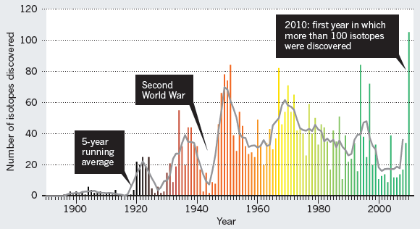
Discovering new exotic isotopes
M. Thoennessen, B. Sherrill, Nature 473, 25 (2011).
http://www.nscl.msu.edu/~thoennes/isotopes/
In this web page new discovered isotopes are reported.
Updated to 2020.

Slide 7
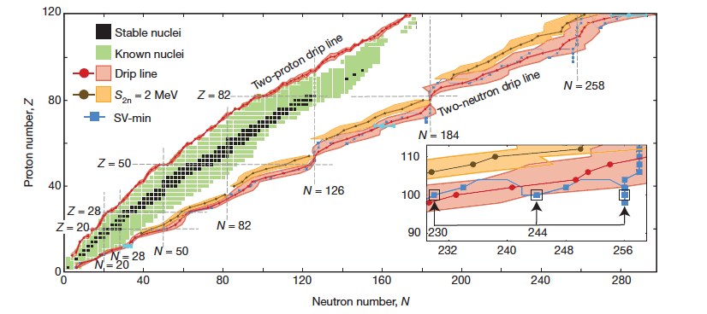
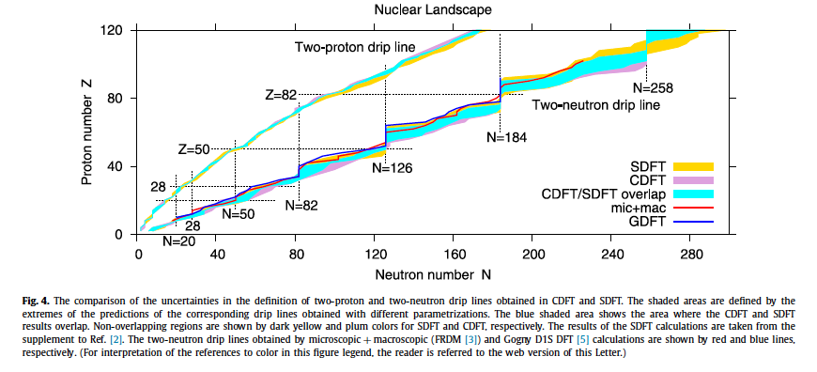
Model extrapolations to the drip line
J. Erler et al., Nature 486, 509 (2012) - SEDF
A.V. Afanasjev et al., Phys. Lett. B726, 680 (2013) - CEDF

Slide 8
In the previous figures:
black dots correspond to stable nuclei: i.e., infinite lifetime.
Stable nuclei can be found around the so-called stability line.
First problems: for each A (that is, for each isobaric chain), which is the nucleus with largest binding energy ? And how does this evolve if we move towards right (left) in the previous figure, that is, if we move increasing (decreasing) (N-Z) ?

Slide 9
Values:
a_{V}=15.85 MeV a_{S}=18.34 MeV a_{C}=0.71 MeV a_{A}=23.21 MeV
The blue line represents constant A: for A=120 we meet Z₀ close to 50 (i.e., Sn).

